Slide 1
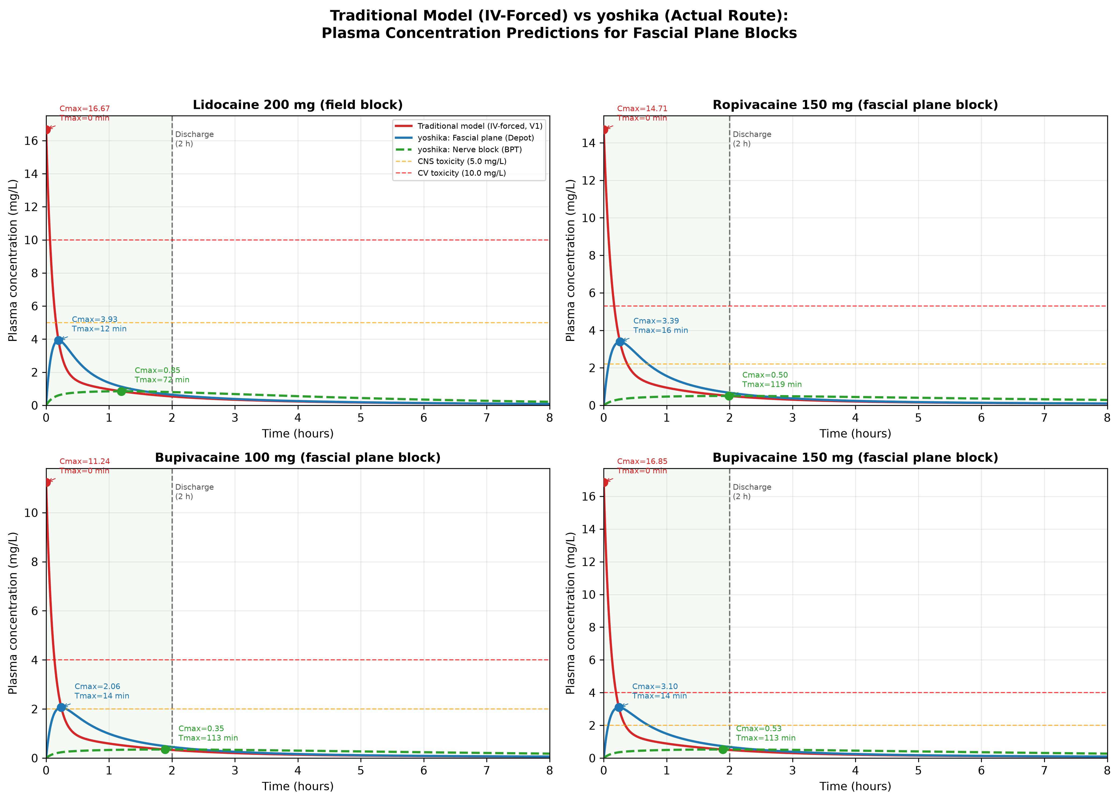
Figure 7: IV-Forced vs Fascial Plane / Nerve Block
Plasma concentration-time curves: traditional IV-forced model (red) vs yoshika fascial plane/depot (blue) and nerve block/BPT (green dashed). Green shading = in-hospital monitoring (0-2 h). Dashed lines = CNS and CV toxicity thresholds. Rate constants shared; only initial compartment differs.

Slide 2
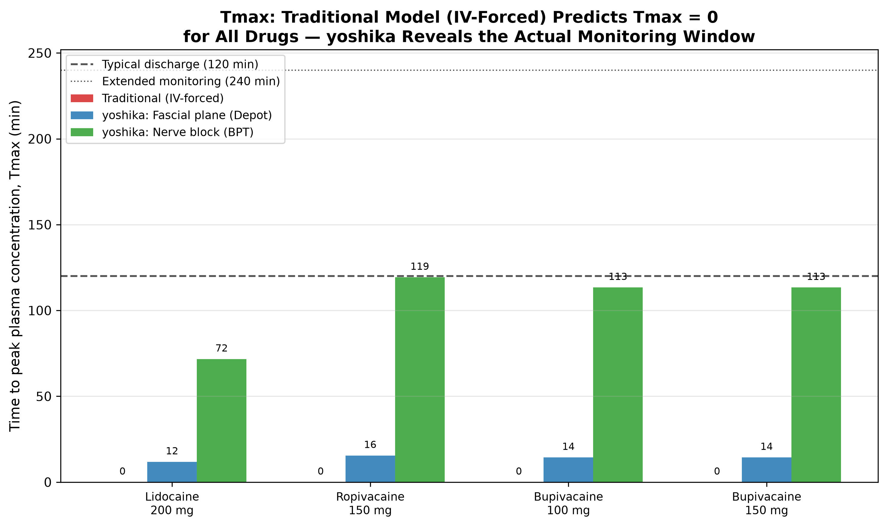
Figure 8: Tmax — IV-Forced Predicts Tmax = 0 (Wrong)
Time to peak plasma concentration (Tmax) by model. Traditional IV-forced model predicts Tmax = 0 for all drugs. yoshika depot model identifies actual Tmax at 12-16 min; BPT model at 72-119 min. Discharge and extended monitoring reference lines shown.

Slide 3
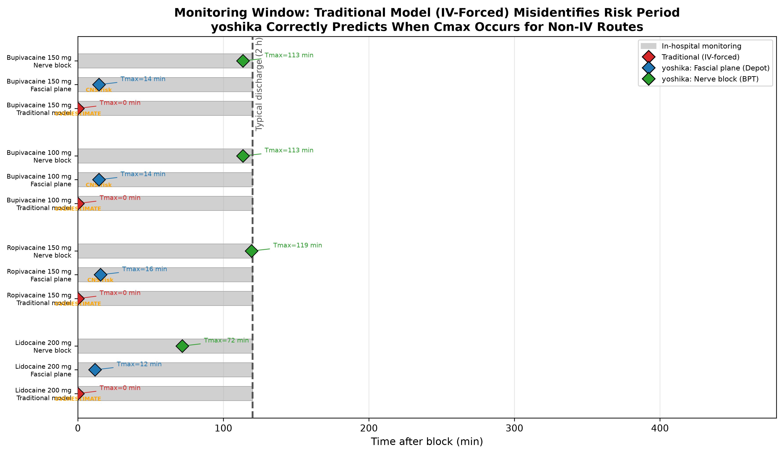
Figure 9: Monitoring Window — Actual Peak Timing
When does Cmax occur relative to discharge? Diamond markers = Tmax under each model. Traditional (red) places peak at t = 0 (wrong for non-IV routes). yoshika identifies actual peak timing for fascial plane and nerve block routes.

Slide 4
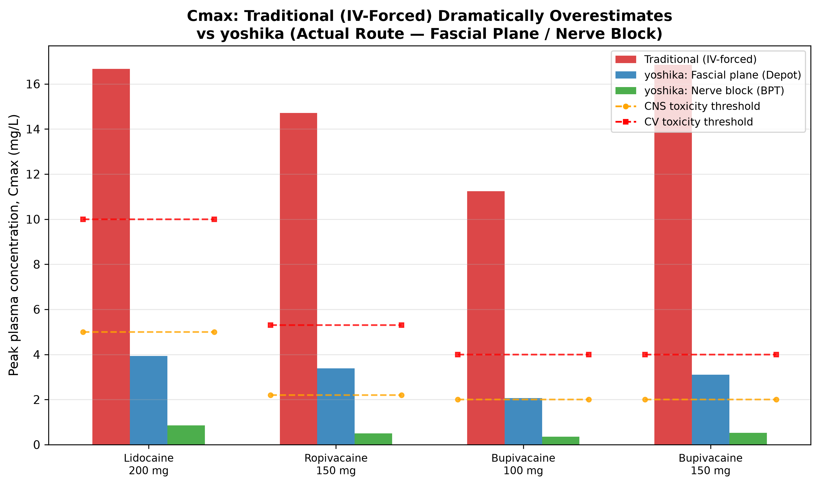
Figure 10: Cmax — IV-Forced Overestimates (False Alarm)
Peak plasma concentration (Cmax) vs toxicity thresholds. Traditional IV-forced model dramatically overestimates Cmax for non-IV routes (false alarm). yoshika depot and BPT models give pharmacokinetically correct predictions.

Slide 5
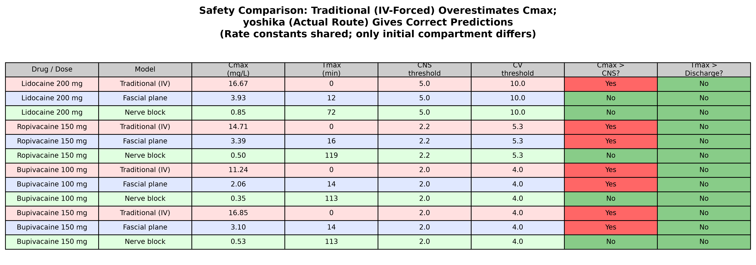
Table: Safety Summary (Shared Rate Constants)
Rate constants shared across all models; only initial compartment differs. Red cells = Cmax exceeds CNS threshold or Tmax exceeds discharge. Pink = traditional (IV-forced); blue = fascial plane; green = nerve block.

