Slide 1
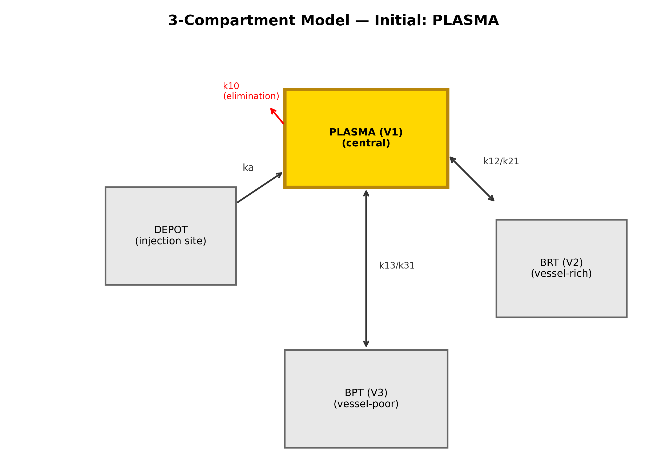
Figure 1
Three-compartment PK model with optional depot input. The initial compartment (plasma highlighted) is a user-selectable argument; disposition rate constants are shared across scenarios.

Slide 2
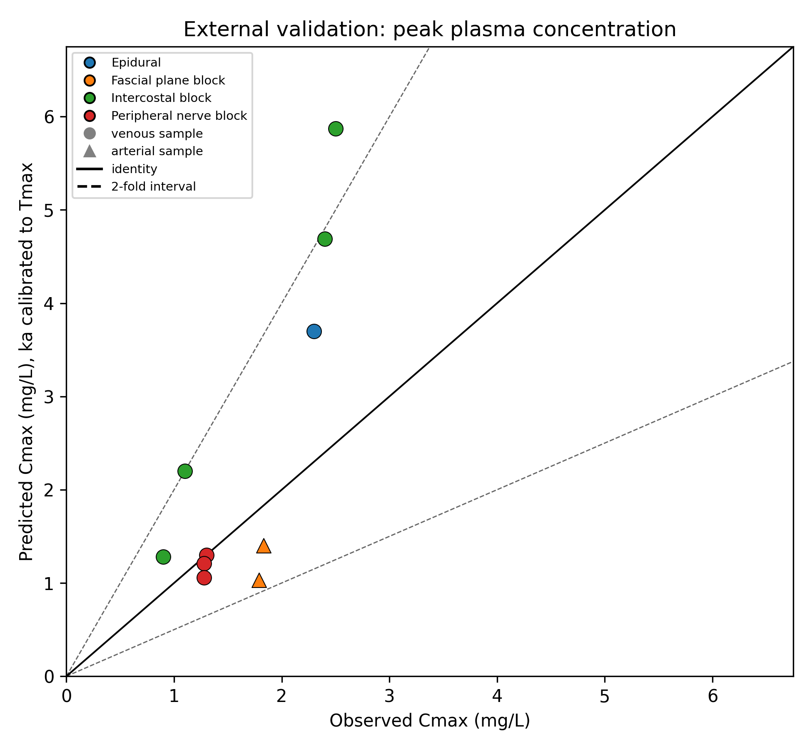
Figure 2
External validation: observed versus predicted peak plasma concentration (depot model, ka calibrated to observed Tmax). Solid line, identity; shaded band, two-fold.

