Slide 1
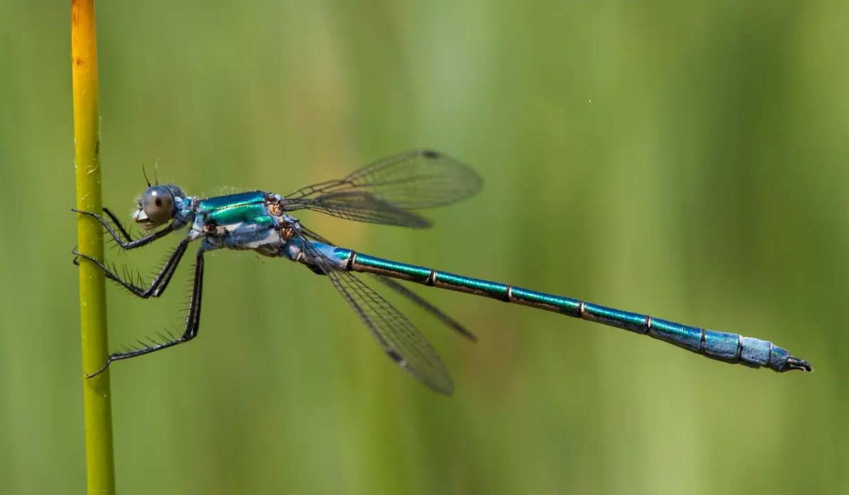
Bio-inspired small target motion detection against cluttered moving backgrounds using optical sensors.
by Boukary DERRA
Supervised by lcl Tijeni Dalleji
Notes:
Détection de petites cibles mobiles dans des arrière-plans complexes en utilisant des capteurs optiques par traitement bio-inspiré

Slide 2
Bio-inspired small target motion detection against cluttered moving backgrounds using optical sensors.
Détection de petites cibles mobiles dans des arrière-plans complexes en utilisant des capteurs optiques par traitement bio-inspiré.

Slide 3

Introduction Générale
Problématique
Small Target Motion Detectors
Directional Small Target Motion Detectors
Neural Network Programming
Conclusion

Slide 4
2. INTRODUCTION
Insects are adapted to detect small targets motion even in cluttered backgrounds;
Inspired by insects visual system, several neural networks have been developed by bio and data scientists ;
This report is about Directional Selective Small Target Motion Detectors (DSTMDs).

Slide 5
2. Small Target Motion Detectors
Artificial VS
LSM
TSM
STMD(ESTMD)
STMSM
ESTMD-EMD & EMD-ESTMD
DSTMD
Insect VS
Feedback-ESTMD
STMD+
Apg-STMD

Slide 6
STMD | Accepted / Published DATE | AUTHORS
ESTMD | July 30, 2008. | S. D. Wiederman, P. A. Shoemaker, and D. C. O’Carroll
ESTMD-EMD & EMD-ESTMD | Jun. 2011. ************ | H. Eichner, M. Joesch, B. Schnell, D. F. Reiff, and A. Borst
Feedback-ESTMD | July 10, 2018. | H. Wang, J. Peng, and S. Yue
DSTMD | August 29, 2018. | H. Wang, J. Peng, and S. Yue
STMD+ | April 5, 2019 | H. Wang, J. Peng, X. Zheng, and S. Yue
Apg-STMD | Dec 17, 2021 | Hongxin Wang, J. Zhao, Huatian Wang, J. Peng and S. Yue

