Slide 1
How to compress 3 programs to 1?
Tamara Gademann & Boukje Heidstra

Slide 2
What we have:
NDE = Nexus Data Editor
TNT = new technology for creating the shortest tree
winclada = create this tree

Slide 3
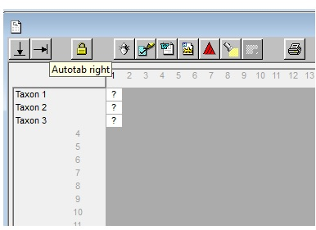
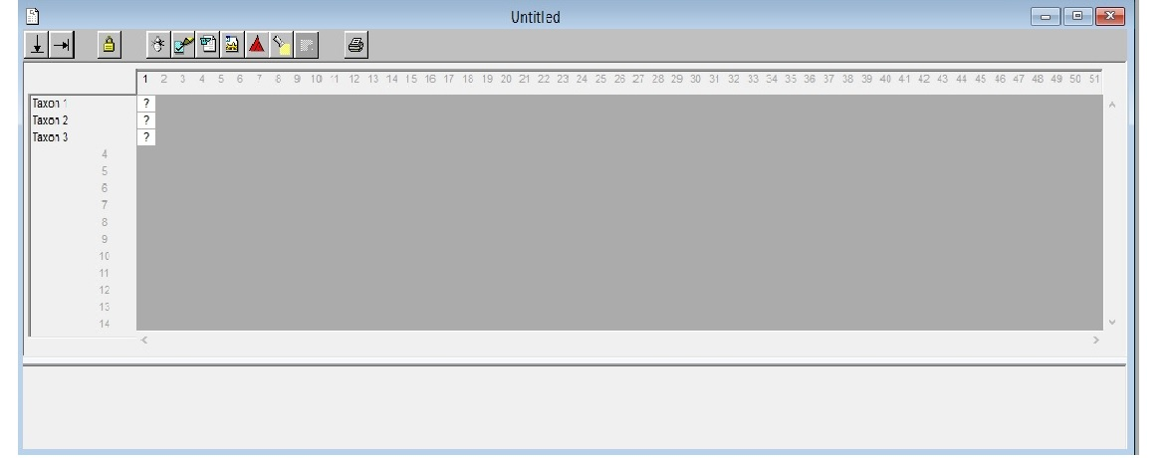
NDE

Slide 4
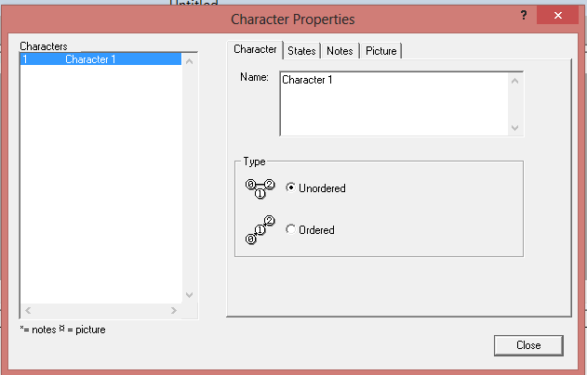
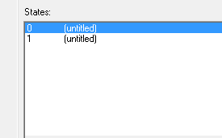

Slide 5
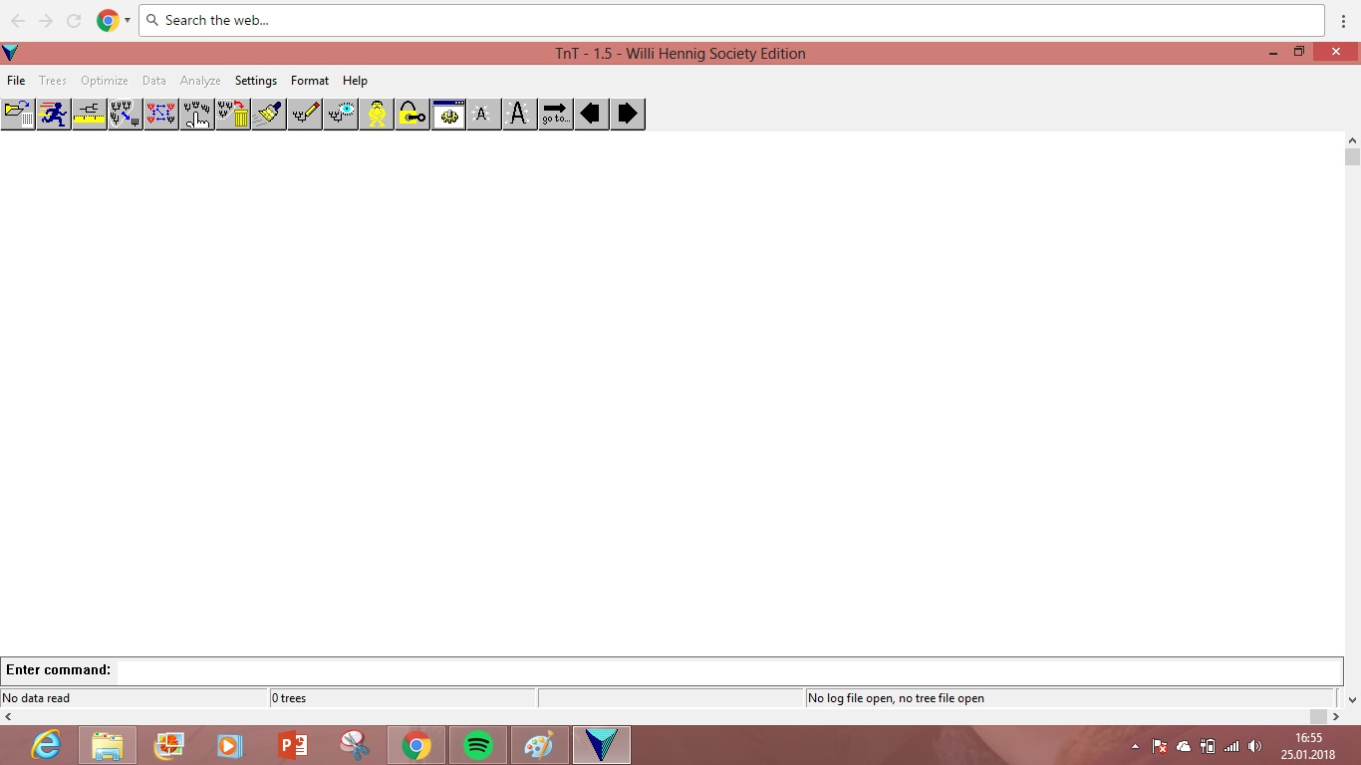
TNT

Slide 6
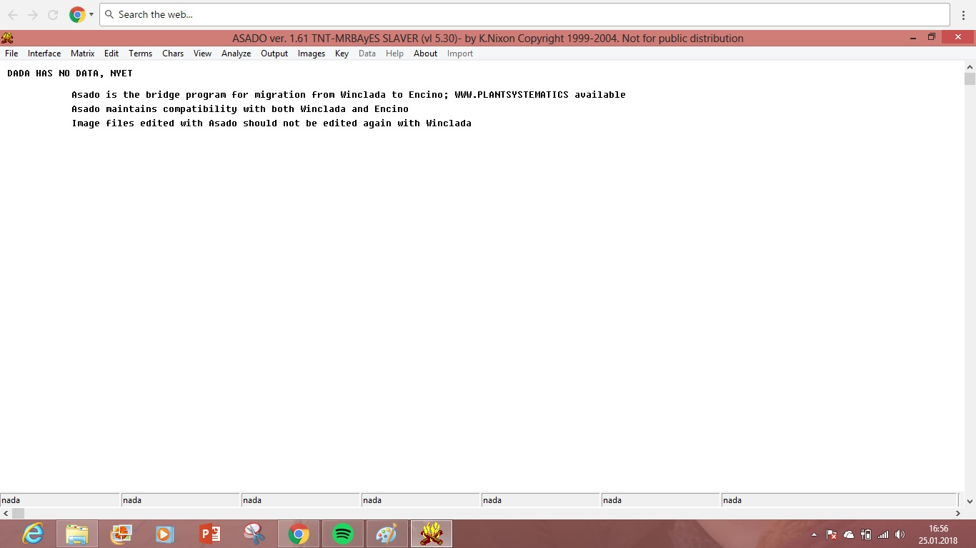
WinClada
it’s only possible to load .tnt files in here, that’s also why you need the TNT software

Slide 7
Our Plan
Python to convert the NDE files and to create trees
so that we don’t need TNT and WinClada anymore

