Slide 1
Measuring & Estimating costs

Slide 2
Modern categorization:
Health care sector costs:
Include medical resources consumed by health care entities.
These types of costs are similar to the definition of direct medical costs but do not include direct medical costs paid for by the patient (e.g., deductibles, co-payments) or other non–health care entities.

Slide 3
Costs to other sectors:
Some diseases and their treatment impact other non–health care sectors, such as Home care services (e.g. Geriatrics or handicapped).
One example often noted is that when measuring resources used and savings incurred by the treatment of patients with schizophrenia, researchers should consider the impact on other sectors as the cost of social workers.

Slide 4
Patient and family costs:
This categorization includes costs to the patient and his or her family without regard to whether the costs are medical or non-medical in nature.
Thus, these costs include the patient’s or family’s share of direct medical as well as direct nonmedical costs.

Slide 5
Productivity costs:
It is analogous to the economic term indirect costs.

Slide 6
Conclusion
Treatment of an illness may include a combination of these types of costs.
Many studies report only the direct medical (i.e., health care sector) costs.
This may be appropriate depending on the objective of the study. For example, if the objective is to measure the costs to the hospital for two treatments that are expected to differ only in direct medical costs, measurement of the other types of costs may not be warranted.

Slide 7
3- Timing Adjustments for Costs
Bringing Past Costs to the Present: Standardization of Costs:
When costs are estimated from information collected for more than 1 year before the study, adjustment of costs is needed; this is also referred to as standardization of costs.
To standardize the cost of two medications, this can be done by calculating the number of units (doses) of each medication used per case and multiplying this number by the current unit cost for each medication.

Slide 8
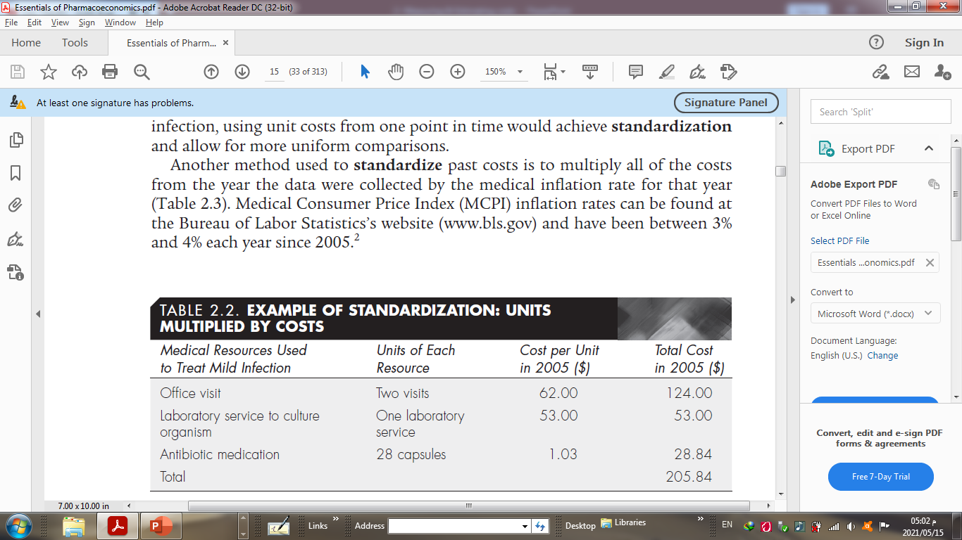

Slide 9
Bringing Future Costs (Benefits) to the Present: Discounting
If costs are estimated based on dollars spent or saved in future years, another type of modification, called discounting, is needed.
People (and businesses) prefer to receive money today rather than at a later time.
Therefore, money received today is worth more than the same amount of money received next year.
For example, if I asked to borrow $1,000 from you today and assured you I would pay you back the $1,000 in 3 years, you would not agree to lend me the money unless I paid you more than $1,000 in 3 years

Slide 10
Modifications for this time value are estimated using a discount rate.
From this parameter, the present value (PV) of future expenditures and savings can be calculated.
The discount rate generally accepted for health care interventions is between 3% and 5%.

Slide 11
4- Resources for Cost Estimations
The more similar a cost estimation method is to “real-world” practice, the better estimate this method provides.
Sometimes costs are collected retrospectively from medical records or reimbursement claims data.
Claims data review is a relatively inexpensive way to collect cost data for patients but may be incomplete.
Sources of estimates for four types of common direct medical cost categories will be addressed: medications, medical services, personnel costs, and hospitalizations.

Slide 12
Medications:
The average wholesale price (AWP) is often used when calculating the cost of pharmaceutical products.
The AWP is higher than what pharmacies, institutions, or third party payers actually pay for medications.
The wholesale acquisition costs (WAC) are estimates of costs to wholesalers from the manufacturer.
Researchers should be clear about the source they use to estimate pharmacy costs, to enhance comparability of studies

Slide 13
Medical Services:
Medical services, such as office or clinic visits and outpatient laboratory and surgical procedures, are frequently included in direct medical cost estimates.
Providers have a list of charges for these types of services, but payers usually pay less than this “list price.” When the perspective is that of the purchaser (or payer) ex: insurance company.
A common source for US reimbursement rates (the amount reimbursed by payers to the providers of health services) is the Physician’s Fee Reference (both a book and a searchable database are available).

Slide 14
Personnel:
It is taken into consideration when the perspective of the study is that of the provider of health services (e.g., hospital, clinic, physician’s office, pharmacy).
Also, when the provision of different health care alternatives involves a difference in the amount of time spent by medical personnel.
For example, if a hospital wanted to determine the cost-effectiveness of instituting a pharmacy discharge counseling service, an important cost estimate would include the time of the pharmacists who would provide this service.

Slide 15
Hospitalizations:
The level of the precision of estimates varies widely for studies that include hospital costs as a part of their evaluation.
In an ascending order from least precise (gross or macro-costing) to most precise (micro-costing), four methods for estimating hospital costs are:
Per diem (per day)
Disease-specific per diem
Diagnosis-related group (DRG)
Micro-costing.
The level used is determined by the importance of the hospital-related costs to the overall evaluation, the perspective of the study, the availability of cost data, and the resources available for conducting the study.

Slide 16
Per Diem:
The least precise method of estimating hospital costs is the per diem method of costing.
For each day that a patient is in a hospital setting, an average cost per day for all types of hospitalizations is used as a multiplier.
For example, if the average cost reimbursement per day for hospitalizations of all patients was $2,000 per day, the cost estimate for a 3-day stay for appendicitis would be the same as the estimate for a 3-day stay for cardiac bypass surgery (3 days × $2,000/ day = $6,000).

Slide 17
Disease-Specific Per Diem:
It would be more precise to use estimated costs per day for specific disease or a disease-specific per diem.
Here the average reimbursement rate might be $1,500 per day for the appendicitis case ($4,500 for 3 days) and $10,000 per day ($30,000 for 3 days) for the cardiac bypass surgery case.
So, this method of hospitalization costs is disease-specific.

Slide 18
Diagnosis-Related Group (DRG):
A relatively available and often-used method of estimating hospital costs to the payer is the payment rate for DRGs.
This method is used to classify clinically cohesive diagnoses and procedures that use similar resources.
Each patient is assigned one of more than 500 DRGs based on factors such as principal diagnosis, specific procedures involved, secondary diagnoses, and age.
The average reimbursement for each DRG can be used to approximate the cost to the payer.

Slide 19
Micro-costing:
The most precise method of estimating hospital costs is micro-costing.
Micro-costing involves collecting information on resource use for each component of an intervention (in this example, each component of a hospitalization) to estimate and compare alternative interventions.
This usually entails a review of patients’ hospital records to determine what specific services (e.g., medications, laboratory services, procedures) were used and to assign a cost to each service.
Records are kept for each service to determine how much to charge the payers (patient and third-party payers) for each hospital stay.

