Slide 1
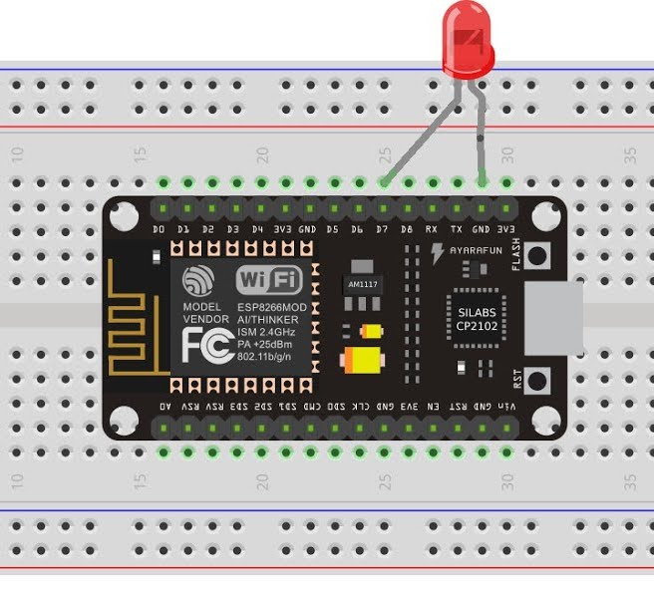
Connected Air Conditioner
Team members:
Çağrı Kılıçoğlu
Abdulsamed Bayrakoğlu
Solution:
Infrared Sender is placed in ESP 8266 NodeMCU
Weather data from cloud is sent to ESP 8266 every 5 minutes via WiFi
Necessary ON or OFF signal is sent to the air conditioner from ESP 8266 with IR sender.
(Signals for the air conditioner is previously obtained with IR receiver.)
Problem: Abrupt changes in humidity & temperature between indoor and outdoor temperature affects personal health causing constant fatigue and dry skin problems
Technologies: ESP 8266 NodeMCU, IR Sender, ENode.js, Amazon Cloud Services,openweathermap.org
CmpE 490 IoT Course Final Project, 2018 Spring, Bogazici University Computer Engineering Department

