Slide 1
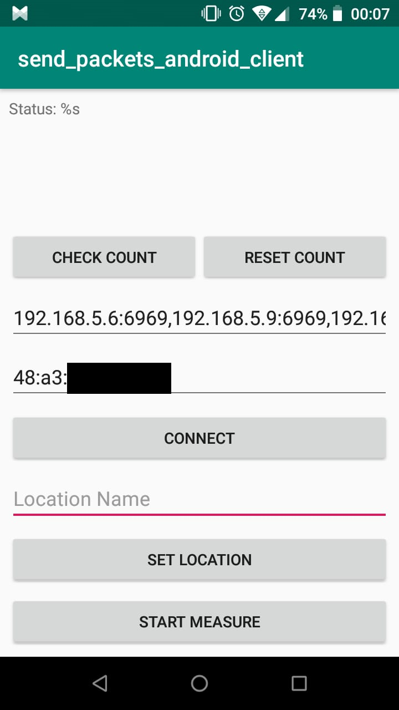
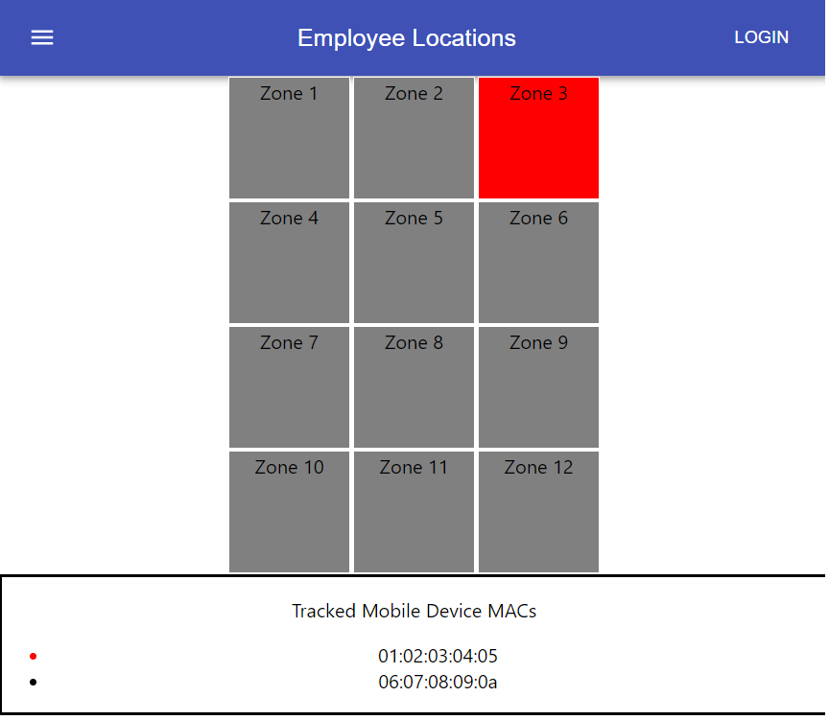
Employee Location Tracking
Team members:
Mahmut Karaca
Nihat Şen
Burak Tepedelen
Solution:
Dividing workplace to several zones, establishing Wi-Fi monitor nodes, fingerprinting the zones collecting a Wi-Fi model
Tracking known Wi-Fi capable mobile devices of employees through nodes
Estimating current zone of the target mobile device in the cloud
Problem: Tracking location of employees to increase worktime effectiveness
Technologies: Raspberry Pi 3, Nodemcu, Wi-fi Adapter, Node.js, MQTT, Android, Sqlite3,etc.
See https://github.com/bounIoT/EmployeeTracking for further details.
CmpE 490 IoT Course Final Project, 2019 Spring, Bogazici University Computer Engineering Department

