Slide 1
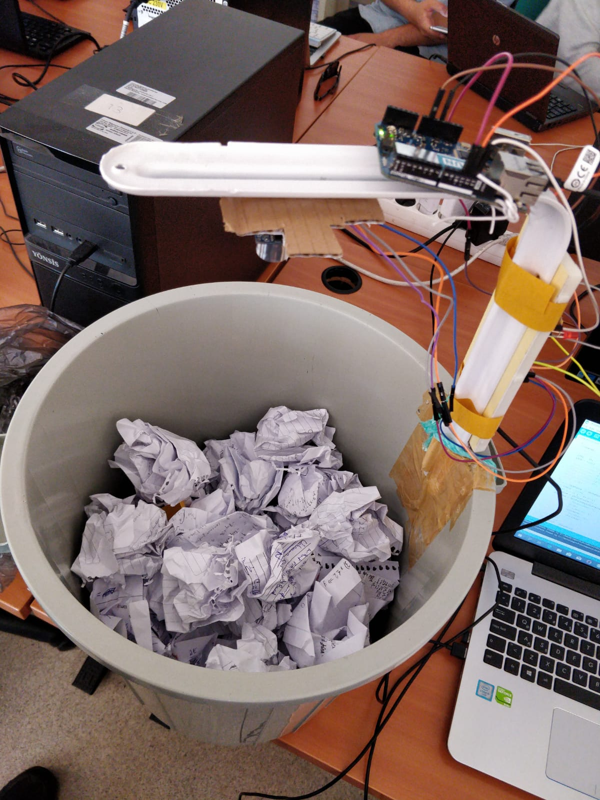
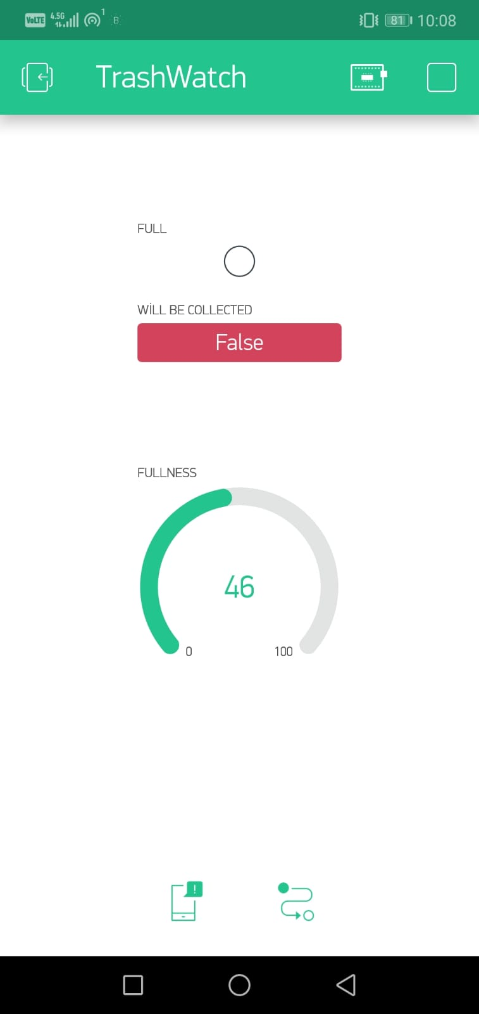
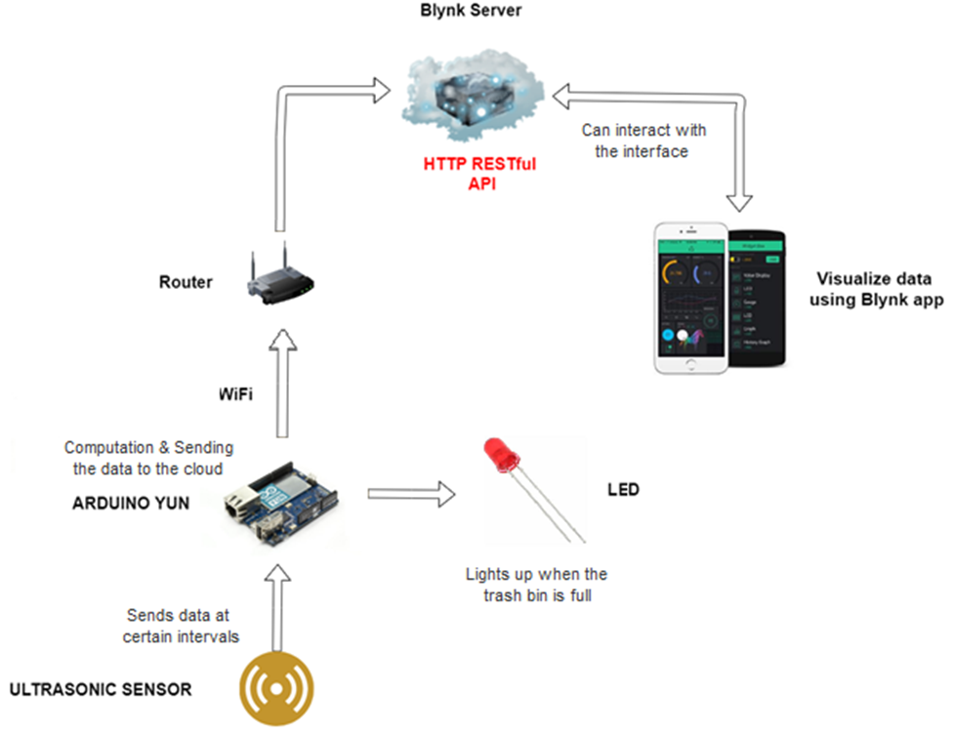
TrashWatch
Team members:
Atakan Aydoğdu
Yunus Ege Saygılı
Özgür Solak
Solution:
Ultrasonic sensor watching over the trash
Simple computation via Arduino
Connected to Cloud using WiFi
Blynk Cloud reporting to Blynk App
Blynk App alerting user via notification
Problem: Environmental pollution due to trash on the floor & inefficient garbage collection in campus
Technologies: Arduino YUN, HC-SR04 Ultrasonic sensor, LED, WiFi, Blynk
See https://github.com/bounIoT/TrashWatch for further details.
CmpE 490 IoT Course Final Project, 2019 Spring, Bogazici University Computer Engineering Department

