Slide 1

Neural Network Basics
李翔

Slide 2
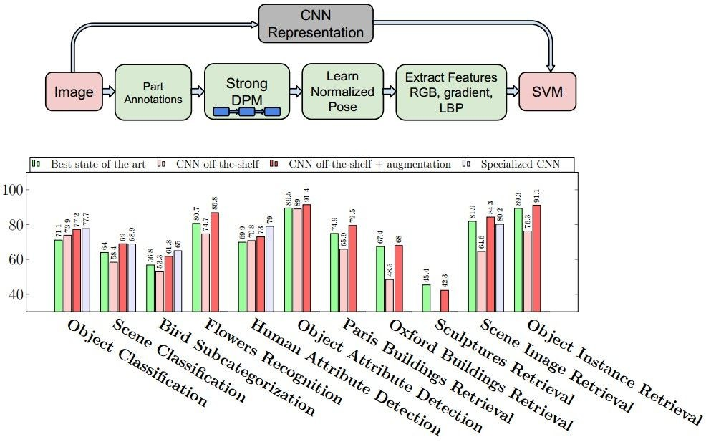
Why (convolutional) neural networks?
State of the art performance on many problems
Most papers in recent vision conferences use deep neural networks
Razavian et al., CVPR 2014 Workshops

Slide 3
Traditional Recognition Approach
Hand-designed
feature extraction (e.g. SIFT, HOG)
Trainable
classifier
Image/ Video
Pixels
Object
Class
  Features are key to recent progress in recognition, but research shows they’re flawed…
Where next?
Adapted from Lana Lazebnik

Slide 4
What about learning the features?
  Learn a feature hierarchy all the way from pixels to classifier
  Each layer extracts features from the output of previous layer
  Train all layers jointly
Image/ Video
Pixels
Layer 1
Layer 2
Layer 3
Object
Class
Lana Lazebnik

Slide 5
“Shallow” vs. “deep” architectures
Traditional recognition: “Shallow” architecture
Image/ Video
Pixels
Hand-designed
feature extraction
Trainable
classifier
Object
Class
Deep learning: “Deep” architecture
Image/ Video
Pixels
Layer 1
Layer N
Simple classifier
…
Object Class
Lana Lazebnik

Slide 6
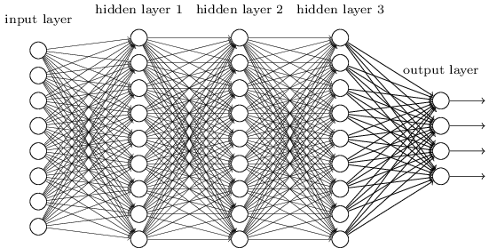
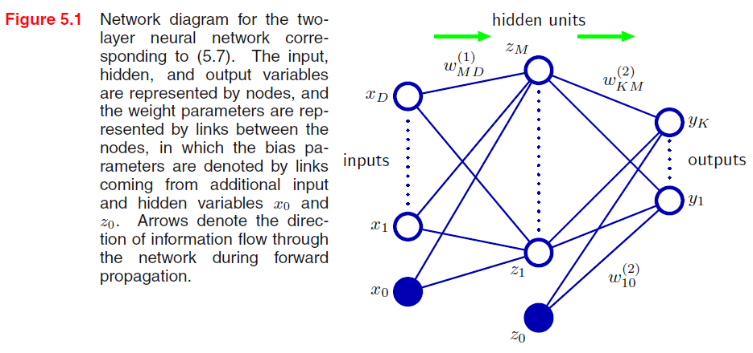


Neural network definition
Activations:
Nonlinear activation function h (e.g. sigmoid, RELU):
Recall SVM:
w^{T}x + b
Figure from Christopher Bishop

Slide 7

Neural network definition
Layer 2
Layer 3 (final)
Outputs (e.g. sigmoid/softmax)
Finally:
(multiclass)
(binary)
(binary)

Slide 8
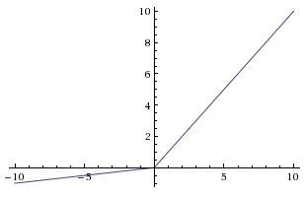
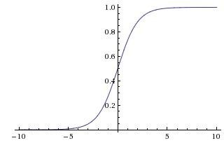

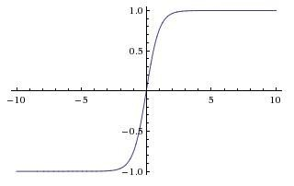


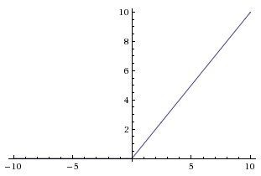
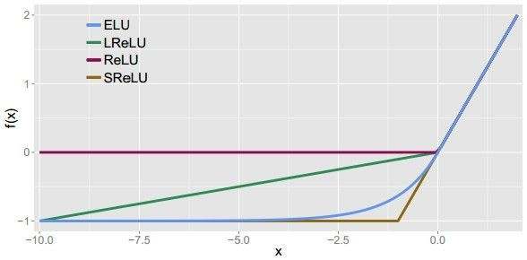
Leaky ReLU
max(0.1x, x)
Activation functions
Sigmoid
Maxout ELU
tanh
tanh(x)
ReLU
max(0,x)
Andrej Karpathy

Slide 9
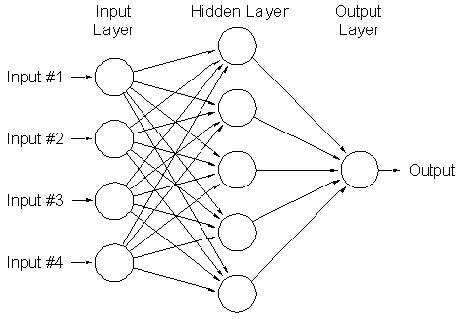
A multi-layer neural network
Nonlinear classifier
Can approximate any continuous function to arbitrary accuracy given sufficiently many hidden units
Lana Lazebnik

Slide 10
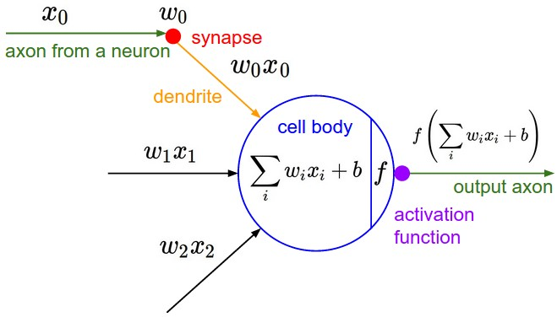
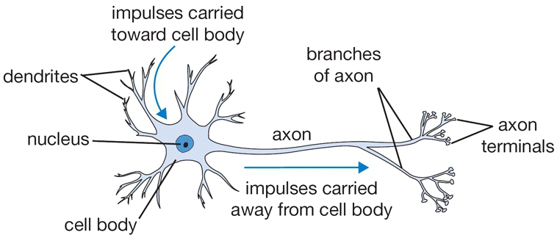
Inspiration: Neuron cells
Neurons
  accept information from multiple inputs,
  transmit information to other neurons.
Multiply inputs by weights along edges
Apply some function to the set of inputs at each node
If output of function over threshold, neuron “fires”
Text: HKUST, figures: Andrej Karpathy
Notes:
From Wikipedia: At the majority of synapses（突触）, signals are sent from the axon（轴突，神经细胞长的凸起，将信号传递给其他细胞） of one neuron to a dendrite（树突） of another... All neurons are electrically excitable, maintaining voltage gradients across their membranes… If the voltage changes by a large enough amount, an all-or-none electrochemical pulse called an action potential（动作电位） is generated, which travels rapidly along the cell's axon, and activates synaptic connections with other cells when it arrives.

Slide 11
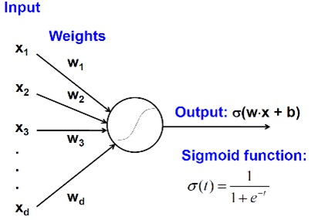
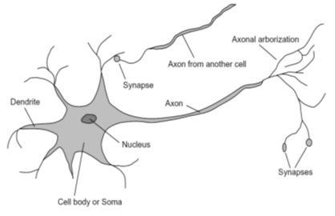
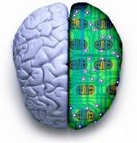
Biological analog
A biological neuron
An artificial neuron
Jia-bin Huang

Slide 12
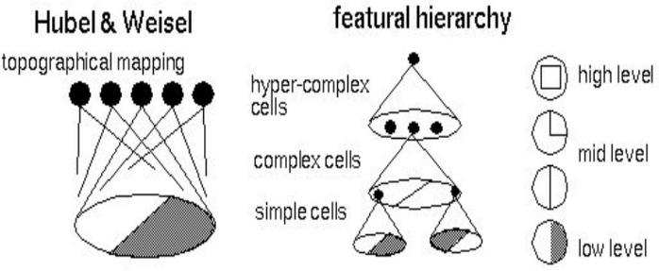
Biological analog
Hubel and Weisel’s architecture
Multi-layer neural network
Adapted from Jia-bin Huang

Slide 13
Multilayer networks
Cascade neurons together
Output from one layer is the input to the next
Each layer has its own sets of weights
HKUST

Slide 14
Feed-forward networks
Predictions are fed forward through the network to classify
HKUST

Slide 15
Feed-forward networks
Predictions are fed forward through the network to classify
HKUST

Slide 16
Feed-forward networks
Predictions are fed forward through the network to classify
HKUST

Slide 17
Feed-forward networks
Predictions are fed forward through the network to classify
HKUST

Slide 18
Feed-forward networks
Predictions are fed forward through the network to classify
HKUST

Slide 19
Feed-forward networks
Predictions are fed forward through the network to classify
HKUST

Slide 20
Deep neural networks
Lots of hidden layers
Depth = power (usually)
Weights to learn!
Weights to learn!
Weights to learn!
Weights to learn!
Figure from http://neuralnetworksanddeeplearning.com/chap5.html

Slide 21
How do we train them?
The goal is to iteratively find such a set of weights that allow the activations/outputs to match the desired output
We want to minimize a loss function
The loss function is a function of the weights in the network
For now let’s simplify and assume there’s a single layer of weights in the network

Slide 22
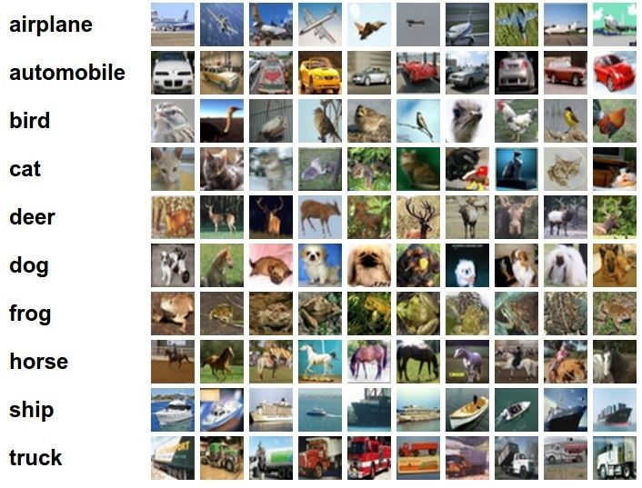
Classification goal
Example dataset: CIFAR-10 10 labels
50,000 training images each image is 32x32x3
10,000 test images.
Andrej Karpathy

Slide 23

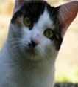
Classification scores
image
parameters
f(x,W)
10 numbers, indicating class scores
[32x32x3]
array of numbers 0...1 (3072 numbers total)
Andrej Karpathy

Slide 24
Linear classifier
3072x1
(+b)
10x1
10x1
10x3072
10 numbers, indicating class scores
[32x32x3]
array of numbers 0...1
parameters, or “weights”
Andrej Karpathy

Slide 25
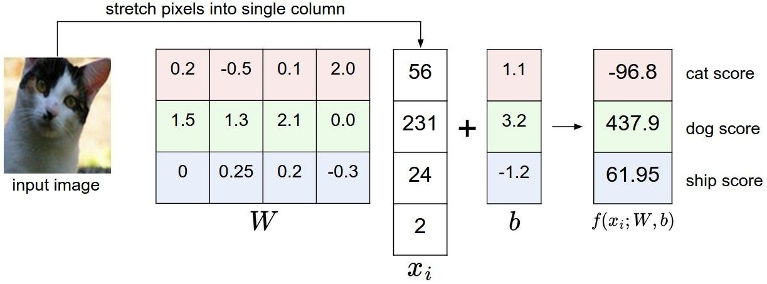
Linear classifier
Example with an image with 4 pixels, and 3 classes (cat/dog/ship)
Andrej Karpathy

Slide 26

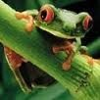
Linear classifier
Going forward: Loss function/Optimization
TODO:
1. Define a loss function that quantifies our unhappiness with the scores across the training data.
cat car frog
3.2
5.1
-1.7
1.3
4.9
2.0
2.2
2.5
-3.1
2. Come up with a way of efficiently finding the parameters that minimize the loss function. (optimization)
Andrej Karpathy

Slide 27
Linear classifier
Suppose: 3 training examples, 3 classes. With some W the scores
are:
cat car frog
3.2
5.1
-1.7
1.3
4.9
2.0
2.2
2.5
-3.1
Adapted from Andrej Karpathy

Slide 28





Linear classifier: Hinge loss
Suppose: 3 training examples, 3 classes. With some W the scores
Hinge loss:
Given an example
are:
where where
is the image and
is the (integer) label,
and using the shorthand for the scores vector:
cat car frog
the loss has the form:
3.2
5.1
-1.7
1.3
4.9
2.0
2.2
2.5
-3.1
Want: s_{yi} >= s_{j} + 1
i.e. s_{j} – s_{yi} + 1 <= 0
If true, loss is 0
If false, loss is magnitude of violation
Adapted from Andrej Karpathy

Slide 29
Linear classifier: Hinge loss
Suppose: 3 training examples, 3 classes. With some W the scores
Hinge loss:
Given an example
are:
where where
is the image and
is the (integer) label,
and using the shorthand for the scores vector:
the loss has the form:
cat car frog | 3.2 5.1 -1.7 | 1.3 2.2 4.9 2.5 2.0 -3.1
Losses: | 2.9
= max(0, 5.1 - 3.2 + 1)
+max(0, -1.7 - 3.2 + 1)
= max(0, 2.9) + max(0, -3.9)
= 2.9 + 0
= 2.9
Adapted from Andrej Karpathy

Slide 30
Linear classifier: Hinge loss
Suppose: 3 training examples, 3 classes. With some W the scores
Hinge loss:
Given an example
are:
where where
is the image and
is the (integer) label,
and using the shorthand for the scores vector:
the loss has the form:
cat 3.2 car 5.1 frog -1.7 | 1.3 4.9 2.0 | 2.2 2.5 -3.1
Losses: 2.9 | 0
= max(0, 1.3 - 4.9 + 1)
+max(0, 2.0 - 4.9 + 1)
= max(0, -2.6) + max(0, -1.9)
= 0 + 0
= 0
Adapted from Andrej Karpathy

Slide 31
Linear classifier: Hinge loss
Suppose: 3 training examples, 3 classes. With some W the scores
Hinge loss:
Given an example
are:
where where
is the image and
is the (integer) label,
and using the shorthand for the scores vector:
the loss has the form:
cat car frog | 3.2 5.1 -1.7 | 1.3 4.9 2.0 | 2.2 2.5 -3.1
Losses: | 2.9 | 0 | 12.9
= max(0, 2.2 - (-3.1) + 1)
+max(0, 2.5 - (-3.1) + 1)
= max(0, 5.3 + 1)
+ max(0, 5.6 + 1)
= 6.3 + 6.6
= 12.9
Adapted from Andrej Karpathy

Slide 32

Linear classifier: Hinge loss
Suppose: 3 training examples, 3 classes. With some W the scores
Hinge loss:
Given an example
are:
where where
is the image and
is the (integer) label,
and using the shorthand for the scores vector:
cat car frog
the loss has the form:
3.2
5.1
-1.7
1.3
4.9
2.0
2.2
2.5
-3.1
and the full training loss is the mean over all examples in the training data:
L = (2.9 + 0 + 12.9)/3
Losses:
2.9
0
12.9
= 15.8 / 3 = 5.3
Lecture 3 - 12
Adapted from Andrej Karpathy

Slide 33
Linear classifier: Hinge loss
Adapted from Andrej Karpathy

Slide 34


Linear classifier: Hinge loss
λ = regularization strength (hyperparameter)
Weight Regularization
In common use: L2 regularization L1 regularization
Dropout (will see later)
Adapted from Andrej Karpathy

Slide 35



Another loss: Softmax (cross-entropy)
scores = unnormalized log probabilities of the classes.
where
cat car frog
Want to maximize the log likelihood, or (for a loss function) to minimize the negative log likelihood of the correct class:
3.2
5.1
-1.7
Andrej Karpathy

Slide 36

Another loss: Softmax (cross-entropy)
unnormalized probabilities
cat car frog
3.2 5.1 -1.7 | exp
0.13
0.87
0.00
24.5
164.0
0.18
L_i = -log(0.13)
= 0.89
normalize
unnormalized log probabilities
probabilities
Adapted from Andrej Karpathy

Slide 37
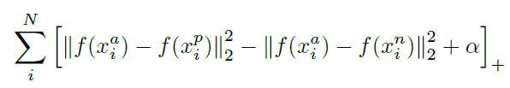
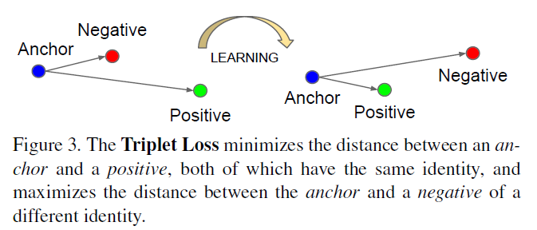
Other losses
Triplet loss (Schroff, FaceNet)
Anything you want!
a denotes anchor
p denotes positive
n denotes negative

Slide 38
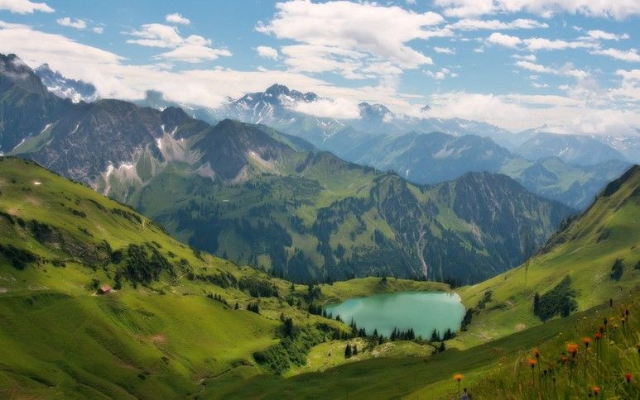

How to minimize the loss function?
Andrej Karpathy

Slide 39

How to minimize the loss function?
In 1-dimension, the derivative of a function:
In multiple dimensions, the gradient is the vector of (partial derivatives).
Andrej Karpathy

Slide 40
current W:
gradient dW:
[0.34,
-1.11,
0.78,
0.12,
0.55,
2.81,
-3.1,
-1.5,
0.33,…]
loss 1.25347
[?,
?,
?,
?,
?,
?,
?,
?,
?,…]
Andrej Karpathy

Slide 41
current W:
W + h (first dim):
gradient dW:
[0.34,
-1.11,
0.78,
0.12,
0.55,
2.81,
-3.1,
-1.5,
0.33,…]
loss 1.25347
[0.34 + 0.0001,
-1.11,
0.78,
0.12,
0.55,
2.81,
-3.1,
-1.5,
0.33,…]
loss 1.25322
[?,
?,
?,
?,
?,
?,
?,
?,
?,…]
Andrej Karpathy

Slide 42
current W:
W + h (first dim):
gradient dW:
[0.34,
-1.11,
0.78,
0.12,
0.55,
2.81,
-3.1,
-1.5,
0.33,…]
loss 1.25347
[0.34 + 0.0001,
-1.11,
0.78,
0.12,
0.55,
2.81,
-3.1,
-1.5,
0.33,…]
loss 1.25322
[-2.5,
?,
?,
?,
?,
?,
?,
(1.25322 - 1.25347)/0.0001
= -2.5
?,
?,…]
Andrej Karpathy

Slide 43
current W:
W + h (second dim):
gradient dW:
[0.34,
-1.11,
0.78,
0.12,
0.55,
2.81,
-3.1,
-1.5,
0.33,…]
loss 1.25347
[0.34,
-1.11 + 0.0001,
0.78,
0.12,
0.55,
2.81,
-3.1,
-1.5,
0.33,…]
loss 1.25353
[-2.5,
?,
?,
?,
?,
?,
?,
?,
?,…]
Andrej Karpathy

Slide 44
current W:
W + h (second dim):
gradient dW:
[0.34,
-1.11,
0.78,
0.12,
0.55,
2.81,
-3.1,
-1.5,
0.33,…]
loss 1.25347
[0.34,
-1.11 + 0.0001,
0.78,
0.12,
0.55,
2.81,
-3.1,
-1.5,
0.33,…]
loss 1.25353
[-2.5,
0.6,
?,
?,
?,
?,
?,
?,
(1.25353 - 1.25347)/0.0001
= 0.6
?,…]
Andrej Karpathy

Slide 45
current W:
W + h (third dim):
gradient dW:
[0.34,
-1.11,
0.78,
0.12,
0.55,
2.81,
-3.1,
-1.5,
0.33,…]
loss 1.25347
[0.34,
-1.11,
0.78 + 0.0001,
0.12,
0.55,
2.81,
-3.1,
-1.5,
0.33,…]
loss 1.25347
[-2.5,
0.6,
?,
?,
?,
?,
?,
?,
?,…]
Andrej Karpathy

Slide 46



This is silly. The loss is just a function of W:
want
Andrej Karpathy

Slide 47

This is silly. The loss is just a function of W:
want
Calculus
= ...
Andrej Karpathy

Slide 48
current W:
gradient dW:
[0.34,
-1.11,
0.78,
0.12,
0.55,
2.81,
-3.1,
-1.5,
0.33,…]
loss 1.25347
[-2.5,
0.6,
0,
0.2,
0.7,
-0.5,
1.1,
1.3,
-2.1,…]
dW = ...
(some function data and W)
Andrej Karpathy

Slide 49
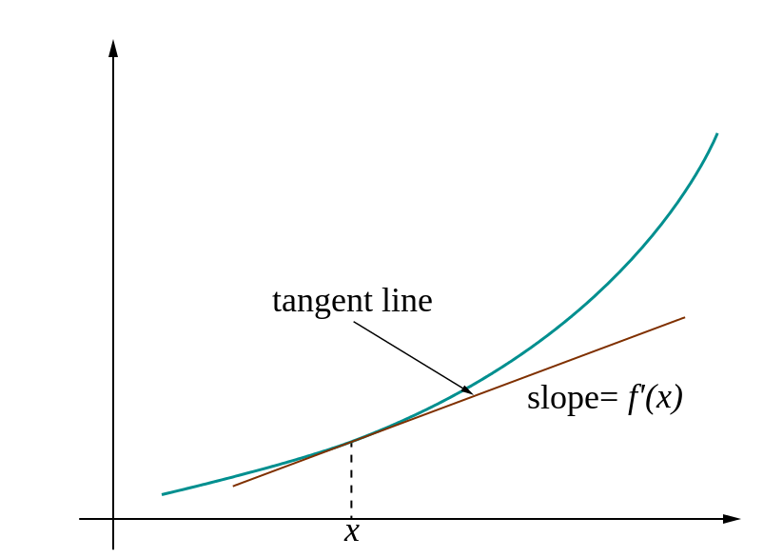
Loss gradients
Denoted as (diff notations):
i.e. how does the loss change as a function of the weights
We want to change the weights in such a way that makes the loss decrease as fast as possible

Slide 50
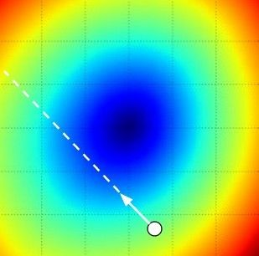
Gradient descent
We’ll update weights
Move in direction opposite to gradient:
L
Time
Learning rate
W_2
original W
W_1
negative gradient direction
Figure from Andrej Karpathy

Slide 51
Gradient descent
Iteratively subtract the gradient with respect to the model parameters (w)
I.e. we’re moving in a direction opposite to the gradient of the loss
I.e. we’re moving towards smaller loss

Slide 52
Mini-batch gradient descent
In classic gradient descent, we compute the gradient from the loss for all training examples
Could also only use some of the data for each gradient update
We cycle through all the training examples multiple times
Each time we’ve cycled through all of them once is called an ‘epoch’
Allows faster training (e.g. on GPUs), parallelization

Slide 53
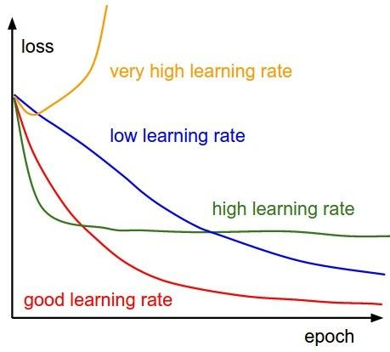
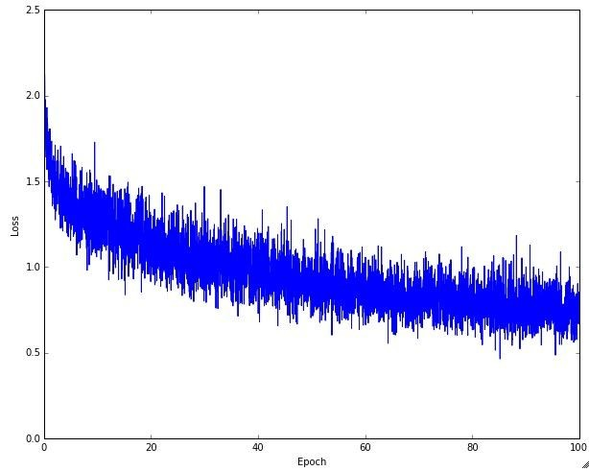
Learning rate selection
The effects of step size (or “learning rate”)
Andrej Karpathy

Slide 54
Gradient descent in multi-layer nets
We’ll update weights
Move in direction opposite to gradient:
How to update the weights at all layers?
Answer: backpropagation of error from higher layers to lower layers

Slide 55
Backpropagation: Graphic example
First calculate error of output units and use this to change the top layer of weights.
output
k
j
i
Update weights into j
w⁽²⁾
hidden
w⁽¹⁾
input
Adapted from Ray Mooney, equations from Chris Bishop

Slide 56
Backpropagation: Graphic example
Next calculate error for hidden units based on errors on the output units it feeds into.
output
k
j
i
hidden
input
Adapted from Ray Mooney, equations from Chris Bishop

Slide 57
Backpropagation: Graphic example
Finally update bottom layer of weights based on errors calculated for hidden units.
output
k
j
i
Update weights into i
hidden
input
Adapted from Ray Mooney, equations from Chris Bishop

Slide 58
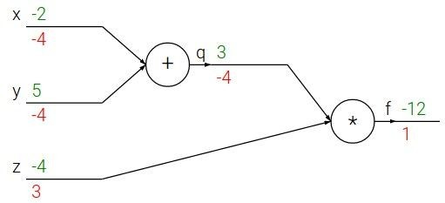

e.g. x = -2, y = 5, z = -4
Fei-Fei Li & Andrej Karpathy & Justin Johnson Lecture 4 - 13 Jan 2016
Lecture 4 - 10
Andrej Karpathy
Notes:
https://www.youtube.com/watch?v=QWfmCyLEQ8U&list=PL16j5WbGpaM0_Tj8CRmurZ8Kk1gEBc7fg&index=4

Slide 59





e.g. x = -2, y = 5, z = -4
Want:
Fei-Fei Li & Andrej Karpathy & Justin Johnson Lecture 4 - 13 Jan 2016
Lecture 4 - 11
Andrej Karpathy

Slide 60

e.g. x = -2, y = 5, z = -4
Want:
Fei-Fei Li & Andrej Karpathy & Justin Johnson Lecture 4 - 13 Jan 2016
Lecture 4 - 12
Andrej Karpathy

Slide 61
e.g. x = -2, y = 5, z = -4
Want:
Fei-Fei Li & Andrej Karpathy & Justin Johnson Lecture 4 - 13 Jan 2016
Lecture 4 - 13
Andrej Karpathy

Slide 62

e.g. x = -2, y = 5, z = -4
Want:
Fei-Fei Li & Andrej Karpathy & Justin Johnson Lecture 4 - 13 Jan 2016
Lecture 4 - 14
Andrej Karpathy

Slide 63
e.g. x = -2, y = 5, z = -4
Want:
Fei-Fei Li & Andrej Karpathy & Justin Johnson Lecture 4 - 13 Jan 2016
Lecture 4 - 15
Andrej Karpathy

Slide 64

e.g. x = -2, y = 5, z = -4
Want:
Fei-Fei Li & Andrej Karpathy & Justin Johnson Lecture 4 - 13 Jan 2016
Lecture 4 - 16
Andrej Karpathy

Slide 65
e.g. x = -2, y = 5, z = -4
Want:
Fei-Fei Li & Andrej Karpathy & Justin Johnson Lecture 4 - 13 Jan 2016
Lecture 4 - 17
Andrej Karpathy

Slide 66

e.g. x = -2, y = 5, z = -4
Want:
Fei-Fei Li & Andrej Karpathy & Justin Johnson Lecture 4 - 13 Jan 2016
Lecture 4 - 18
Andrej Karpathy

Slide 67


e.g. x = -2, y = 5, z = -4
Chain rule:
Want:
Fei-Fei Li & Andrej Karpathy & Justin Johnson Lecture 4 - 13 Jan 2016
Lecture 4 - 19
Andrej Karpathy

Slide 68

e.g. x = -2, y = 5, z = -4
Want:
Fei-Fei Li & Andrej Karpathy & Justin Johnson Lecture 4 - 13 Jan 2016
Lecture 4 - 20
Andrej Karpathy

Slide 69
e.g. x = -2, y = 5, z = -4
Chain rule:
Want:
Fei-Fei Li & Andrej Karpathy & Justin Johnson Lecture 4 - 13 Jan 2016
Lecture 4 - 21
Andrej Karpathy

Slide 70


activations
f
Fei-Fei Li & Andrej Karpathy & Justin Johnson Lecture 4 - 13 Jan 2016
Lecture 4 - 22
Andrej Karpathy

Slide 71


activations
“local gradient”
f
gradients
Fei-Fei Li & Andrej Karpathy & Justin Johnson Lecture 4 - 13 Jan 2016
Lecture 4 - 23
Andrej Karpathy

Slide 72

activations
“local gradient”
f
gradients
Fei-Fei Li & Andrej Karpathy & Justin Johnson Lecture 4 - 13 Jan 2016
Lecture 4 - 24
Andrej Karpathy

Slide 73
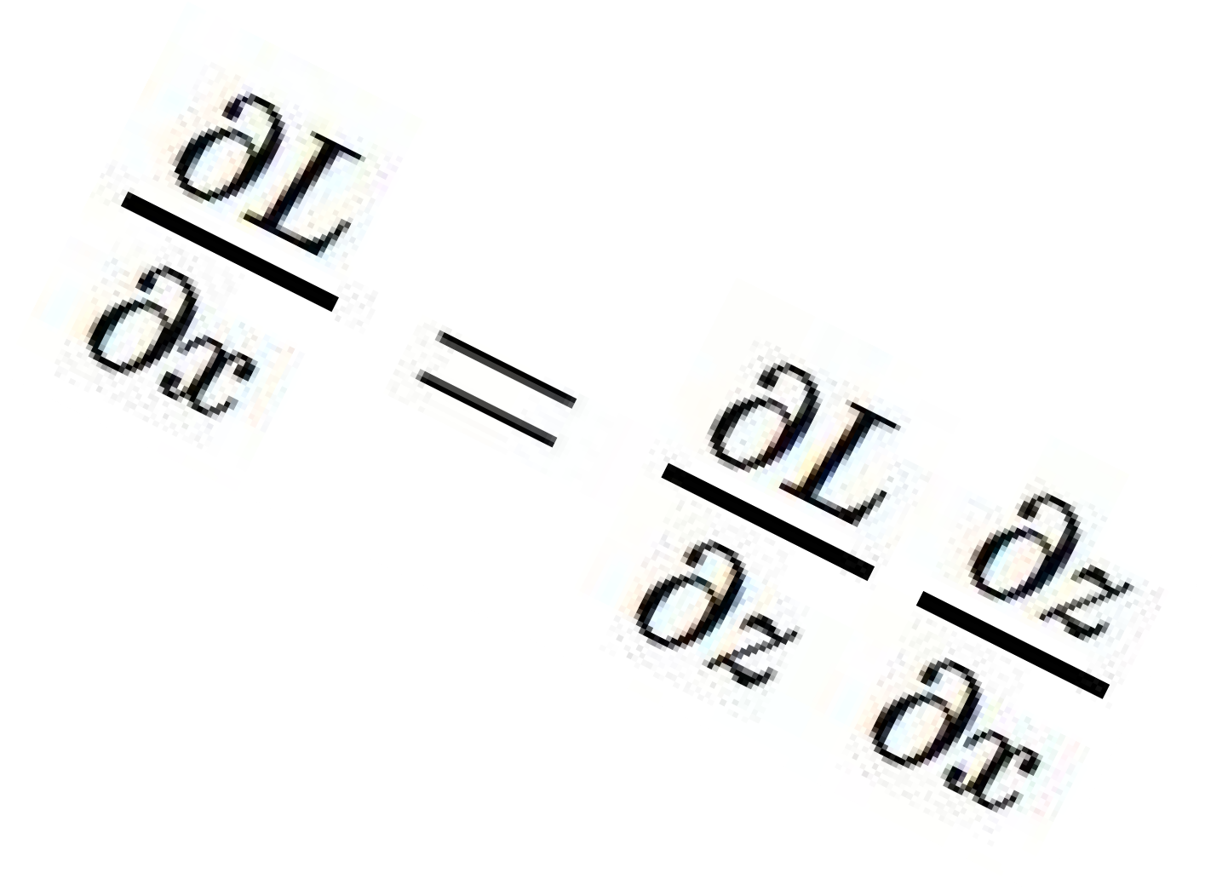
activations
“local gradient”
f
gradients
Fei-Fei Li & Andrej Karpathy & Justin Johnson Lecture 4 - 13 Jan 2016
Lecture 4 - 25
Andrej Karpathy

Slide 74
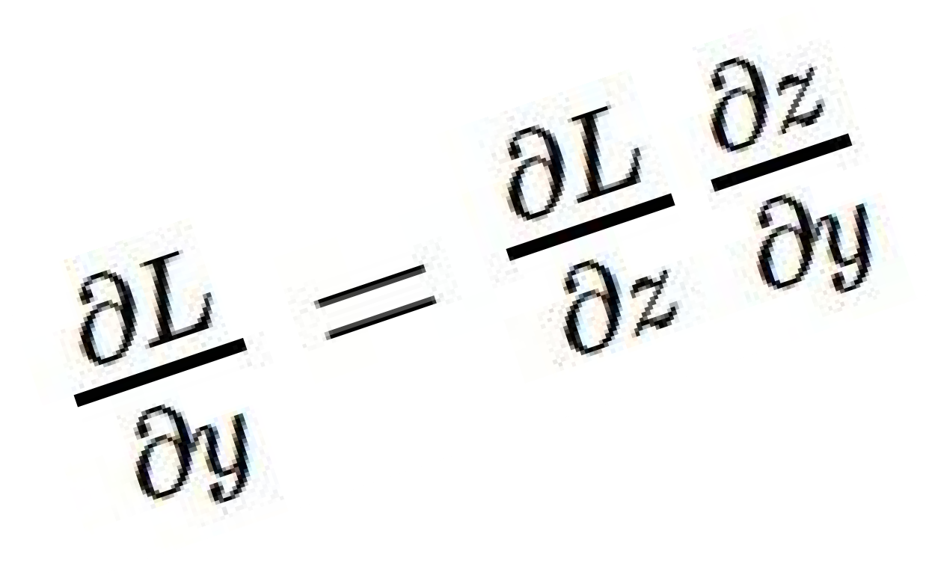
activations
“local gradient”
f
gradients
Fei-Fei Li & Andrej Karpathy & Justin Johnson Lecture 4 - 13 Jan 2016
Lecture 4 - 26
Andrej Karpathy

