Slide 1

AGI HOUSE HACKATHON — LONG-HORIZON AGENTS
01 / 11
MISE
A LONG-HORIZON PHYSICAL AGENT
Tell it what to cook. It plans, executes, and recovers when things go wrong.

Slide 2
THE BIGGER VISION
02 / 11
From voice to plate
VOICE
→
DECOMPOSE
→
RETRIEVE
→
KIT
→
PREP
→
COOK
THIS HACKATHON
A voice request is decomposed into an ingredient list, a robot retrieves each raw ingredient, kits them into a tray, then cuts and preps them so they're ready to cook.
Kitting is a repeatable task across industries — meal kits, hospitals, warehouses. We built that one piece, well.

Slide 3
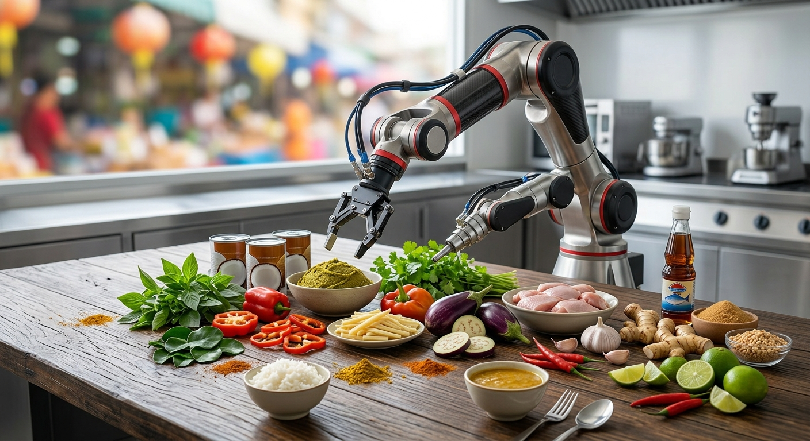
THE PROBLEM
03 / 11
Agents fail silently
“An agent that succeeds 99% of the time still fails a 100-step task more often than not.”

Slide 4
ARCHITECTURE
04 / 11
How it thinks
GOAL
→
PLAN
→
ACT
→
OBSERVE
→
VERIFY
on fail
DIAGNOSE
→
REPLAN
→
ACT AGAIN
Hard boundary: the LLM only interprets goals, diagnoses failures, and replans — named parameters, never joint angles. IK, motion, grasp, and verification are deterministic Python, the same code path every run.
The LLM never touches a trajectory. Physics is run by code, not a model.

Slide 5
MID-RUN VERIFICATION
05 / 11
How does it recognize failure
GRIPPER CHECK
→
LIFT CHECK
→
VERIFIED
dist(gripper, object) < 0.06m AND object height > table + 0.05m
verifier.py is deterministic, zero LLM involvement. It independently re-derives success from observed physics — never from what the controller claims happened.
Every result is checked against the world model — the checkpointed record of what should be true for each object. A mismatch is logged as expected vs. observed and written to disk immediately.
The seeded failure closes the gripper on empty air — caught from geometry alone.

Slide 6
FAILURE RECOVERY
06 / 11
How does it recover
DIAGNOSE DRIFT
→
PICK NEW STRATEGY
→
REPLAN
→
ACT AGAIN
Example: a missed grasp on basil is classified as behavioral drift — right object, right timing, wrong execution. The planner swaps in a genuinely different strategy — a lower, rotated side-grasp — not a blind retry of the same motion.
Recovery is a different strategy, not the same action repeated.

Slide 7
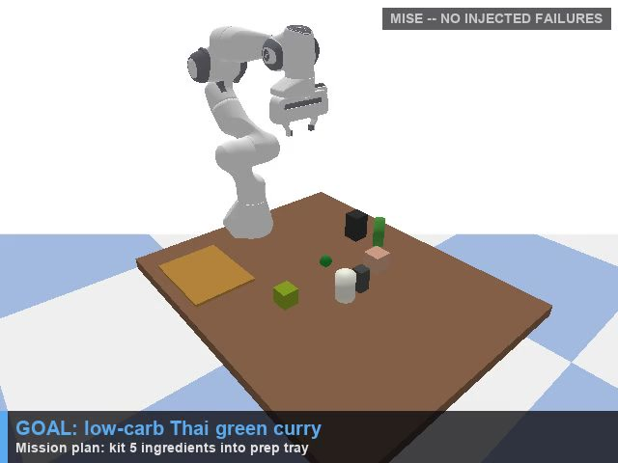
DEMO — CLEAN RUN
07 / 11
Clean run
5 of 5 ingredients kitted. Zero failures.

Slide 8

DEMO — STRESS TEST
08 / 11
Stress test
5 injected failures. 5 of 5 still kitted.

Slide 9
PERFORMANCE
09 / 11
Failure count doesn't matter
5/5
5/5
5/5
0 FAILURES · HAZARD 0.0
1 FAILURE · HAZARD 0.09
5 FAILURES · HAZARD 0.33
Every seeded failure is diagnosed, replanned, and recovered — before the mission derails.

Slide 10
RELIABILITY ENGINEERING
10 / 11
Built on real bugs
Base collided with table
→
repositioned + safe start pose
IK never reached target
→
stronger gains + held waypoints
“Success” still dragged objects
→
fixed true gripper opening
Every fix was diagnosed from contact-force and joint-state telemetry — not guessed.

Slide 11
JUDGING CRITERIA
11 / 11
Every criterion, demonstrated
✓
Mid-run verification
✓
Drift detection
✓
Hazard rate tracking
✓
Checkpointed world state
✓
Three-level evaluation
✓
Reliability over horizon length
Not bolted on for the demo — built into the architecture.

