Slide 1
BOUNDLESS
Governed agent finance for Kite Passport
Rules First,
Agents Run.
Judge memory target
Delegated payments need a governance layer.
Kite Passport handles identity, session scope, and delegated payment permission.
Boundless adds policy, operator controls, and explicit proof before execution.
Boundless is the control layer between agent intent and real-money execution. It gives agents bounded authority without handing away full wallet control.
The product shows both approved and blocked outcomes, not just successful payments.
3
2
1
Kite
Live surfaces
Decision paths
Core thesis
Protocol fit
submission / member-test / proof
allow and block both produce receipts
bounded financial authority
delegation + policy + proof
Boundless by Miraix AI · Encode x Kite hackathon
01

Slide 2
PROBLEM
Delegation without execution governance is too coarse for capital-moving agents.
Wallet permission alone answers who can pay. It does not answer whether this exact request should execute now, under this budget, on this protocol, with this rationale.
01
02
03
Permission is broader than intent
Ops teams need a runtime gate
Proof has to include failures
Once a session exists, the missing layer is not more autonomy. It is a way to check scope, amount, venue, and human posture before the payment continues.
Real systems need active, review, and paused modes. They need something stronger than “the agent has a wallet”.
The hard problem is not logging success. It is showing why a request was blocked before money moved.
This is why Boundless is not another wallet or trading bot. It is a pre-execution control layer.
Problem framing · delegated payments need bounded authority
02

Slide 3
SOLUTION
Boundless turns wallet authority into a policy envelope.
The operator defines rules first. The agent then submits a request against those rules. Only in-policy requests move forward.
1
Session permission
2
Boundless policy
3
Execution decision
Kite Passport handles identity, delegated payment permission, and session scope.
Per-tx limit, daily budget, allowed assets, allowed protocols, operator mode, and proof requirements.
Approve, review, pause, or block the request before real-money execution proceeds.
4
Proof surface
5
Runtime operations
6
Product claim
Write pass and fail outcomes as receipts so the human can audit what happened.
Operator can issue, update, revoke, review, and resume from the app instead of hiding everything in CLI demos.
Agents can run, but only inside explicit financial boundaries.
Solution framing · Rules first, then agent execution
03

Slide 4
ARCHITECTURE
Kite handles delegation. Boundless governs execution.
This is not a replacement for Passport. It is the control plane layered above it.
1. Kite Passport
2. Boundless Policy
3. Payment Check
4. Proof
Identity, delegated payment permission, session boundary
Wallet scope, per-tx budget, daily budget, allowed assets, operator mode
Prepare request, allow or block before execution
Session, request, decision, payment result, receipt
Boundless is the pre-execution layer. It decides whether a payment request continues, pauses for review, or stops before money moves.
Architecture · delegation below, governance above
04

Slide 5
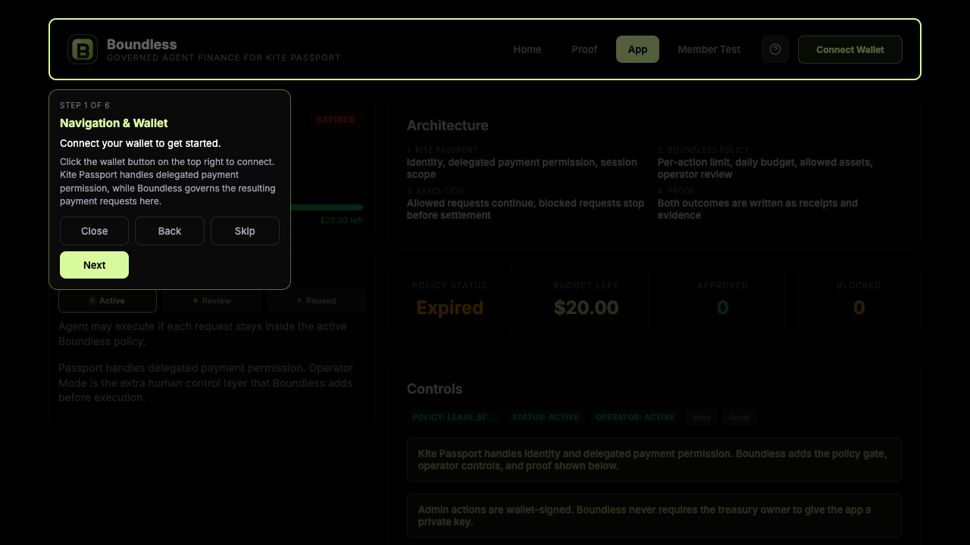
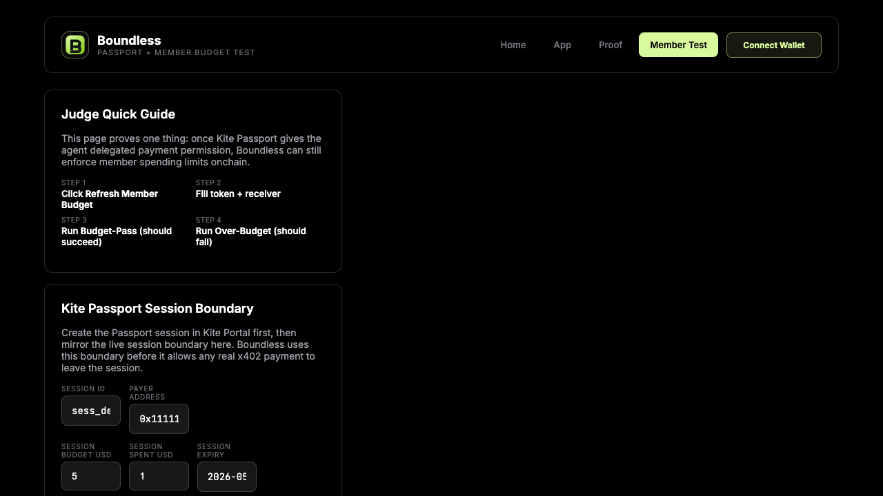
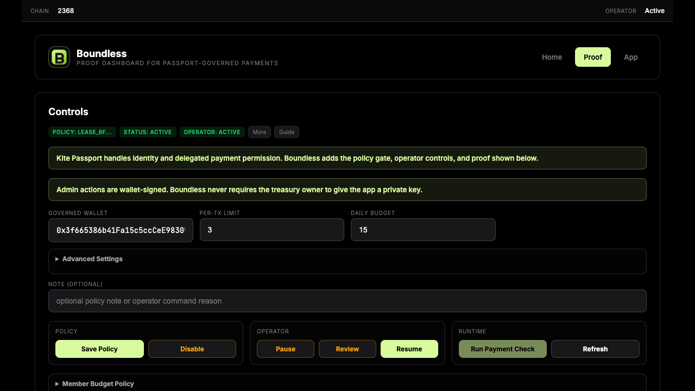
LIVE PRODUCT
Three surfaces make the product legible to operators and judges.
The live demo is not a landing page. It exposes policy operations, a member payment check flow, and a proof surface.
Operator Surface
Member Test
Proof Surface
Set policy, operator posture, and runtime controls
Mirror session boundary and run the payment check flow
Render session, decision, payment result, and receipt
Live demo · submission, member-test, proof
05

Slide 6
DEMO FLOW
What the recorded demo proves
The flow is intentionally simple: define rules, mirror the session boundary, prepare a request, then prove what happened.
1
Save policy
The operator defines the Boundless policy envelope.
Pass / Fail Proof
2
Save session boundary
Member Test mirrors the active Kite Passport session budget and expiry.
The important claim is not only that a payment can succeed. The more defensible claim is that out-of-policy requests are blocked and explained before money moves.
3
Prepare x402 request
Boundless checks the request locally before paid execution continues.
That gives Kite a stronger agentic economy story: delegated payment permission plus runtime governance plus proof.
4
Complete paid request
The allowed path completes; the blocked path stops before settlement.
5
Open proof
The proof page shows session, request, decision, payment result, and receipt.
Demo structure · show policy, request, proof
06

Slide 7
WHY BOUNDLESS
Boundless gives Kite a stronger story than “agents can pay”.
The harder and more valuable question is whether agents should be allowed to pay under the current conditions. That is the layer Boundless owns.
What shipped
Judge takeaway
Live operator surface at /submission
Boundless is the control layer between agent intent and real-money execution.
Session-bound payment flow at /member-test
Receipts and evidence at /proof
Kite Passport handles delegation. Boundless defines the rules, checks the request, and preserves proof.
Wallet-signed admin controls for policy actions
Allow / block outcomes rendered as product surfaces
Live demo: unboundai.xyz
Project: Boundless by Miraix AI
Close · governed agent payments with bounded financial authority
07

