Slide 1



E-Waste Generation Classification

Slide 2

Learning Objectives
The primary objective of this project is to develop a highly accurate and dependable E-Waste Image Classification model for categorizing electronic waste based on visual data. This advanced model will leverage transfer learning with the EfficientNetV2B0 algorithm, a state-of-the-art convolutional neural network. Automating e-waste identification will facilitate efficient sorting and recycling, representing a pivotal advancement towards a circular economy for electronics, promoting environmental stewardship, and safeguarding public health.
GOAL
Source :
www.freepik.com/

Slide 3
Tools and Technology used
Python Used as the primary programming language for data preprocessing, exploratory data analysis, and implementation of machine learning algorithms. Python's libraries, such as numpy, matplotlib, scikit-learn, and others, facilitated efficient data manipulation, visualization, and model development.
TensorFlow & Keras Used for constructing, training, and fine-tuning deep learning models. The EfficientNetV2B0 architecture was implemented using Keras within the TensorFlow framework.
Pillow (PIL) Used for loading image files and performing basic image processing operations (PIL / pillow).
Gradio Used the gradio library to develop user-friendly web interfaces for deploying and interactively testing machine learning models.
Jupyter Notebooks Used for an interactive and collaborative coding environment. Jupyter Notebooks provided a seamless platform for code execution, visualization, and documentation.

Slide 4
Methodology
Dataset Preparation
Used E-Waste Image Dataset (10 classes: Mobile, Keyboard, TV, etc.)
Data split into train (2400), validation (300), and test (300) sets.
Images resized to 128x128 and rescaled for model compatibility.
Exploratory Data Analysis
Visualized class distribution and image samples.
Confirmed balanced dataset and correct labeling.
Data Preprocessing
Applied image normalization using “preprocess_input”.
Used data augmentation (flip, rotation, zoom) to increase variation and reduce overfitting.
Model Architecture
Used EfficientNetV2B0 as a pre-trained base (transfer learning).
Removed top layers and added “GlobalAveragePooling2D”, “Dropout (0.2)”, “Dense (10 units, softmax)”

Slide 5
Fine-Tuning Strategy
Initially made the full model trainable.
Then froze first 100 layers to retain pre-trained knowledge.
Focused training on higher layers and new classifier head.
Model Compilation
Optimizer: “Adam (lr = 0.0001)”
Loss: “SparseCategoricalCrossentropy”
Metrics: “Accuracy”
Training Strategy
Batch size: 100 | Epochs: 15
Used “EarlyStopping (patience=3)” with “restore_best_weights=True” to prevent overfitting.
Model Evaluation
Achieved 96% test accuracy.
Evaluated with classification report and confusion matrix.
High precision, recall, and F1-scores across all classes.

Slide 6
Model Deployment
Created a simple Gradio web interface.
Enabled real-time testing of image predictions.
Problem Statement:
E-waste (electronic waste) is rapidly increasing globally, posing severe threats to environmental safety and public health due to hazardous substances in discarded devices.
Manual classification of e-waste is labor-intensive, time-consuming, and prone to errors, leading to inefficient recycling and waste management.
Lack of automated systems results in poor sorting accuracy, making it difficult to recover valuable materials or safely dispose of harmful components.
There's a pressing need for an AI-driven image classification system to accurately and quickly identify e-waste categories for streamlined recycling processes.

Slide 7
Solution:
Used AI to automatically identify and classify different types of e-waste.
Applied deep learning (EfficientNetV2B0) to reduce manual sorting efforts and increase accuracy.
Built a fast and scalable system for large-scale recycling operations.
Trained the model to recognize 10 categories of e-waste for proper disposal.
Added a simple web interface using Gradio for easy real-time testing.

Slide 8
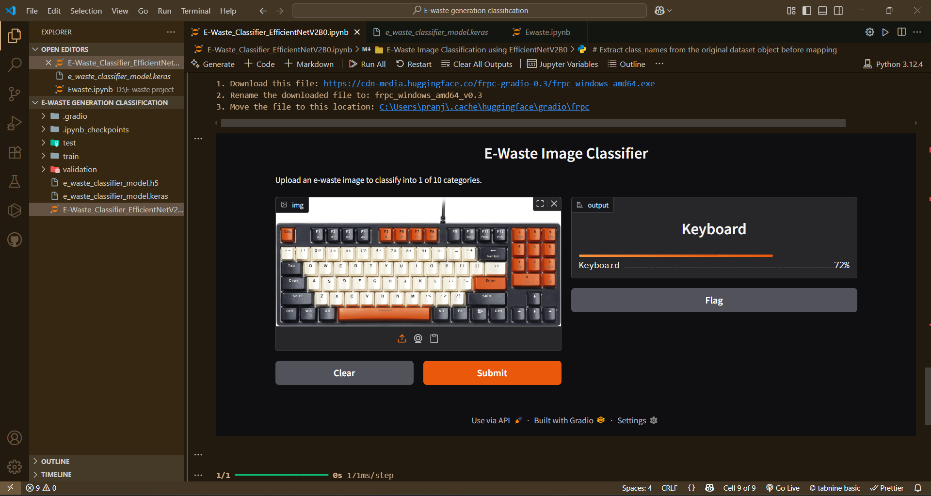
Screenshot of Output:

Slide 9
Conclusion:
This project successfully demonstrated how deep learning and transfer learning can be applied to solve real-world problems like e-waste classification. By using the EfficientNetV2B0 model with a fine-tuned architecture, we achieved high accuracy (96%) across 10 classes of electronic waste.
We learned to:
Work with image datasets and perform data preprocessing and augmentation.
Utilize transfer learning to save time and computational effort while maintaining accuracy.
Build and fine-tune a custom classification model based on EfficientNet.
Evaluate performance using metrics like accuracy, confusion matrix, and F1-score.
Deploy the model using Gradio to create an interactive, user-friendly interface.
This project proves that AI can significantly improve waste management processes, reduce human effort, and promote sustainability through smart automation.

