Slide 1

CMPE 451 PROJECT DEVELOPMENT IN SOFTWARE ENGINEERING
ACTOPUS TEAM FINAL PRESENTATION

Slide 2
USER SCENERIO
The user which name was Ümit is alrady registered user. One day he want to go a concert and sign in the Actopus via actopus account.He thought that this site is user friendly and whenever I entered Actopus, I can easily reach whatever I want. Then he search the concerts using search bar at the the top of the web page.When he was searching he used the “concert” tag.

Slide 3
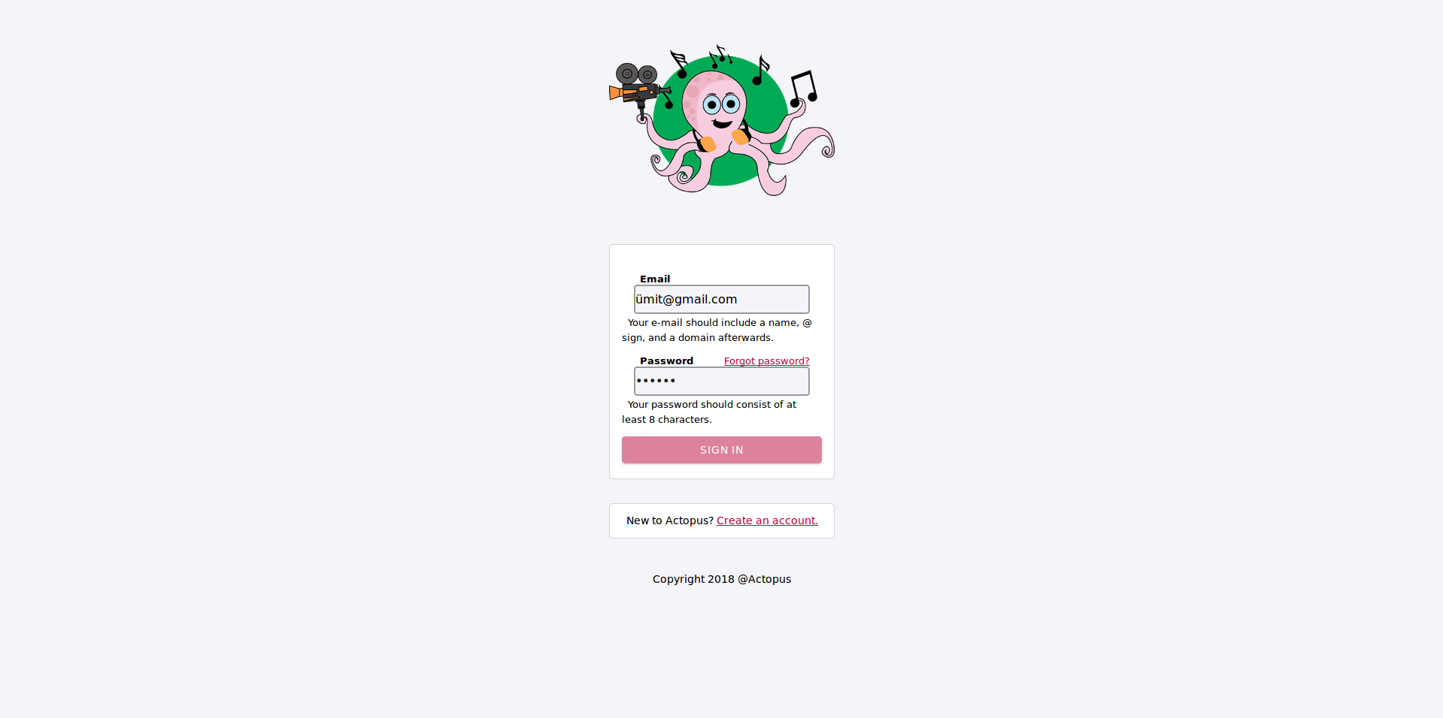
Sign In Page

Slide 4
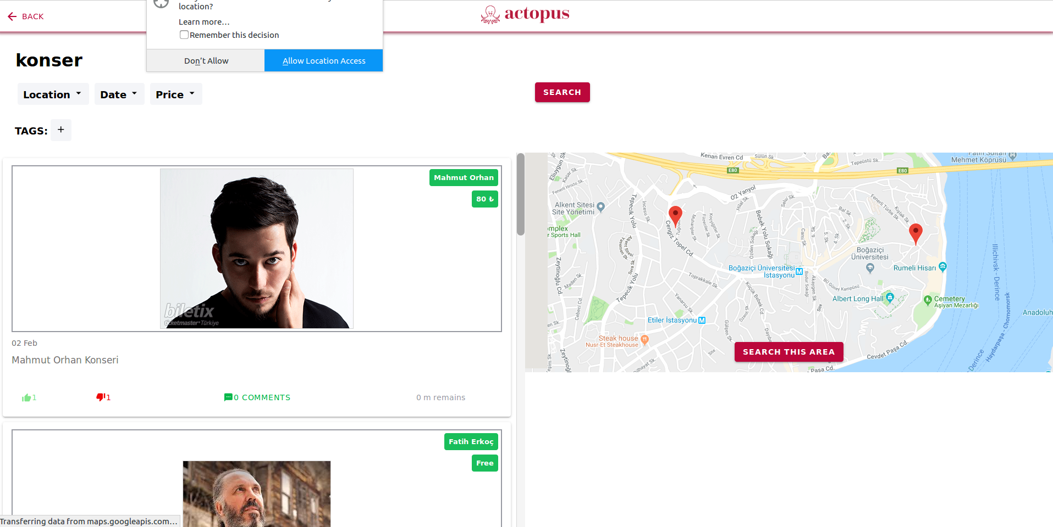
Search With Concert Tag

Slide 5
USER SCENERIO
Then he found searched concert all around the world using “concert” tag but he lives in Istanbul so he need to minimize the area. He clicked the “Search this area” button on the right hand side and look at the events in Istanbul. But there were lots of event. His aim was attending a Jazz concert. Then he found Jazz Concert which name was “Caz Konseri - Ali Taylan Cemgil ve Olgun Acar” which created by Murat Ahtapot.

Slide 6
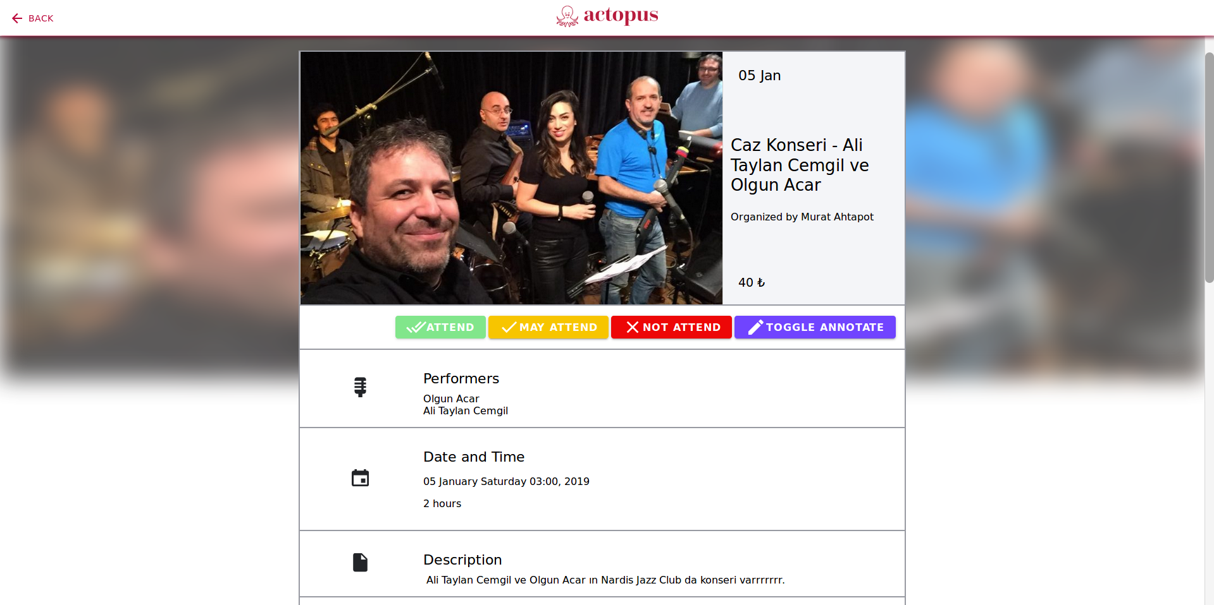
Event Description

Slide 7
USER SCENERIO
He looked the details of event , the place of the Jazz concert is very convenient for him because of the location. The event was in the Karaköy/Istanbul. He click the attend button. Then he remembered that he he promise his best friend Oğuz about going concert. He send the link of the event via WhatsApp. Oğuz was not registered user of Actopus platform. He clicked the link and saw the event as a guest. He tried to write comment in event but he could not. Then he also tried attend the event for clicking the “Attend” button. And failed again. After that he recognized that he should register.

Slide 8
Oğuz saw the home page of Actopus and he thought that the logo of Actopus is very creative, he also thought that the legs of the octopus on the logo represents the communication between people. Then he clicked register and signed up the platform. Whenever he sign up, he saw the event which Ümit’s shared link. Then he write comment and also click the “Attend” button.

Slide 9
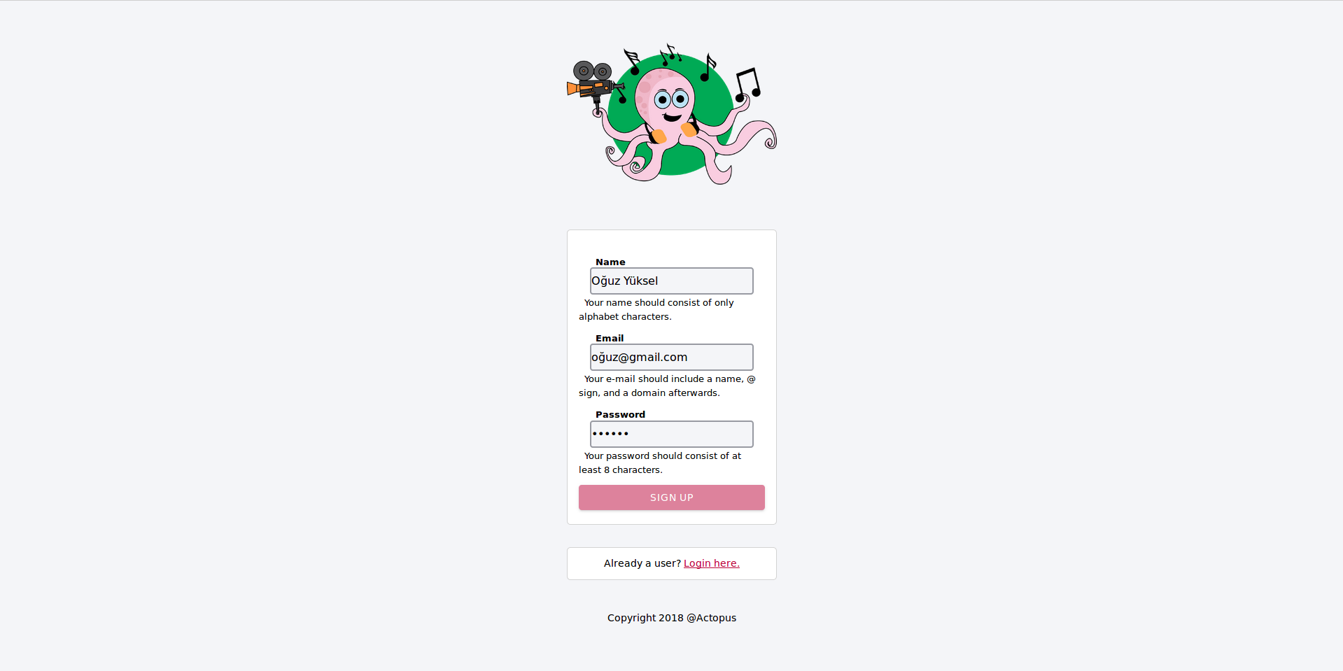
Sign Up Page

Slide 10
Event Attendance

Slide 11
USER SCENERIO
Then he followed the his teacher Suzan Üsküdarlı who is using Actopus platform. Then he clicked his feed and saw the events which was created by Suzan Üsküdarlı. He tried discover Actopus platform and went to his profile page. He changed his interests with selecting the tags what he wants. Then he clicked his feed again and saw the new events according to his interests.

Slide 12
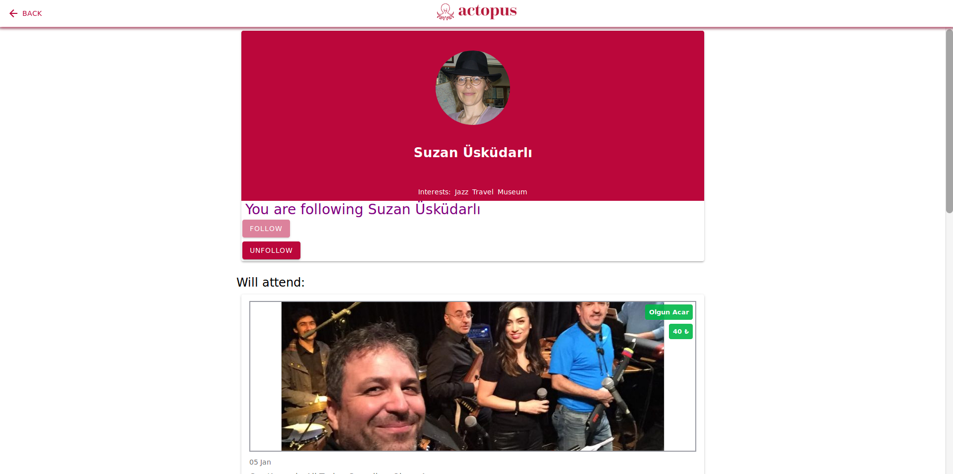
Profile Page Of A User

Slide 13
USER SCENERIO
Oğuz liked the platform so much and he decided to create new event about the his university department annual pizza with meat party. He chose a picture about the event , chose the location via google map using his mouse , wrote the description about the event and followed each procedures about event creation.

Slide 14
USER SCENERIO
Then Ümit is the classmate of Oğuz and they follows each other. After Oğuz’s event creation, Ümit saw the event and looked at the details. Then he tried to annotate the pizza with meat which was in the event description. He annotated the pizza with meat and wrote there “This is Lahmacun.This is very special food all around the Turkey.”

