Slide 1
CMPE436-Project
Word Race

Slide 2
Word Race is a multiplayer round based typing competition game where players race to type words correctly before time runs out.
Players join lobby (max 8 players) and should click ready, game starts when there is at least 2 people and everyone is ready.
Every round n-1 words appear on the screen and players have 13 seconds to write one of the words. First one to write each word becomes successful for that round. Players also get points every round proportional to time left when they successfully write a word.
Every three rounds, difficult increases (words become longer).
2 consecutive misses means elimination.

Slide 3
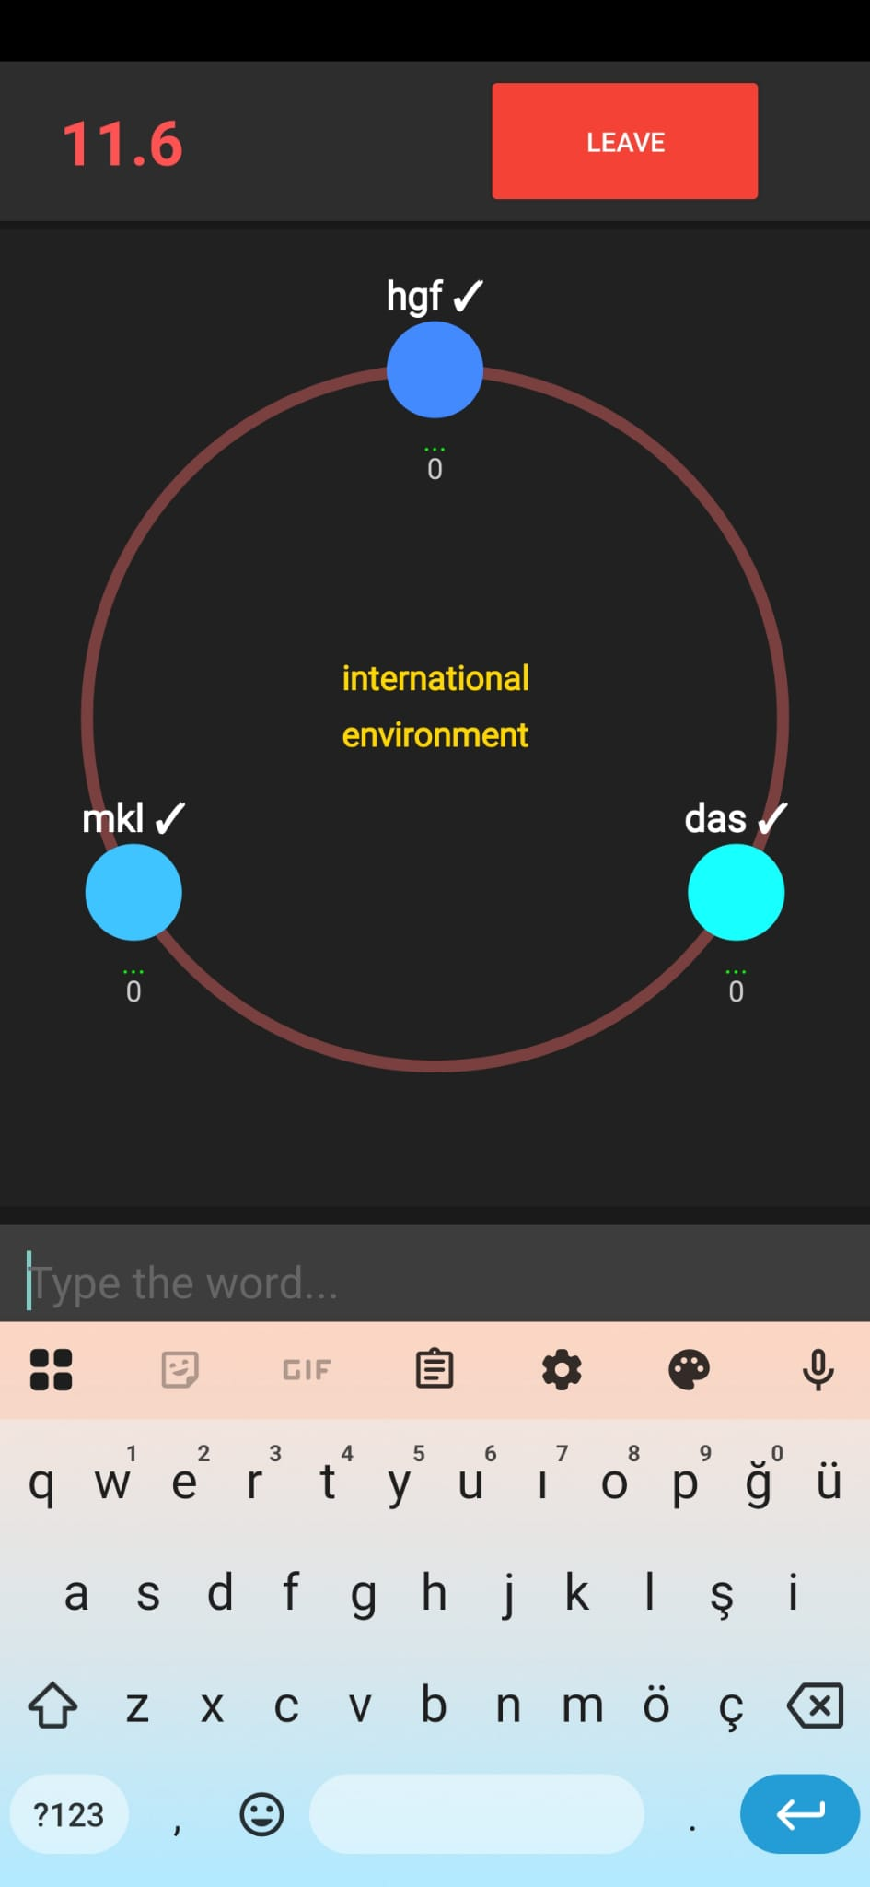
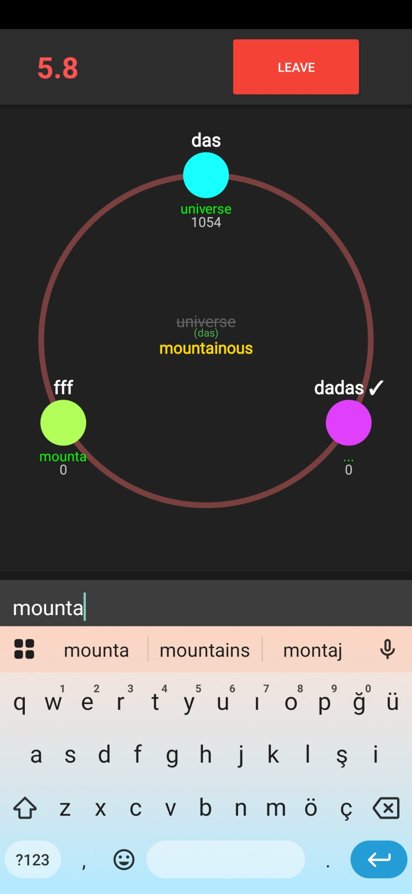

Slide 4
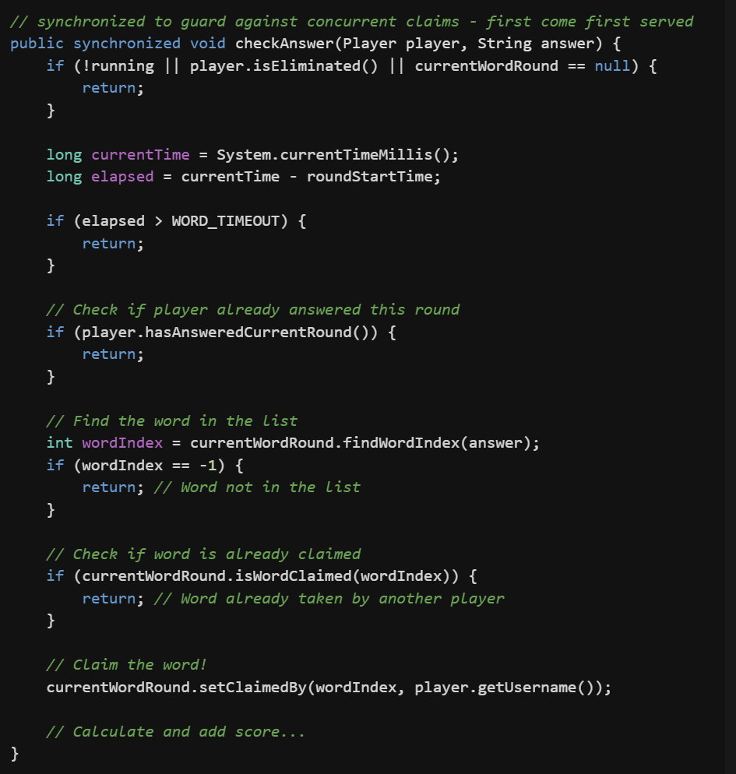
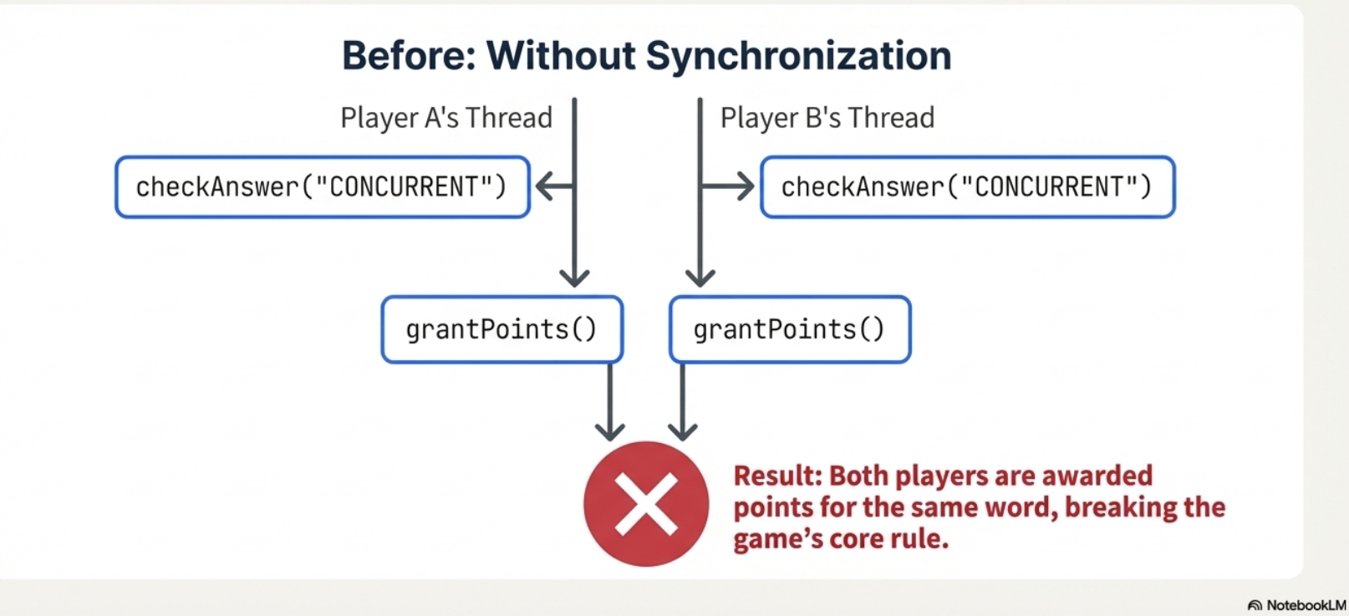
Race Condition – Word Claiming
The Scenario:
3 players are in a round
2 words are available: "hello", "world"
Player A and Player B both type "hello«
at nearly the same time.
Who gets the word?

Slide 5
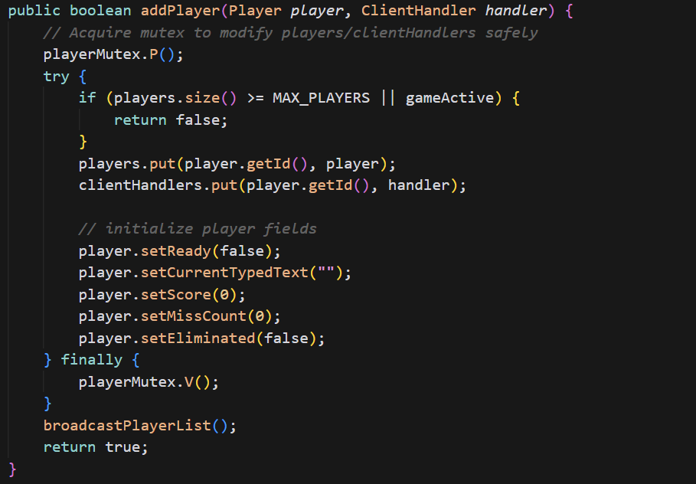
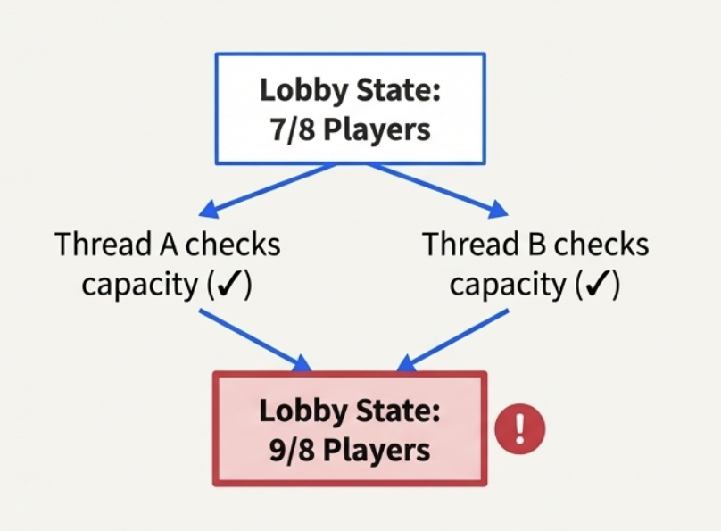
Race Condition - Player Join/Leave Operations
Lobby has 7/8 players,1 slot remaining,
Player A and Player B both click "Join" simultaneously

Slide 6
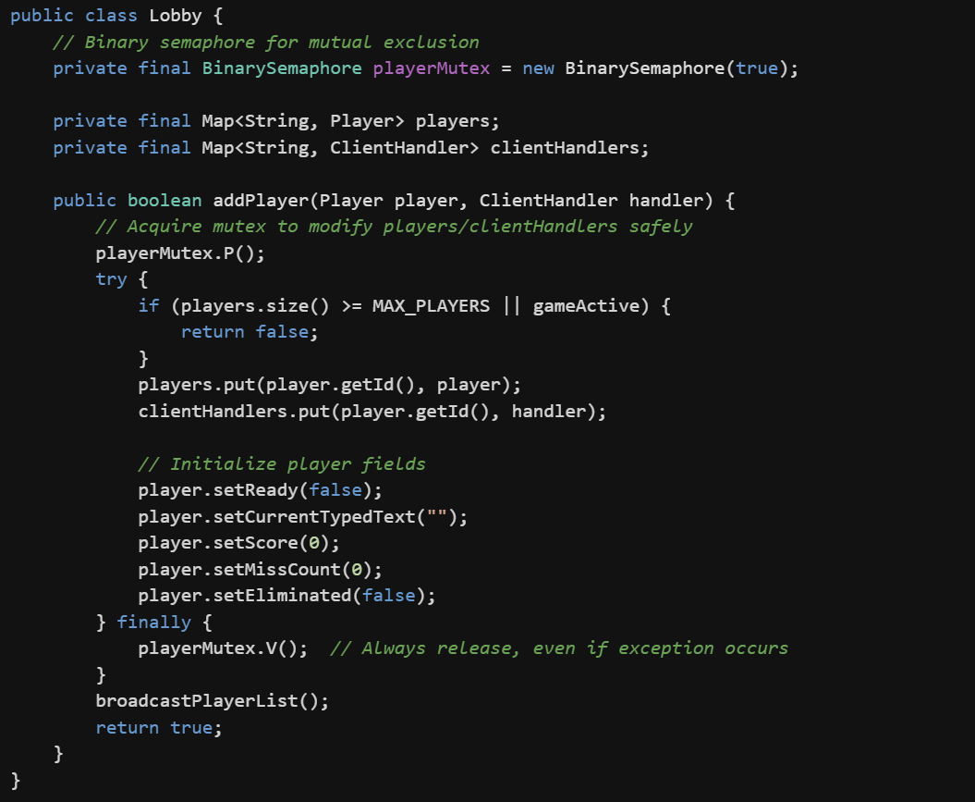
Protecting Shared Resources

Slide 7
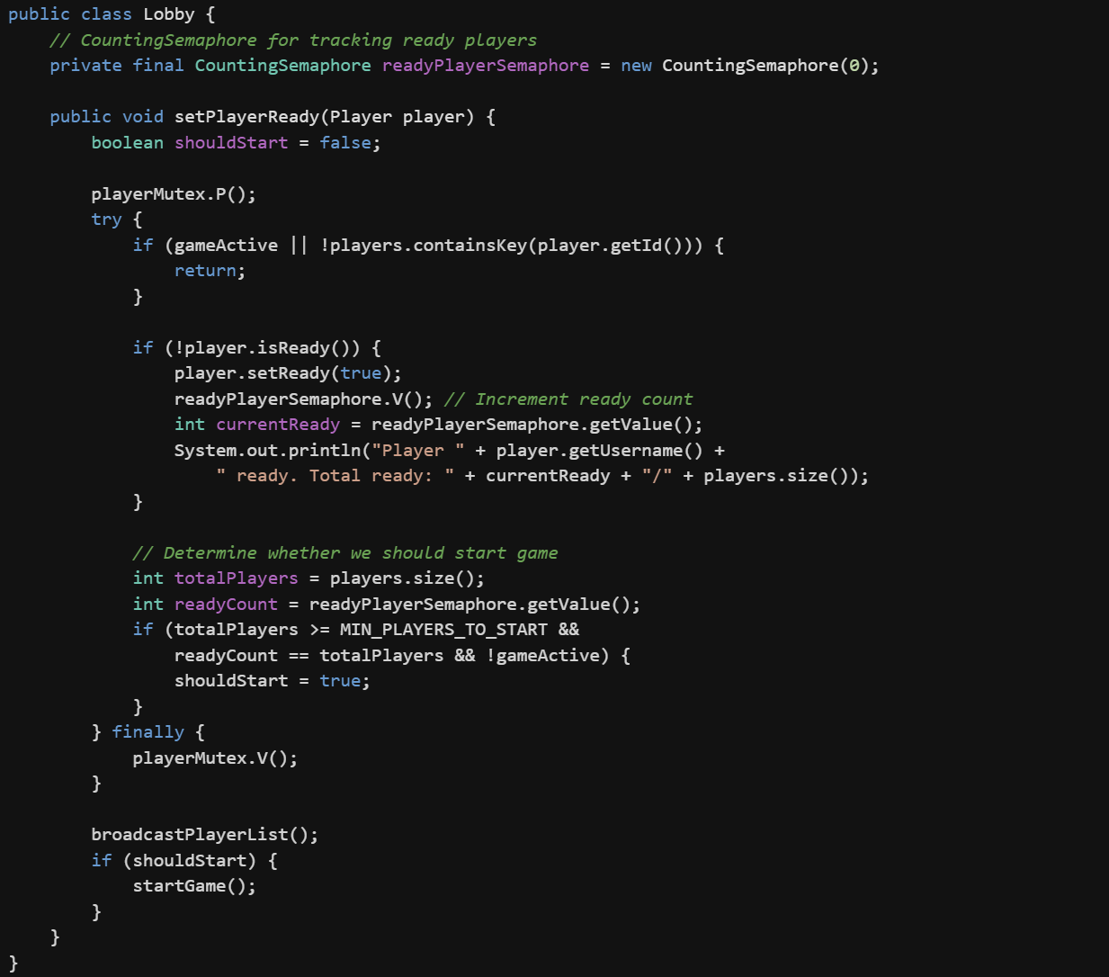
Ready Player Tracking

Slide 8
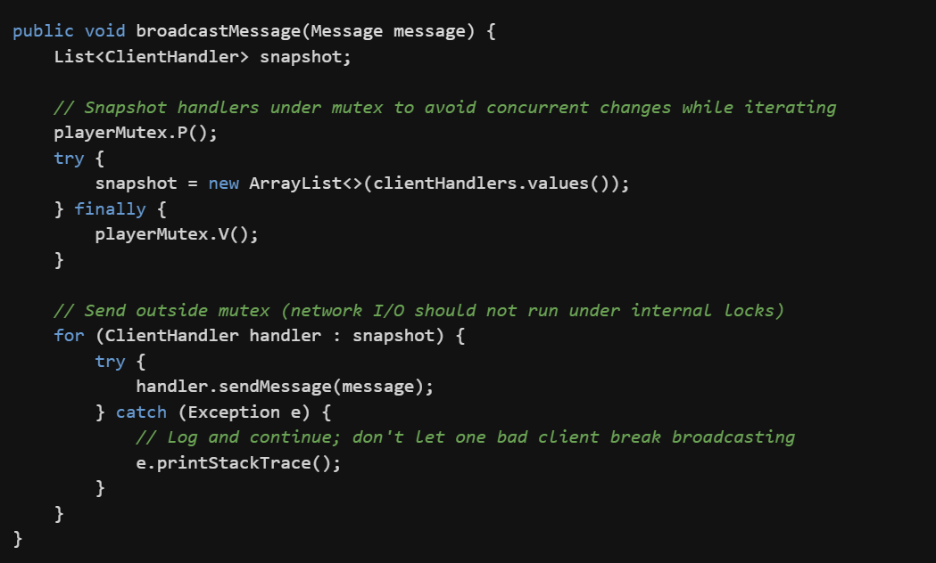
Race Condition – Server concurrently sending messages to clients
GameThread wants to broadcast "NEW_WORD" to all players
Simultaneously, a player disconnects and is removed from the list
Rule: Minimize time spent holding locks. Never do I/O while holding a lock.

Slide 9
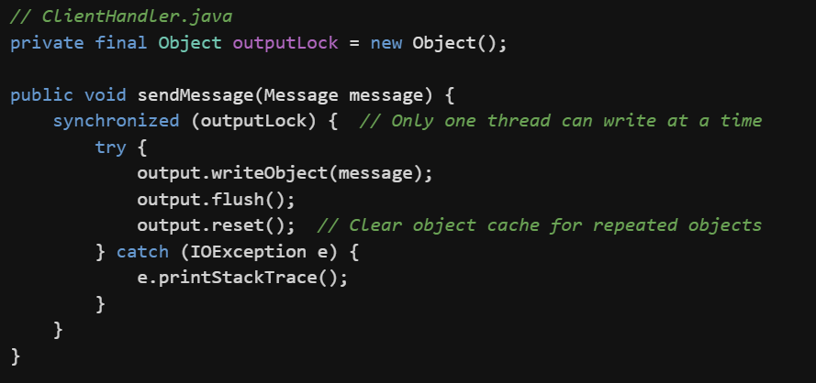
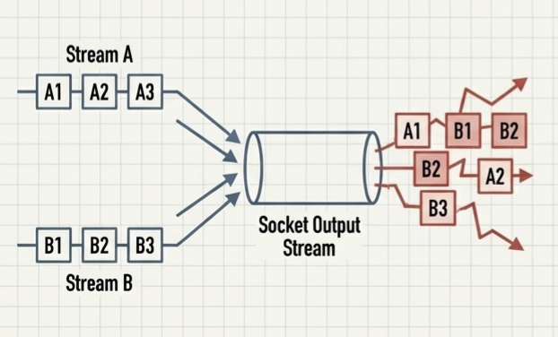
Output Stream: Multiple threads trying to write to same socket simultaneously.

Slide 10
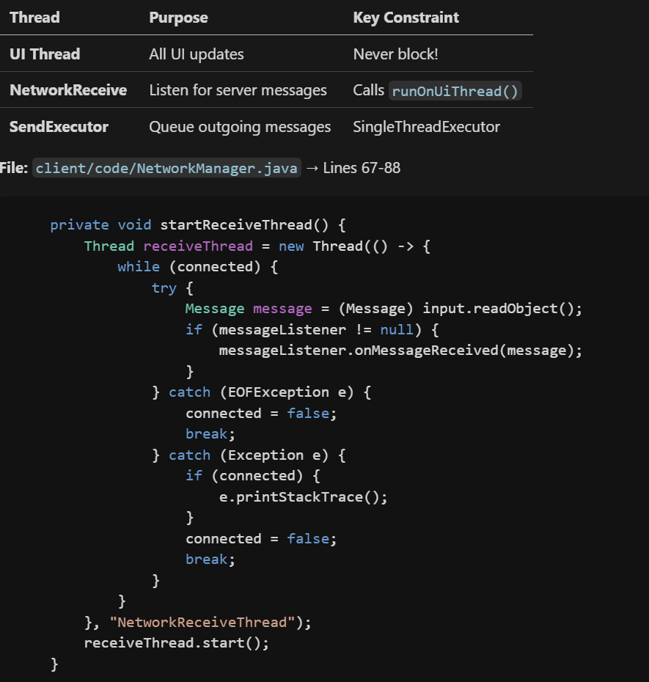
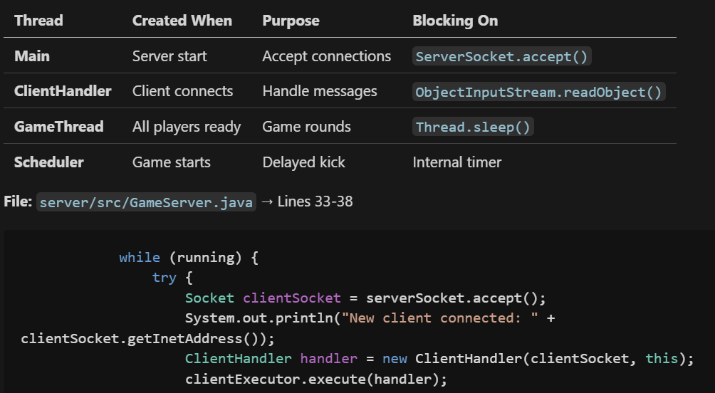
Server side threads Client side threads

Slide 11
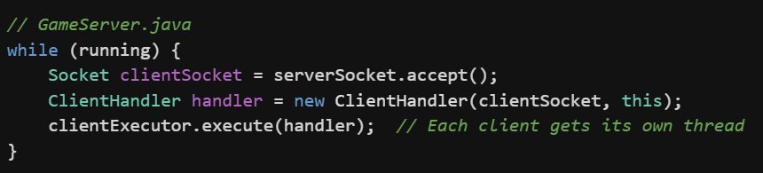
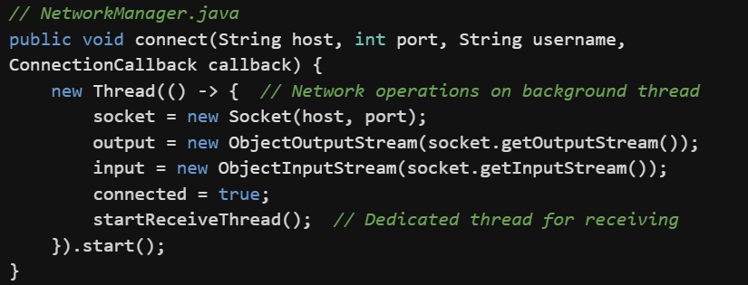
Server: Accepting Connections
Client Side:

Slide 12
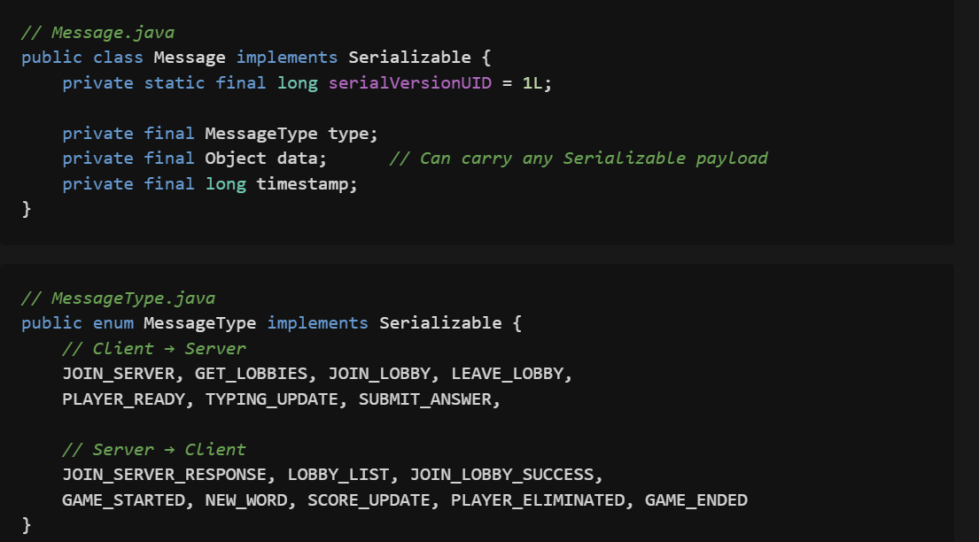
Java Serializaiton for Network Protocol
Why? Simple transfer without manual parsing.

Slide 13
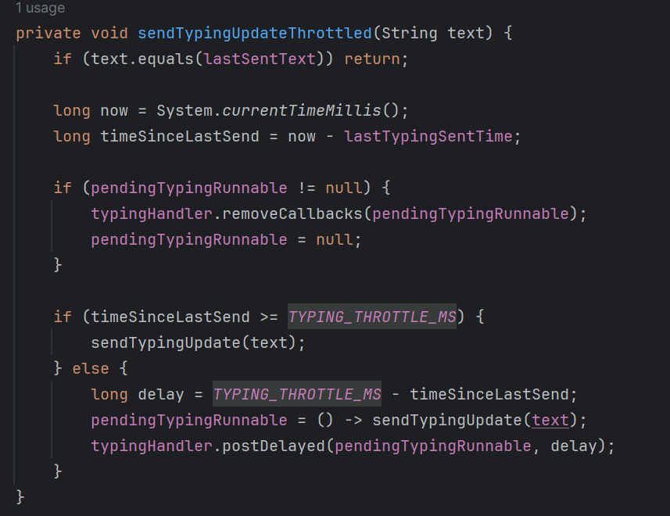
Client Side Throttling
Why? Typing generates many events - flooding server degrades performance for all players

Slide 14
