Slide 1

Add BPM in your business web applications with Bonita Open Solution
Add conference logo here !
Frédéric Bouquet
Sébastien Prunier

Slide 2




Frédéric Bouquet
Consultant & Trainer at Bonitasoft
BPM & Bonita Evangelist, Community manager
Opensource, Groovy & Java enthusiast
*JUG, *Camp and Devoxx* addict
www.espacedefouille.org
@bouquetf

Slide 3

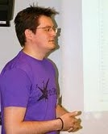
Sébastien Prunier
Software Engineer at Mosica
BPM & Bonita Open Solution enthusiast
Recently changed my opinion on Javascript :-)
*JUG, *Camp and Devoxx* addict
sebprunier.wordpress.com
@sebprunier

Slide 4
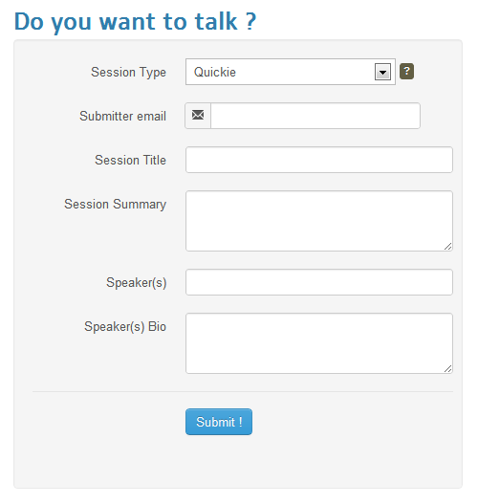

How to become a speaker ?
Call For Papers

Slide 5

Nice application, but …
No e-mail confirmation after submission
No user management (staff, admin)
No back-office (paper validation process)
People can submit spam
…
Ok, we can imagine some feature requests now !

Slide 6
The solution
B
P
M
S

Slide 7
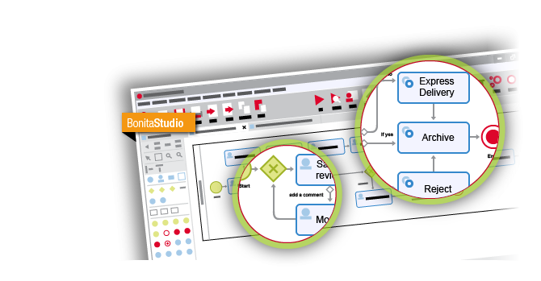
Bonita Open Solution
Draw …

Slide 8
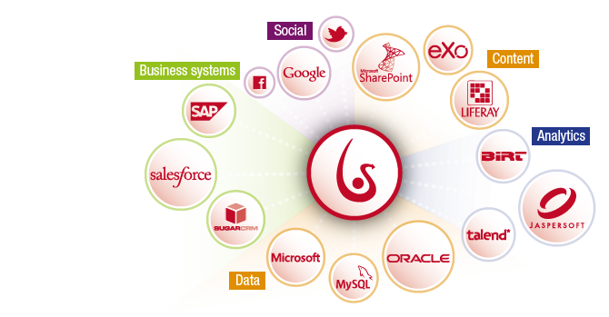
Bonita Open Solution
Connect …

Slide 9
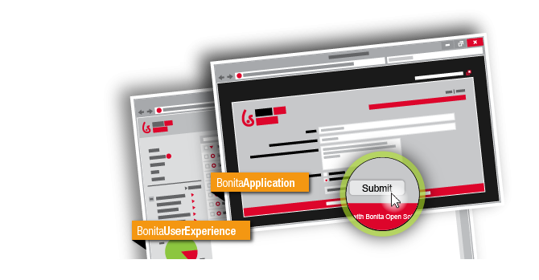
Bonita Open Solution
Run !

Slide 10
What are we going to do ?
Draw a « Paper validation » process
Draw application forms
Implement some feature requests
Connect the « Call For Paper » application to the process
Use the User Experience

Slide 11
Global architecture
Create new process instances
Call For Paper Application
Paper validation Process
Update application data
Process data
Application data
(papers, votes)

Slide 12
Paper Validation Process
Validate paper is not a spam
Vote for paper
Notify speakers
Send an acknowledgment

Slide 13
Feature request #1
Send an acknowledgment to the submitter

Slide 14
Feature request #2
Check that
the paper
is not a spam

Slide 15
Feature request #3
Enable collaborative vote for papers

Slide 16
Feature request #4
Show validated papers on the web application

Slide 17
To go further …

