Slide 1

Add BPM in your business web application with Bonita Open Solution
Frédéric Bouquet
Sébastien Prunier

Slide 2




Frédéric Bouquet
Consultant & Trainer at Bonitasoft
BPM & Bonita Evangelist, Community manager
Opensource, Groovy & Java enthusiast
*JUG, *Camp and Devoxx* addict
www.espacedefouille.org
@bouquetf

Slide 3

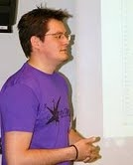
Sébastien Prunier
Software Engineer at Mosica
BPM & Bonita Open Solution enthusiast
Recently changed my opinion on Javascript :-)
*JUG, *Camp and Devoxx* addict
sebprunier.wordpress.com
@sebprunier

Slide 4
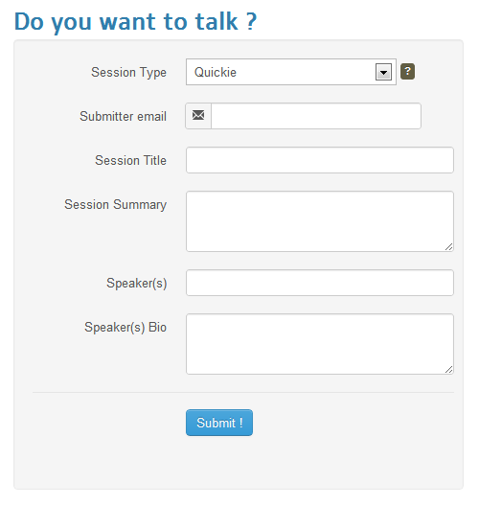

How to become a speaker ?
Call For Papers

Slide 5
Nice application, but …
No e-mail confirmation after submission
No user management (staff, admin)
No back-office
People can submit SPAM

Slide 6
The solution
B
P
M
S

Slide 7
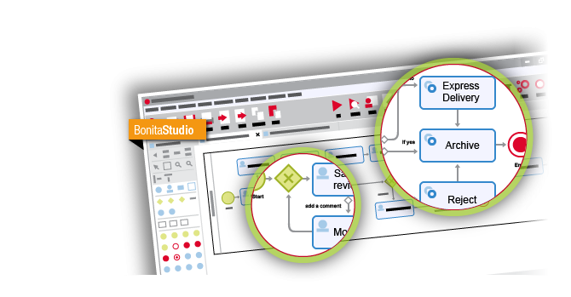
Bonita Open Solution
Draw

Slide 8
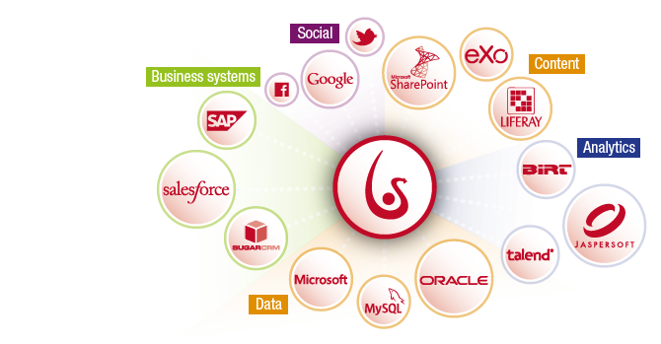
Bonita Open Solution
Connect

Slide 9
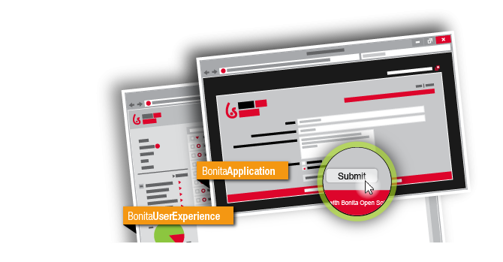
Bonita Open Solution
Run

Slide 10
Paper Validation Process

