Slide 1
RNLI Casualty Check Card Digitalisation
Sophia McCall, Kieran Rendall, Egle, Kayisah

Slide 2
Goals
Quick + Accurate diagnosis and treatment of the patient
Updating made easier
Environmental factors considered
Global Goal: Good Health

Slide 3
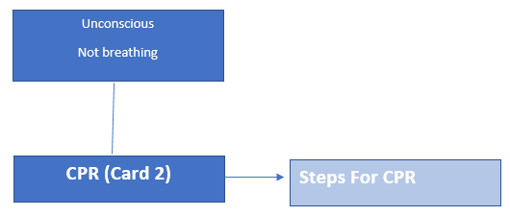
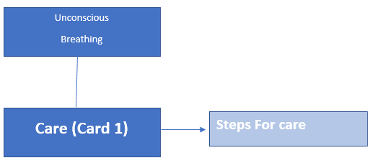
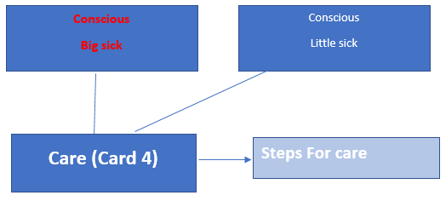
Quick and Accurate Diagnosis and Treatment

Slide 4
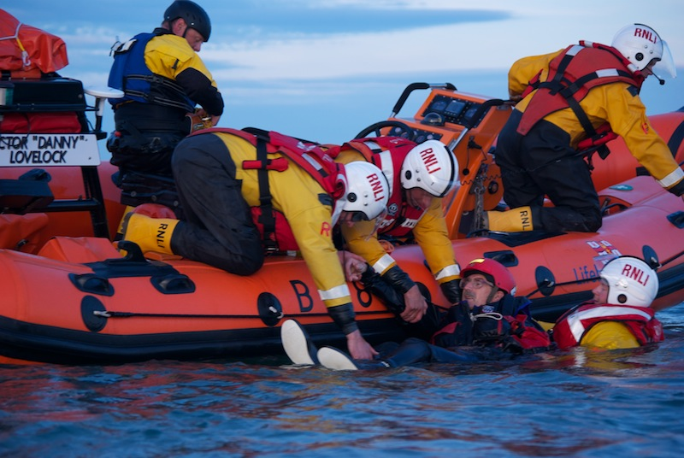
Real-life application

Slide 5
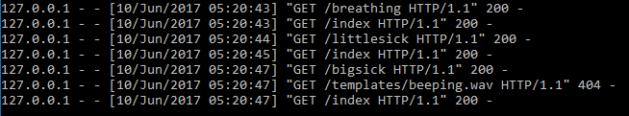

Updating made easier
Server pushes data to client via text file
Supporting charities by saving money and distribution ease

Slide 6
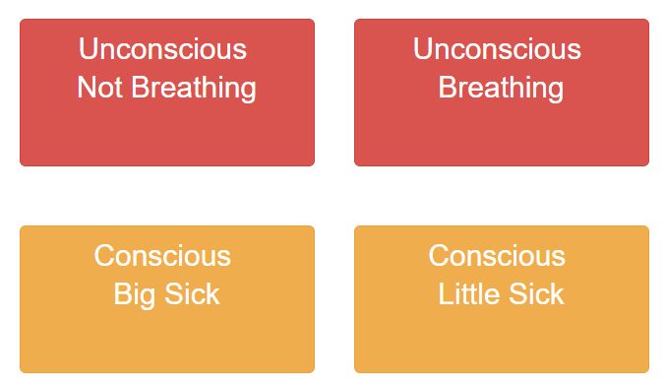
Environmental factors considered

Slide 7
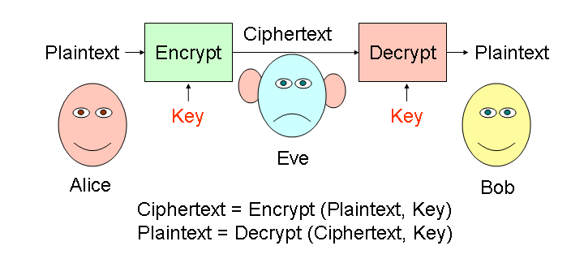
Developments for the future
Further development into specialist hand held devices created and issued for the RNLI
Hardware
Water Resistance IP68
Infinity Display + Radio
Rugged
Dictionary expansions for potential diagnoses and their treatments
Implementation of role based access control to certain app features i.e. if the application was to be released to the public in contrast to RNLI personnel use
Implementation of patient records database linked to application

