Slide 1
RNLI Casualty Check Card Digitalisation
Sophia McCall, Kieran Rendall, Egle Arge , Kayisan Dalmeida

Slide 2
Goals
Quick + Accurate diagnosis and treatment of the patient
Software updates made easier to re-distribute latest medical content and information
End user environmental factors considered
Global Goal: Good Health

Slide 3
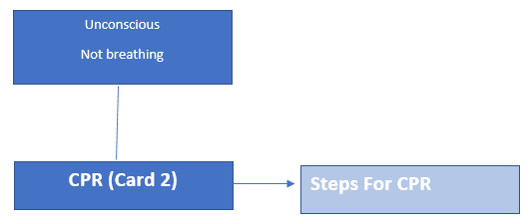
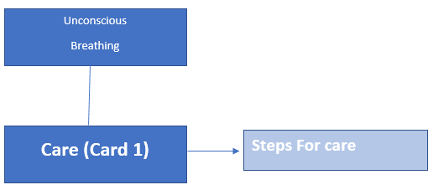
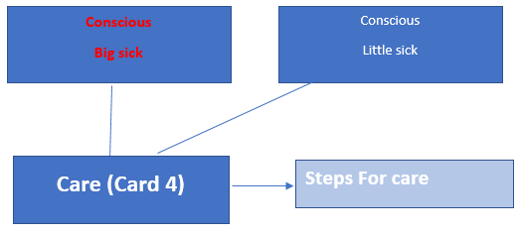
Quick and Accurate Diagnosis and Treatment

Slide 4
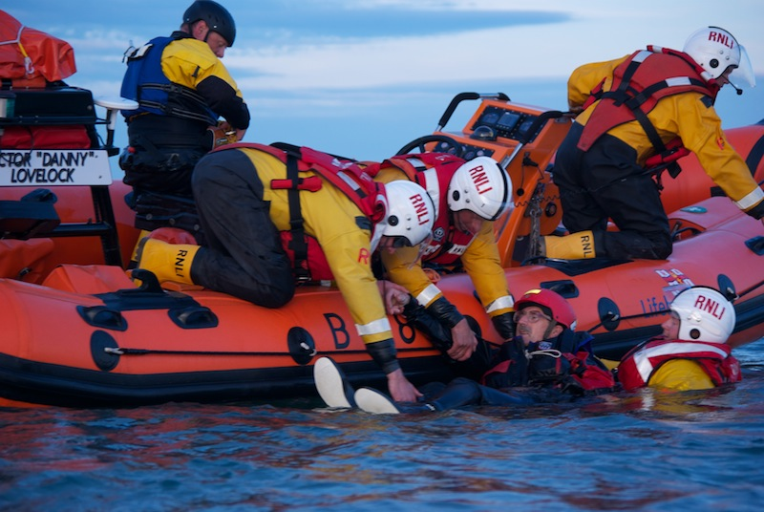
Real-life application

Slide 5
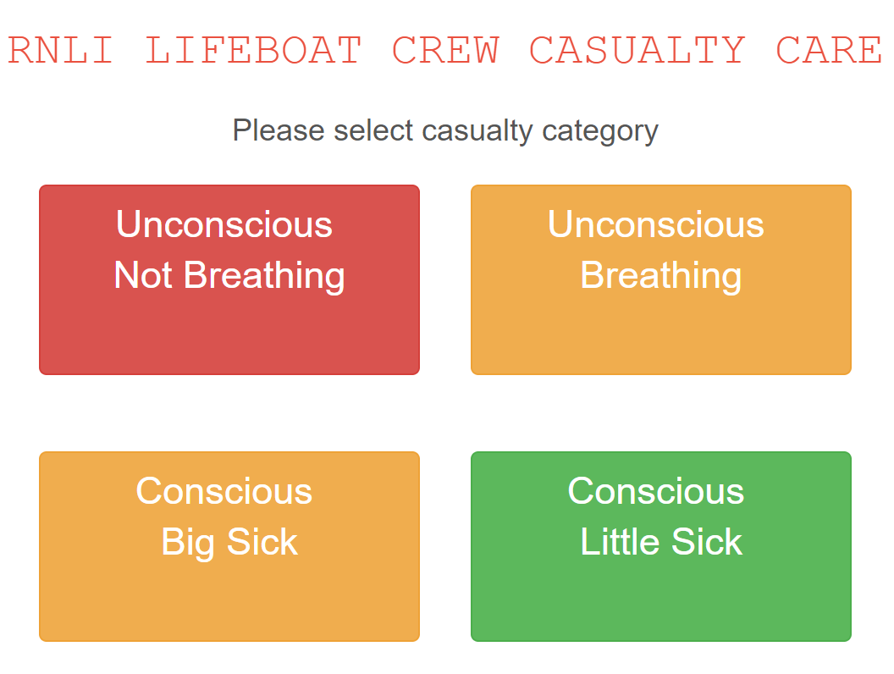
Environmental factors considered
Text-to-speech
AI integration
Vibration with beep notifications

Slide 6
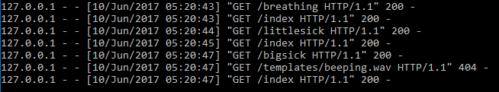

Updating made easier
Server pushes data to client via text file
Supporting charities by saving money and distribution ease

Slide 7
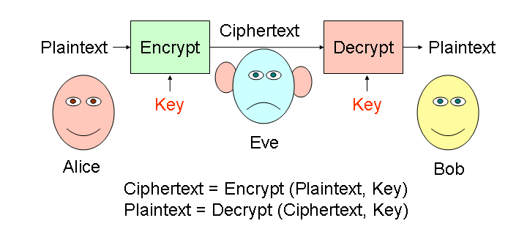
Developments for the future
Implementation of role based access control to certain app features i.e. if the application was to be released to the public in contrast to RNLI personnel use
Implementation of patient records database linked to application
Further development into specialist hand held devices created and issued for the RNLI
Hardware
Water Resistance Industry Standard (IP68)
Rugged
Dictionary expansions for potential diagnoses and their treatments

