Slide 1
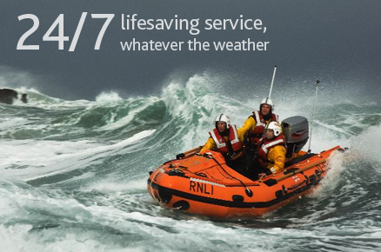

RNLI - Charity that Saves Lives at Sea
RNLI Mission
RNLI Mission
90% of drowning deaths occur in developing countries. Rescue services are non-existent.
24-hour life boat search and rescue
Challenge: Fisherman’s Friend
Develop a solution ensuring individuals are safe and sound
  Boat owners – Register
  Captain & Crew – Inform
  Rescuers/ MRCC – Help
  RNLI – User Base & incidents & impact

Slide 2
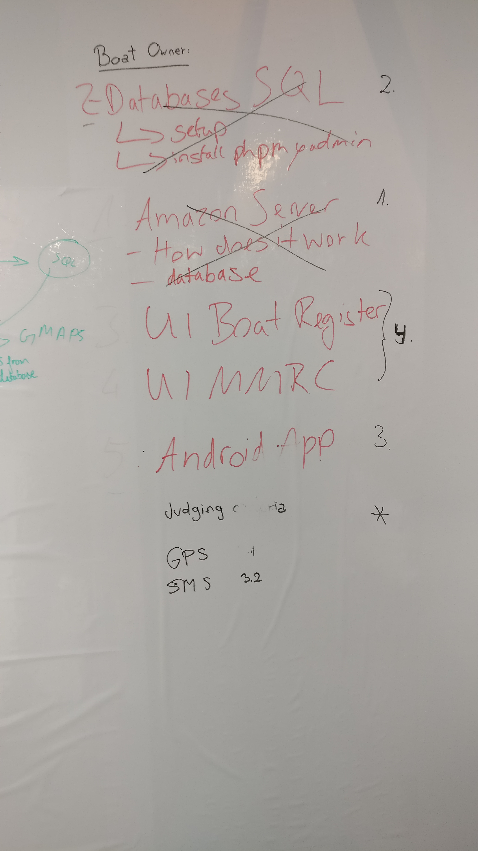
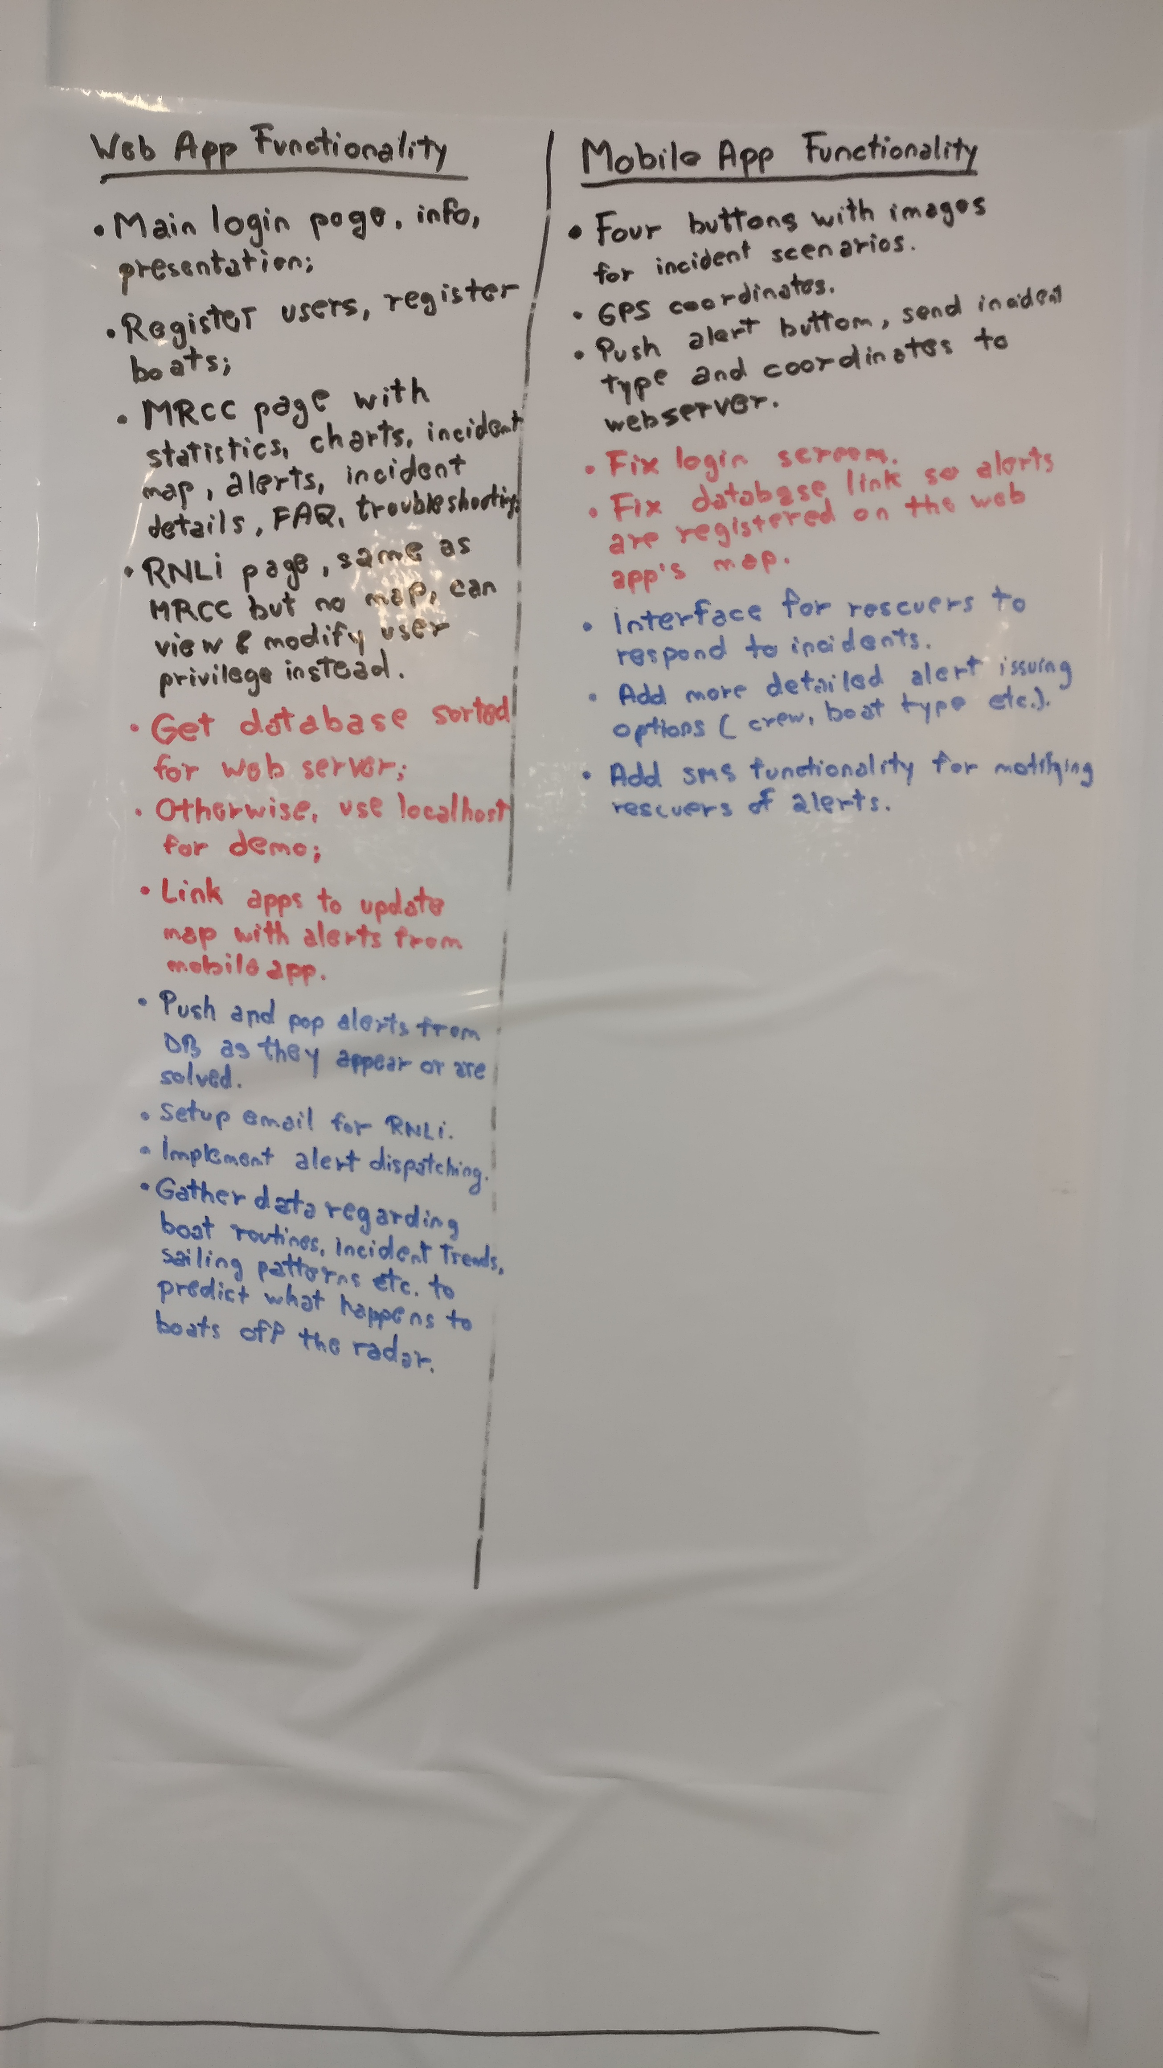
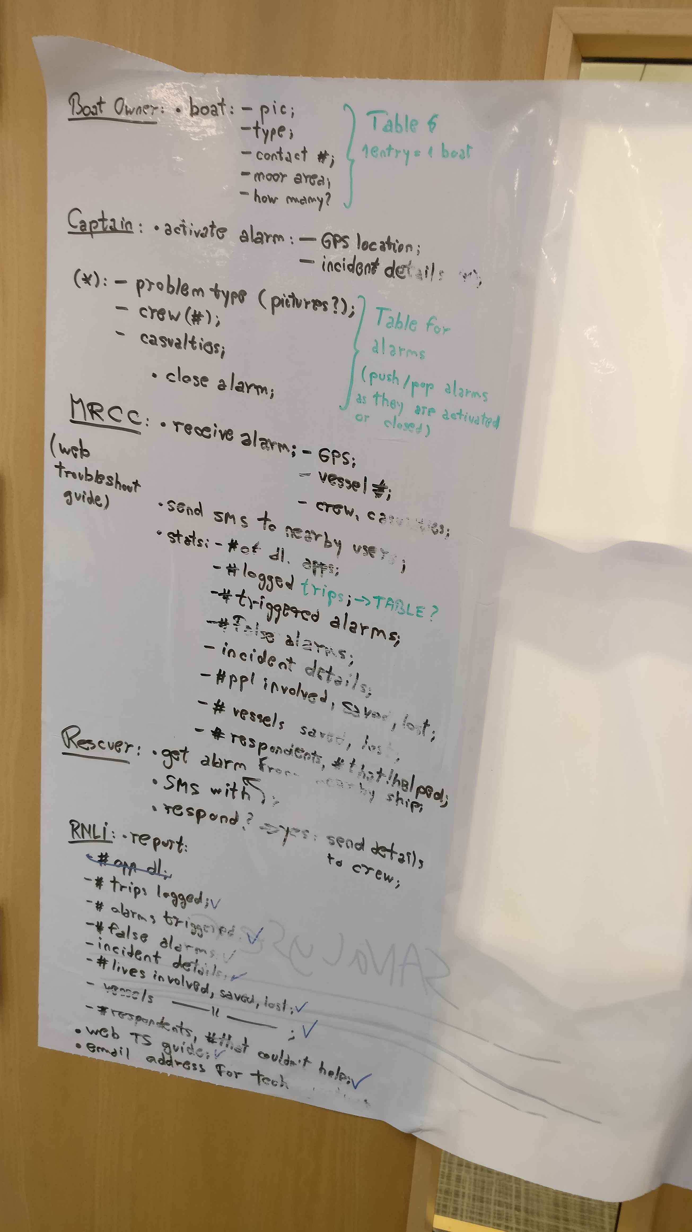

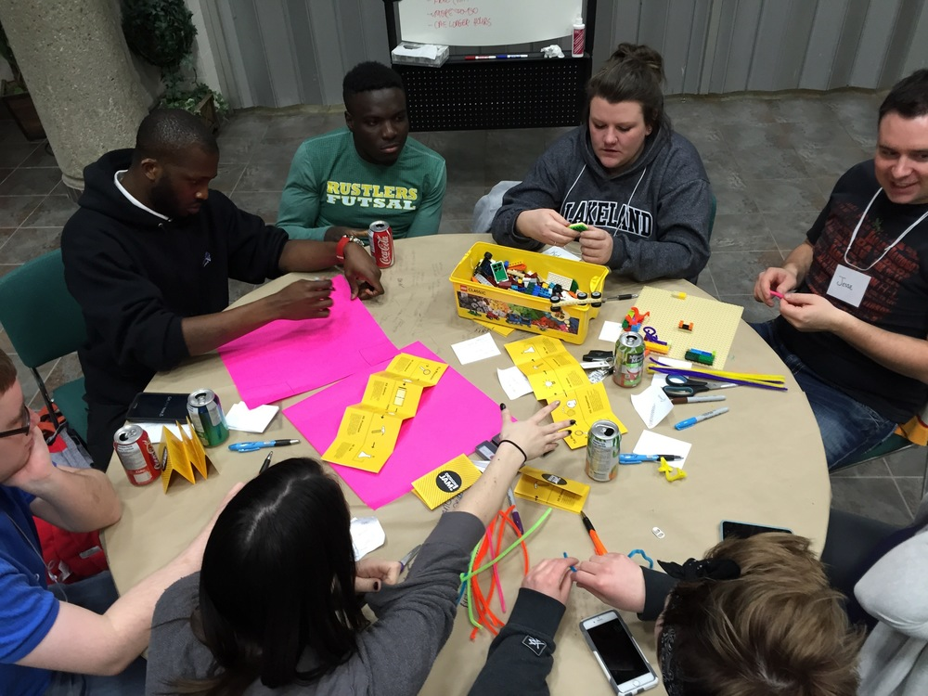
Development
No prior Android development experience
Brainstorming & Planning
I

Slide 3



Our Solution

Slide 4
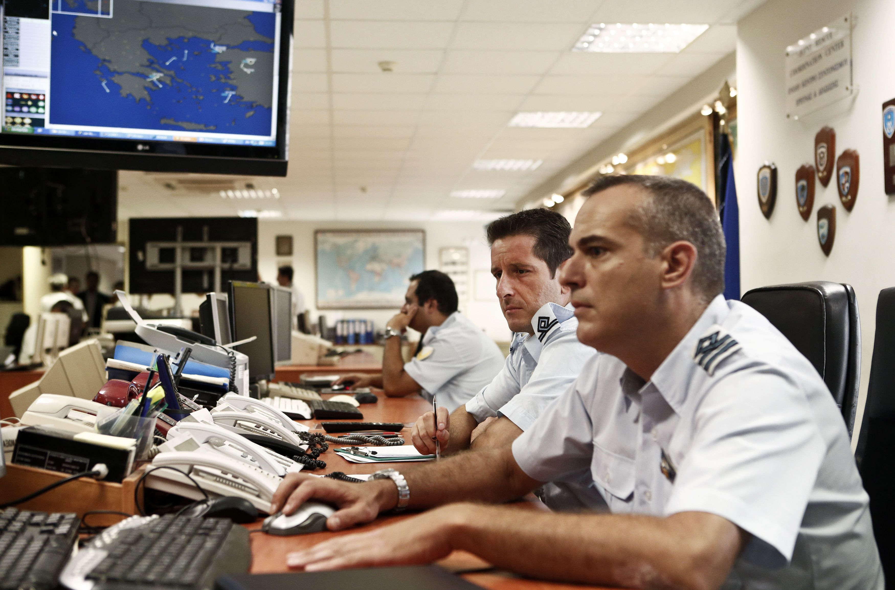
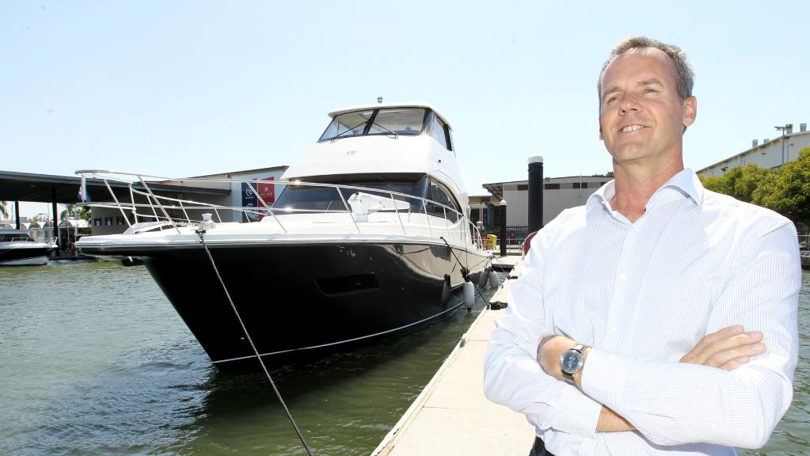
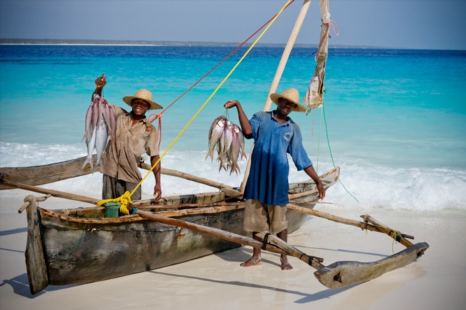
From The Perspective of:

