Slide 1
Bournemouth Blind Society 4sight
Anna, Simon, Scott, Emma, Liam
Team 12

Slide 2
The Problem
Guideance sytem
Visually Impared
New and subsiquent visitors
Extendable
Notes:
We have been tasked with creating an application that addresses 4 key points.
it is required to provide non visual guideance to assist in the navigation of a location.
the user base will be individuals who are visually impared, from partial to full sight lose.
It should suport users who are attempting to navigate a loaction for the first time, but also assit those who are revisiting to allow them to become comfortable with the enviroment.
After it has been implemented at Chaseside it should be extendable and adaptable to other public locations where existing GPS solutions arent viable.
Bournemouth Blind Society would like to develop a solution that supports blind or partially sighted individuals visiting a site for the first time or a site that they are otherwise not 100% comfortable navigating. While BBS expects the solution will extend to many public places (like offices, parks, public locations) in the future, Code for Good teams should develop a solution that first tackles the challenge of visiting the Chaseside Bournemouth office for a blind or partially sighted individual. Teams are encouraged to think creatively about what would most benefit an individual utilizing the solution. Teams may consider incorporating an audible map, warnings about obstructions, and directions for key features of the building, i.e. lifts, toilets, restaurant, etc. Teams could also consider functionality embedded into the solution that automates challenging processes for a blind or partially sighted individual, i.e. opening a door or selecting the correct floor in the lift.

Slide 3
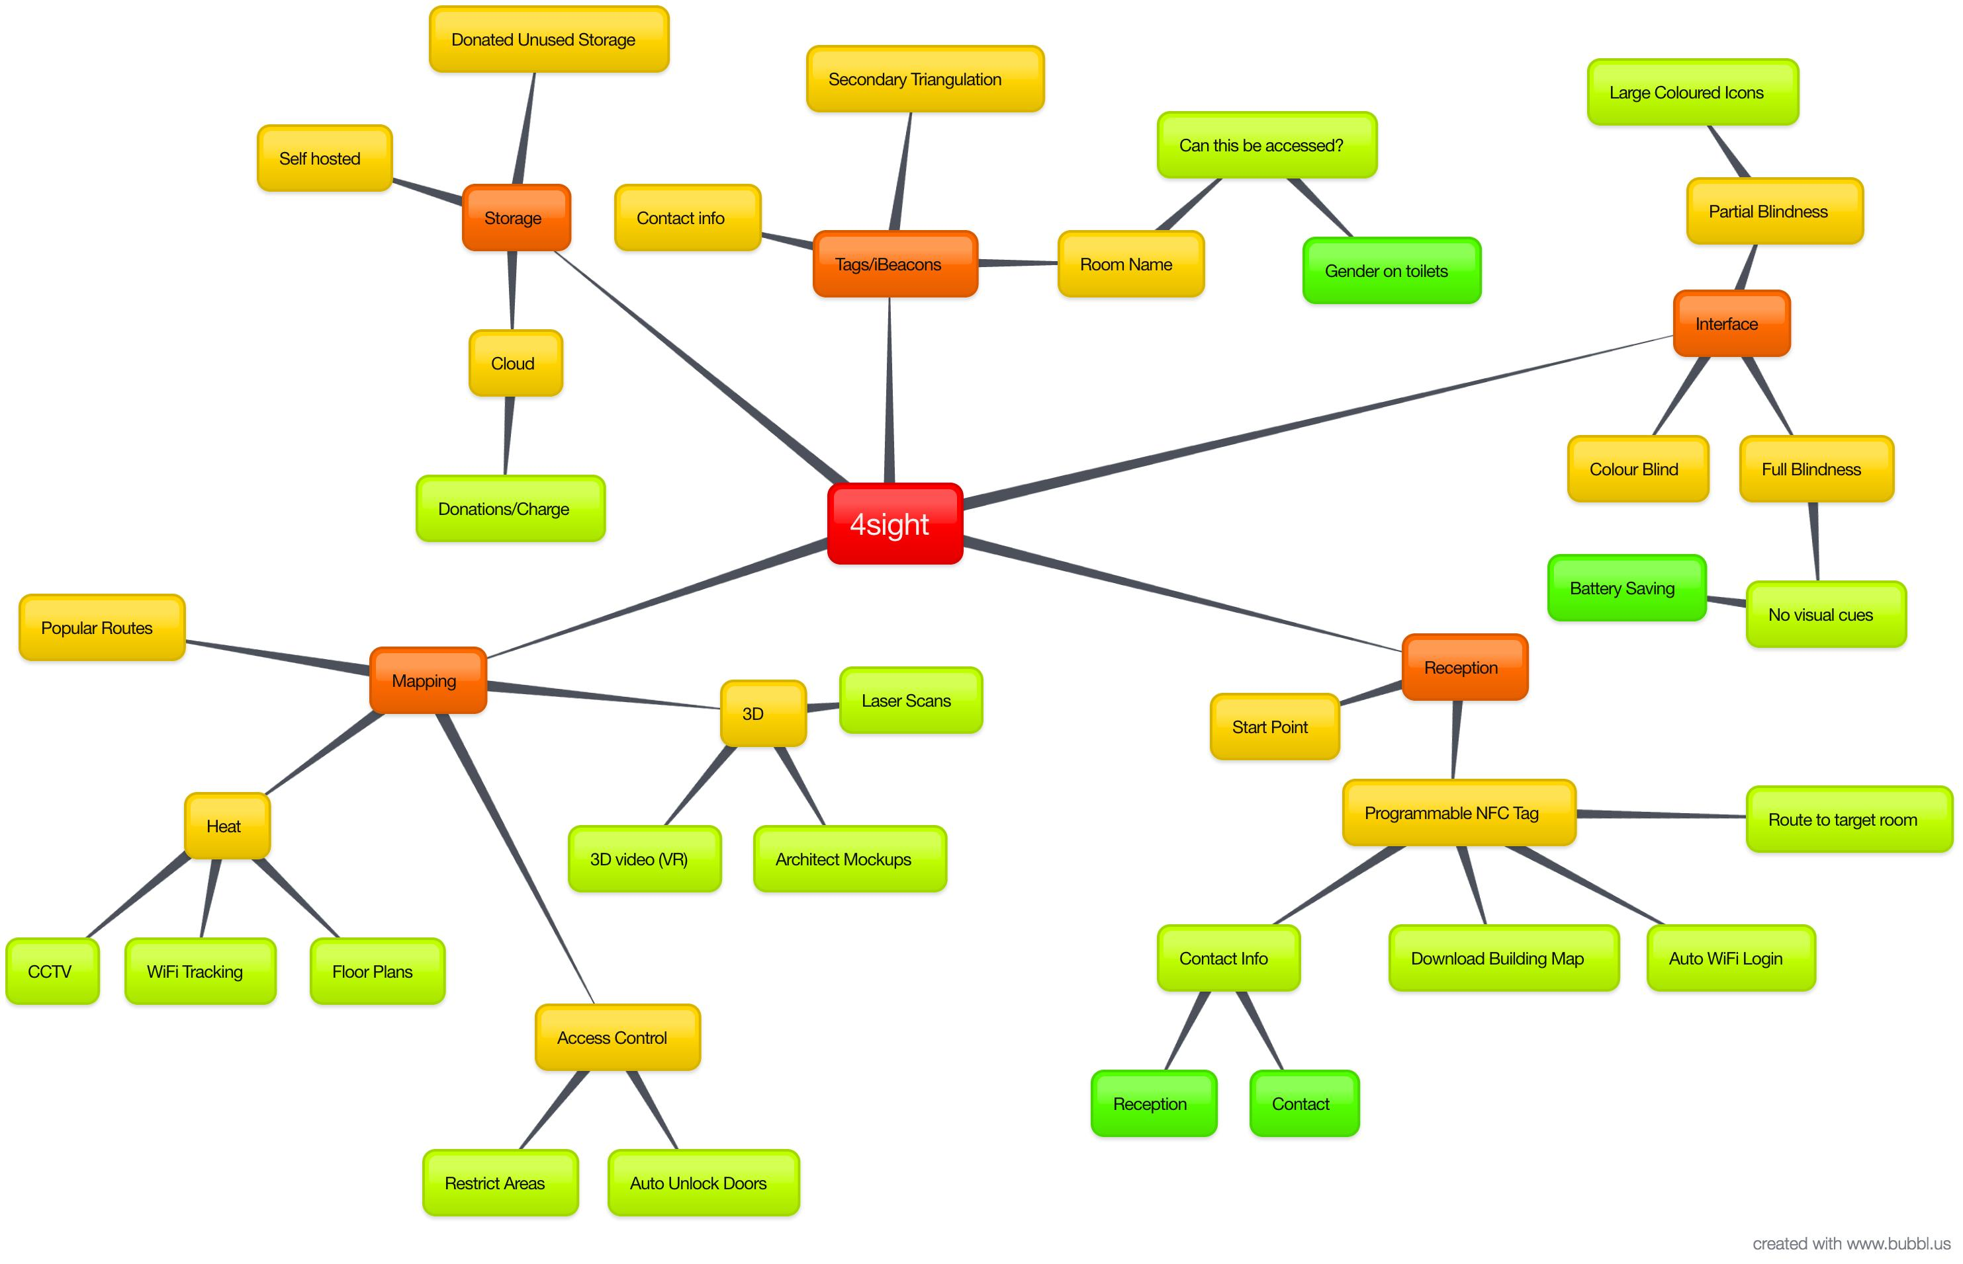
Brain Storm

Slide 4
About the App

Slide 5
Meeting the brief
VI is a spectrum
Things change and learning is repitition.
Notes:
Our guideance system works on audio and touch cues to allow a visually imapred user to navigate to their desired location. As VI is a spectrum we have catered for those who are partially sighted by including the option to veiw icons on the screen along with a map of their current location and the route they need to take and their next movements. For those with total loss of sight we have suported them by extending the interaction interface that they are familier with using. Our app will allow them to navigate around any location and help reduce the risk of injury.
With real time updates and pattern recognition even seasoned users of a location will be able to find the route that sutes their needs best, wether it’s the quickest route, to aviod obsicles or crowds of people.
By leveraging technology that already exists at most public locations and repurposing it we hope to make the implementation of our system at a new location as easy as possible.

Slide 6
Consideration
Cost of implementaion
Notes:
We understand that the cost of the hardware implementation will ether need to be covered by the hosting company or the charity, therefore these costs will need to as low as reasonably possible. to achieve this we have tried to tap into systems that are already in place.

Slide 7
Further Development
Research
Notes:
Some features we feel could benefit from research within the VI community.

Slide 8
Road Map

Slide 9
Further Implementation
Sighted use
Multiple uses for iBeacons
Reusable data
Notes:
How often have you got lost in a new building or got caught in a crowd? The apllication could be extended to allow sighted people to take advantage of its navagation and route finding features.
The iBeacons would allow for multiple uses with different applications. I.e. one located in the atrum of the Hampshire building could give a breif history of the company and the atruim itself or one lo ated outside an office door could list contact details and link to a calander to show avalibility.
With the heat maps it would be possible to use the information to plan effective advertising in a sales location, plan routes and investigate congestied passages to see how to effectivly move people around the location.

Slide 10
Questions

