Slide 1

Team 12: Inglip’s Minions
Anna, Simon, Scott, Emma, Liam

Slide 2

Development

Slide 3
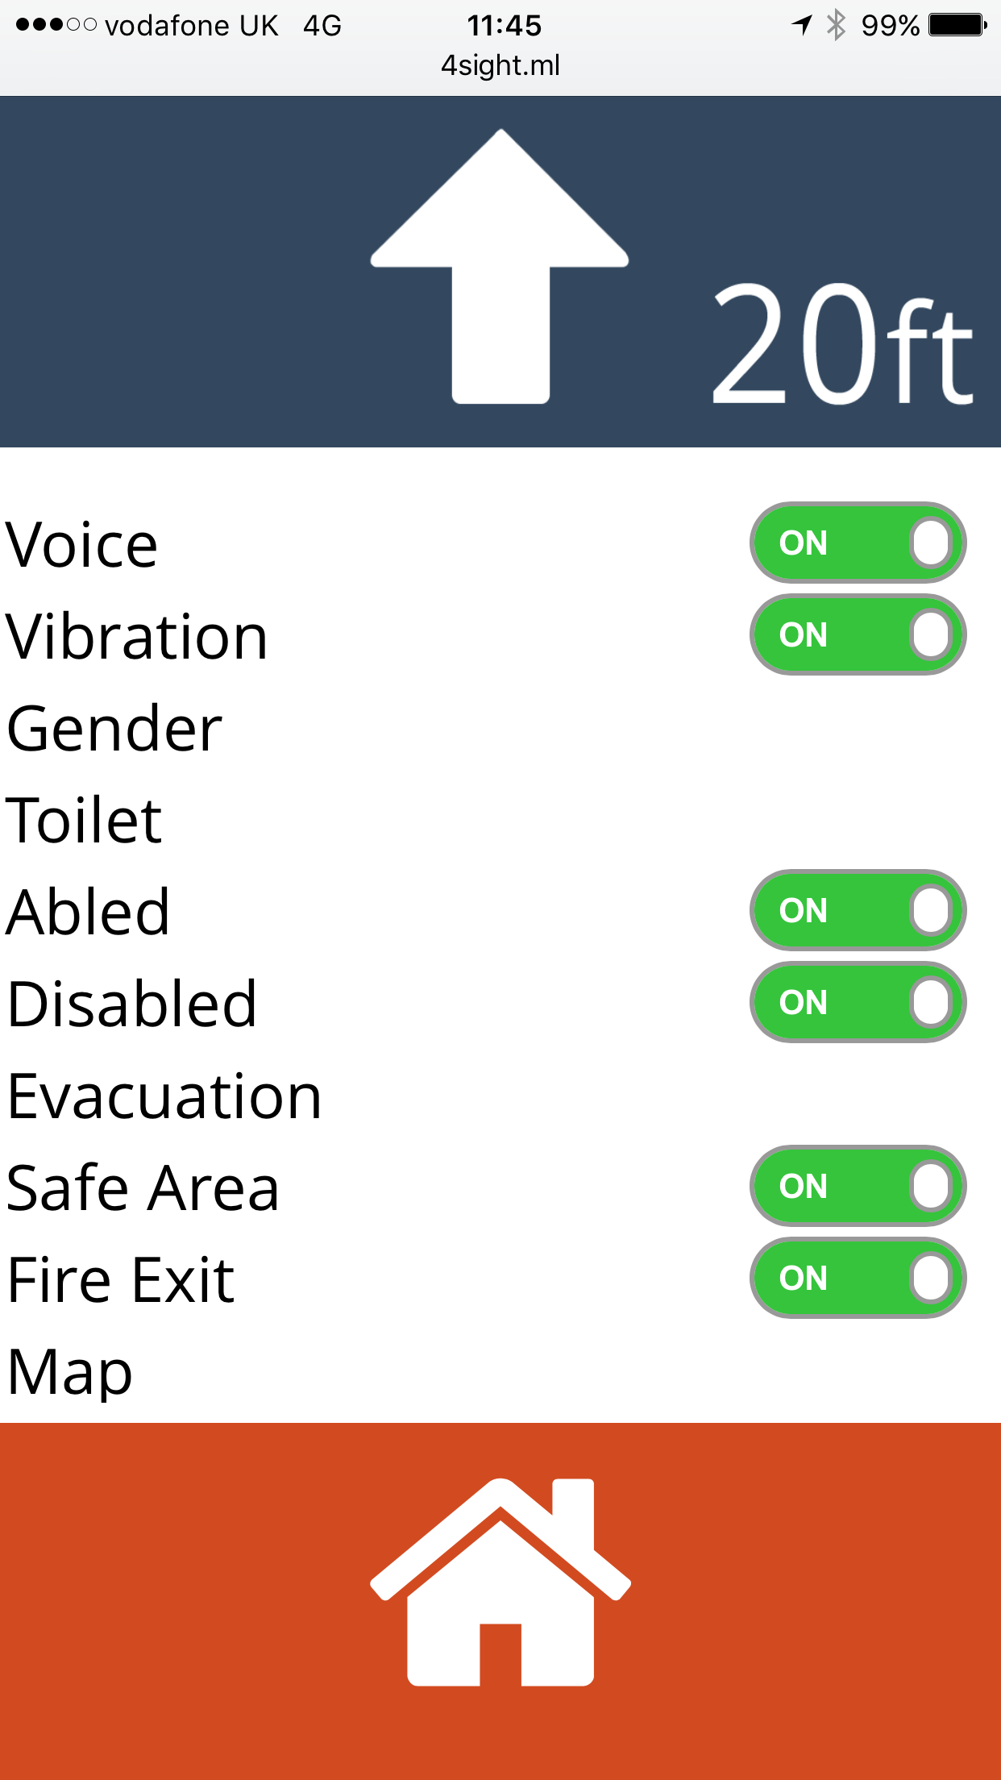
Settings

Slide 4
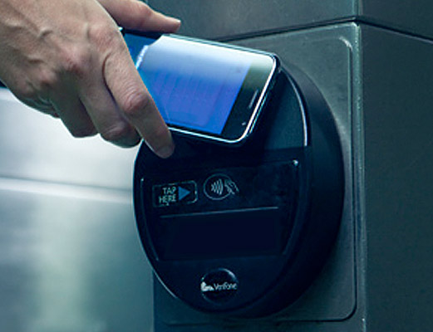
Features
We use iBeacons for destinations and heat maps for routes
NFC

Slide 5
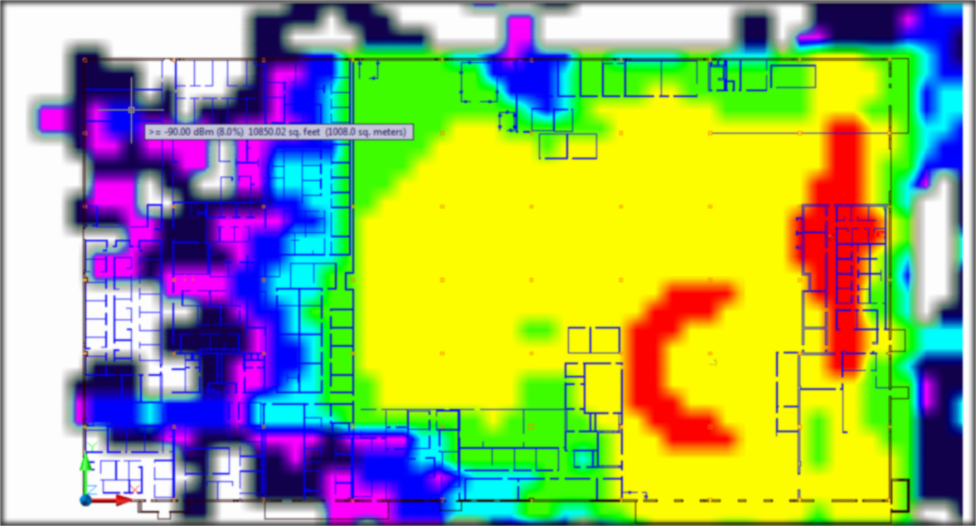
Features
We use iBeacons for destinations and heat maps for routes
Heat Map

Slide 6

Features
We use iBeacons for destinations and heat maps for routes
Guideance & Navigation

Slide 7

Considerations

Slide 8
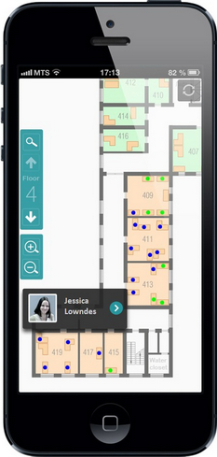
The Future
Sighted Use

Slide 9
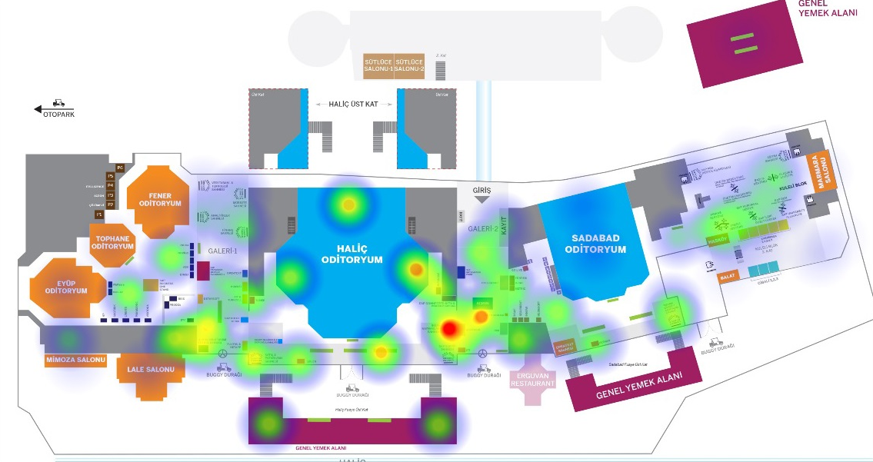
The Future
Reusable Data

Slide 10

The Future
Multiple uses for iBeacons

Slide 11
Any Questions?

