Slide 1
iBeacon Spacial Information
Trials and Tribulations

Slide 2
Guiding principle
Autonomy/independence: Guide, don’t control

Slide 3
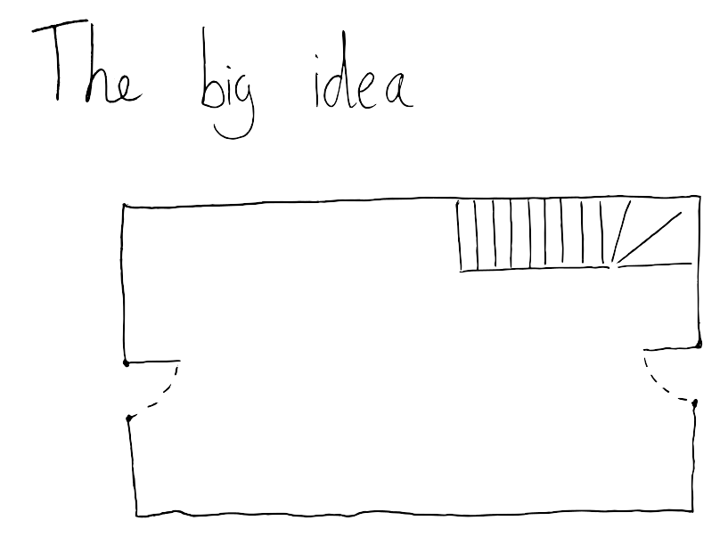

Slide 4


Slide 5
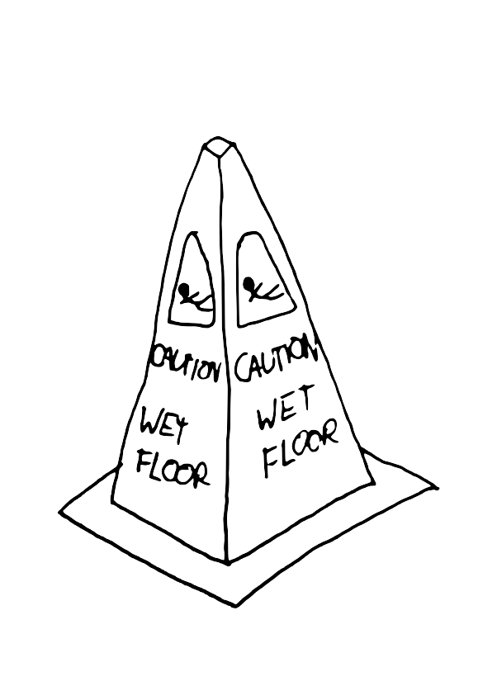

Slide 6


Slide 7
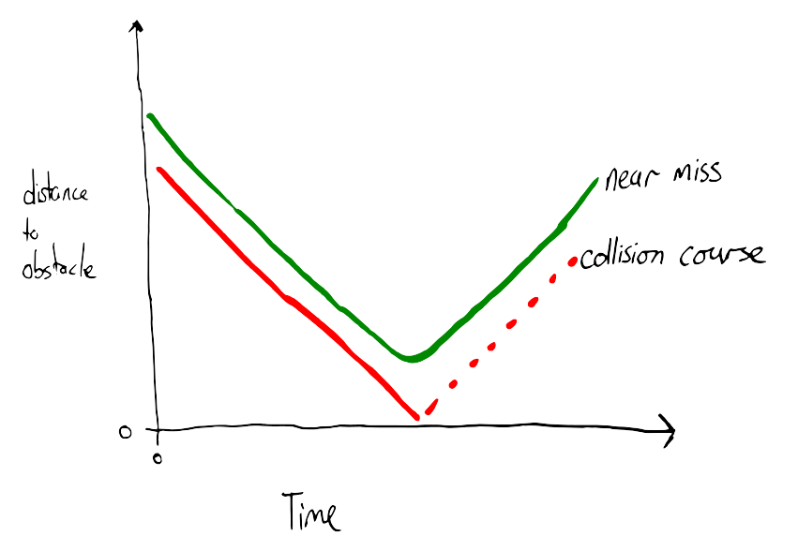

Slide 8
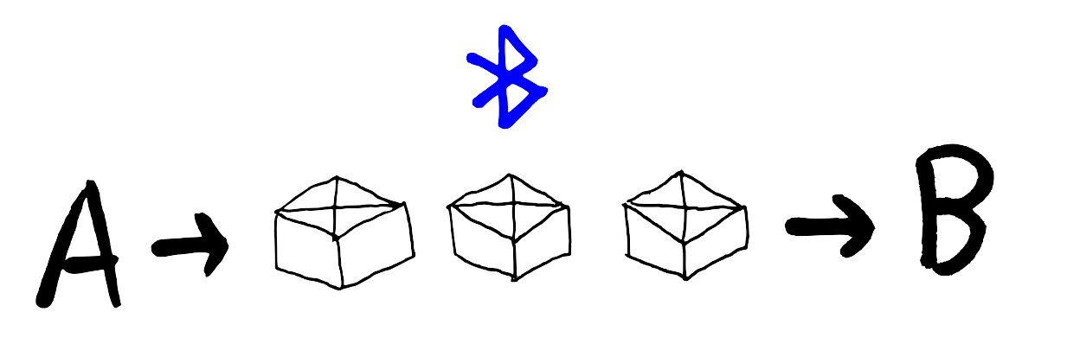
That failed.

Slide 9
What we did instead
Voice guide to buildings

Slide 10
What Worked
Regional / Room information on cue from Android Phone
Expandable
Our original ideas could work with the right technology, which bluetooth is not.

