Slide 1


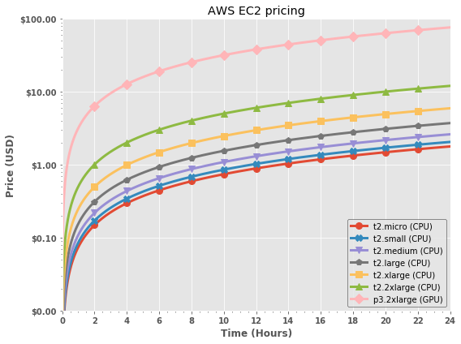
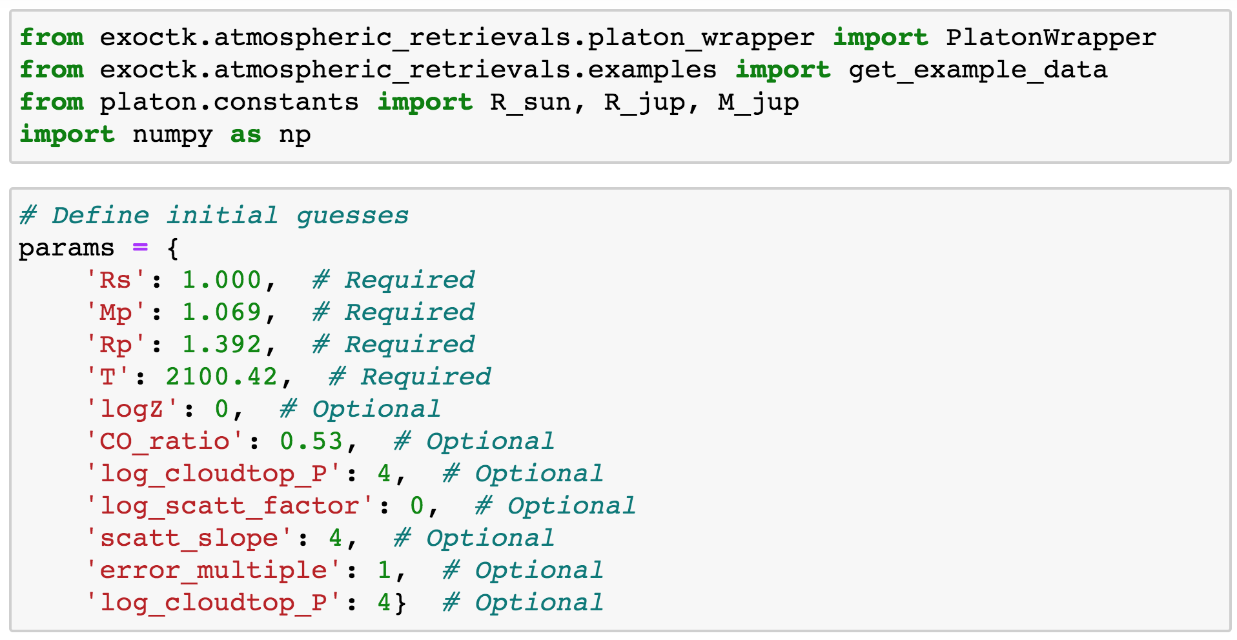
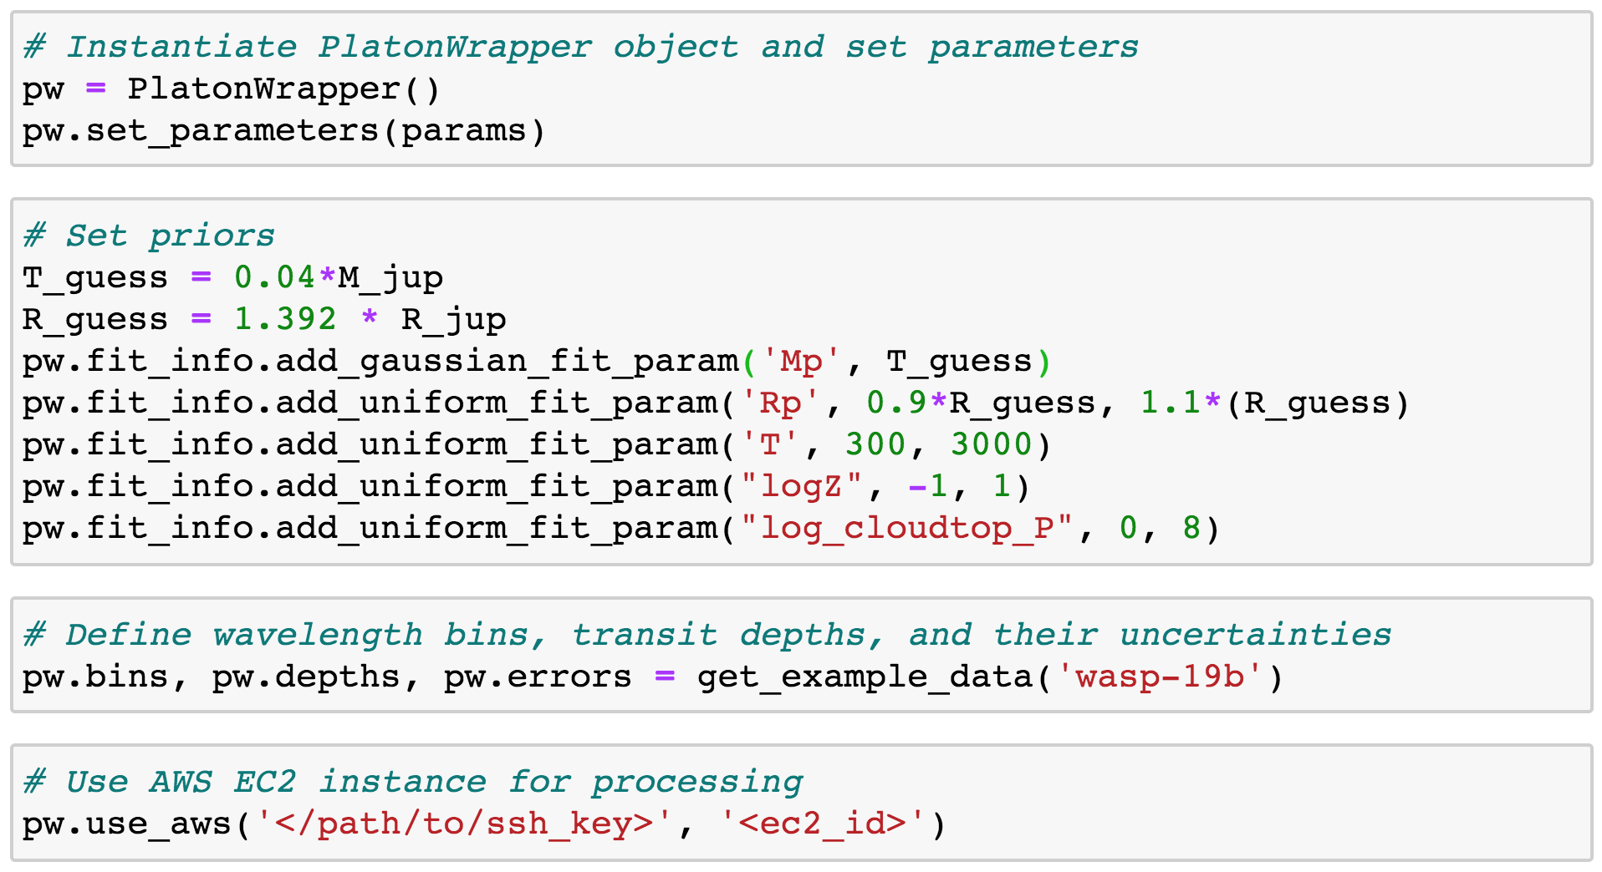
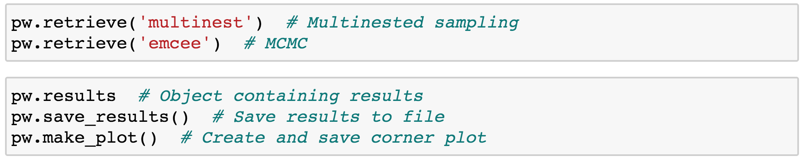


Enabling Fast Bayesian Exoplanet Atmospheric Retrievals Using Amazon Web Services
Matthew Bourque, Kevin Stevenson, Joseph Filippazzo, and the ExoCTK team
235
Abstract
Bayesian atmospheric retrievals will be critical to the robust determination of exoplanetary atmospheric properties in the JWST era and beyond. However, some groups may be challenged by the need of programming expertise and/or computational resources required to perform such retrievals, thus limiting their ability to participate scientifically. The Exoplanet Characterization Toolkit (ExoCTK), which is an open-source data analysis software package and web application focused on the atmospheric characterization of exoplanets and time-series observation planning, aims to address these challenges by developing a module that performs atmospheric retrievals using GPU-enabled Amazon Web Services (AWS) EC2 instances. Here we present the design, usage, and results of this software.
1. ExoCTK
4. Amazon Web Services
The Exoplanet Characterization Toolkit (ExoCTK) is
2. Atmospheric Retrievals
Atmospheric Retrievals are algorithms used to determine the physical parameters of an exoplanetary atmosphere. The atmospheric_retreivals subpackage within the exoctk repository contains methods and tools for performing retrievals with PLATON (PLanetary Atmospheric Transmission for Observer Noobs)¹. Users can choose to performing retrievals on a local machine, or using Amazon Web Services (AWS) Elastic Computing (EC2) instances by properly configuring an EC2 instance and invoking the use_aws() method. A simple example using WASP-19b is provided below.
5. Results
6. Future Work
6. Acknowledgements and References
Support for this project was provided by the STScI Director’s Research Fund and the 2019 STScI Data Science Innovation Initiative.
1. For more information on PLATON, see https://platon.readthedocs.io/.

