Slide 1


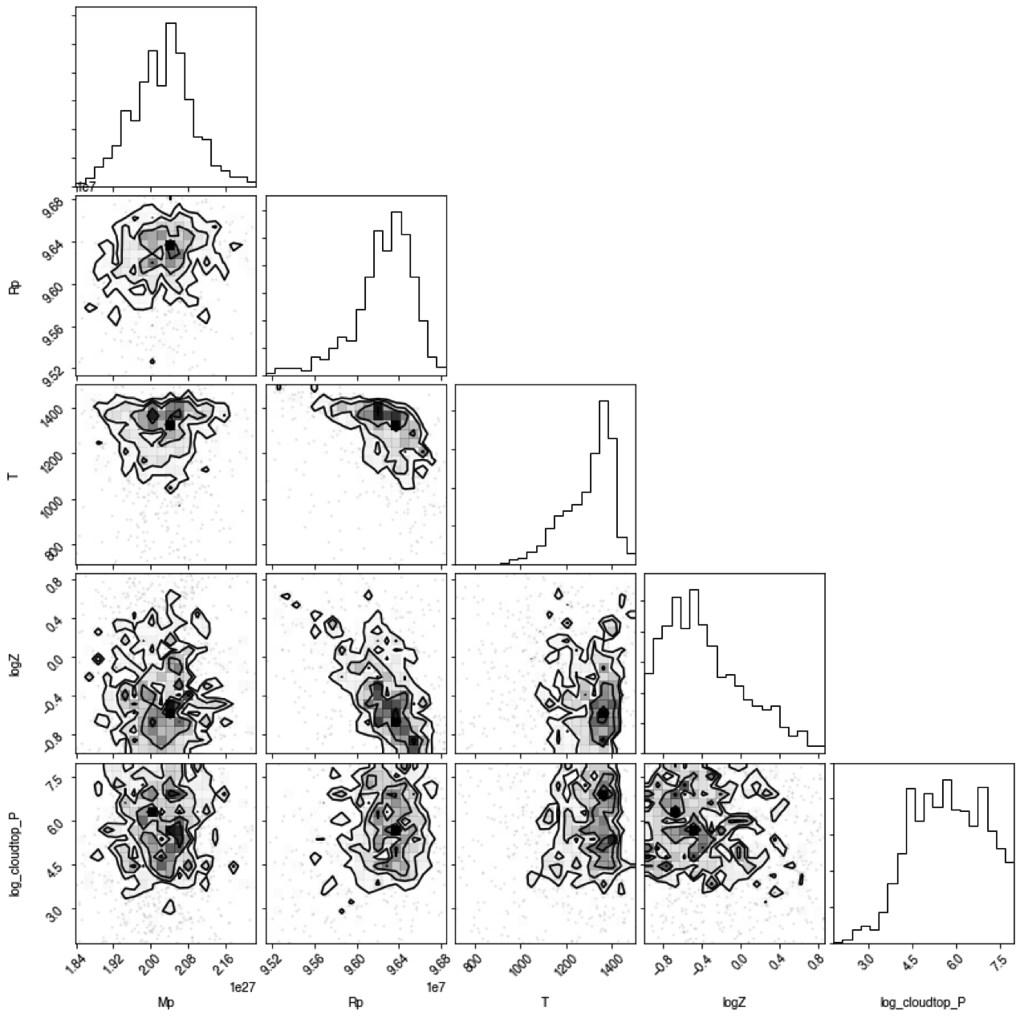
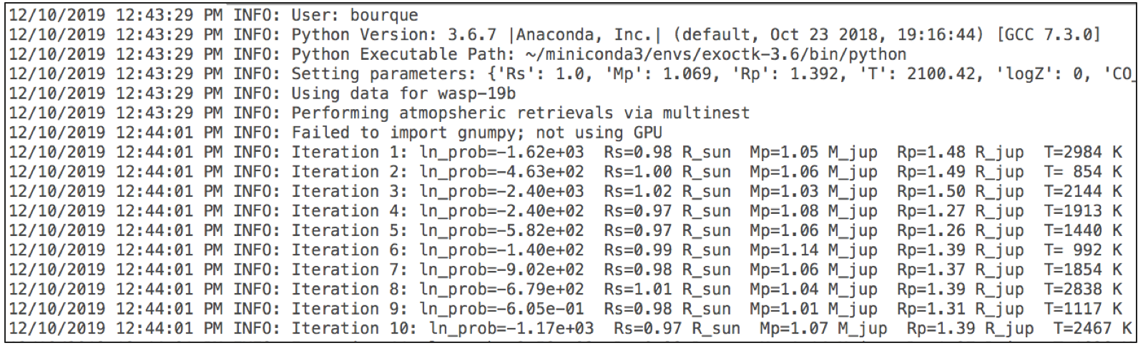
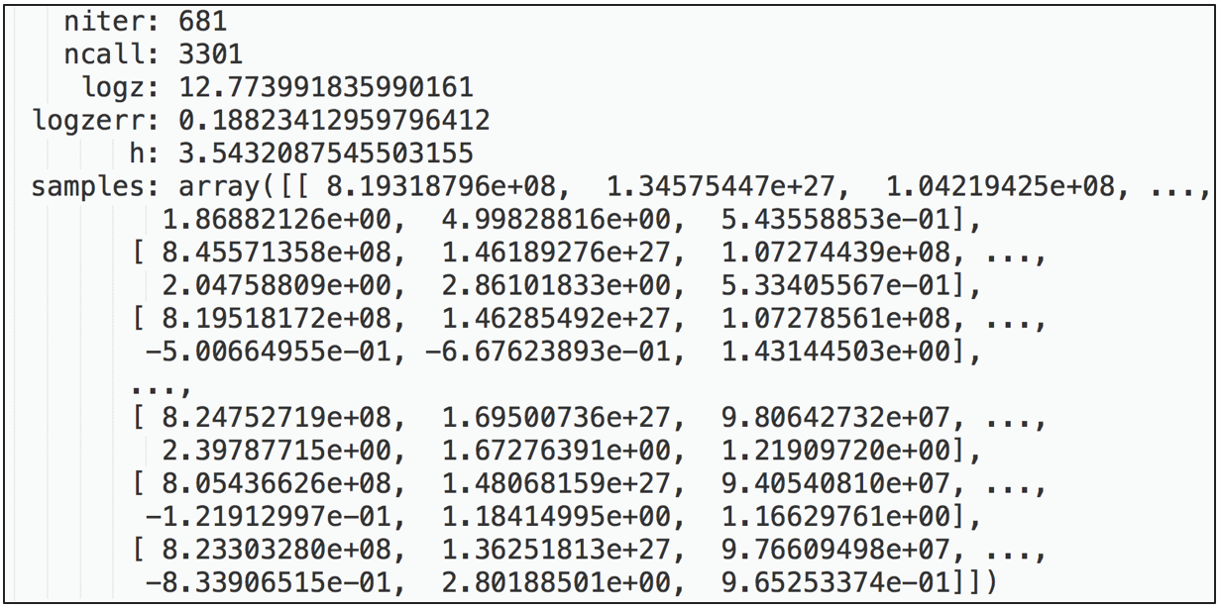
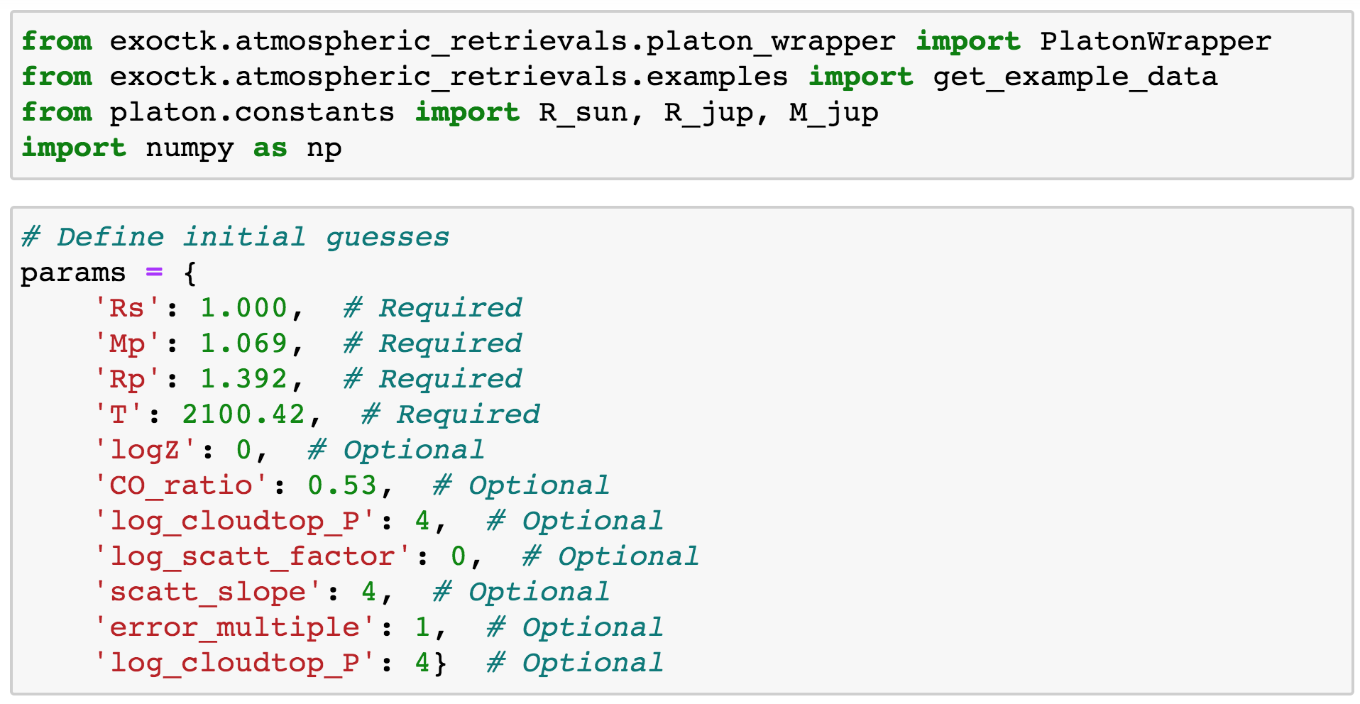
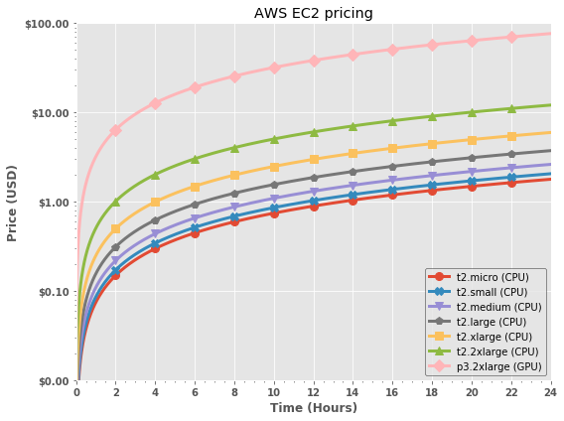
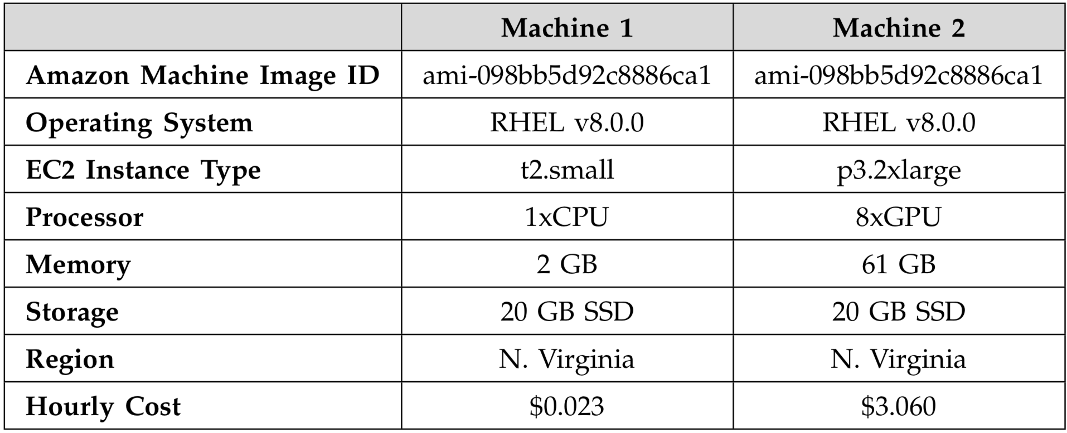
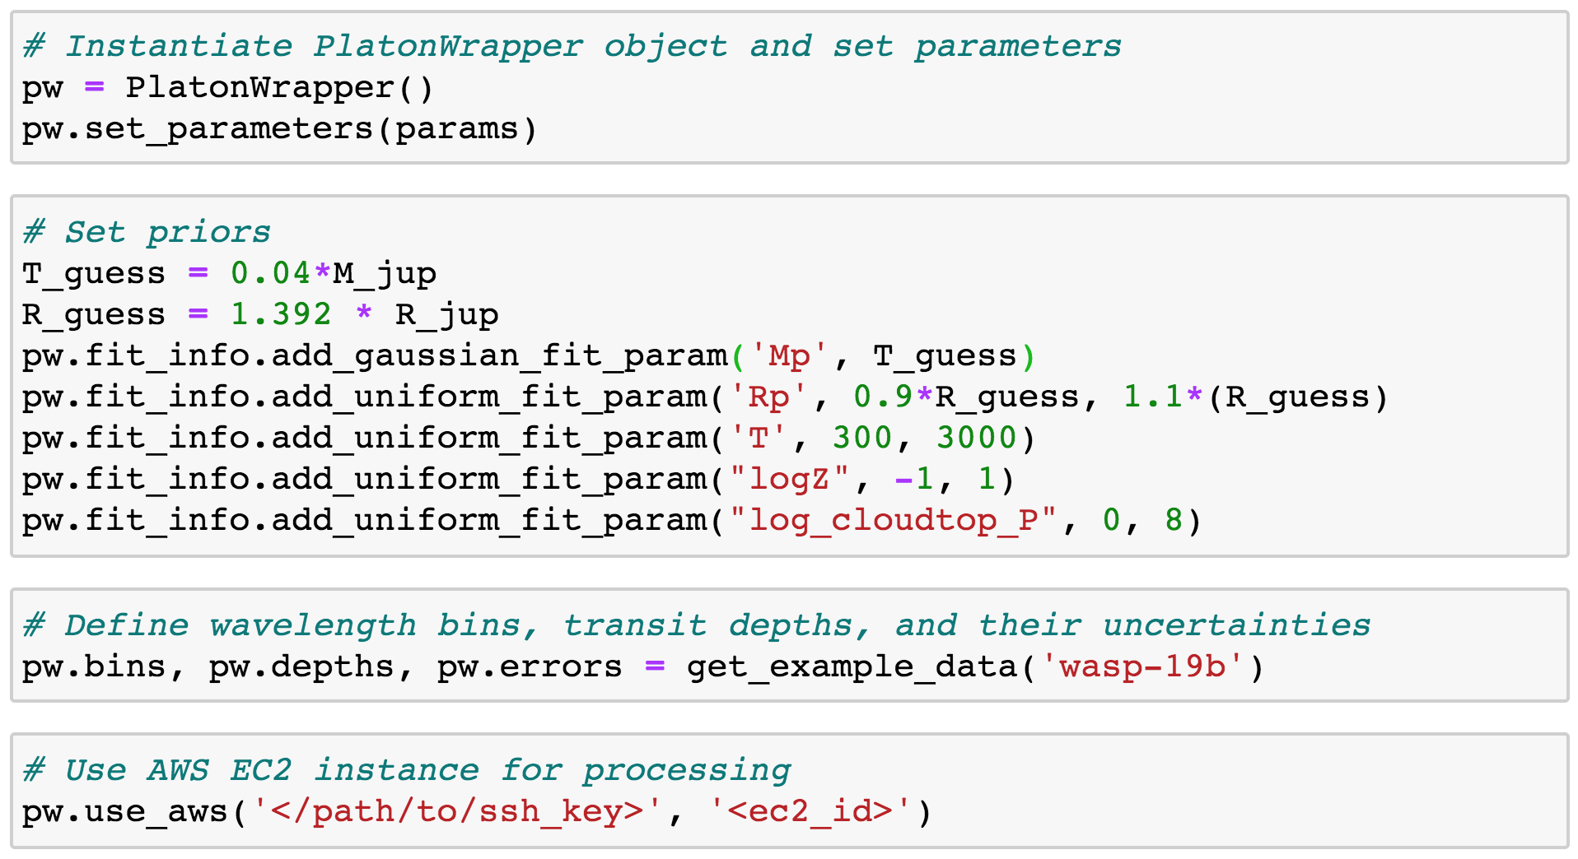
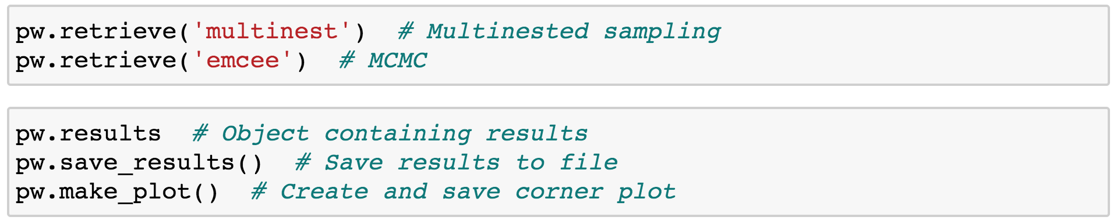
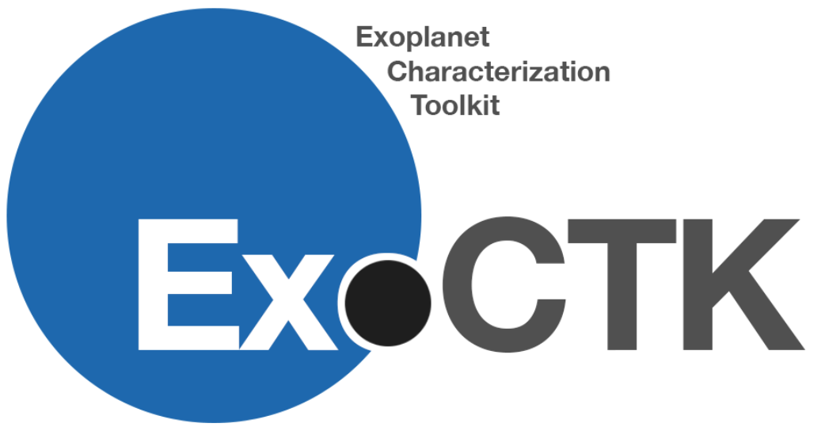

Enabling Fast Bayesian Exoplanet Atmospheric Retrievals Using Amazon Web Services
Matthew Bourque, Kevin Stevenson, Joseph Filippazzo, and the ExoCTK team
235
Abstract
Bayesian atmospheric retrievals will be critical to the robust determination of exoplanetary atmospheric properties in the JWST era and beyond. However, some groups may be challenged by the need of programming expertise and/or computational resources required to perform such retrievals, thus limiting their ability to participate scientifically. The Exoplanet Characterization Toolkit (ExoCTK), which is an open-source data analysis software package and web application focused on the atmospheric characterization of exoplanets and time-series observation planning, aims to address these challenges by developing a module that performs atmospheric retrievals using GPU-enabled Amazon Web Services (AWS) EC2 instances. Here we present the design, usage, and results of this software.
1. ExoCTK
3. Outputs
The Exoplanet Characterization Toolkit (ExoCTK) is is a python-based, open-source, data analysis software package and web application focused primarily on the atmospheric characterization of exoplanets and time-series observation planning. ExoCTK is available on the web at https://exoctk.stsci.edu and on GitHub at https://github.com/ExoCTK/exoctk/.
2. Atmospheric Retrievals
Atmospheric Retrievals are algorithms used to determine the physical parameters of an exoplanetary atmosphere. The atmospheric_retreivals subpackage within the exoctk repository contains methods and tools for performing retrievals with PLATON (PLanetary Atmospheric Transmission for Observer Noobs)¹. Users can choose to performing retrievals on a local machine, or using Amazon Web Services (AWS) Elastic Computing (EC2) instances by properly configuring an EC2 instance and invoking the use_aws() method. A simple example using WASP-19b is provided below.
The output products consist of a corner plot (left) describing the results of the fit, a log file (top right) that describes the execution of the software, and a results file (bottom right) containing the results of the fit.
4. Amazon Web Services
6. Future Work
More methods for storing, visualizing, and interacting with results
Support for other retrieval algorithms, namely CHIMERA (Caltech Inverse Modeling and Retrieval Algorithms
A web interface for performing retreivals, akin to other ExoCTK web tools
Something else
6. Acknowledgements and References
Support for this project was provided by the STScI Director’s Research Fund and the 2019 STScI Data Science Innovation Initiative.
1. For more information on PLATON, see https://platon.readthedocs.io/.

