Slide 1


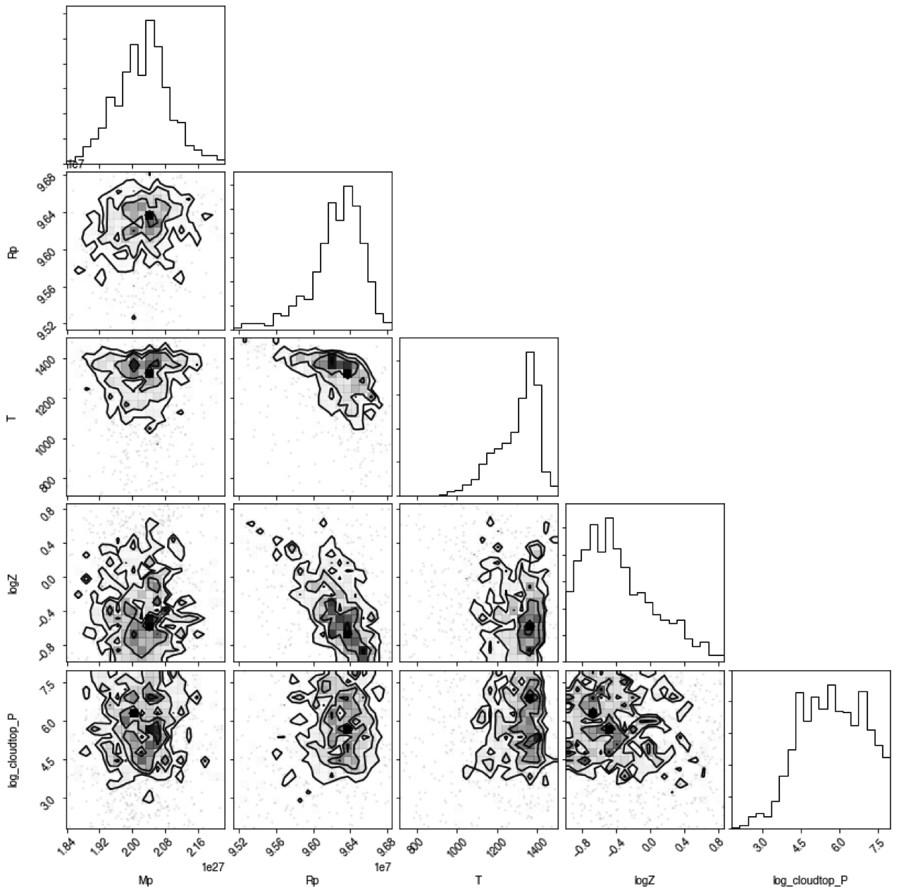
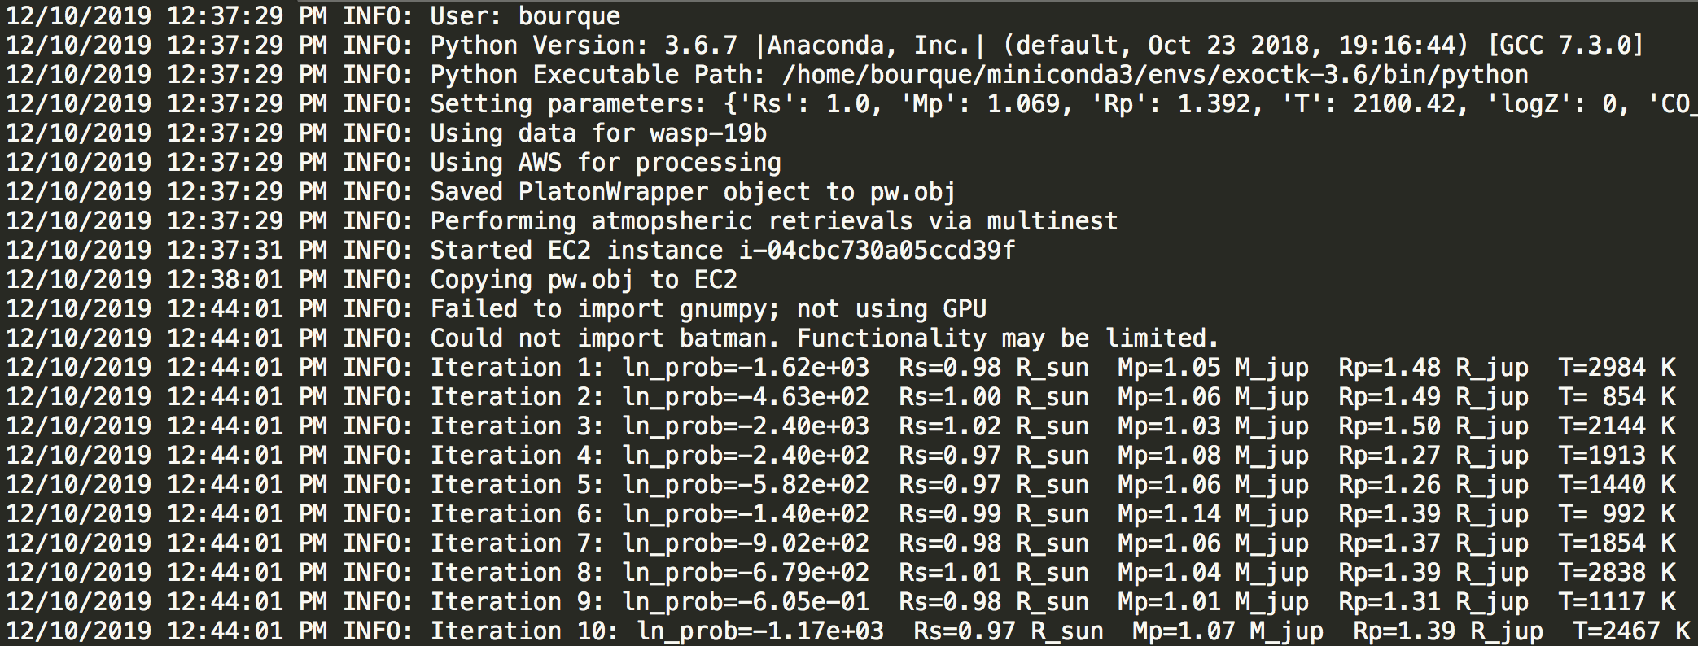
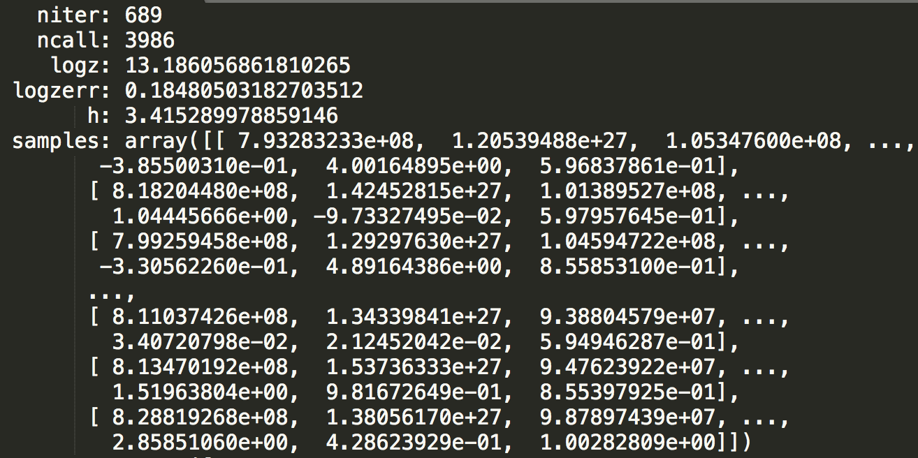
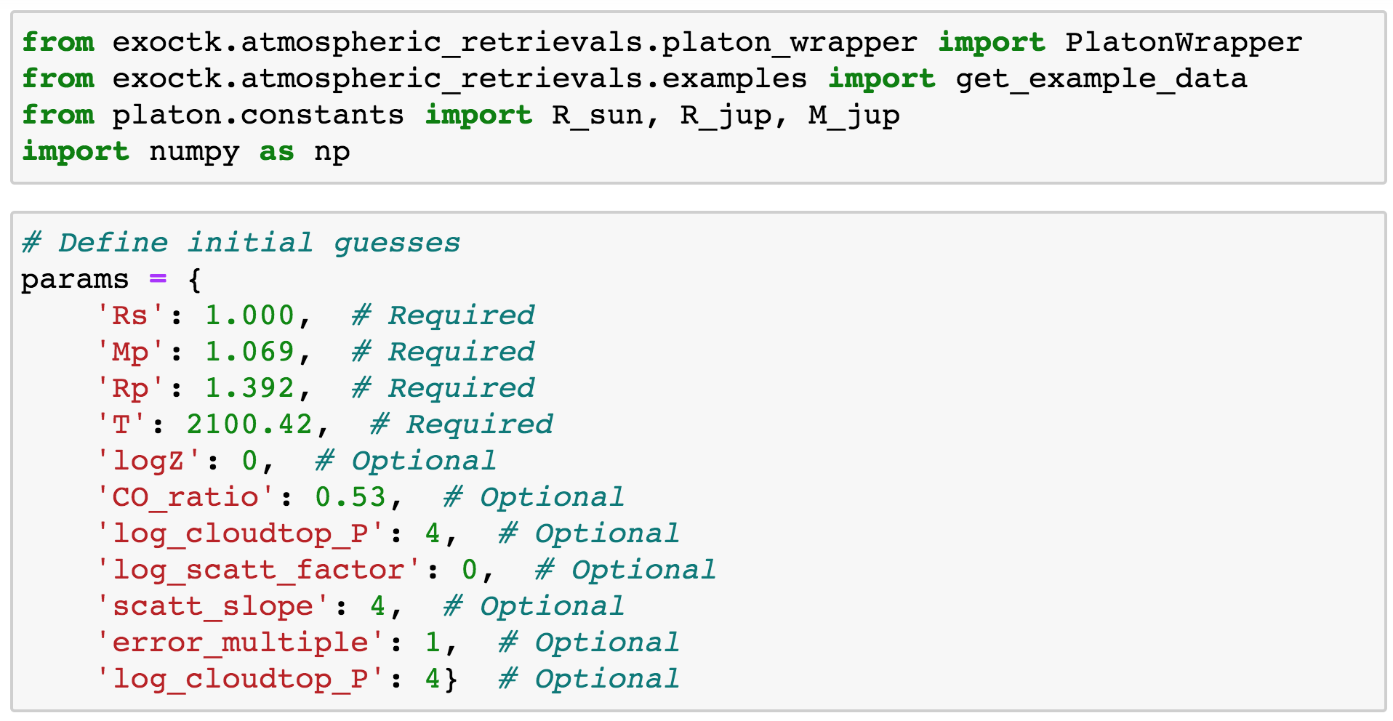
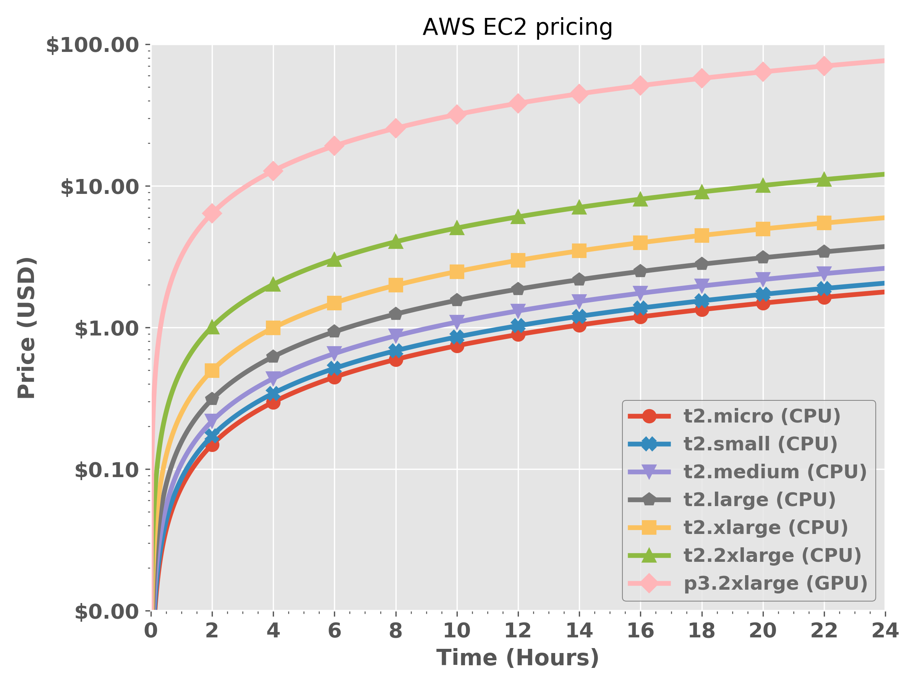
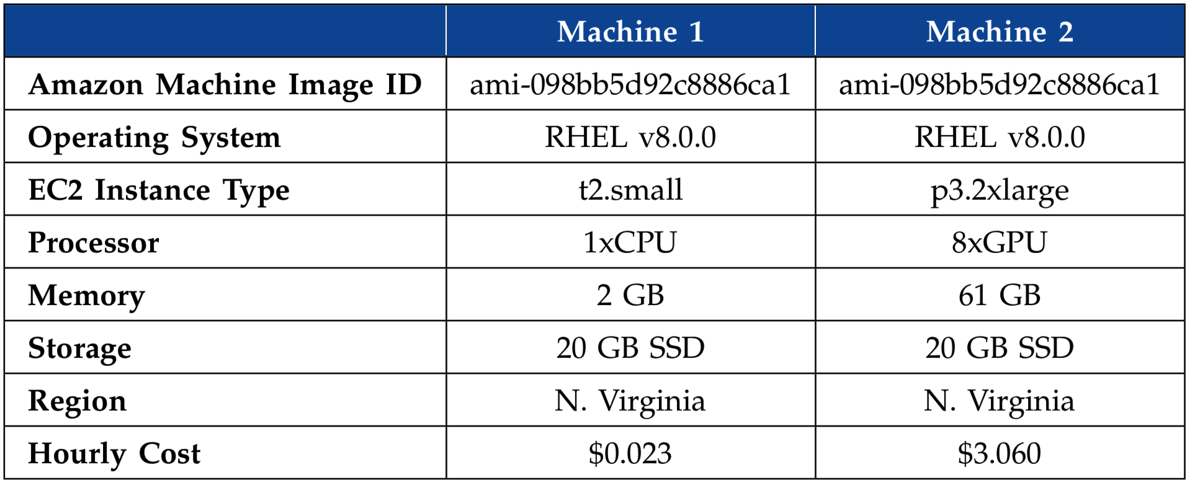
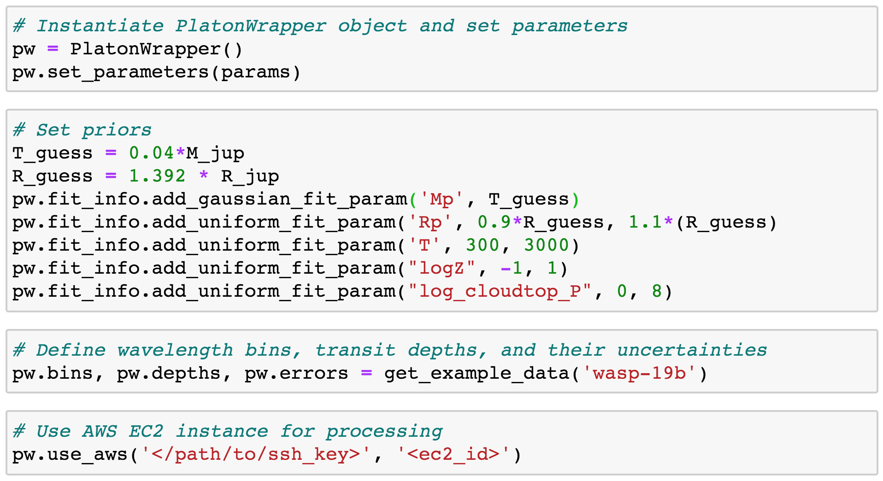
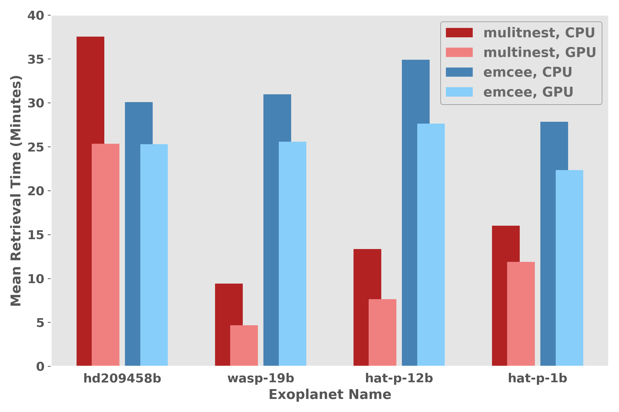
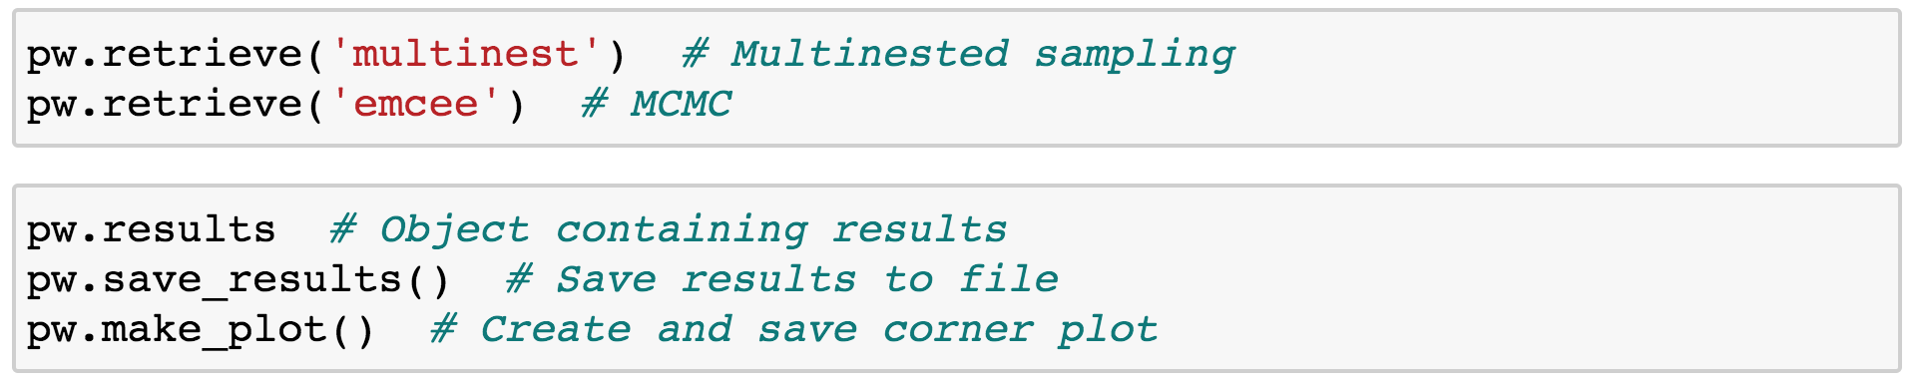
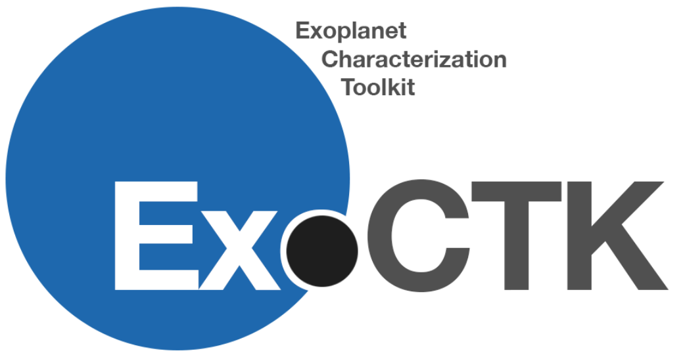

Enabling Fast Bayesian Exoplanet Atmospheric Retrievals Using Amazon Web Services
235
Matthew Bourque, Kevin Stevenson, Joseph Filippazzo, and the ExoCTK team
HONOLULU, HAWAI’I 4 - 8 JANUARY 2020
Abstract
Bayesian atmospheric retrievals will be critical to the robust determination of exoplanetary atmospheric properties in the JWST era and beyond. However, some groups may be challenged by the need of programming expertise and/or computational resources required to perform such retrievals, thus limiting their ability to participate scientifically. The Exoplanet Characterization Toolkit (ExoCTK), which is an open-source data analysis software package and web application focused on the atmospheric characterization of exoplanets and time-series observation planning, aims to address these challenges by developing a module that performs atmospheric retrievals using GPU-enabled Amazon Web Services (AWS) EC2 instances. Here we present the design, usage, and results of this software.
1. ExoCTK
3. Outputs
The Exoplanet Characterization Toolkit (ExoCTK) is a python-based, open-source software package and web application focused on the time-series observation planning and data analysis of exoplanets. ExoCTK is available on the web at https://exoctk.stsci.edu and on GitHub at https://github.com/ExoCTK/exoctk/.
2. Atmospheric Retrievals
Atmospheric Retrievals are algorithms used to determine the physical parameters of an exoplanetary atmosphere. The atmospheric_retrievals subpackage within the exoctk repository contains methods and tools for performing retrievals with PLATON (PLanetary Atmospheric Transmission for Observer Noobs)¹. Users can choose to performing retrievals on a local machine, or on virtual machines located in the cloud on the Amazon Web Services (AWS) Elastic Computing (EC2) platform by properly configuring an EC2 instance and invoking the use_aws() method. A simple example using WASP-19b is provided below.
The output products consist of a corner plot (left) describing the results of the fit, a log file (top right) that describes the execution of the software, and a results file (bottom right) containing the results of the fit.
4. Amazon Web Services
(Top Left) The total cost of running various AWS EC2 instances, as a function of time.
We conducted trial runs of the atmospheric retrieval software with transmission spectra from four exoplanets², using two different AWS EC2 instances (one CPU-enabled, and one GPU-enabled). The table in the top right provides the specifications of these instances, and the average results from five trial runs are given in the plot on the bottom right.
5. Future Work
More methods for storing, visualizing, and interacting with results
A web interface for performing retrievals, akin to other ExoCTK web tools
Support for other retrieval algorithms, namely CHIMERA (Caltech Inverse Modeling and Retrieval Algorithms)
Easier AWS EC2 configuration process via build scripts
Acknowledgements and References:
Support for this project was provided by the STScI Director’s Research Fund and the 2019 STScI Data Science Innovation Initiative.
For more information on PLATON, see https://platon.readthedocs.io/.
Transmission spectra were acquired from ExoMAST, available at https://exo.mast.stsci.edu/.

