Slide 1
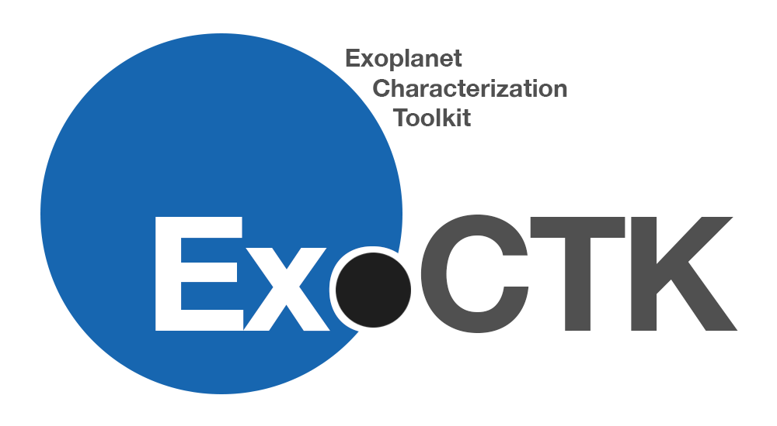
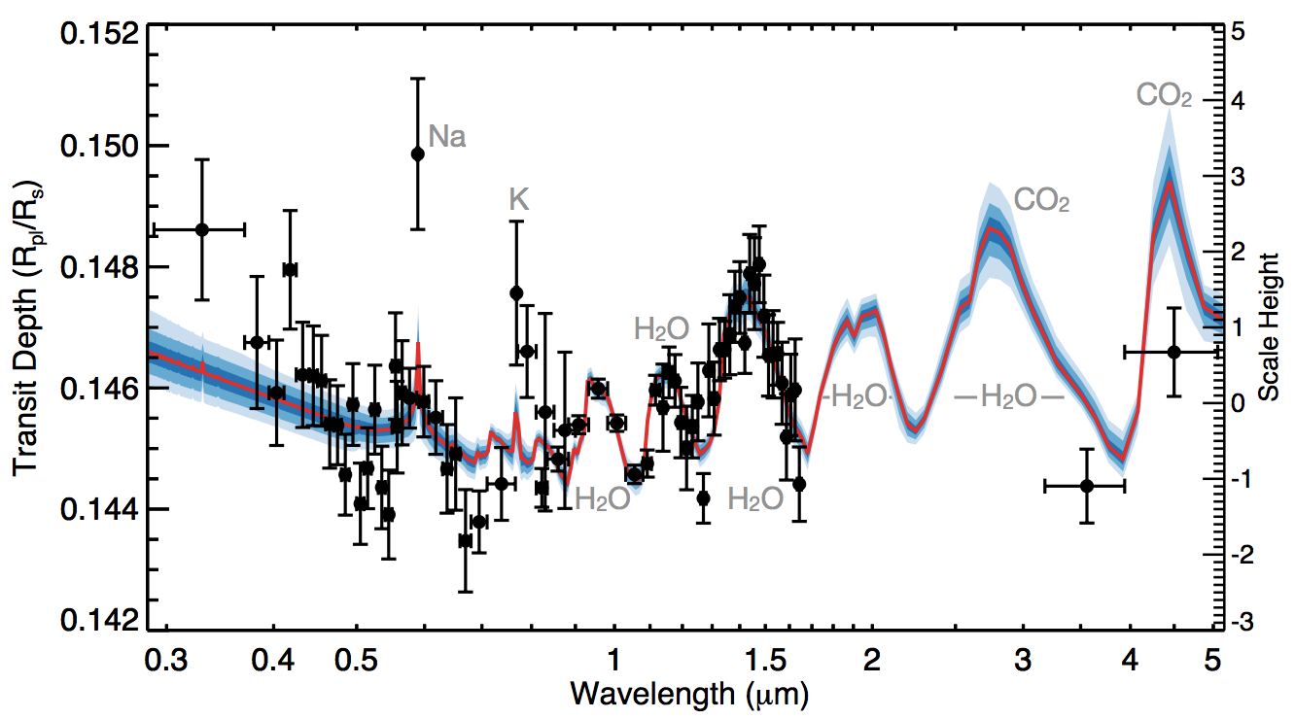
Atmospheric Retrievals
Atmospheric retrievals is an attempt to determine the physical parameters of an exoplanet atmosphere
Given a set of initial guesses and a defined parameter space, retrieval algorithms will explore this parameter space to determine which physical parameters result in the best fit
Important physical parameters include:
  Mass of the planet
  Radius of the planet
  Temperature of the planet’s atmosphere
  Metallicity
  C/O ratio
  Cloud abundance
Wakeford et al., 2017

Slide 2
Atmospheric Retrievals with platon and AWS
The atmospheric_retrievals/ subpackage in exoctk currently provides a way to perform atmospheric retrievals via PLATON
  New feature as of this workshop!
  PLATON – Planetary Atmospheric Transmission for Observer Noobs (https://platon.readthedocs.io)
  Support for multinested sampling (multinest) and MCMC (emcee) methods
  Users may perform the retrievals on a local machine or using Amazon Web Services (AWS) Elastic Computing (EC2) instances
Notable modules:
  platon_wrapper.py – wrapper module for PLATON
  examples.py – contains examples of how to use the code, with accompanying example data

Slide 3
Atmospheric Retrievals with platon and aws
Feature development expected to continue. Possible future work includes:
  More methods for storing, visualizing, and interacting with results
  Support for other retrieval algorithms such as CHIMERA (Caltech Inverse Modeling and Retrieval Algorithms)
  A web interface for performing retrievals, akin to other ExoCTK web tools

Slide 4
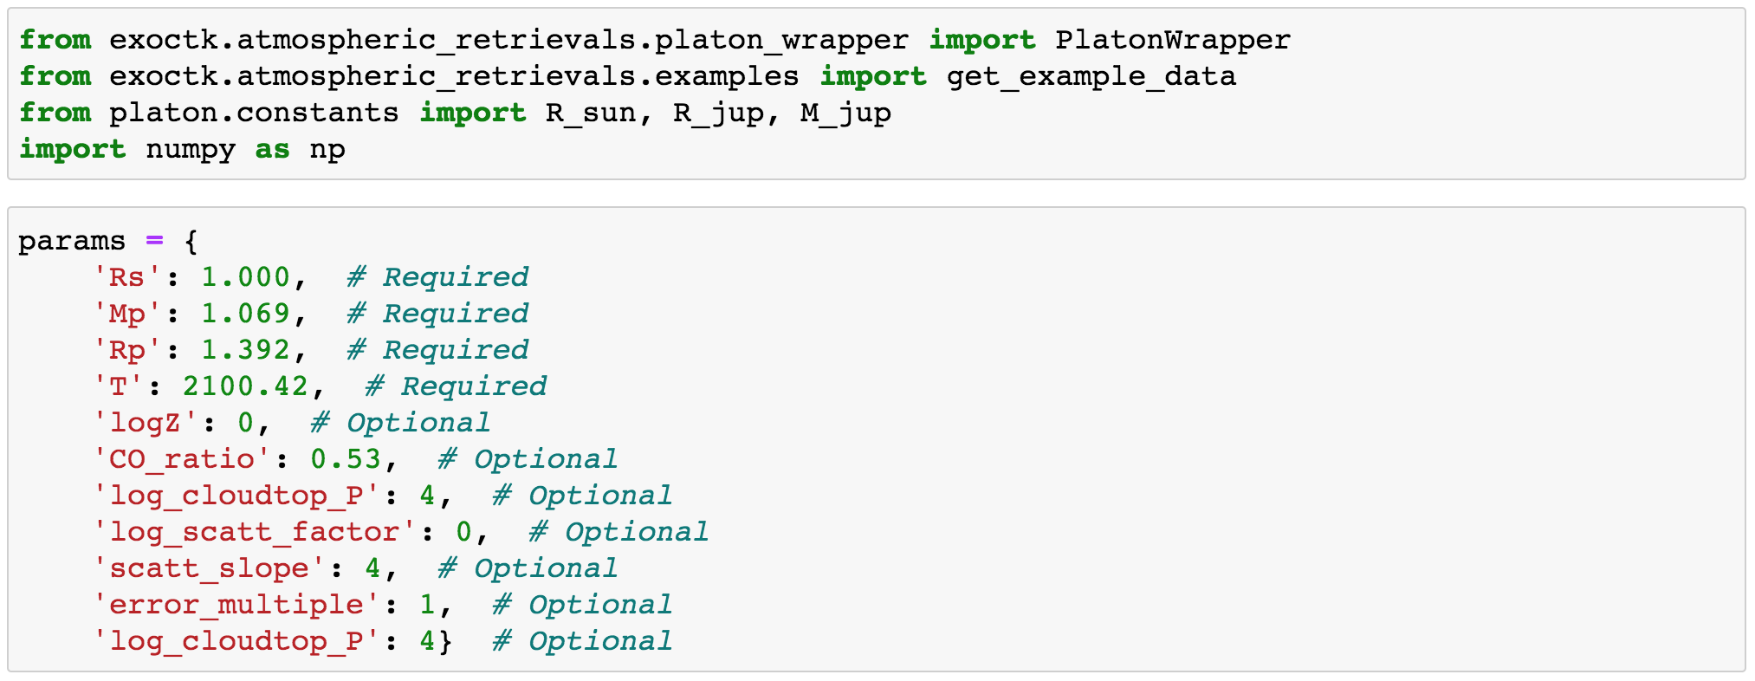
Atmospheric Retrievals with platon and aws: Wasp 19b example
Example: wasp 19b
Notes:
What is assumed to be T_star? What are the defaults

Slide 5
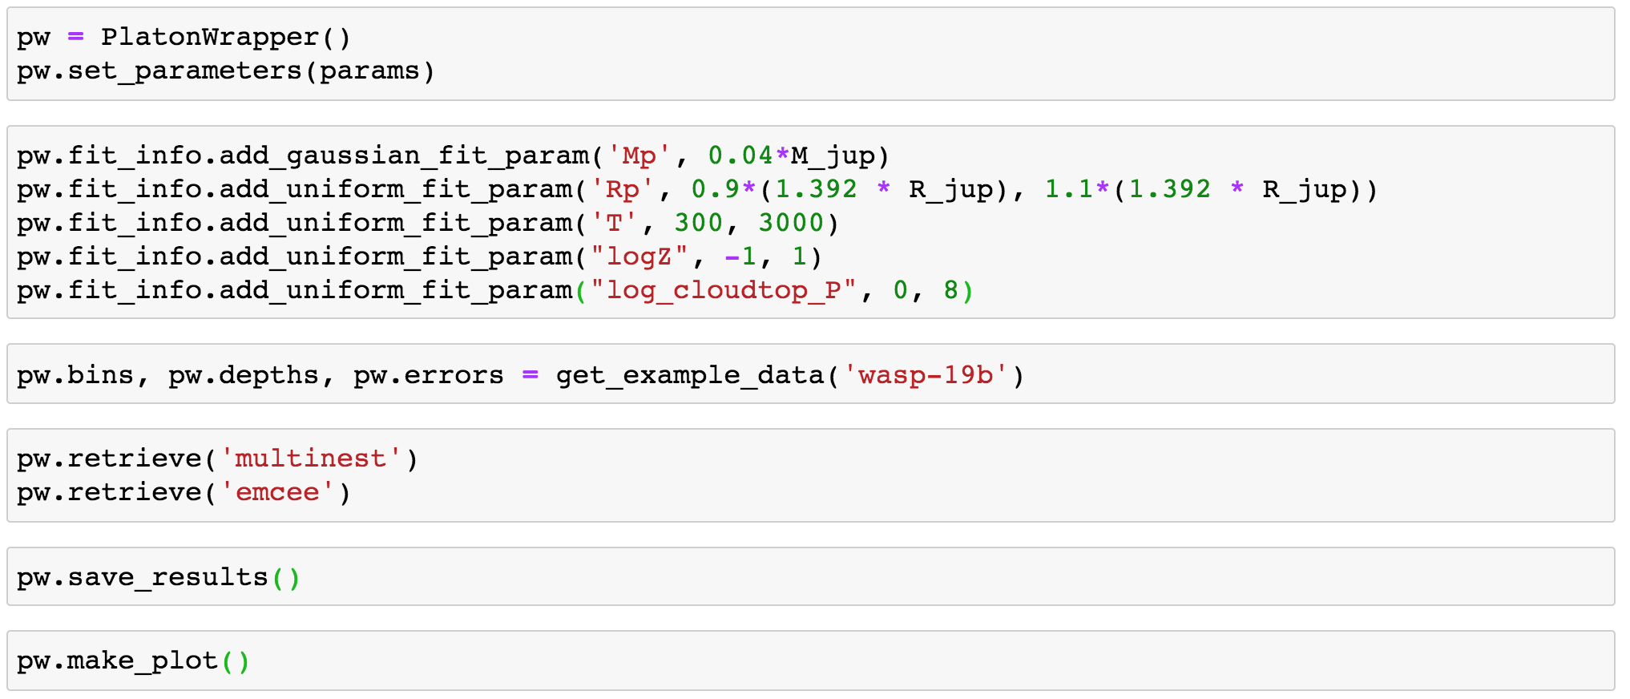
Atmospheric Retrievals with platon and aws: wasp 19b example
Example: wasp 19b

Slide 6
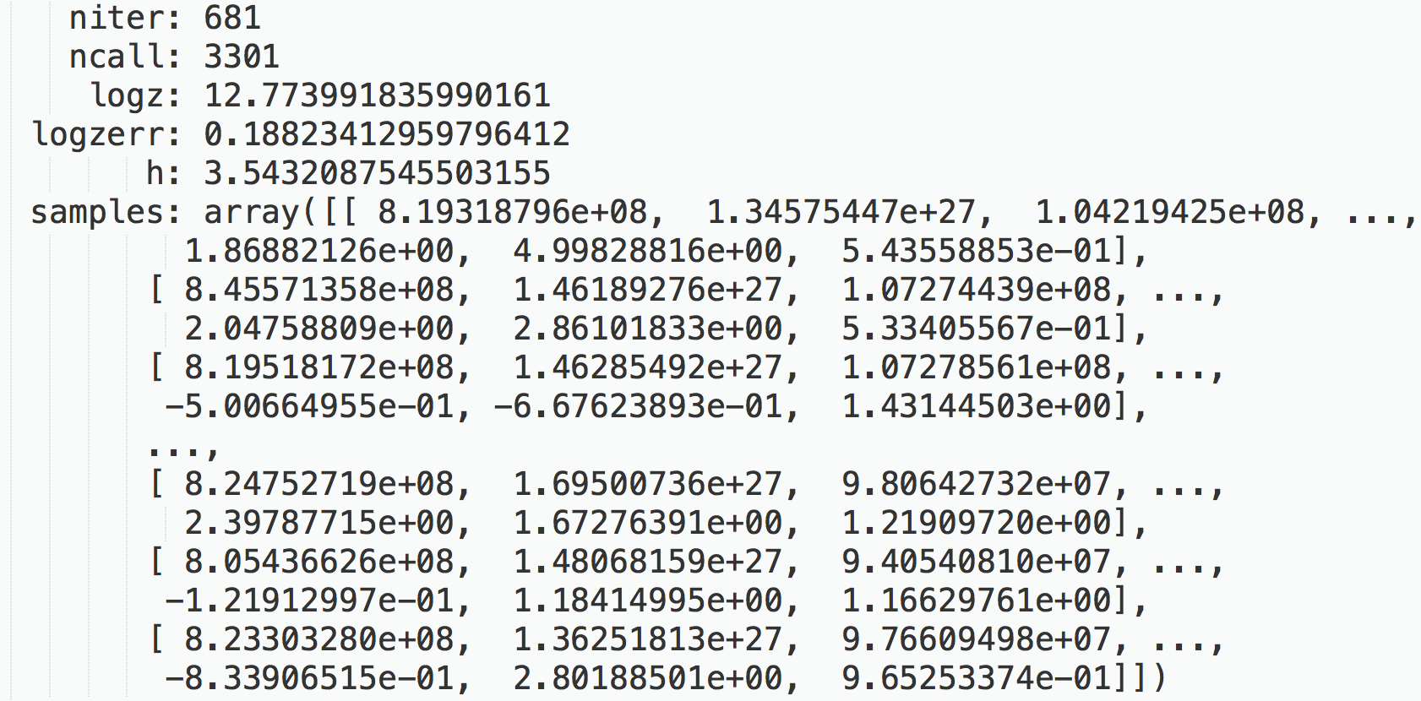
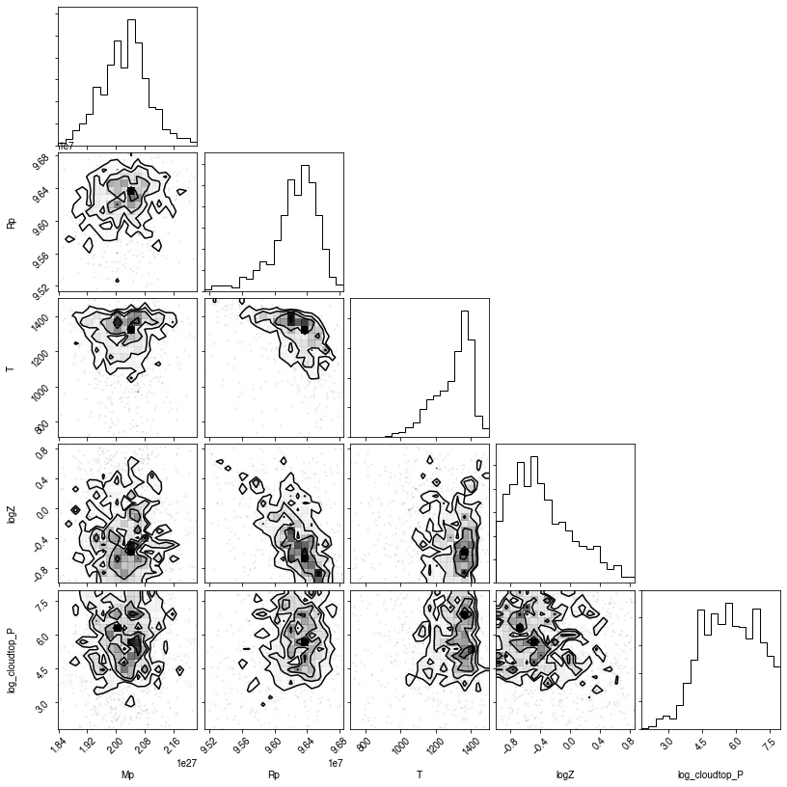
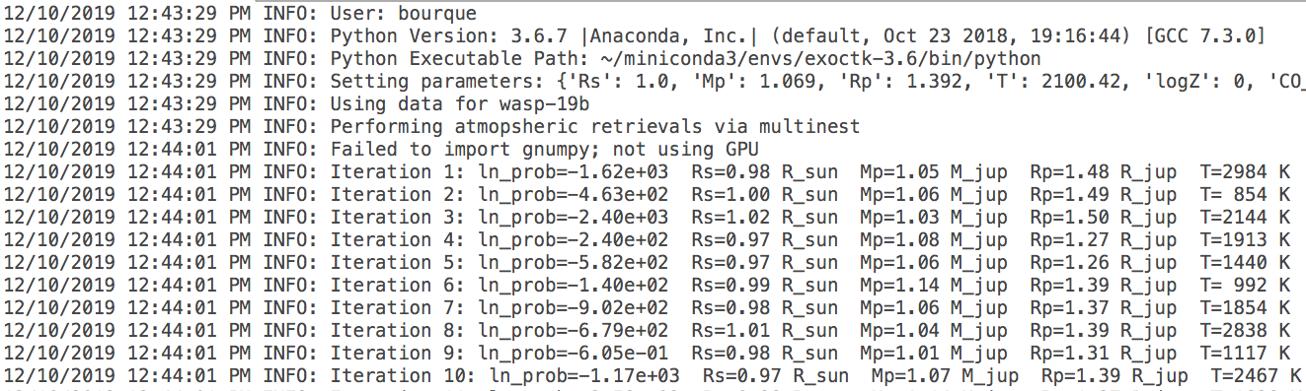
Atmospheric Retrievals with platon and aws: wasp 19b example
Example: wasp 19b
Results file
Log file
Corner plot

Slide 7

Atmospheric Retrievals with platon and AWS
Why use AWS?:
  Atmospheric retrievals can be computationally expensive
  Can be a burden to day-to-day research work
  Outsource computational effort to cloud-based machines for low costs
  For example, a simple AWS machine costs ~$0.023/hour
There will be an optional ~30 minute demo at the end of this workshop that shows how to perform retrievals using AWS!
See also: Enabling Fast Bayesian Exoplanet Atmospheric Retrievals using AWS (poster 109.04; tomorrow 9:00-10:00)

