Slide 1

JavaScript in 10 Slides Eoin Woods & Mike Hempenstall November 2013
Eoin Woods www.eoinwoods.info

Slide 2
What is JavaScript?
Not Java and not a scripting language
A funny little language with 3 core concepts
but one that has had first class functions since inception
Probably the most important language of “now”
ECMA Script
Typescript
Dart
asmjs
Core to our future web user interface development

Slide 3
JavaScript is Small
Basic types
Maps
Functions
… that’s it really
… plus arrays and objects (which are really maps)

Slide 4
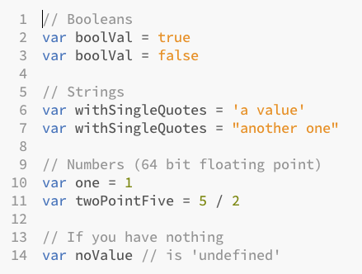
Basic Types

Slide 5
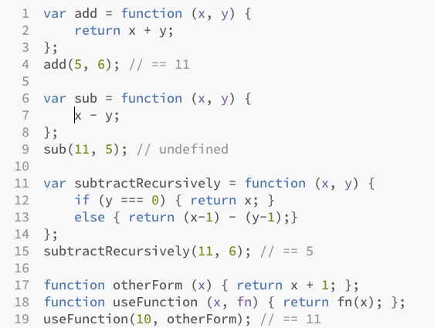
Functions

Slide 6
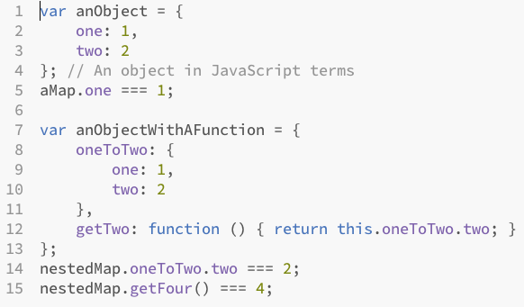
Object (really just maps)

Slide 7
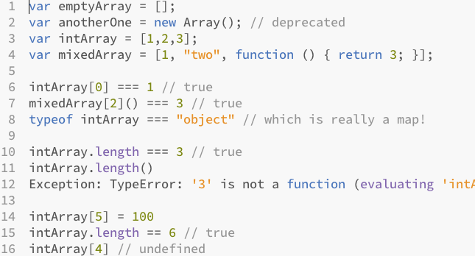
Arrays (really just special maps)

Slide 8
A few things to know
Functions (not braces) define scopes
Use “===“ not “==“ to avoid type conversion
There are no classes but “class” is a keyword
Remember that functions provide scope, not blocks
null is an object (!) undefined means a missing value

Slide 9

More Information
Reference
https://developer.mozilla.org/en-US/docs/Web/JavaScript/Reference)
Learning Advanced JavaScript
http://ejohn.org/apps/learn
Stack Overflow JavaScript Questions
http://stackoverflow.com/questions/tagged/javascript
Doug Crockford's Overview of JavaScript
http://javascript.crockford.com/survey.html
Doug Crockford's JavaScript conventions
http://javascript.crockford.com/code.html
JavaScript the Good Parts on Safari
http://bit.ly/IptYIH

Slide 10
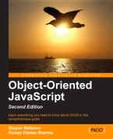


Books
All on Safari here: http://tinyurl.com/p8k2y8k

Slide 11
Questions and Comments?
Eoin Woods www.eoinwoods.info contact@eoinwoods.info

