Slide 1
LANGUAGE NETWORKS
THE SMALL WORLD OF HUMAN LANGUAGE
Akilan Velmurugan
Computer Networks – CS 790G

Slide 2
Overview
Language Network?
  How it is analyzed as a Complex Network
  What are the results
Can it be extended
  Area of study
Compare with wordnet
  Analyze results
Conclusion

Slide 3
Small world of human language
Studies started from 1970’s
  Zifs law: Frequency of words decays as a power function of its rank
Mid 1990’s
  Information transmission are made by words which interact with each other
After 2000s
  Frequency distribution of words
  Word interaction as a complex network
Source: The small world of human language by Ferrer and Sole
Notes:
The co-occurrence of words in sentences relies on the network structure of the lexicon

Slide 4
Word Web of human language
Word web designed by Ferrer I Cancho and Richard V Sole in 2001 consisted 470000 words
Lexicon: set of words
  Language = lexicon + grammar
Vertices of word web are distinct words and the undirected edges are interactions between words
Word web can be considered as a collaboration net where words are collaborators in language
Total number of connections grows unproportionally to the total number of vertices
Source: Evolution of Networks by S.N.Dorogovtsev and J.F.F.Mendes
Notes:
If a pair of distinct words interact at least in one sentence, they are connected by an undirected edge.

Slide 5
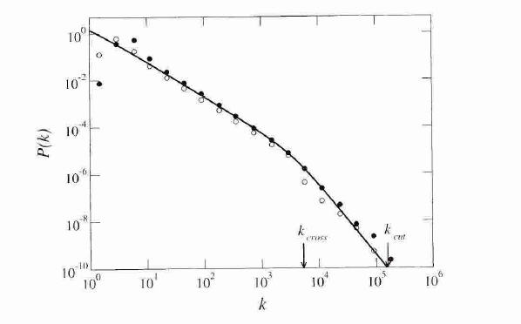
Word Web of human language
Degree distribution of Word Web
  Average number of connections k = 72
    K_{cross} and K_{cut} regions – power law dependence due to size effect
Source: Evolution of Networks by S.N.Dorogovtsev and J.F.F.Mendes
Notes:
Degree distribution of words in word web

Slide 6
Small world of human language
The co-occurrence of words in sentences reflects language organization in a subtle manner that can be described in terms of a graph of word interactions
Properties to be studied
    Small world effect
    Scale free distribution
Source: The small world of human language by Ferrer and Sole

Slide 7
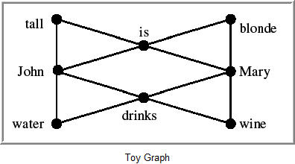
Small world of human language
Co-occurrence between words in the same sentence
  Link between every pair of neighboring words
  Toy graph linking words at a distance of 1 or 2 in the same sentence
Source: The small world of human language by Ferrer and Sole
Notes:
If the distance is long, the risk of capturing spurious co-occurrences increases

Slide 8
Small world of human language
Co-occurrence at a distance of one
  Red flowers
  Stay here
  Getting dark
Co-occurrence at a distance of two
  Hit the ball
  Table of wood
  Live in Nevada
Decide max distance according to min distance of the most co-occurrences
Source: The small world of human language by Ferrer and Sole

Slide 9
Small world of human language
Four fold reasons
  a context of two words is considered to be the lowest distance at which computational linguistics methods can be applied
  Most of the relations exists in with a distance of two which studies the nature of interaction
  Interested in making more links than more relations
  Seeing syntactic dependencies to form the short distance link
Source: The small world of human language by Ferrer and Sole

Slide 10
Small world of human language
Restricted graph (RWN)
      P_{ij} > p_{i}p_{j}
Unrestricted graph (UWN)
      P_{ij} < p_{i}p_{j}
  spurious pair: presence of correlation between pair of words co-occurs less than expected of independent words
Source: The small world of human language by Ferrer and Sole

Slide 11
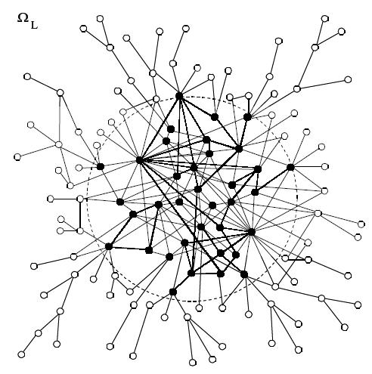

Small world of human language
Graph of human language
- Language set
- mapping into graph
- set of edges
- edge between
Black nodes - common words
White nodes - rare words
Source: The small world of human language by Ferrer and Sole

Slide 12
Small world of human language
Small world effect
  Clustering co-efficient “C”
    Should be higher than for a random graph
    Clustering co-efficient of a random graph = 1.55X10⁻⁴
  Path length “d”
    Should be equal to random graph
    Average path length of a random graph = 3
Source: The small world of human language by Ferrer and Sole

Slide 13
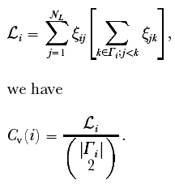

Small world of human language
0 denoting existence of a link
1 denoting existence of a link
Set of nearest neighbors
Clustering co-efficient over W_{L},
Source: The small world of human language by Ferrer and Sole

Slide 14


Small world of human language
Average path length “d”:
- Minimum path length
Average path length of a word,
Overall Average path length,
Source: The small world of human language by Ferrer and Sole

Slide 15
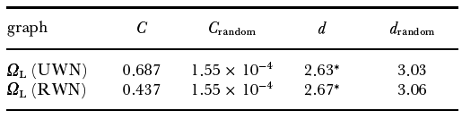
Small world of human language
Criteria for small world network
Results of wordweb
Source: The small world of human language by Ferrer and Sole

Slide 16
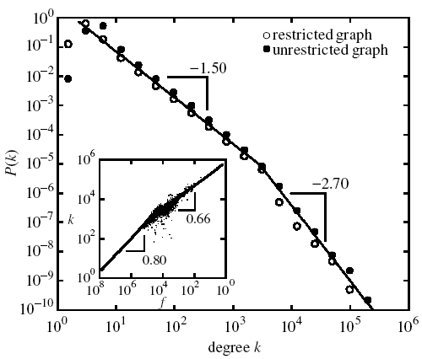
Small world of human language
Source: The small world of human language by Ferrer and Sole

Slide 17
Small world of human language
Source: The small world of human language by Ferrer and Sole

Slide 18
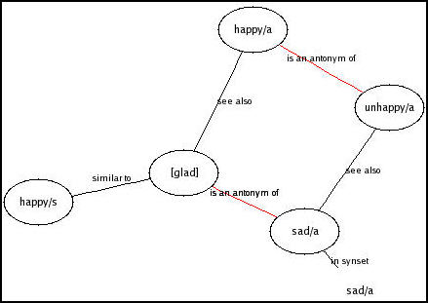
Wordweb Vs Wordnet

Slide 19
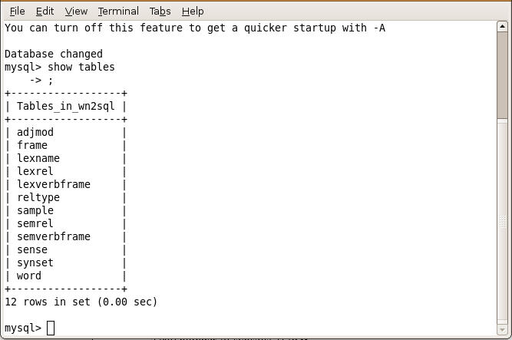
Wordnet dataset

Slide 20
Wordnet analysis
Total number of words: 148730
Total number of synsets: 117658
Statistical analysis of the output characteristics taking single relation to form a complex network
Cause of small world property in comparison with thesaurus

Slide 21


Questions and Comments

