Slide 1
Western Blot IRS1 after WYE-132 treatment, D013T

Slide 2
1st Replicate

Slide 3
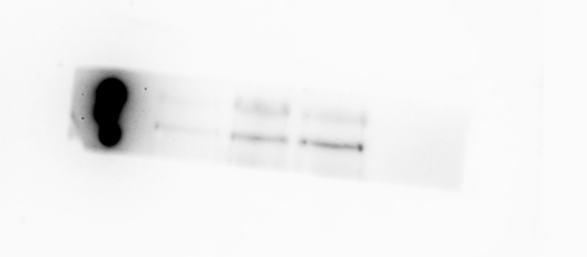
IRS-1-15 Min-P013
kD
245
180
140
DMSO
1µM WYE
5µM WYE

Slide 4
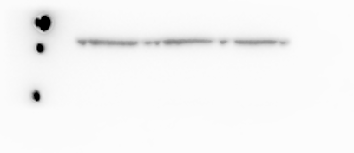
HSP-90-15 sek.
100
75
60

Slide 5
2nd Replicate

Slide 6
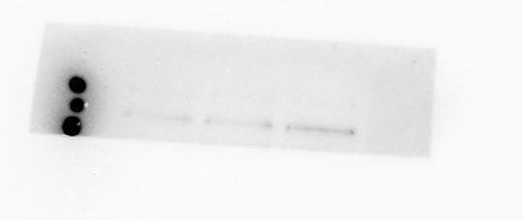
D013T01-12Min-IRS-1
kD
245
180
140
DMSO
1µM WYE
5µM WYE

Slide 7
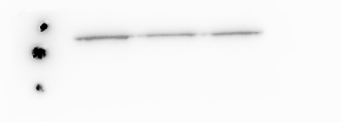
D013T01-HSP90
KD
100
75
60
DMSO
1µM WYE
5µM WYE

Slide 8
3rd Replicate

Slide 9
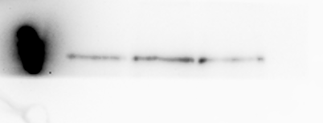
D013T01_WYE_IRS-1_10min
245
180
140
DMSO
1µM WYE
5µM WYE

Slide 10
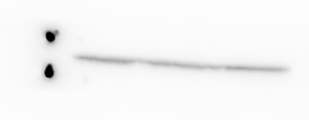
D013T01_WYE_HSP90_10 sec
100
75
DMSO
1µM WYE
5µM WYE

