Slide 1
TypeScript

Slide 2
What is it?
Typed superset of JavaScript
Is built on, and compiles to, JavaScript
Supports any ES3-compatible environment

Slide 3
What does it give me?
Type safety
Modules, classes (with constructors and public/private members), enums, interfaces, generics, and lambdas
Auto completion (IntelliSense) in your favourite IDE

Slide 4
What do I need to run it?
Compiles from any command line on any OS
Node/npm
Bext experience in:
Visual Studio
IntelliJ / WebStorm
Eclipse
SublimeText 2/3
Emacs
Vim
... But any text editor + command line works

Slide 5
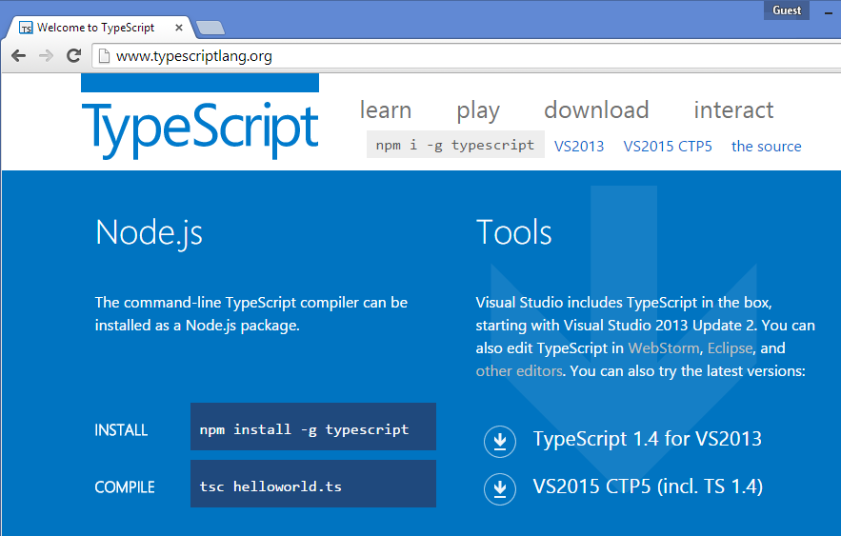
Installation: Visual Studio
You probably have it! (VS 2013 Update 2 and later)

Slide 6
Installation: IntelliJ / WebStorm

Slide 7
Installation: SublimeText 3

Slide 8
Installation: node/npm and cmd

Slide 9
The basics: Types
Any // Base type for all types
Var something; // Infered to any
String
Var name: string

Slide 10
The basics
var age = 18; // Type inference. TypeScript gives it the type number
var age: number = 18; // Exact same thing, but we declare this to be of the number type.

Slide 11
The basics
Var func = function(n1: number, n2: number){
Return n1 + n2;
}
Func: (n: number, n: number) => void = function(n1, n2){
}

Slide 12
Modules: teach me!
Is an encapsulated scope with functions
Not instantiated/«new’ed up»
You call the functions directly on the module.
Equivalent to a module in F#
Kind off like a static class in C#

Slide 13
Modules: show me!

Slide 14
Classes: teach me!
Equivalent to a class in C# or Java
Create instances
Call functions on an instance
Can have private and public members.
Supports ES6 class

Slide 15
Classes: show me!

Slide 16
Enums: teach me!

Slide 17
Enums: show me!

Slide 18
Interfaces: teach me!

Slide 19
Interfaces: show me!

Slide 20
Generics: teach me!

Slide 21
Generics: show me!

Slide 22
Lambdas: teach me!

Slide 23
Lambdas: show me!

