Slide 1
TypeScript

Slide 2
What is it?
Typed superset of JavaScript
Is built on, and compiles to, JavaScript
Supports any ES3 to ES6-compatible environment

Slide 3
What does it give me?
Type safety
Modules, classes (with constructors and public/private members), enums, interfaces, generics, and lambdas
Auto completion (IntelliSense) in your favourite IDE

Slide 4
What do I need to run it?
Compiles from any command line on any OS
Not required, but strongly recommended: node/npm
Bext experience in:
Visual Studio
IntelliJ / WebStorm
Eclipse
SublimeText 2/3
Emacs
Vim
... But any text editor + command line works

Slide 5
Installation: Easiest solution
npm install –g typescript
Ensure tsc.exe is on your PATH by: tsc --version in command line
Use automation tool grunt or gulp to automatically build .ts to .js on file changes.

Slide 6
Tool support
Automatically build .ts to .js when saving a file
If using grunt or gulp, ignore the next slides...

Slide 7
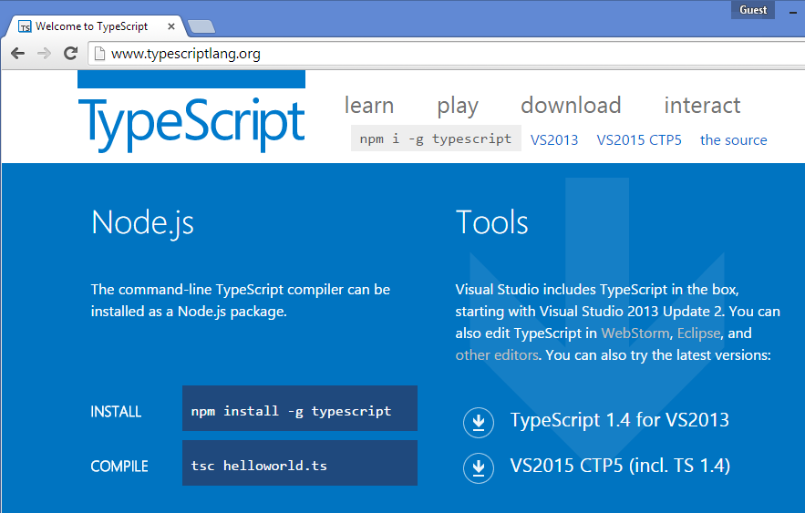
Tool support: Visual Studio
TypeScript ships with VS 2013 Update 2 and later
But you may need to download 1.4 separately (ships with Update 4)

Slide 8
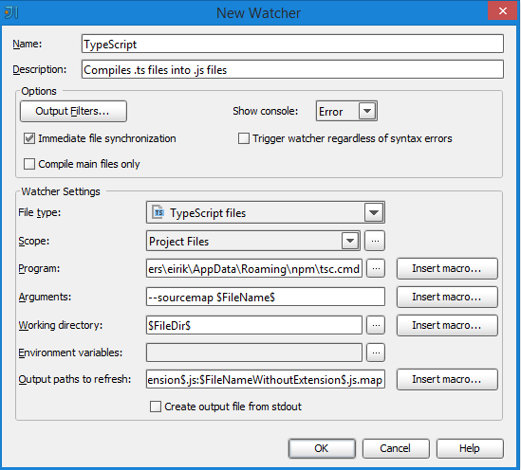
Installation: IntelliJ / WebStorm
In IntelliJ: File -> Settings -> [IDE Settings] Plugins -> Browse Repositories -> Search «file watchers». Install File Watchers plugin.
Auto detection:
If no auto detect pops up, see next slide...

Slide 9
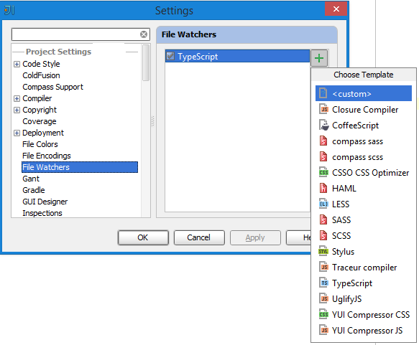
Installation: IntelliJ / WebStorm
Add a File Watcher manually:
File -> Settings -> [Project Settings] File Watchers -> Add -> TypeScript

Slide 10
Installation: SublimeText 3
Tools -> Build Systems -> New Build System -> Copy & paste content from «typescript.sublime-build» file in git repo
Set as default build system, build with ctrl+b

Slide 11
Installation: node/npm and cmd
With node/npm: npm install –g typescript
By downloading and running installer:

Slide 12
Language features

Slide 13
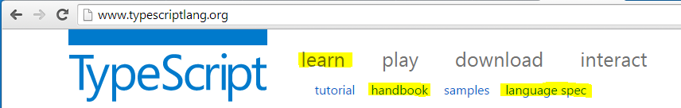
Resources

Slide 14
Yay, code!
\CheatSheet\src\typescript-cheatSheet.ts

Slide 15
Definition files
.d.ts
Provides typed definitions of existing libraries
Jquery, bootstrap, angular, knockout, etc
Provides auto completion for the IDE
Referenced in a .ts file
/// <reference path="../scripts/typings/jquery.d.ts" />

Slide 16
Definition files
https://github.com/borisyankov/DefinitelyTyped

Slide 17
AngularJS

Slide 18
What is it?
Single Page Application
A web page that acts like its a single page
Google mail
By Google

Slide 19
Why should I care?
Separation of concerns: MVV*, models - views – controllers
Separates the javascript from html
Dependency injection and testability
Directives, async promises, two-way model binding

Slide 20
When should I use it?
It’s a framework for building a full-size SPA
Use it if you’re building a full SPA site.
Other, great libraries for two-way binding and async promises.
Taking dependency on Angular for just a fraction of its features is unnecessary

Slide 21
More code please!
\CheatSheet\src\angularjs-cheatSheet.ts
(plain java script)

Slide 22
LibraryApp

Slide 23
The domain
Simple web application for a library
Basic functions:
Search for books
Rent a book
Deposit a book
See status for a rented book

Slide 24
Your options
Work with the C# solution
Work with the Java solution
Work with the nodejs solution

Slide 25
Out of the box for all solutions
AngularJS is wired with:
Routing
A directive
A service
Views with controllers
The search for books feature is implemented for reference

Slide 26
The backend
Don’t worry about it!
http://openmockapi.azurewebsites.net

Slide 27
Optional: gulp & node
The automation framework gulp is present for all solutions
The default gulp command will rebuild all .ts files
The gulp watch command will watch for, and build on changes
Readme.txt
Explore the gulpfile.js

Slide 28
Show me the code
A quick tour

Slide 29
Show me the code
git clone https://github.com/eaardal/booster-typescript-angularjs
...\LibraryApp\CSharp\
...\LibraryApp\Java\
...\LibraryApp\Node\

