Slide 1
TypeScript

Slide 2
What is it?
Typed superset of JavaScript
Is built on, and compiles to, JavaScript
Supports any ES3 to ES6-compatible environment

Slide 3
What does it give me?
Type safety at compile time
Modules, classes (with constructors and public/private members), enums, interfaces, generics, and lambdas
Auto completion (IntelliSense) in your favourite IDE

Slide 4
What do I need to run it?
Compiles from any command line on any OS
Not required, but strongly recommended: node/npm
Bext experience in:
Visual Studio
IntelliJ / WebStorm
Eclipse
SublimeText 2/3
Emacs
Vim
... But any text editor + command line works

Slide 5
Installation: Easiest solution
npm install –g typescript
Ensure tsc.exe is on your PATH by: tsc --version in command line
Use automation tool grunt or gulp to automatically build .ts to .js on file changes.
SublimeText

Slide 6
Tool support
Automatically build .ts to .js when saving a file
If using grunt or gulp, ignore the next slides...

Slide 7
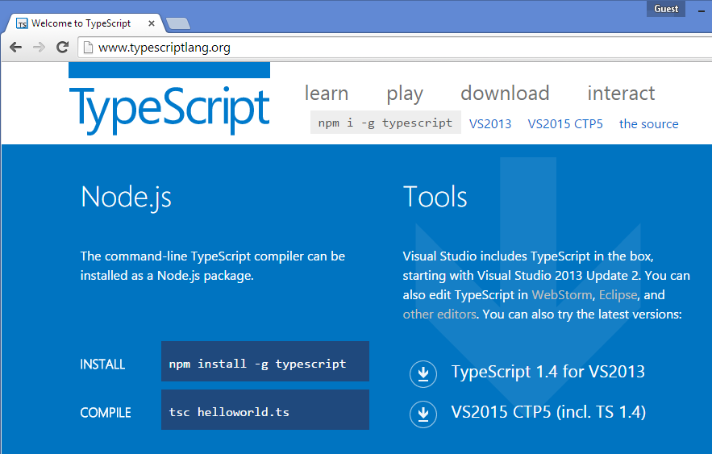
Tool support: Visual Studio
TypeScript ships with VS 2013 Update 2 and later
But you may need to download 1.4 separately (ships with Update 4)

Slide 8
Tool support: Visual Studio
TypeScript 1.0 ships with VS 2013 Update 2
TypeScript 1.4 is the latest
Some work might be required to make VS use correct version
Ensure correct version by cmd: tsc --version
Download latest TS from http://typescriptlang.org
Ensure tsc is on your PATH

Slide 9
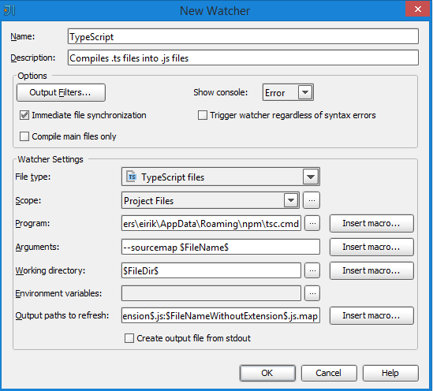
Tool support: IntelliJ / WebStorm
In IntelliJ: File -> Settings -> [IDE Settings] Plugins -> Browse Repositories -> Search «file watchers». Install File Watchers plugin.
Auto detection:
If no auto detect pops up, see next slide...

Slide 10
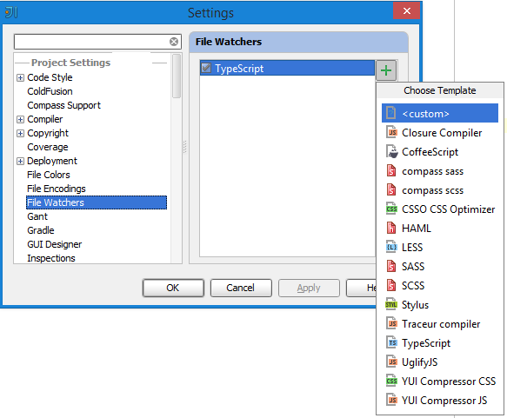
Tool support: IntelliJ / WebStorm
Add a File Watcher manually:
File -> Settings -> [Project Settings] File Watchers -> Add -> TypeScript

Slide 11
Tool support: SublimeText 3
Tools -> Build Systems -> New Build System -> Copy & paste content from «typescript.sublime-build» file in git repo
Set as default build system, build with ctrl+b

Slide 12
Installation: node/npm and cmd
With node/npm: npm install –g typescript
By downloading and running installer:

Slide 13
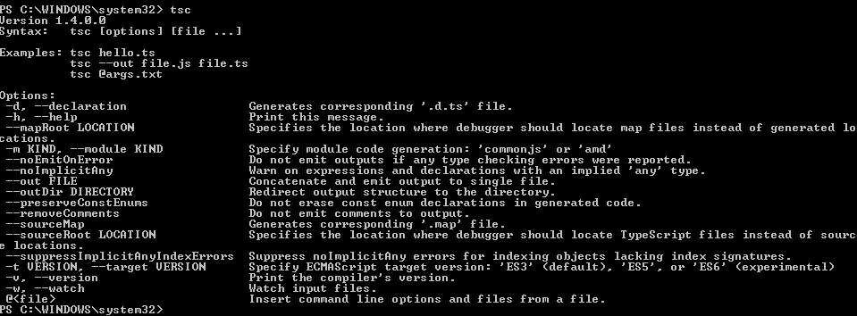
Command line demo
How to compile .ts from command line

Slide 14
Language features

Slide 15
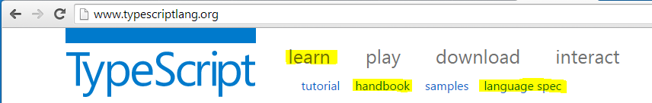
Resources

Slide 16
Yay, code!
\CheatSheet\src\typescript-cheatSheet.ts

Slide 17
Definition files
.d.ts
Provides typed definitions of existing libraries
Jquery, bootstrap, angular, knockout, etc
Provides auto completion for the IDE
Referenced in a .ts file
/// <reference path="../scripts/typings/jquery.d.ts" />

Slide 18
Definition files
https://github.com/borisyankov/DefinitelyTyped

Slide 19
AngularJS

Slide 20
What is it?
Single Page Application
A web page that acts like its a single page
Google mail
By Google

Slide 21
Why should I care?
Separation of concerns: MVV*, models - views – controllers
Separates the javascript from html
Dependency injection and testability
Directives, async promises, two-way model binding

Slide 22
When should I use it?
It’s a framework for building a full-size SPA
Use it if you’re building a full SPA site.
Other, great libraries for two-way binding and async promises.
Taking dependency on Angular for just a fraction of its features is unnecessary

Slide 23
More code please!
\CheatSheet\src\angularjs-cheatSheet.ts
(plain java script)

Slide 24
LibraryApp

Slide 25
The domain
Simple web application for a library
Basic functions:
Search for books
Rent a book
Deposit a book
See status for a rented book

Slide 26
Your options
Work with the C# solution
Work with the Java solution
Work with the nodejs solution

Slide 27
Out of the box for all solutions
AngularJS is wired with:
Routing
A directive
A service
Views with controllers
The search for books feature is implemented for reference

Slide 28
The backend
Don’t worry about it!
http://openmockapi.azurewebsites.net

Slide 29
Optional: gulp & node
The automation framework gulp is present for all solutions
The default gulp command will rebuild all .ts files
The gulp watch command will watch for, and build on changes
Readme.txt
Explore the gulpfile.js

Slide 30
Show me the code
A quick tour

Slide 31
Show me the code
git clone https://github.com/eaardal/booster-typescript-angularjs
...\LibraryApp\CSharp\
...\LibraryApp\Java\
...\LibraryApp\Node\

