Slide 1
TypeScript

Slide 2
What is it?
Typed superset of JavaScript
Is built on, and compiles to, JavaScript
Supports any ES3 to ES6-compatible environment

Slide 3
What does it give me?
Type safety
Modules, classes (with constructors and public/private members), enums, interfaces, generics, and lambdas
Auto completion (IntelliSense) in your favourite IDE

Slide 4
What do I need to run it?
Compiles from any command line on any OS
Node/npm
Bext experience in:
Visual Studio
IntelliJ / WebStorm
Eclipse
SublimeText 2/3
Emacs
Vim
... But any text editor + command line works

Slide 5
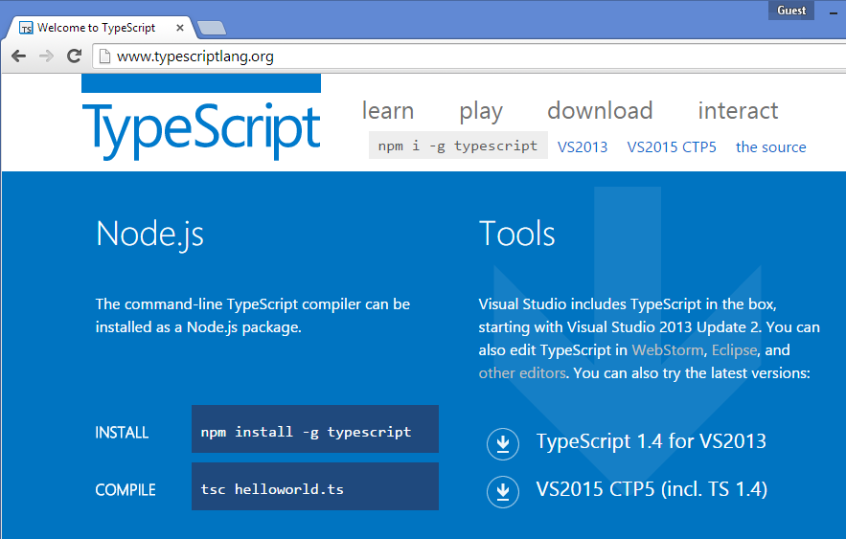
Installation: Visual Studio
You probably have it! (VS 2013 Update 2 and later)

Slide 6
Installation: IntelliJ / WebStorm

Slide 7
Installation: SublimeText 3

Slide 8
Installation: node/npm and cmd

Slide 9
The basics: Types
Any // Base type for all types
Var something; // Infered to any
String
Var name: string

Slide 10
The basics
var age = 18; // Type inference. TypeScript gives it the type number
var age: number = 18; // Exact same thing, but we declare this to be of the number type.

Slide 11
The basics
Var func = function(n1: number, n2: number){
Return n1 + n2;
}
Func: (n: number, n: number) => void = function(n1, n2){
}

Slide 12
Modules: teach me!
Is an encapsulated scope with functions
Not instantiated/«new’ed up»
You call the functions directly on the module.
Equivalent to a module in F#
Kind off like a static class in C#

Slide 13
Modules: show me!

Slide 14
Classes: teach me!
Equivalent to a class in C# or Java
Create instances
Call functions on an instance
Can have private and public members.
Supports ES6 class

Slide 15
Classes: show me!

Slide 16
Enums: teach me!

Slide 17
Enums: show me!

Slide 18
Interfaces: teach me!

Slide 19
Interfaces: show me!

Slide 20
Generics: teach me!

Slide 21
Generics: show me!

Slide 22
Lambdas: teach me!

Slide 23
Lambdas: show me!

Slide 25
LibraryApp:

Slide 26
LibraryApp

Slide 27
The domain
Simple web application for a library
Basic functions:
Search for books
Rent a book
Deposit a book
See status for a rented book

Slide 28
Your options
Work with the C# solution
Work with the Java solution
Work with the nodejs solution

Slide 29
Out of the box for all solutions
AngularJS is wired with:
Routing
A directive
A service
Views with controllers
The search for books feature is implemented for reference

Slide 30
The backend
Don’t worry about it!
http://openmockapi.azurewebsites.net/library

Slide 31
Optional: gulp & node
The automation framework gulp is present for all solutions
The default gulp command will rebuild all .ts files
The gulp watch command will watch for, and build on changes
Readme.txt
Explore the gulpfile.js

Slide 32
Show me the code
https://github.com/eaardal/booster-typescript-angularjs
...\LibraryApp\CSharp\
...\LibraryApp\Java\
...\LibraryApp\Node\

