Slide 1
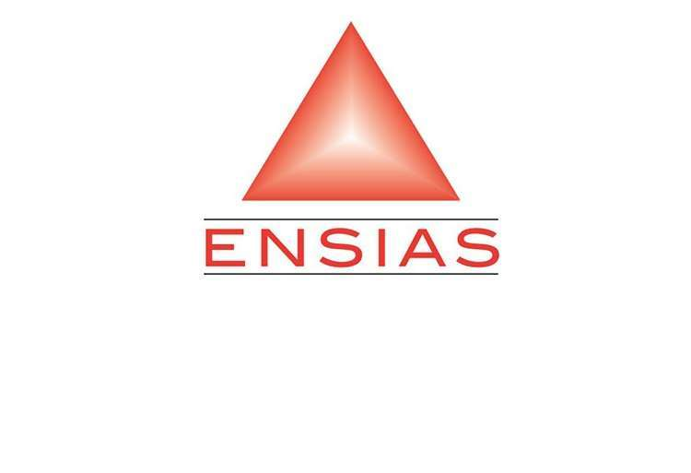

Ingénierie en Data Science and IOT
End Year Project
Generic Patient-Centered Blockchain
Based Electronic Health Record (EHR)
Management System
Defensed By :
BOUZID Abdelfattah .
Supervised by :
Pr. Jamal EL HACHMI
Jury:
Pr. Jamal EL HACHMI
Pr. Abdellatif KOBBANE
Academic Year 2024-2025
Notes:
presentation

Slide 2
Plan:
Introduction
Project Context
Project design
Realization : demo
Conclusion and perspectives

Slide 3
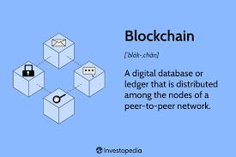
Introduction
Project context
Project design
Realization
Conclusion and perspectives
Introduction
Blockchain definition

Slide 4
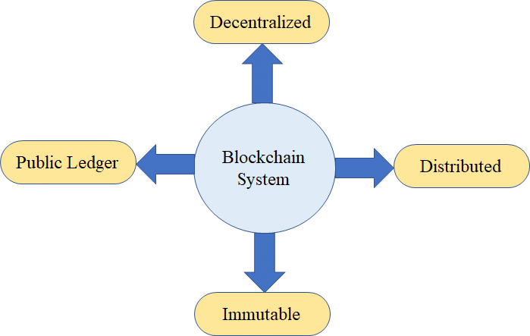
Introduction
Project context
Project design
Realization
Conclusion and perspectives
Introduction
Blockchain definition
Characteristics of Blockchain

Slide 5
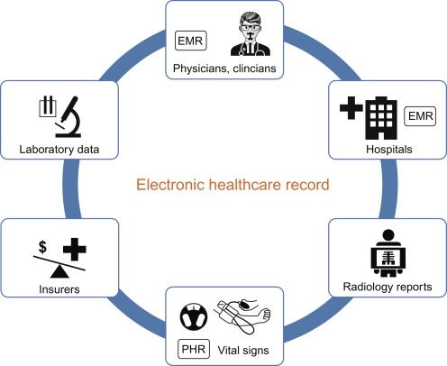
Project design
Realization
Introduction
Project context
Conception du projet
Présentation de la solution
Contexte général du projet
Conclusion and perspectives
Electonic Health Record Management (EHRM) .
Electronic Health Record (EHR)

Slide 6
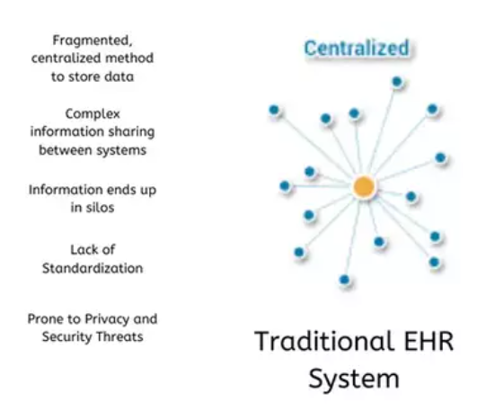
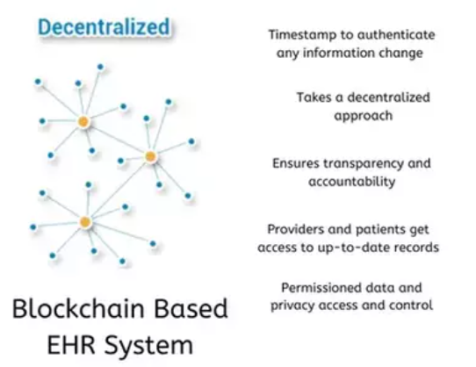
Introduction
Project context
Project design
Realization
Conclusion and perspectives
Problematic

Slide 7
Introduction
Project context
Project design
Realization
Conclusion and perspectives
Project objectives
Proposition of a model and architecture of EHRM based ethereum blockchain technology with a modest implementation in Web3
Motivations
State of the Art: We survey the state of the art, which focuses on background information. about blockchain technology and blockchain used in e-health for securing EHR data in MOROCCO.
Proposed Model : provides a conceptual scenario overview and outlines software components to demonstrate EHRM based Ethereum blockchain .
Implementation :Implement the proposed model and architecture with descentralized app that manage a patients and doctors records a through ethereum blockchain network.

Slide 8
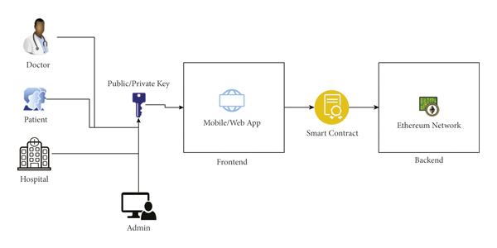

Introduction
Project context
Project design
Realization
Conclusion and perspectives
Proposed System
Architecture of our system

Slide 9
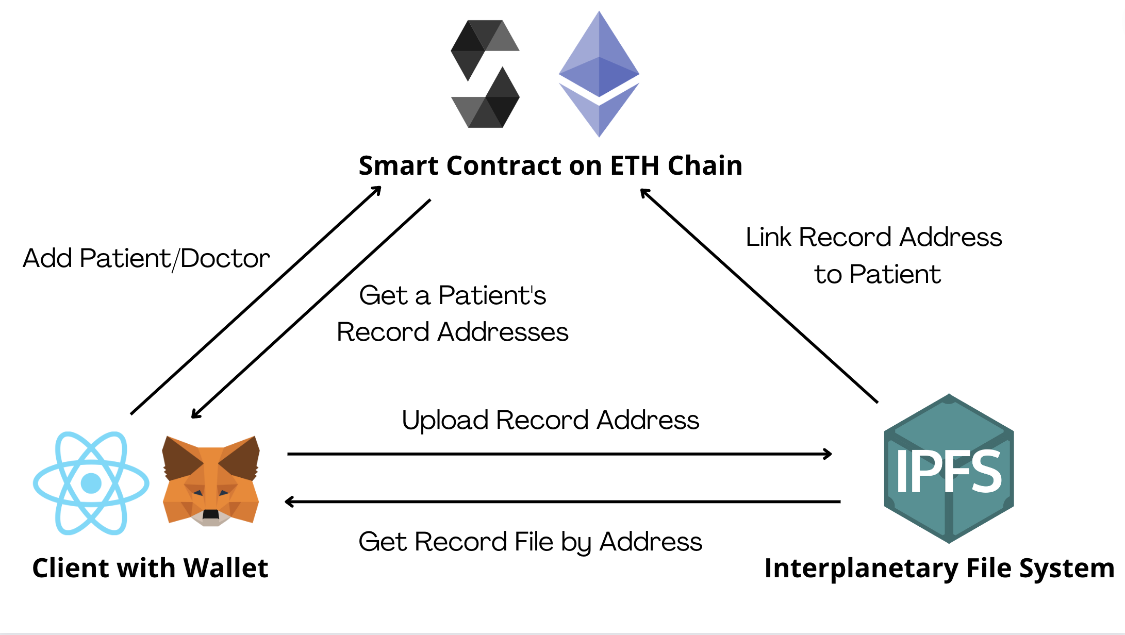
Introduction
Context project
Project design
Realization
Conclusion and perspectives
Path of request
Interactions between the three compoents of our system

Slide 10
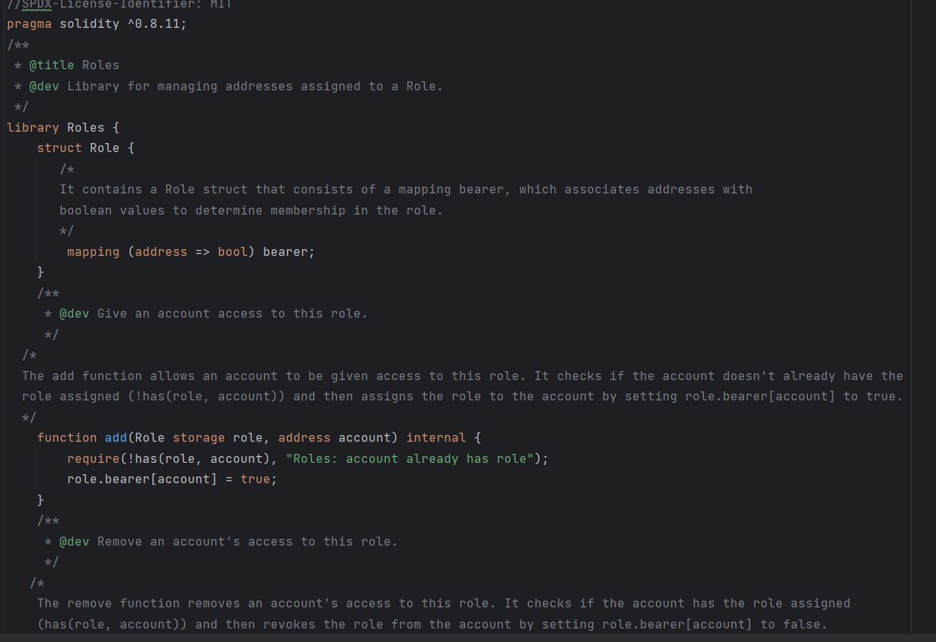
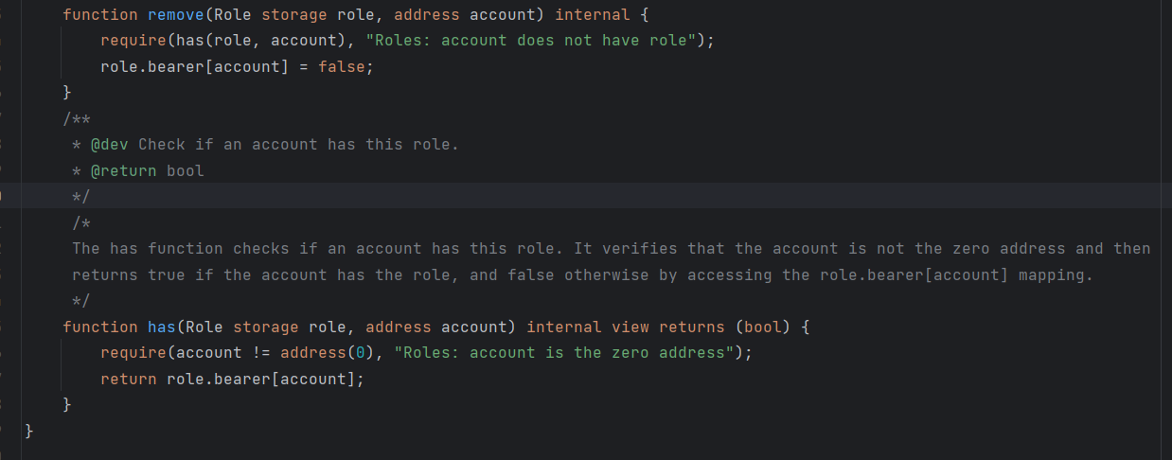
Introduction
Context project
Project design
Realization
Conclusion and perspectives
Smart Contract (SC)
SC : Roles.sol
SC : Roles.sol

Slide 11
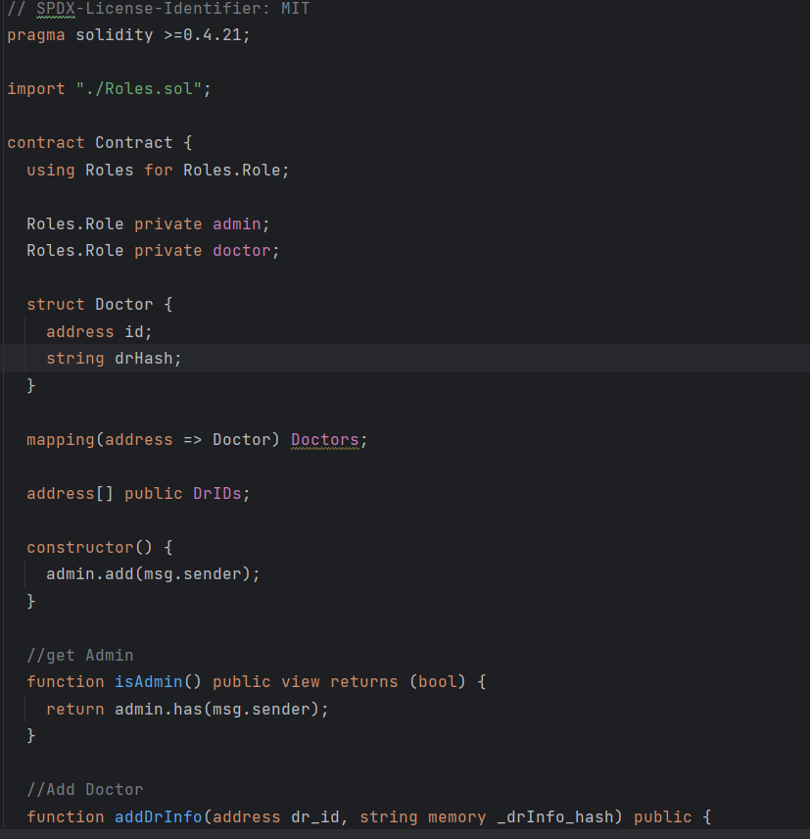
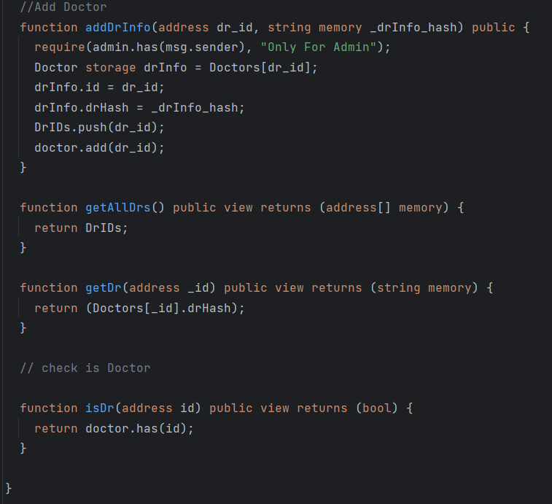
Introduction
Context project
Project design
Realization
Conclusion and perspectives
Smart Contract (SC)
SC : Contract.sol
SC : Contract.sol

Slide 12
Introduction
Context project
Project design
Realization
Conclusion and perspectives
Demo
D:\3A_2023\3A\Projet S5\video

Slide 13
Introduction
Project context
Project design
Realization
Conclusion and perspectives
Conclusion & perspectives
It is important to acknowledge that this is just the beginning of a more extensive and comprehensive system. Several aspects can be further developed and enhanced to achieve a fully functional and scalable EHR management solution.
Enhanced this Dapp of EHRM based blockchain ethereum .
Extensions for others domains .
Collaboration with others experts .

Slide 14
Introduction
Project context
Project design
Realization
Conclusion and perspectives
References :
https://www.researchgate.net/figure/EHR-architecture-of-our-system_fig1_358356059
https://www.researchgate.net/figure/Characteristics-of-Blockchain_fig1_338365570
https://www.sciencedirect.com/topics/engineering/electronic-health-record
https://blockchain.oodles.io/blog/blockchain-healthcare-data-management-ehrs/

Slide 15
Introduction
Project context
Project design
Realization
Conclusion and perspectives
THANKS

