Slide 1

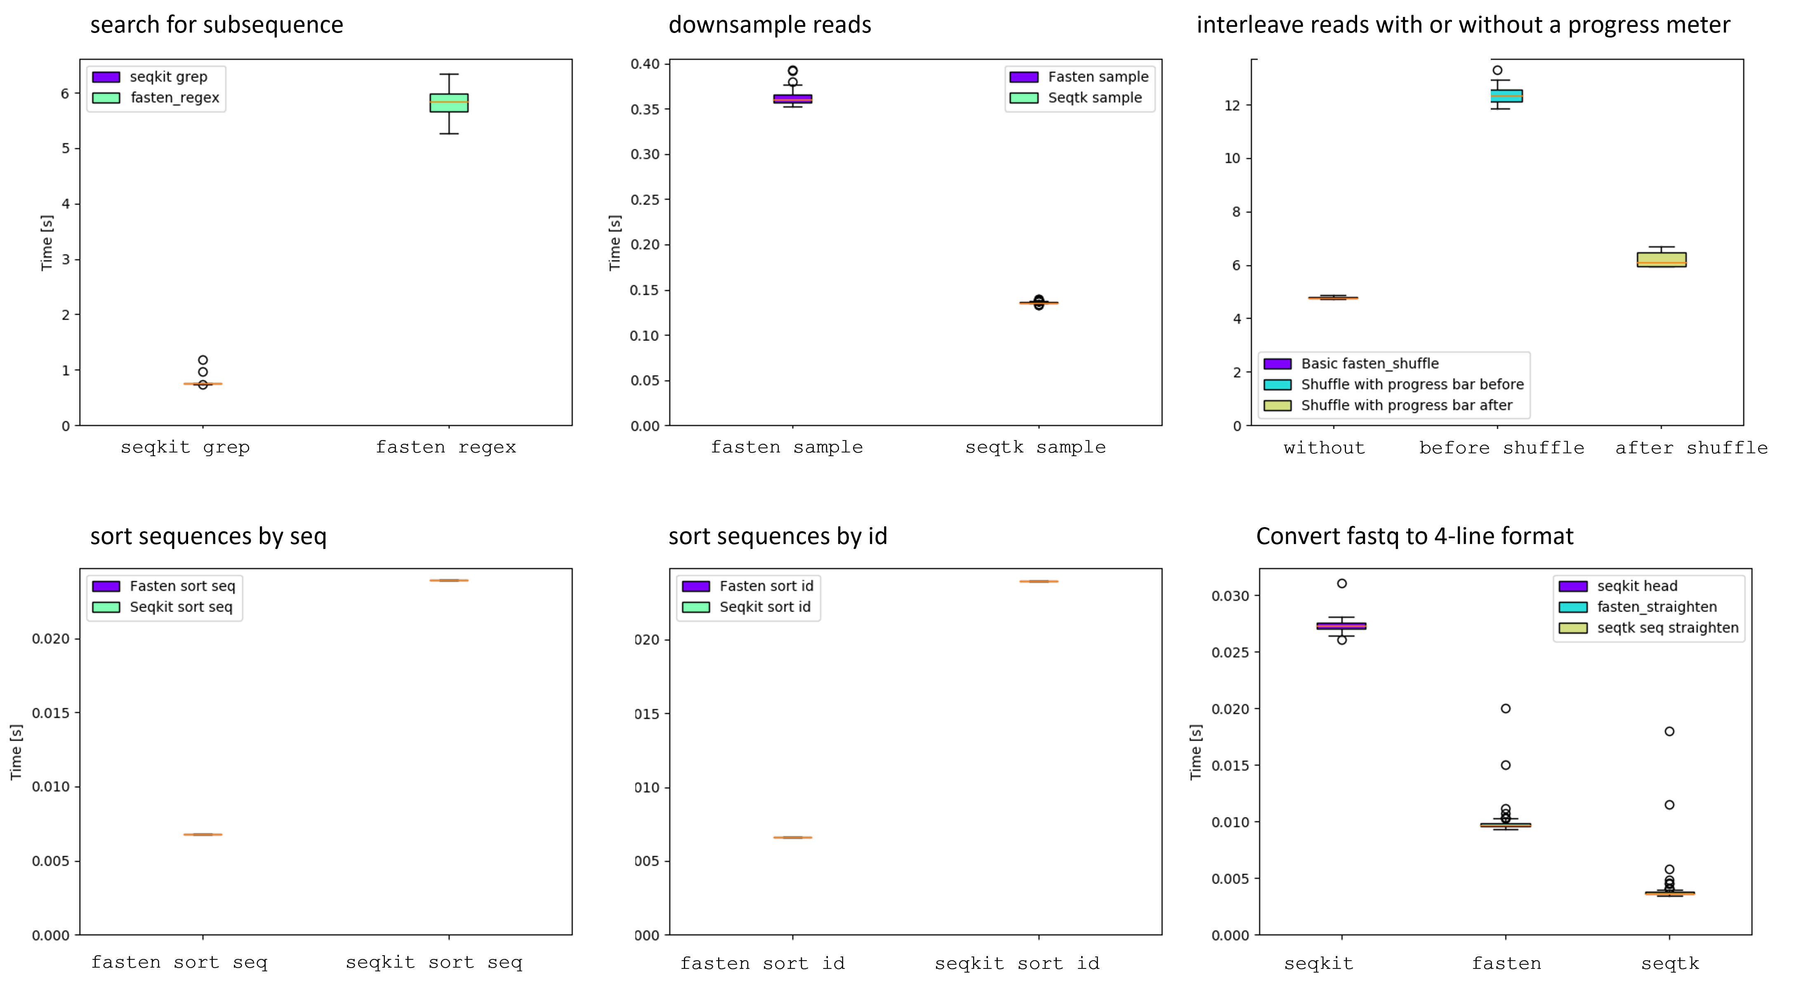

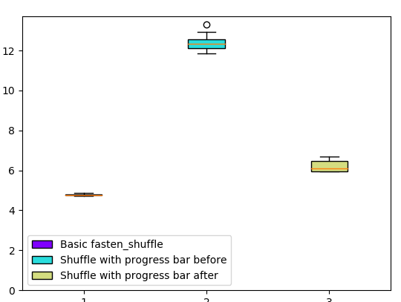

Fasten with Pipes Lee S. Katz^{1,2}, Henk C. den Bakker² ¹ Enteric Diseases Laboratory Branch (EDLB), Centers for Disease Control and Prevention, Atlanta, GA, USA ² Center for Food Safety, University of Georgia, Griffin, GA, USA
Poster # L033
Perform random operations on fastq files, using unix streaming. Secure your analysis with Fasten!
Use this area for key message only. Set the font to be as large as possible, and rely on compelling photo or artwork to emphasize.
BACKGROUND
There are still many gaps for basic bioinformatics on the command line for standard file formats. Bioinformaticians have been able to use many tools to manipulate sequence data files in the fastq format, such as seqkit, seqtk or FASTX-Toolkit. These tools only accept paired end (PE) sequence data when split into multiple files per sample. However, some bioinformaticians prefer to combine PE data from a single sample into one file using the interleaved fastq file format, but this format is not well supported in mainstream tools. Here, we provide Fasten to the community to address these needs.
METHODS
We leveraged the Cargo packaging system in Rust to create a basic framework for interleaved fastq file manipulation. Each executable reads from stdin and prints reads to stdout and only performs one function at a time. The core executables perform these fundamental functions: 1) converting to and from interleaved format, 2) converting to and from other sequence file formats, 3) ‘straightening’ fastq files to a more standard 4-line-per-entry format.
There are 18 executables including but not limited to read metrics, read cleaning, kmer counting, read validation, and regular expressions for interleaved fastq files. We have also taken advantage of Rust to make comprehensive and standardized documentation. Continuous integration was implemented in GitHub Actions for unit testing, containerizing, and benchmarking. Benchmarking was performed against other mainstream packages using hyperfine using 100 replicates and 2 burn-ins.
FINDINGS
Documentation, the container, and code are available at GitHub. Benchmarking results are presented in Figure 1.
WEBSITE
Software https://github.com/fasten
Documentation https://lskatz.github.io/fasten/fasten
EXAMPLES
Read Metrics
$ zcat cleaned.shuffled.fastq.gz | fasten_metrics | column -t
totalLength numReads avgReadLength avgQual
800 8 100 19.53875
# No reads were actually filtered with cleaning, with --min-length=2
Read Cleaning
$ cat testdata/R1.fastq testdata/R2.fastq | \
fasten_shuffle | \
fasten_clean --paired-end --min-length 2 | \
gzip -c > cleaned.shuffled.fastq.gz
Filter for reads with a motif
cat interleaved.fastq | \
fasten_regex --which SEQ --regex ATAT --paired-end | \
> atat-motif.fastq
Get a random paired end read
cat interleaved.fastq | \
fasten_randomize --paired-end | \
head -n 8 > one_pair.fastq
Figures
Figure 1. Six timed benchmarks. A) Searching for a sequence in a fastq file with either seqkit grep or fasten_regex; B) downsampling reads using either fasten sample or seqtk sample; C) sorting fastq entries by sequence with fasten_sort or seqkit sort; D) sorting sequences by id; E) interleaving reads from R1 and R2 files not using fasten_progress, using it before shuffle, or using it after shuffle; and F) converting nonstandard fastq files to a format whose entries are four lines each.
A
B
seqkit grep fasten regex fasten sample seqtk sample
C
D
PRIMARY and SECONDARY COLORS
fasten sort seq seqkit sort seq fasten sort id seqkit sort id
E
F
Basic fasten_shuffle before after seqkit fasten seqtk
SCAN HERE FOR MORE INFORMATION
CONTACT INFO
Lee Katz
gzu2@cdc.gov

