Slide 1
Monitoring, Service Discovery, Containers
Joshua Boverhof

Slide 2
Download
Docker OSX
https://github.com/boot2docker/osx-installer/releases

Slide 3
Outline
ELK Stack
Basic monitoring setup
NERSC Monitoring Setup
Heka, RabbitMQ
Service Discovery
Hashicorp Consul, python zeroconf, Apple Bonjour, Apache Zookeeper, Etcd
Simple solution use DNS (Cnames), Load balancer, proxies. Add a new record load balancer picks it up.
LUA/NGINX load balancer
Example, “rabbit1.internal.nersc.gov”

Slide 4
Outline
Docker
Docker-compose
Create distributed application
Ephemeral/stateless container architectures
Storage plugin (secure) implementations emerging
Open Container Format
Container Specification Controlled by Linux Foundation
runC:
donated as reference implementation
Networking
Span networks across multiple hosts
Swarm
Scheduling containers, scaling, multiple hosts
Plugins
Network, schedule, storage,etc
Notary
Signing/verifying containers
Can use on dockerhub

Slide 5
ELK: Lumberjack/logstash-forwarder
elastic
Logstash
Logstash
Logstash
syslog
IIS
application
Kibana

Slide 6
Lumberjack forwarder
boverhof@ferb:~$ cat /etc/logstash/conf.d/01-lumberjack-input.conf
input {
lumberjack {
port => 5000
ssl_certificate => "/etc/pki/tls/certs/logstash-forwarder.crt"
ssl_key => "/etc/pki/tls/private/logstash-forwarder.key"
}
}
boverhof@ferb:~$ cat /etc/logstash/conf.d/30-lumberjack-output.conf
output {
elasticsearch { host => localhost }
stdout { codec => rubydebug }
}

Slide 7
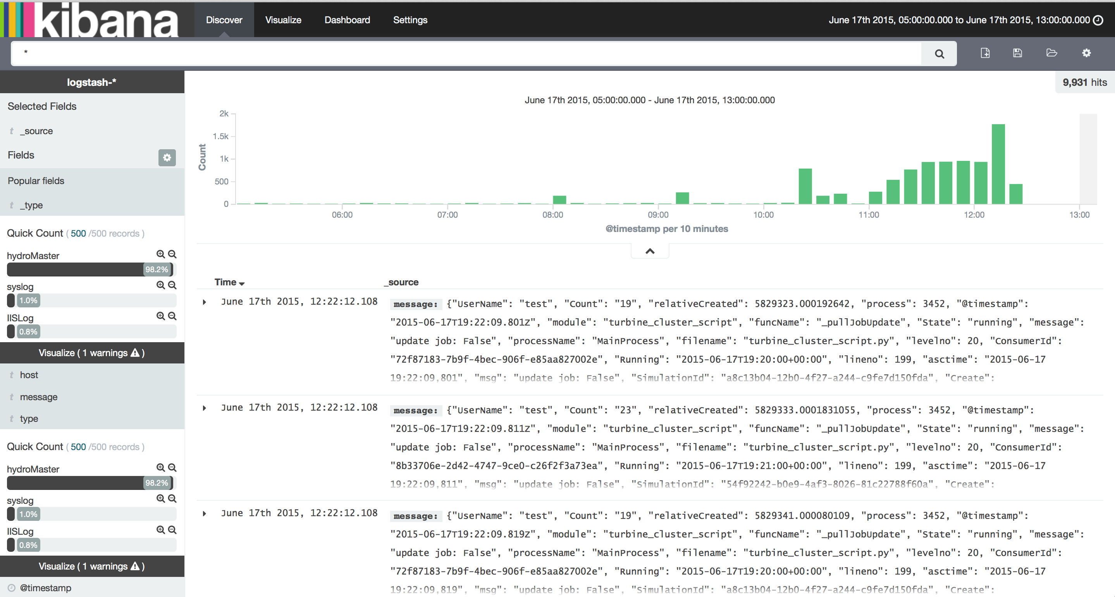
Kibana Turbine

Slide 8
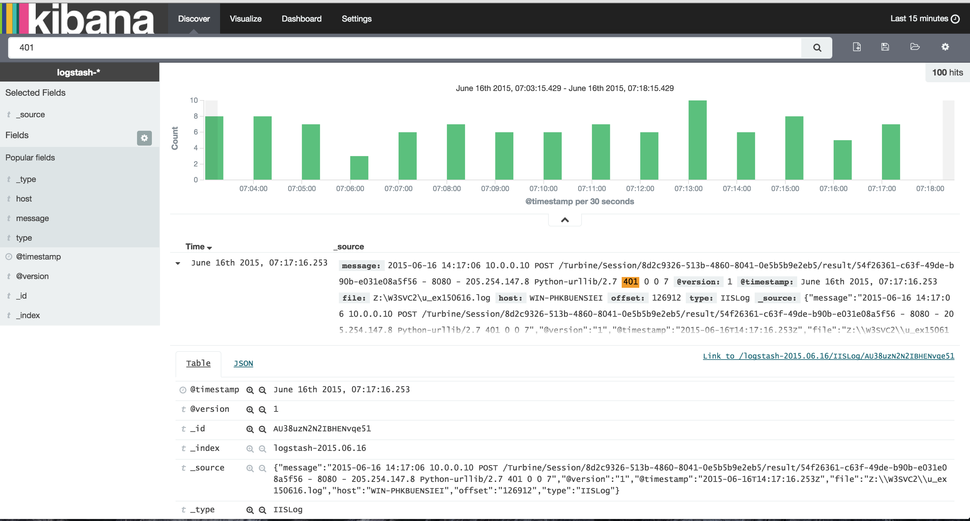
Kibana HTTP 401

Slide 9
NERSC ELK: RabbitMQ
RabbitMQ cluster
Logstash
Logstash
Logstash
collectd
apache
Application
Modbus
BACnet
Logstash
Elastic cluster
Kibana

Slide 10
NERSC ELK: RabbitMQ
RabbitMQ cluster
Logstash
Logstash
Logstash
collectd
apache
Application
Modbus
BACnet
Logstash
Elastic cluster
Kibana

Slide 11
Zeroconf: Service Discovery
Python Zeroconf
Multicast DNS (mDNS) Service Discovery for Python
Multicast DNS (mDNS)
protocol that uses APIs similar to unicast DNS but implemented over a multicast protocol.
Each computer on the LAN stores its own list of DNS resource records and joins the mDNS multicast group.
When an mDNS client wants to know the IP address of a computer given its name, mDNS client sends a request to a well-known multicast address; the computer with the corresponding A record replies with its IP address.

Slide 12
Hashicorp Consul: Service Discovery
Cluster Key/Value Store
Consul Agent run on every node, publishes to Consul Server
HTTP interface
DNS server

Slide 13
Hashicorp Consul: Service Discovery
Consul Agent
Add Services
For the DNS API, the DNS name for services is NAME.service.consul
Configure Agent
$ echo '{"service": {"name": "web", "tags": [“flask"], "port": 80},
"check": {"script": "curl localhost >/dev/null 2>&1", "interval": "10s"}}' \
>/etc/consul.d/web.json
DNS API
$ dig @127.0.0.1 -p 8600 web.service.consul ... ;; QUESTION SECTION: ;web.service.consul. IN A ;; ANSWER SECTION: web.service.consul. 0 IN A 172.20.20.11
HTTP API
$ curl http://localhost:8500/v1/catalog/service/web [{"Node":"agent-one","Address":"172.20.20.11","ServiceID":"web", \ "ServiceName":"web","ServiceTags":["rails"],"ServicePort":80}]

Slide 14
Stateless
Service statelessness
Design principle that is applied within the service-orientation design paradigm
design scalable services by separating them from their state data whenever possible.
reduction of the resources consumed by a service as the actual state data management is delegated to an external component or to an architectural extension.
Stateless protocol (eg. HTTP, REST )
The client–server communication is constrained by no client context being stored on the server between requests

Slide 15
CRT Sensor Architecture
Modbus 67
RabbitMQ
publisher
publisher
publisher
Modbus 11
Modbus 97
Publisher
Each docker container, Polls a single modbus sensor
Use service discovery or scheduler (mesos) to keep track of all publishers
Stateless, polls then throws data on the “metrics” topic
“Metrics” topic can fan out to multiple queues
“Logs” topic where application logs are published to

Slide 16
Docker Startup MacOSX
In your docker shell
% pip install virtualenv
%. Python/bin/activate
% docker --version
Docker version 1.7.0, build 0baf609
% pip install docker-compose
% git clone https://github.com/boverhof/examples.git
% cd examples

Slide 17
Docker Basics
Mount a common directory in Docker instance
% docker run -v $PWD/downloads:/root/downloads -i -t ubuntu /bin/bash
List Containers:
(python)examples % docker ps -a
CONTAINER ID IMAGE COMMAND CREATED STATUS PORTS NAMES
eaf42cada267 ubuntu "/bin/bash" 3 minutes ago Exited (0) 4 seconds ago jolly_jones

Slide 18
Docker Load_balancer
(python)Docker % docker ps -a
CONTAINER ID IMAGE COMMAND CREATED STATUS PORTS NAMES
2474fe7c70f8 loadbalancer_nginx "/bin/sh -c /start" 2 minutes ago Up 2 minutes 0.0.0.0:80->80/tcp, 443/tcp loadbalancer_nginx_1
a52e2e0805af tutum/haproxy "/run.sh" 2 minutes ago Up 2 minutes 80/tcp, 443/tcp, 1936/tcp loadbalancer_haproxy_1
1016ff693289 loadbalancer_app "/bin/sh -c 'python 2 minutes ago Up 2 minutes 5000/tcp loadbalancer_app_1
0d2b5f4f0e6f redis "/entrypoint.sh redi 2 minutes ago Up 2 minutes 6379/tcp loadbalancer_redis_1
(python)Docker % boot2docker ip
192.168.59.103
(python)Docker % curl 192.168.59.103
Visit number 1
Hostname: 1016ff693289
(python)Docker % curl 192.168.59.103
Visit number 2
Hostname: 1016ff693289
(python)Docker % curl 192.168.59.103
Visit number 3
Hostname: 1016ff693289

Slide 19
Docker Load_balancer
(python)load_balancer % docker-compose scale app=3
Creating loadbalancer_app_2...
Creating loadbalancer_app_3...
Starting loadbalancer_app_2...
Starting loadbalancer_app_3...
(python)load_balancer % docker ps -a
CONTAINER ID IMAGE COMMAND CREATED STATUS PORTS NAMES
f8703b688b24 loadbalancer_app "/bin/sh -c 'python 10 seconds ago Up 9 seconds 5000/tcp loadbalancer_app_3
ac8c7e66906d loadbalancer_app "/bin/sh -c 'python 10 seconds ago Up 9 seconds 5000/tcp loadbalancer_app_2
2474fe7c70f8 loadbalancer_nginx "/bin/sh -c /start" 16 minutes ago Up 16 minutes 0.0.0.0:80->80/tcp, 443/tcp loadbalancer_nginx_1
a52e2e0805af tutum/haproxy "/run.sh" 16 minutes ago Up 16 minutes 80/tcp, 443/tcp, 1936/tcp loadbalancer_haproxy_1
1016ff693289 loadbalancer_app "/bin/sh -c 'python 16 minutes ago Up 16 minutes 5000/tcp loadbalancer_app_1
0d2b5f4f0e6f redis "/entrypoint.sh redi 16 minutes ago Up 16 minutes 6379/tcp loadbalancer_redis_1
~ % docker inspect loadbalancer_app_1 loadbalancer_app_2 loadbalancer_app_3 | python -c "import sys,json; l = json.load(sys.stdin); ll = map(lambda a: a['NetworkSettings']['IPAddress'], l); print '\n'.join(ll)"
172.17.0.86
172.17.0.90
172.17.0.91

Slide 20
Docker Load_balancer
Only 1 Flask Web Server registered with HAProxy
(python)load_balancer % docker exec -ti a52e2e0805af bash
root@a52e2e0805af:/# tail -1 /etc/haproxy/haproxy.cfg ; echo
server LOADBALANCER_APP_1 172.17.0.86:5000
Add 2 additional Flask Web Servers
root@a52e2e0805af:/# cat >> /etc/haproxy/haproxy.cfg
server LOADBALANCER_APP_2 172.17.0.90:5000
server LOADBALANCER_APP_3 172.17.0.91:5000
^C
root@a52e2e0805af:/# service haproxy restart

