Slide 1
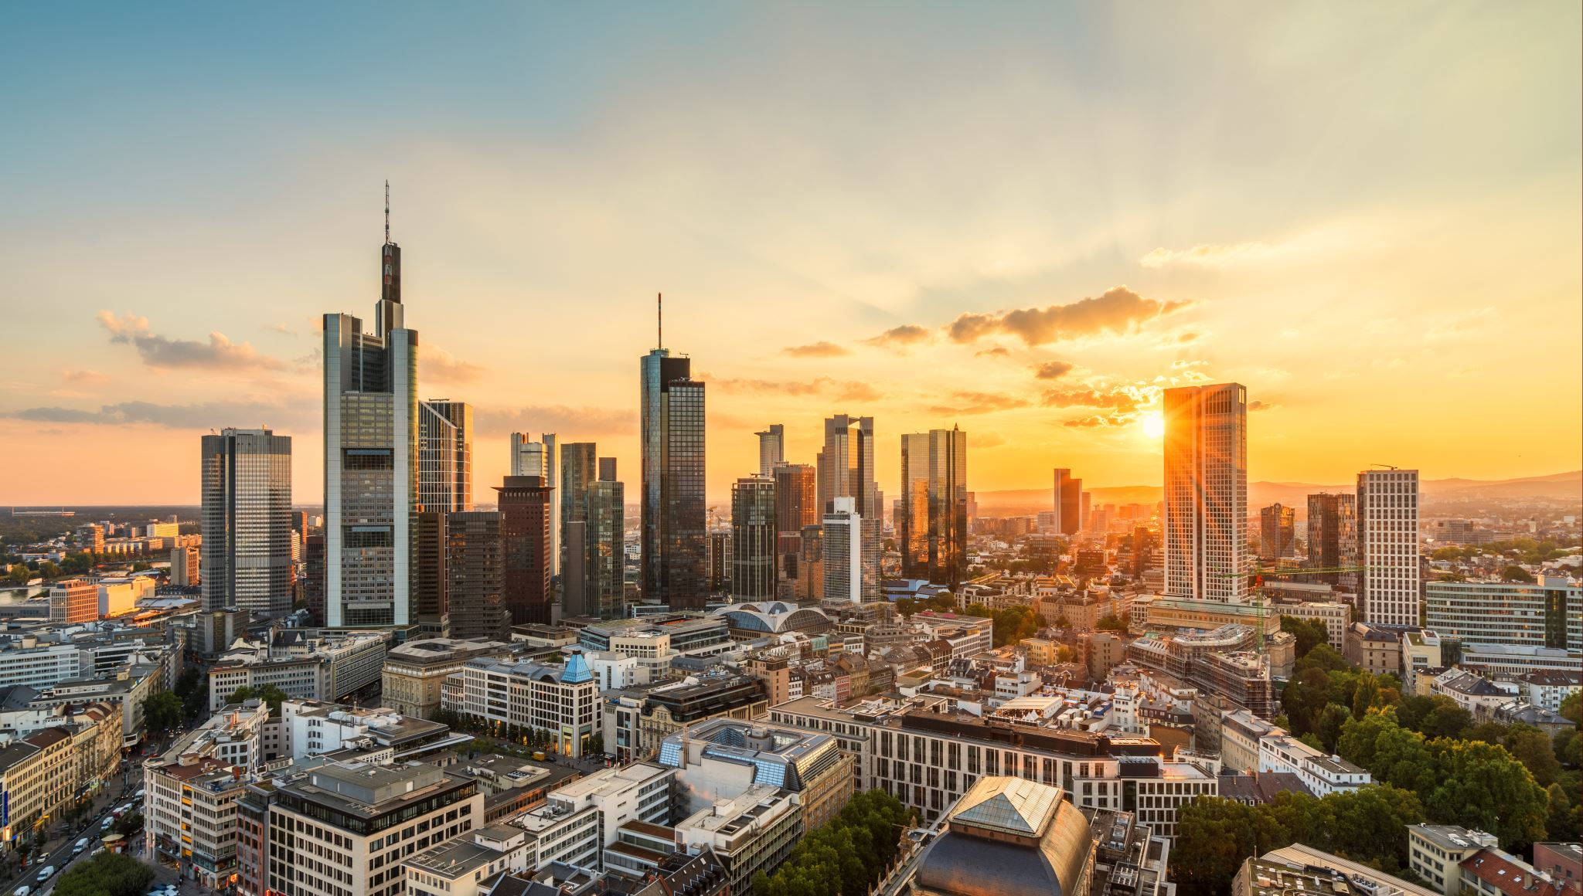
The Battle of Neighborhoods
Amazon warehouse location

Slide 2
Table of Contents
1. Background
2. How We Conduct this Analysis
3. Results
4. Conclusion & Revision

Slide 3
Background
Business Problem:
Amazon currently has one warehouse built in Midtown, Manhattan, NYC
This warehouse enabled most of the delivery in Manhattan changed from Two Days to One Day
Analysts claim that the 5% monthly revenue increase are from NYC area and the 8% of the new prime members are from NYC area.
After careful consideration, the management team voted to open another warehouse in Toronto
The estimated profitability for Toronto area will increase 10%
So where should the warehouse to be built?

Slide 4



How We Conduct this Analysis
By importing the geolocation data into Python, we can generate a list of venues in a particular neighborhood

Slide 5

How We Conduct this Analysis
With the list of venues, we can then turn them into values to analyze how often they appear in one neighborhood.

Slide 6

How We Conduct this Analysis
Using the previous result, we can then use a Machine-Learning method to group different neighborhood by their similarity on venues
Neighborhoods that have very similar venues will be put in one group, which we call a “Cluster”

Slide 7

How We Conduct this Analysis
From the “Clusters”, we can find the clusters that are closet to the Amazon warehouse in Manhattan.
We can then find a similar Clusters in Toronto and so the new Amazon warehouse should be built at that location

Slide 8
Result
The new Amazon warehouse should be built in Downtown Toronto Area, because:
It has high similarity comparing to Midtown, Manhattan
Both areas contain a lot of restaurants
Both areas are approximately at the center of the city

Slide 9
Conclusion & Revision
However, comparing to the real Amazon warehouse location in Toronto, our predict is not correct as the real Amazon warehouse in not located in Downtown Toronto.
Possible Explanation:
1. The model failed to include relevant features, such as rent.
2. Toronto and New York City are two very different cities so that we can’t directly compare between them.

Slide 10

Thank You!

