Slide 1

CSCI 100-01 FINAL PROJECT
Python and Excel

Slide 2

My project aim to show the ways that Python can be used to show unexpected correlations that abound in a dataset in a more interesting manner than Excel can using libraries like Pandas, Seaborn and Matplotlib.

Slide 3
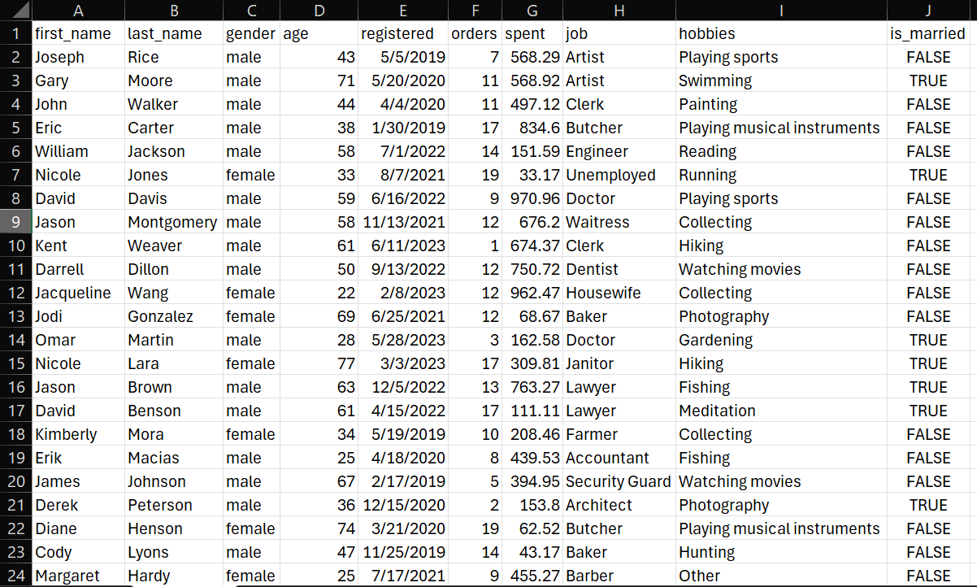
This is a picture of the starting excel sheet…with the original having 1000 entries.

Slide 4
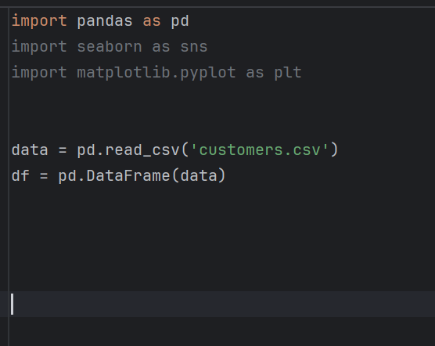
Firstly, I read my csv file into Python and converted it into a Dataframe.

Slide 5
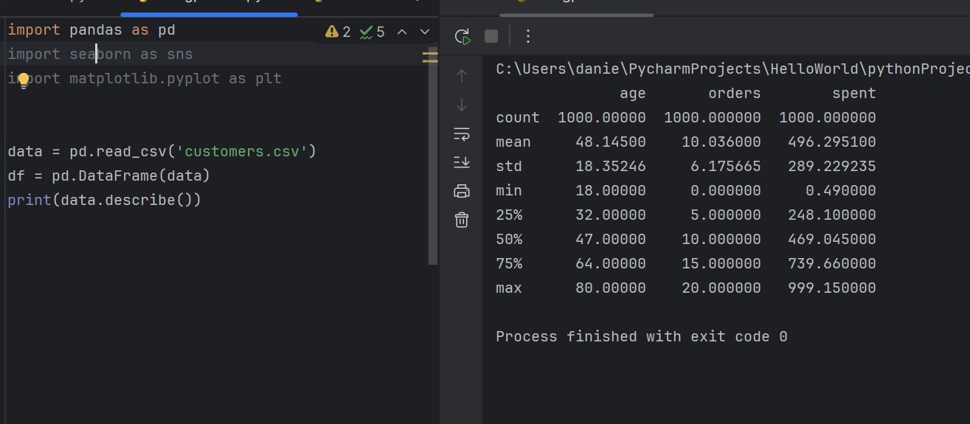
I then handled the data cleaning and pre-processing. I then examined the data set for missing data and dropped those such rows. Next. I tried to get an overall idea of the set by using the describe() function

Slide 6
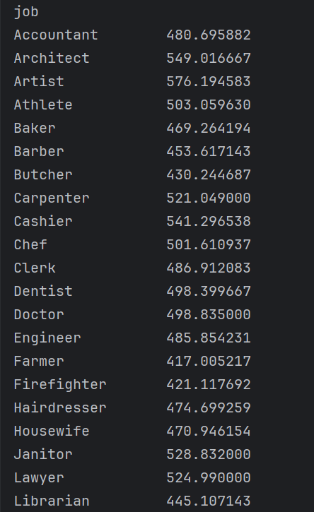
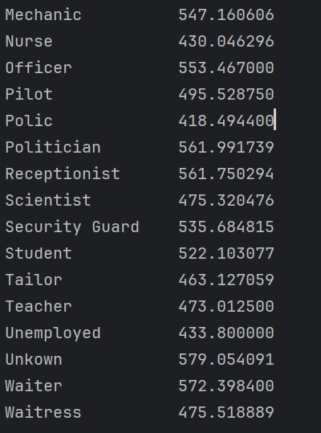
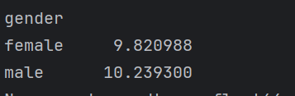
For more insight, I divided the data into groups of ‘job and spent’ and ‘gender and orders’. I them computed the mean of those groups.

Slide 7
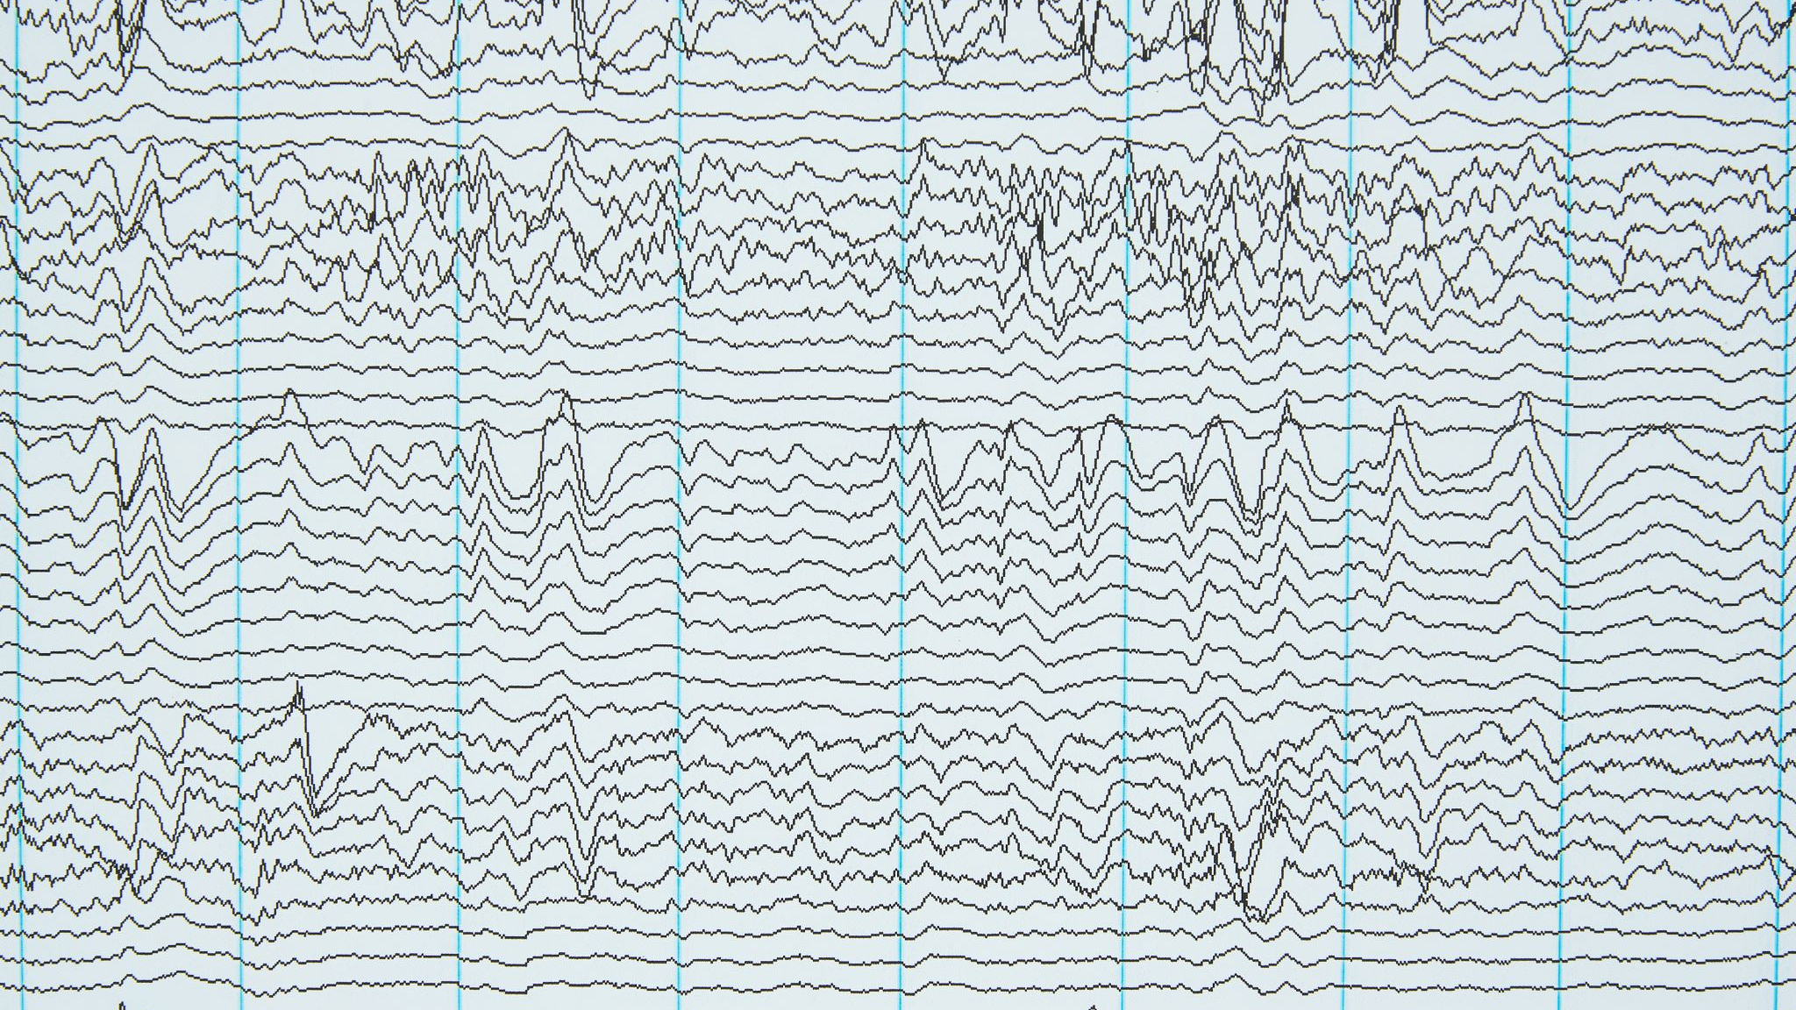
VARIOUS PLOT TYPES

Slide 8
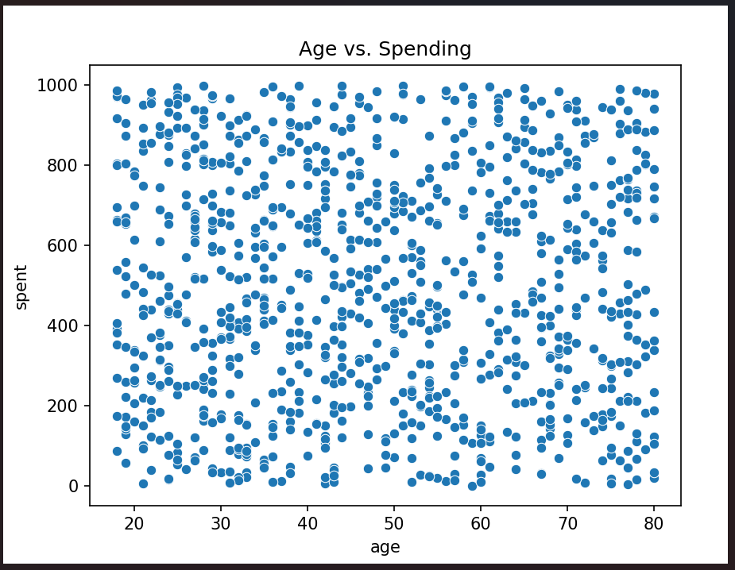
Age vs Spending Scatter plot
The points are mostly spread out so that means that there’s not noticeable correlation between age and number of orders.

Slide 9
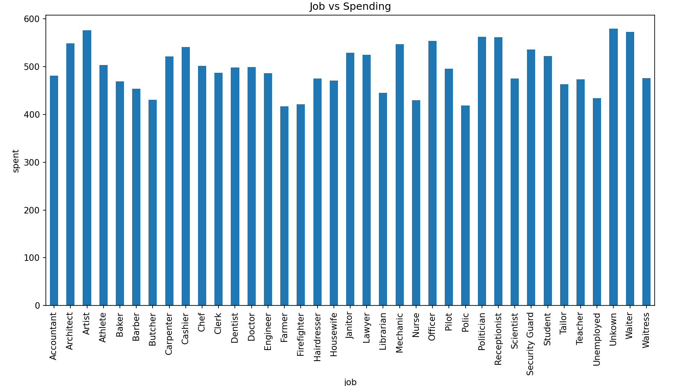
Chart of Job vs Spending
Artists spend the most amount of money, while Police spends the least.

Slide 10
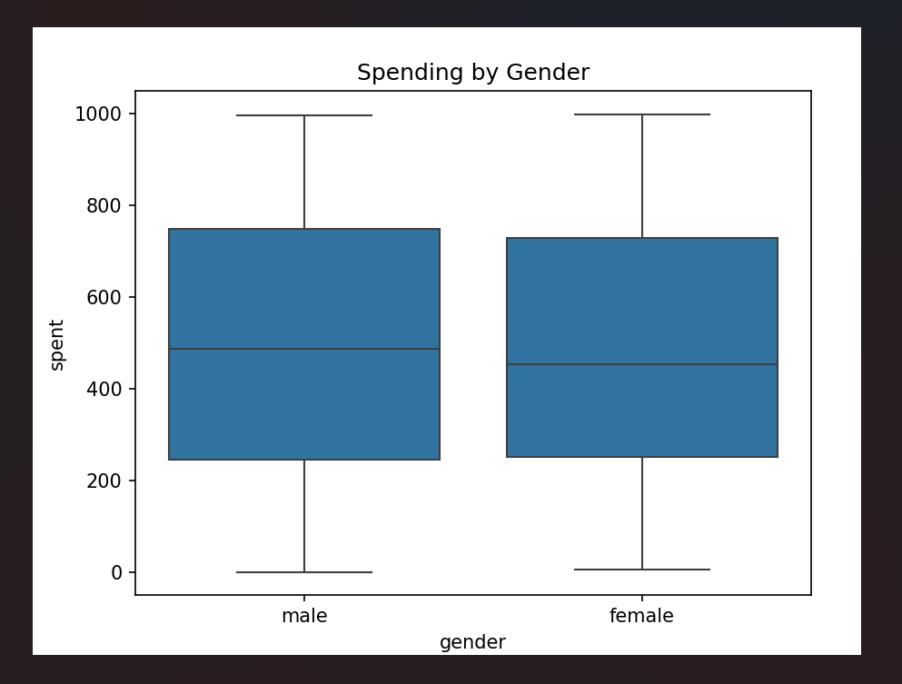
SPENDING BY GENDER BOXPLOT
On average, Men spend more than women. 470 to 430.

Slide 11
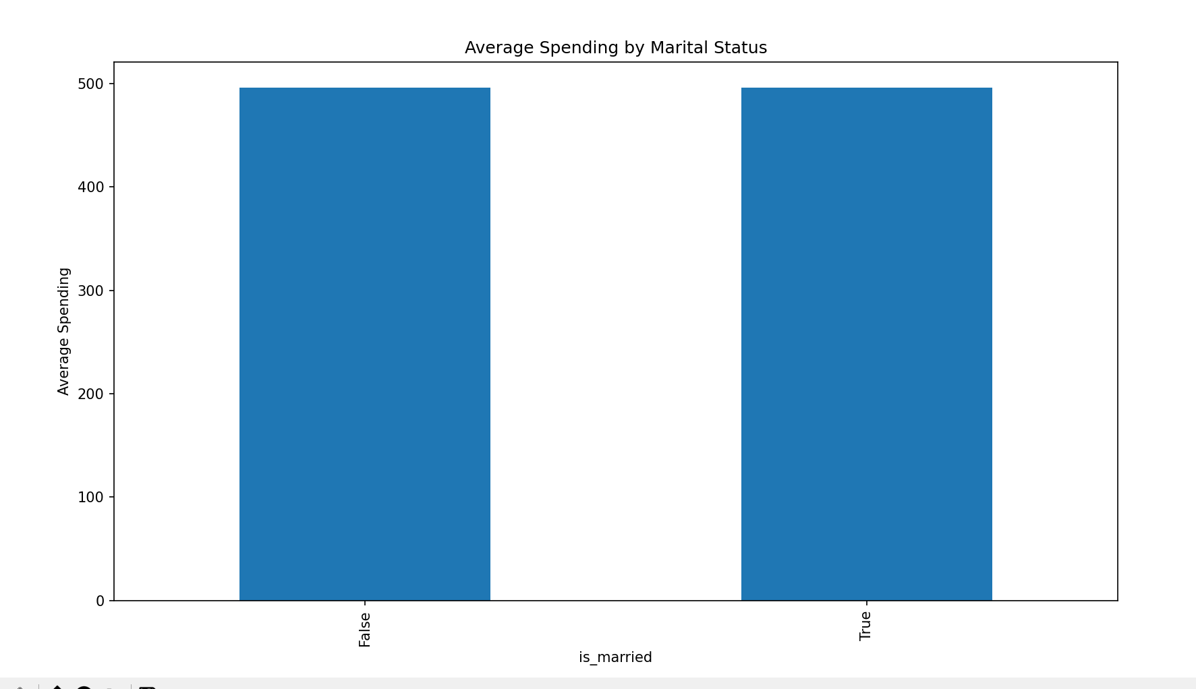
CORRELATION BETWEEN MARITAL STATUS AND SPENDING.
Married and unmarried people spend equal amounts on this product, there is no correlation here.

Slide 12
