Slide 1

Bank Marketing Analysis
DSA 5101 • Machine Learning Project • Fall 2021
Presented by
Lin, Zhixin (e0732596)
Cai, Bowen (e0732654)

Slide 2
Contents
Brief Introduction to this Project
Exploratory Data Analysis
Data Preprocessing
Modeling
Insights & Conclusions
Directions for Further Improvements

Slide 3
Brief Intro. to this project

Slide 4
Background
The data is related with direct marketing campaigns, based on phone calls, of a banking institution. It includes:
Bank client data such as age, education and loan etc.
Previous contact records
Whether the client has subscribed a term deposit
This project aims to:
Analyze the relationships between the final subscription of a term deposit and the client’s personal & contact information
Leverage machine learning algorithm to predict subscription

Slide 5
Data Overview
Our data contains 45211 samples in total
with 16 features and 1 response
response ‘y’ is a binary variable with values of ‘yes’ and ‘no’

Slide 6
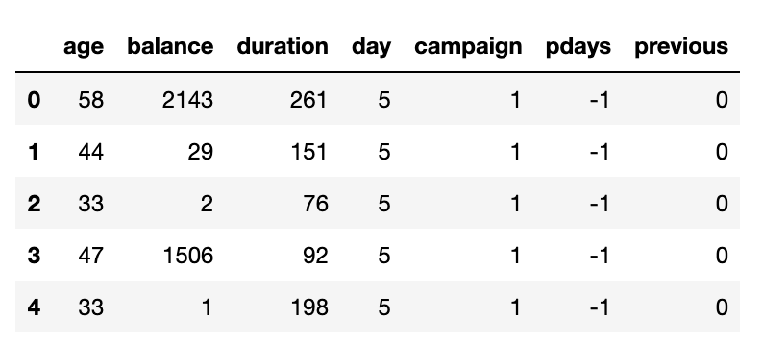
Data Overview
We have 7 numerical features

Slide 7
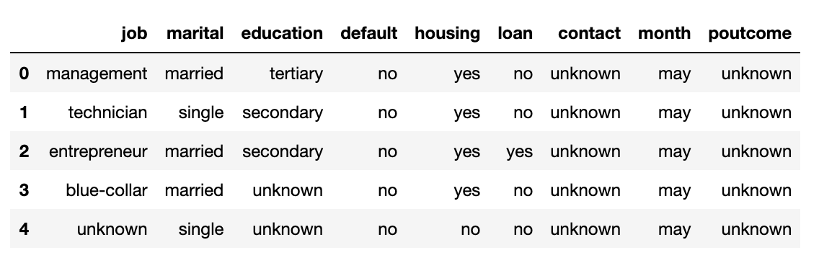
Data Overview
And 9 categorical features

Slide 8
Data Overview
Personal information
Age
Job
Martial
Education
Default
Balance
Housing
Loan
Last Contact to current campaign
Contact
Day
Month
Duration
Others
Campaign
Pdays
Previous
Poutcome

Slide 9
Exploratory Data Analysis

Slide 10
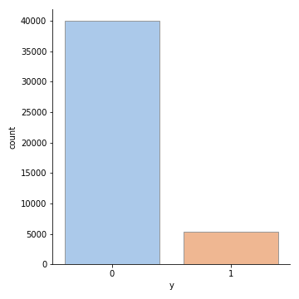
Data Imbalance
There are around 88.3% samples with no subscription, and 11.7% with subscription.
y = 0: not subscribing
y = 1: subscribing

Slide 11
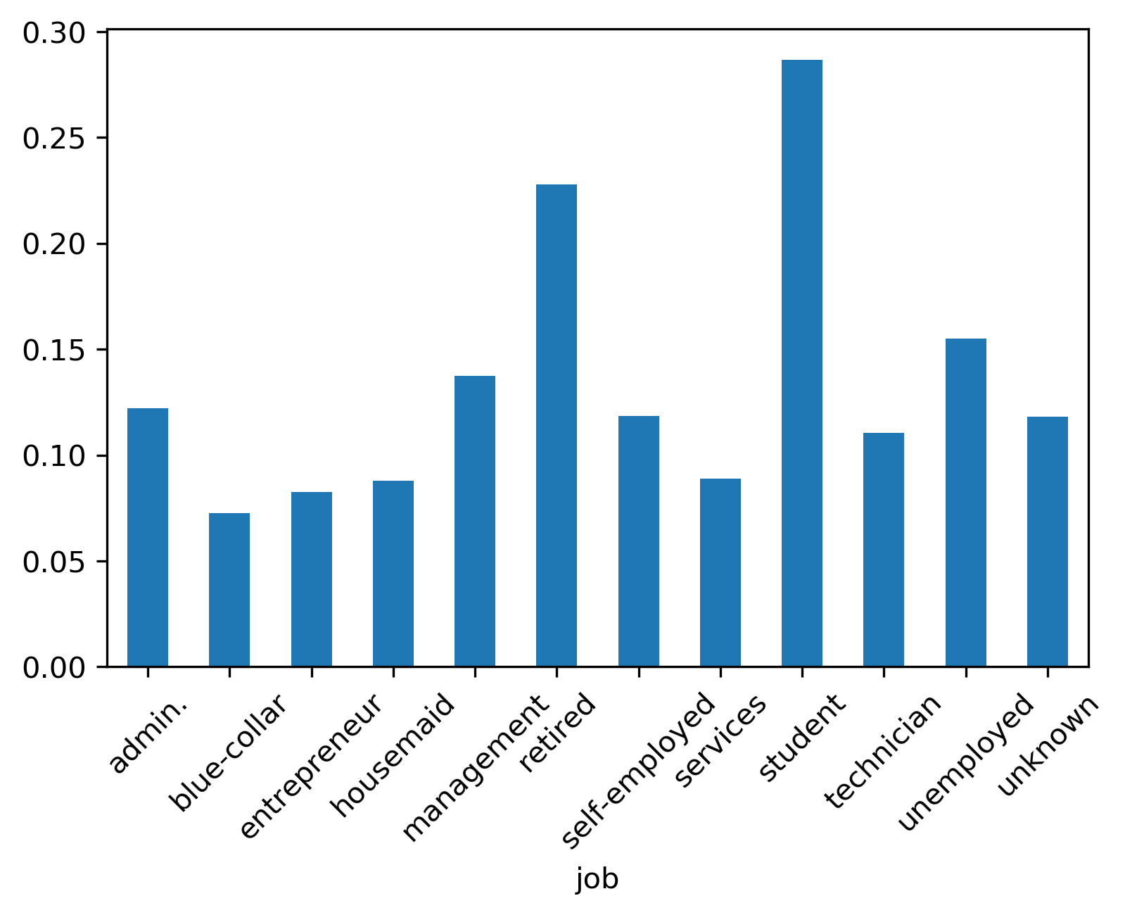
Categorical Features
Job
Average subscribing rate < 0.3 for all jobs
Retired clients and students have relatively higher subscribing rate among all.

Slide 12
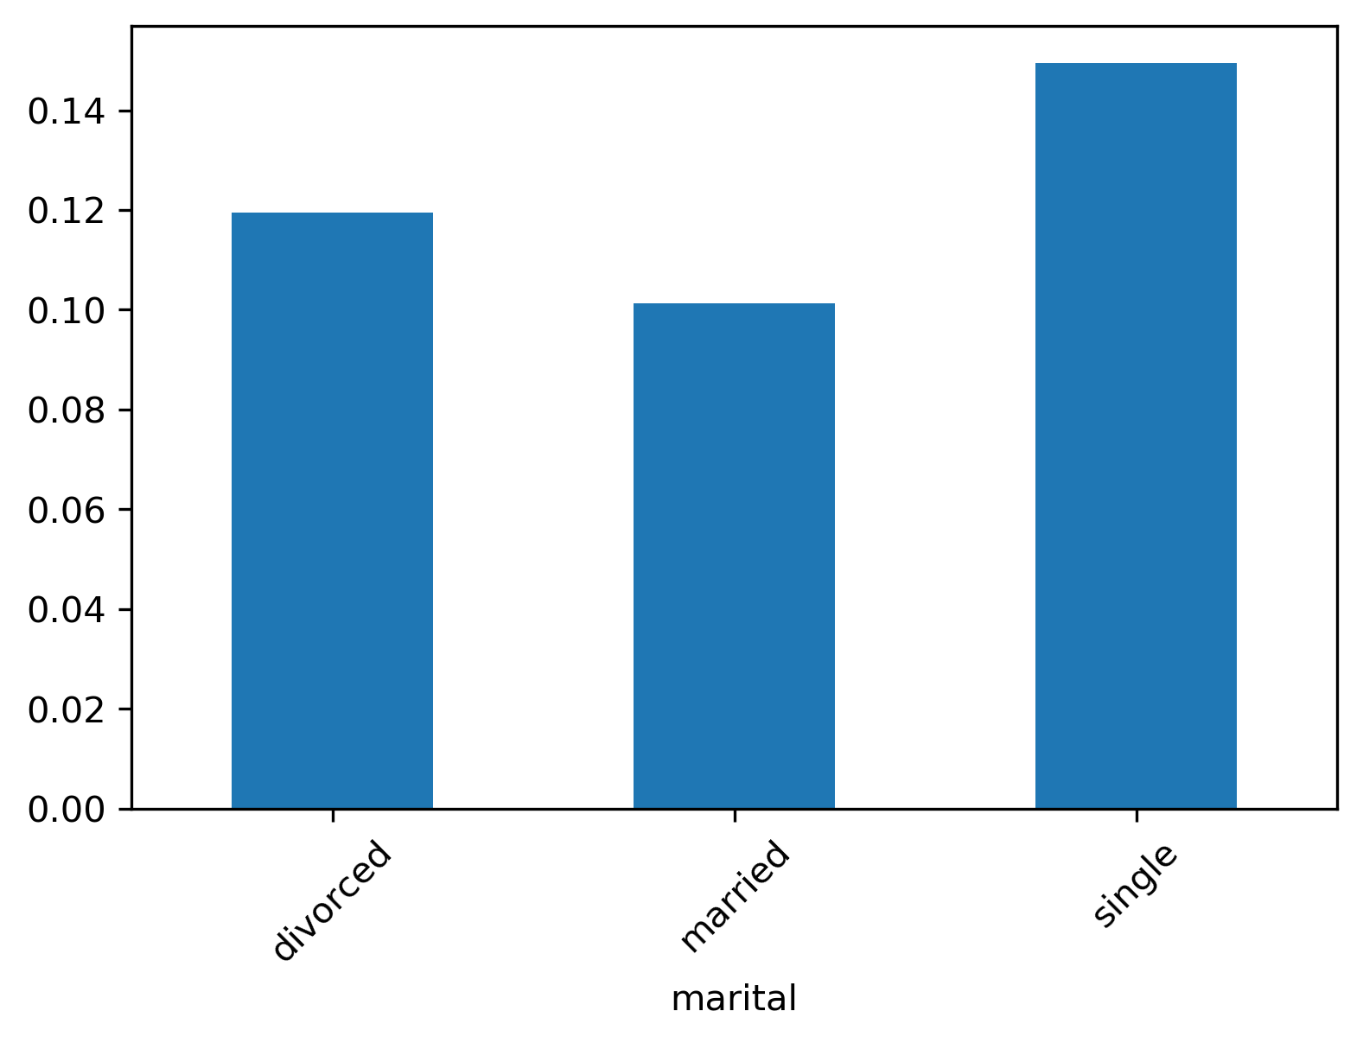
Categorical Features
Martial
Single clients are more likely to subscribe, while married clients have the lowest subscribing rate.

Slide 13
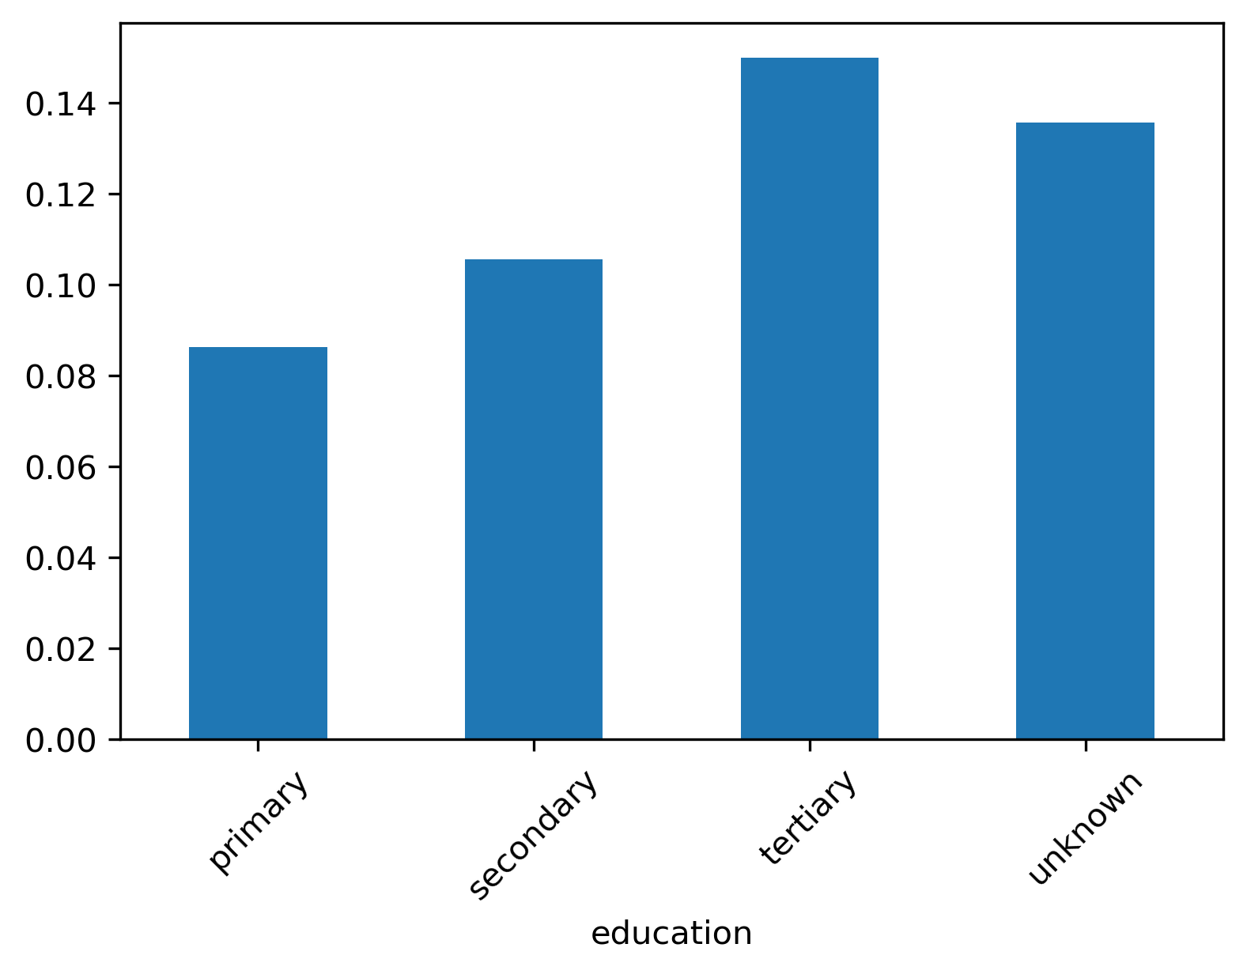
Categorical Features
Education
Clients with higher level of education are more likely to subscribe.

Slide 14
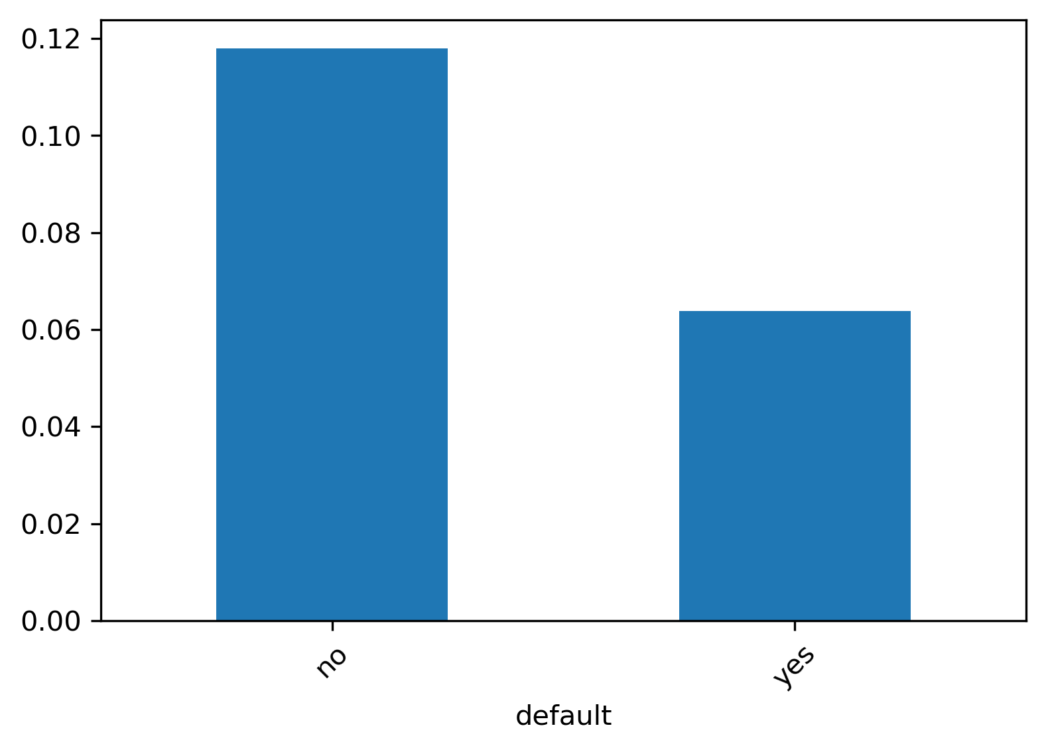
Categorical Features
Default
Clients with default credit are less likely to subscribe.

Slide 15
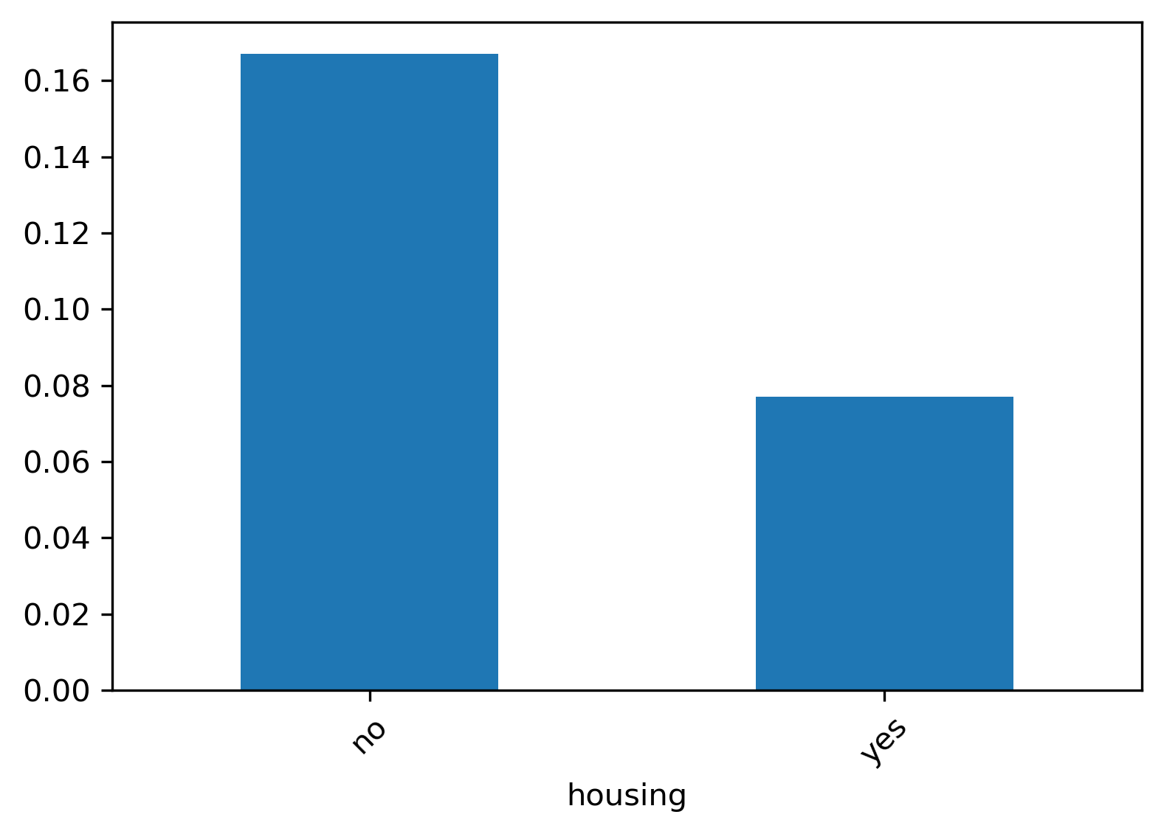
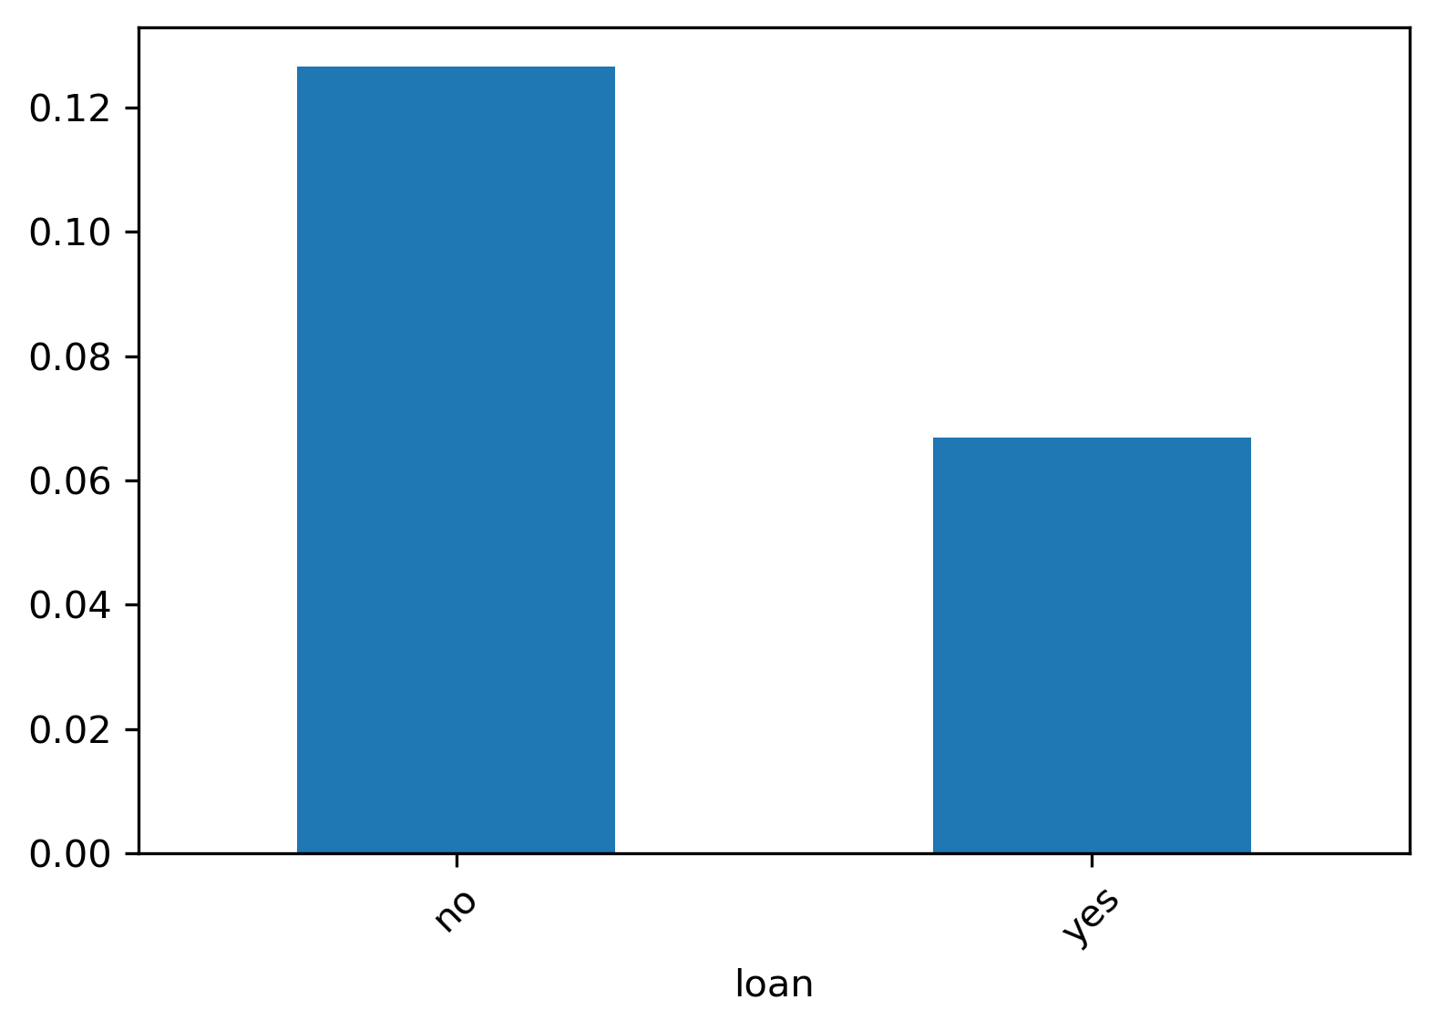
Categorical Features
Housing & Loan
Clients with housing or personal loan are less likely to subscribe a term deposit.
Notes:
With loan -> less manageable wealth

Slide 16
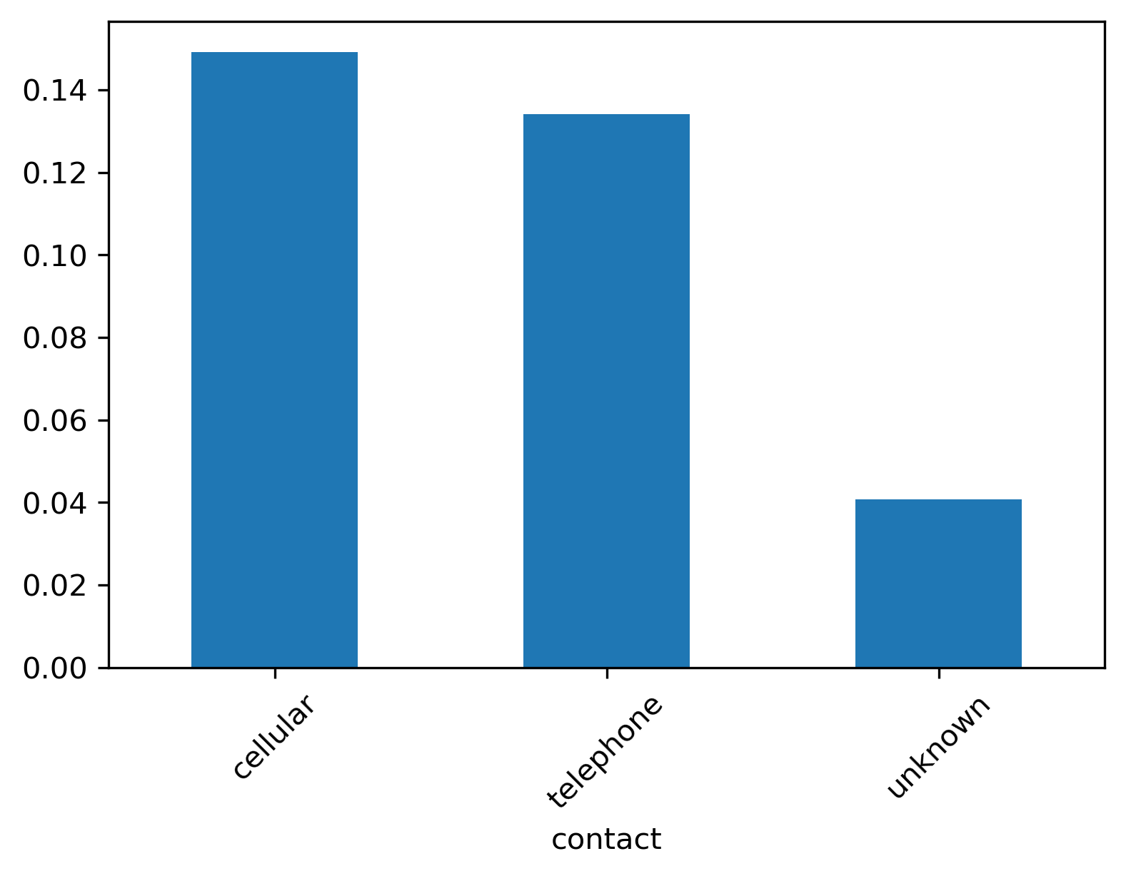
Categorical Features
Contact
Some clients were contacted by known methods (cellular or telephone) while others were contacted by methods we don’t know.
Those whose contact method are known have a higher subscribing probability.

Slide 17
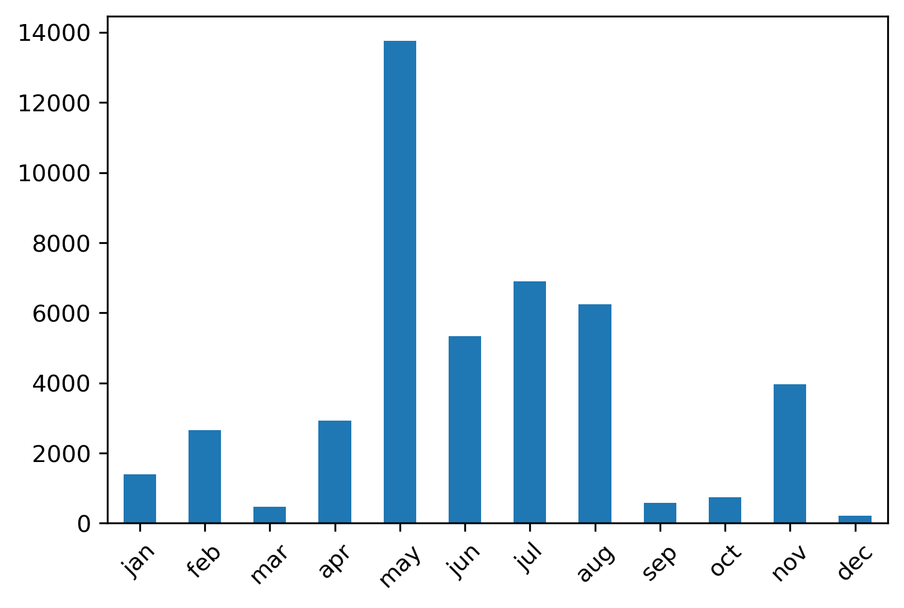
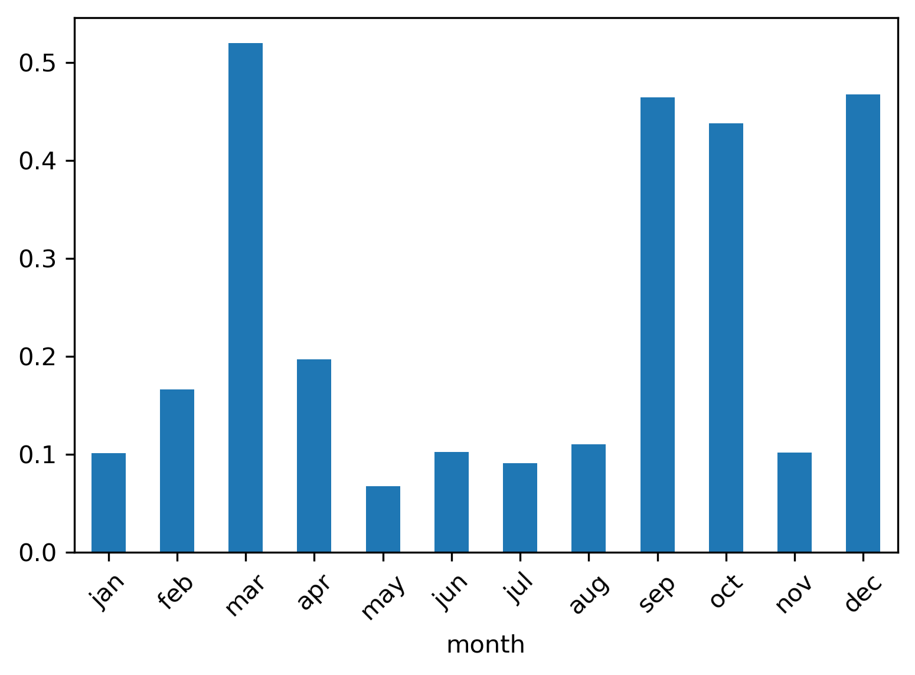
Categorical Features
Month
The marketing call activities are concentrated during summer, while during this time the subscribing conversion is worse than that during fall and winter.
Notes:
From the predictor ‘month’ we know that most bank marketing calls are during summertime, and May is the month with highest activity counts. However, it’s also the month with lowest subscribing conversion.
Besides, according to the subscribing rate by month, one might suggest that it’s better to market the next campaign during fall or winter. In this case, one should notice the fact that during fall and winter the number of calls are significantly fewer. There might be some other reasons for that.

Slide 18
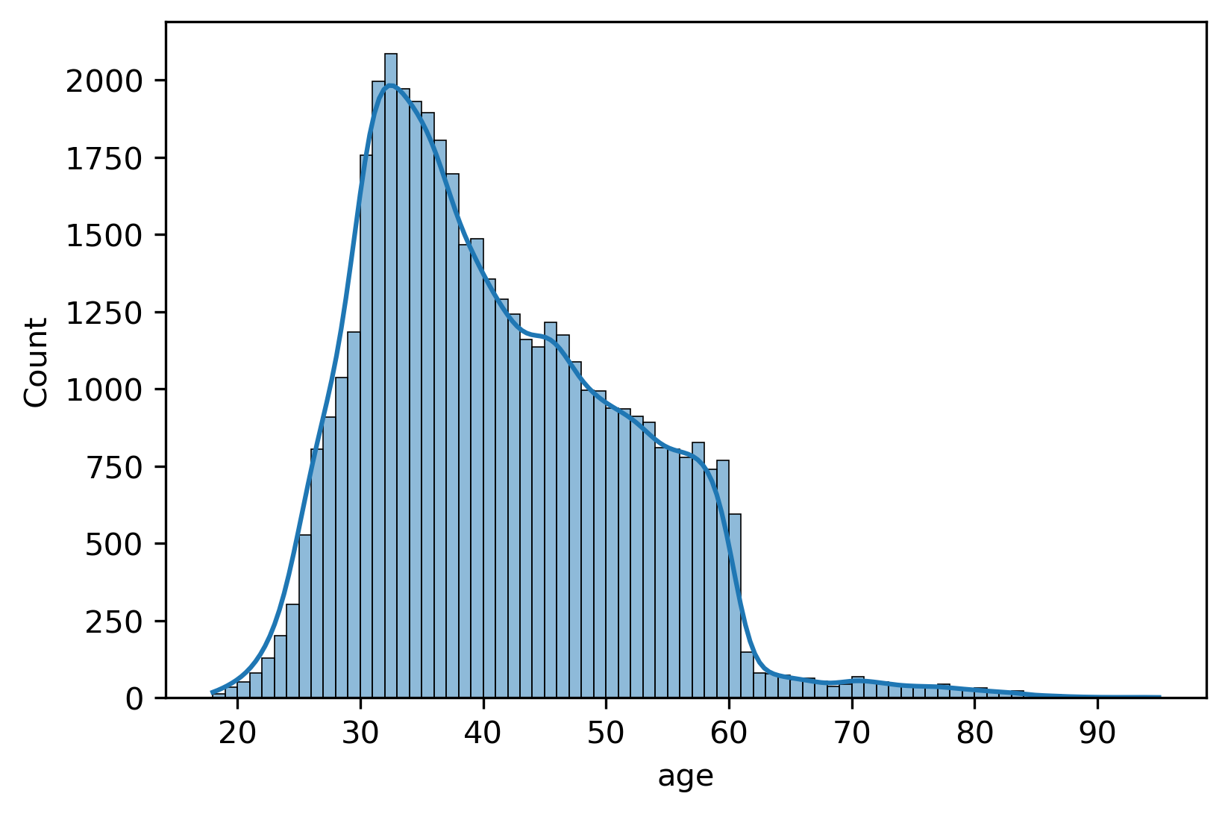
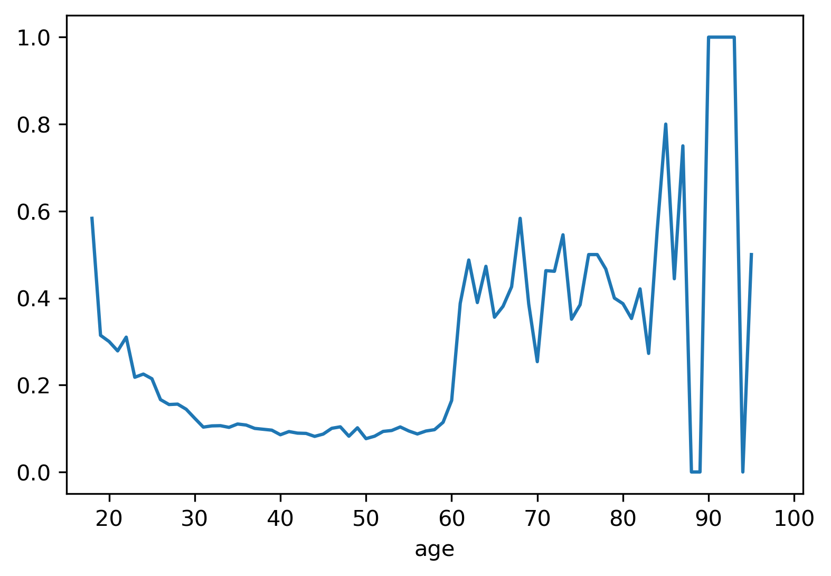
Numerical Predictors
Age
Majority (that's say 97pp or more) is <= 60
Among those with age <= 60, the younger the clients are, the more likely that they are to subscribe
Notes:
Young people with age <= 25 and elder people whose age >= 60 have higher subscribing rate. Besides, students and the retired are also the group with higher probability of subscription.
The retired who can no longer work as younger people to make money but with more cumulative wealth tend to invest through term deposit. They don’t have to spend too much energy to manage it and at the same time can get some fair amounts back.
For young students, they don’t have that much wealth accumulation and wealth-managing experience. As they are more vulnerable to potential risks, they might prefer to choose some low-risk financial products to start with.

Slide 19
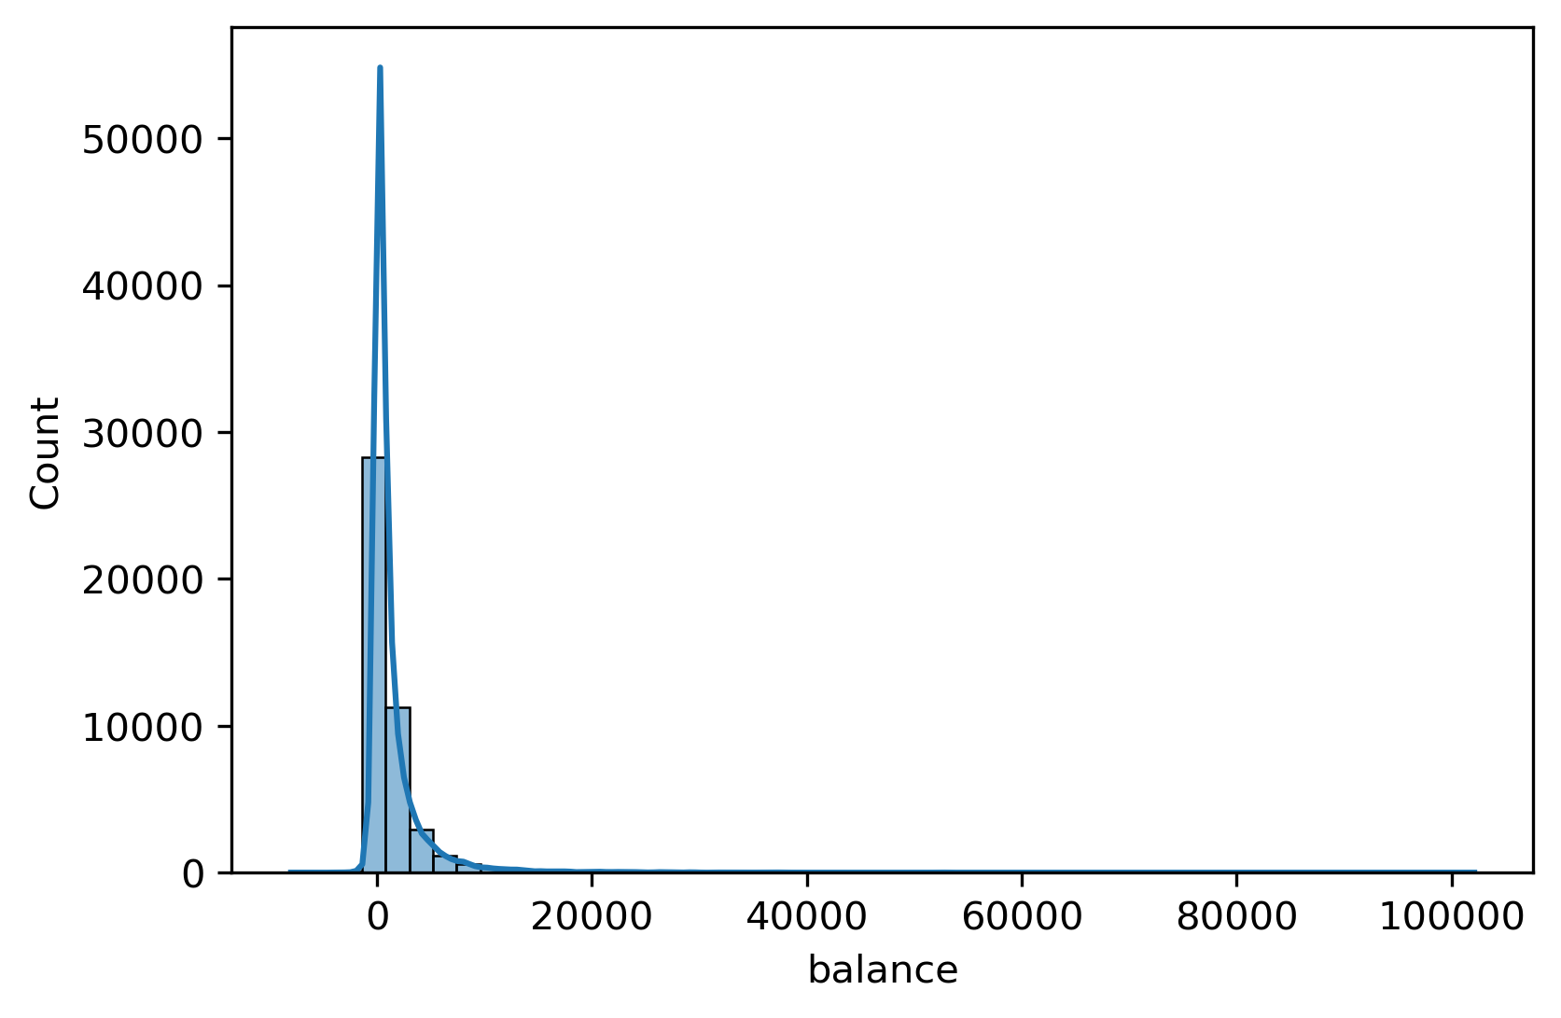
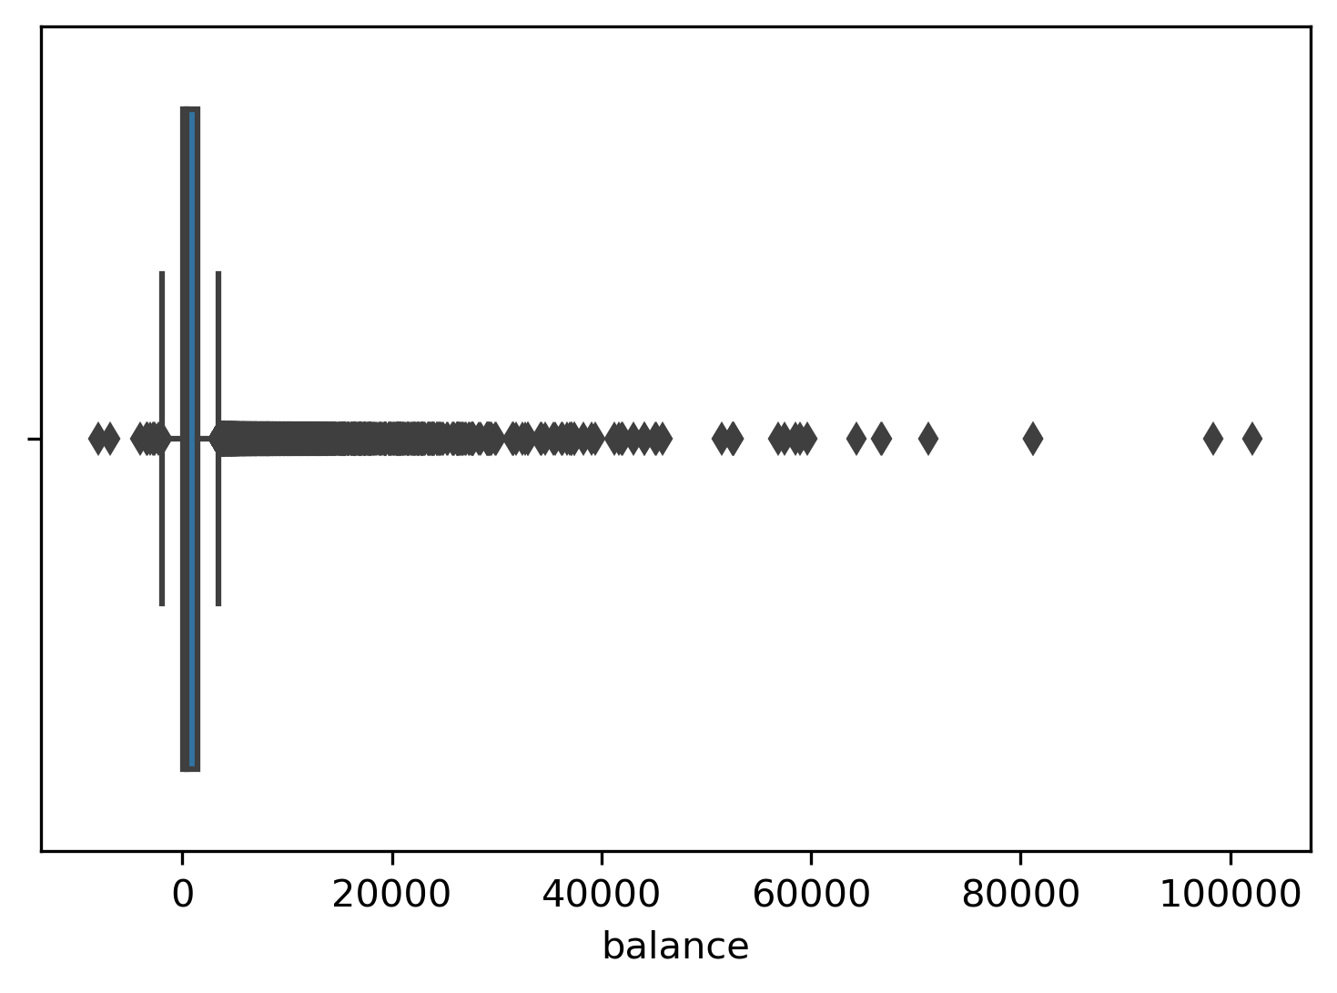
Numerical Predictors
Balance
Clients with negative balance seems to be less likely to subscribe
Shown visually, the distribution of balance is very skewed with detectable outliers which might influence the aggregated values a lot.

Slide 20
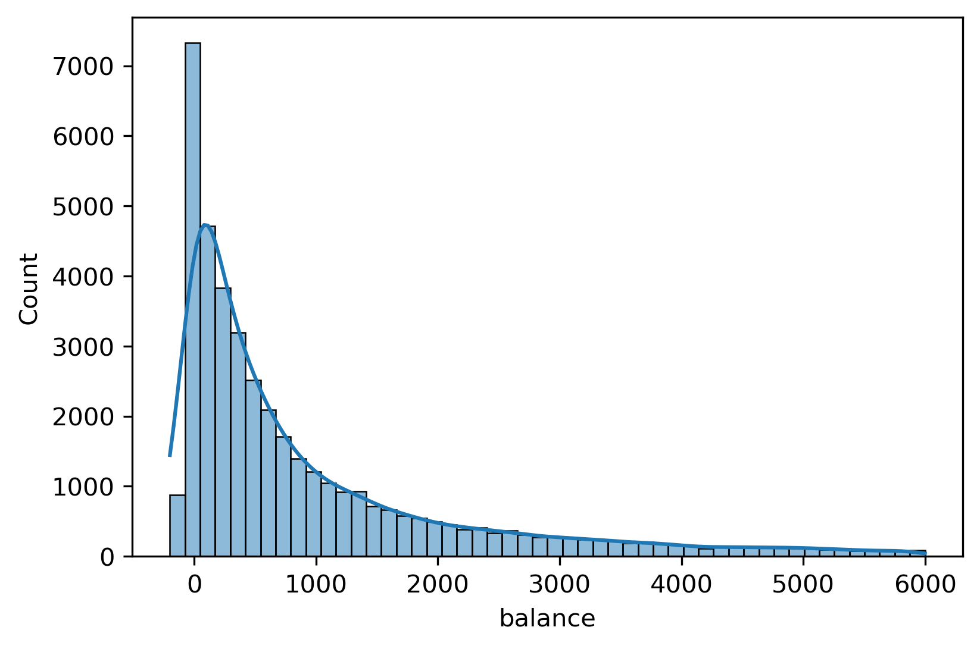
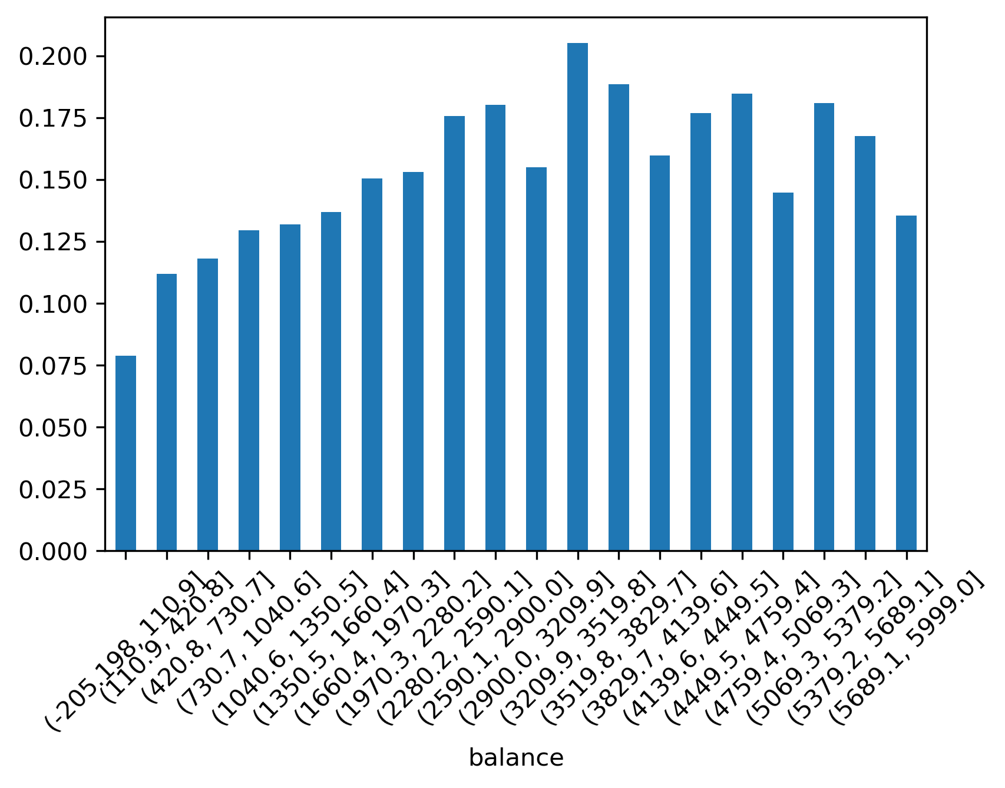
Numerical Predictors
Balance
Based on the 5% and 95% quantiles, we further check the balance within (-200, 6000).
Within this range, clients with higher balance are more likely to subscribe.

Slide 21
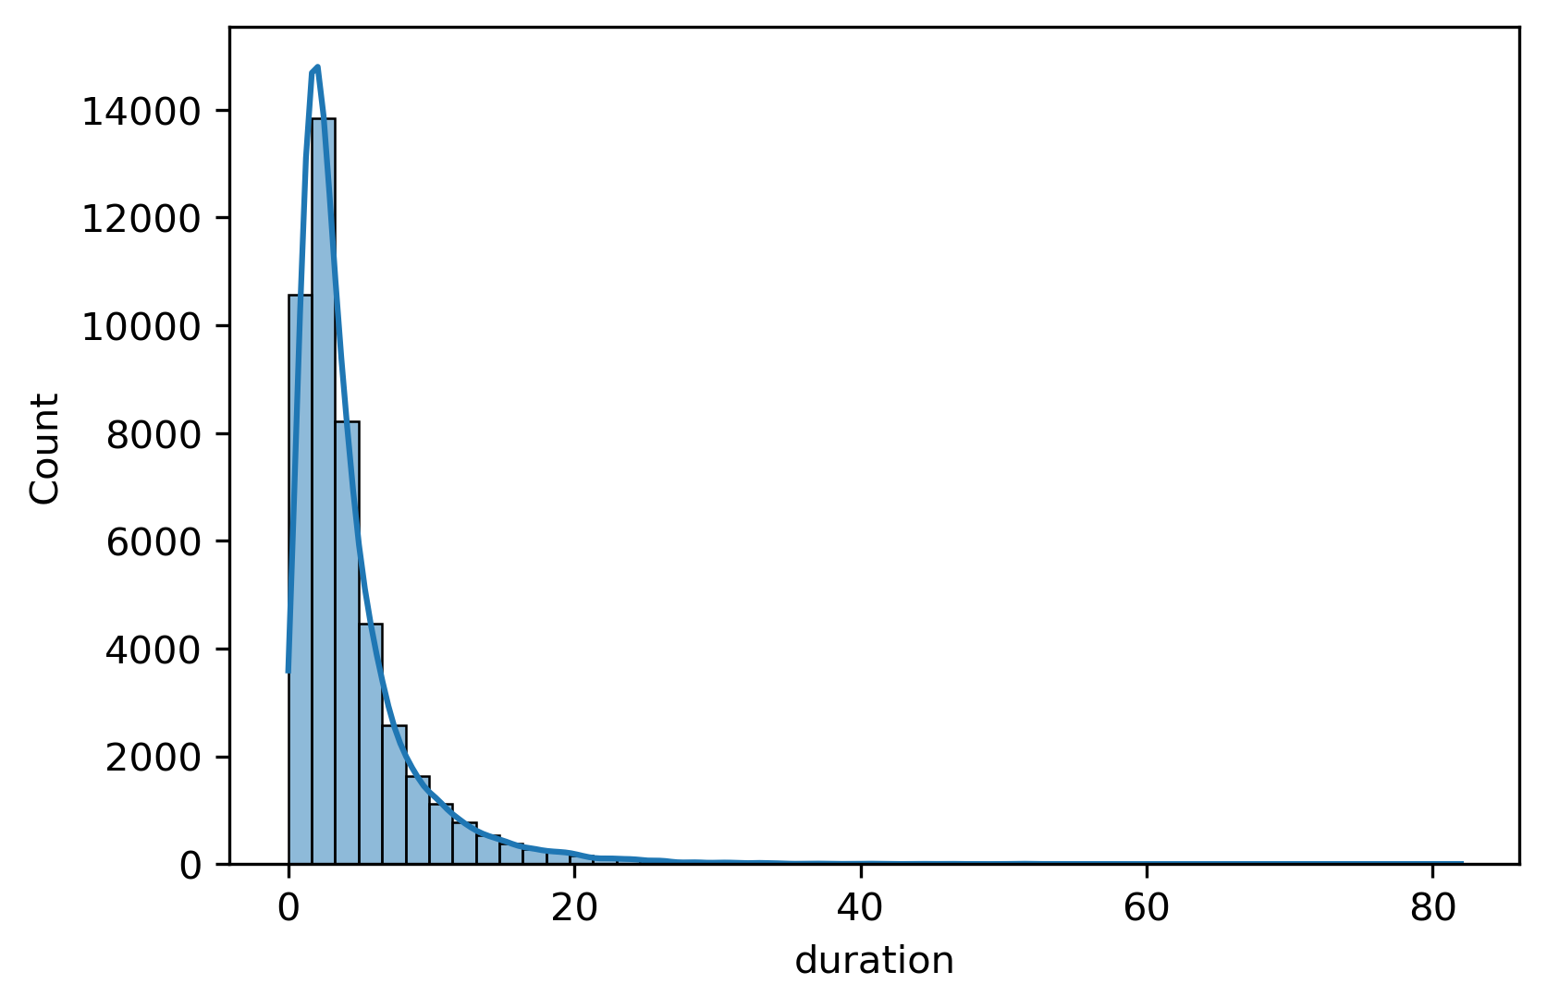
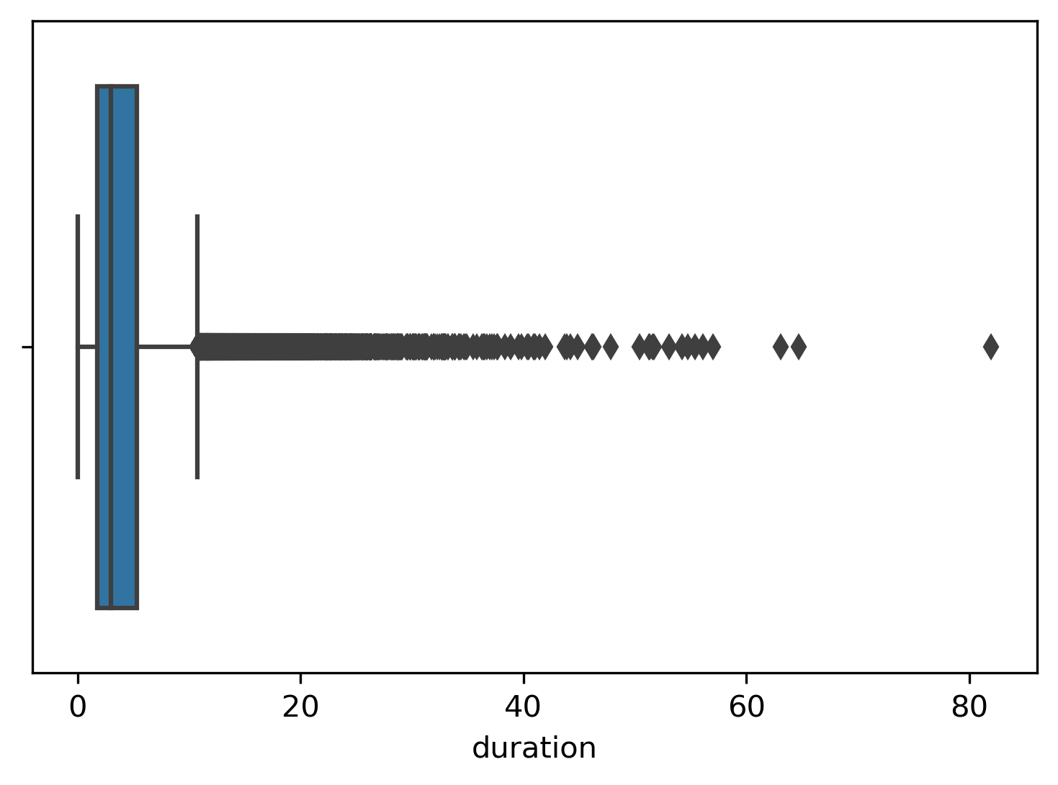
Numerical Predictors
Duration
we turn duration into minutes for plotting
Duration is also positively skewed
Duration higher than 10~15 min are regarded as outliers

Slide 22
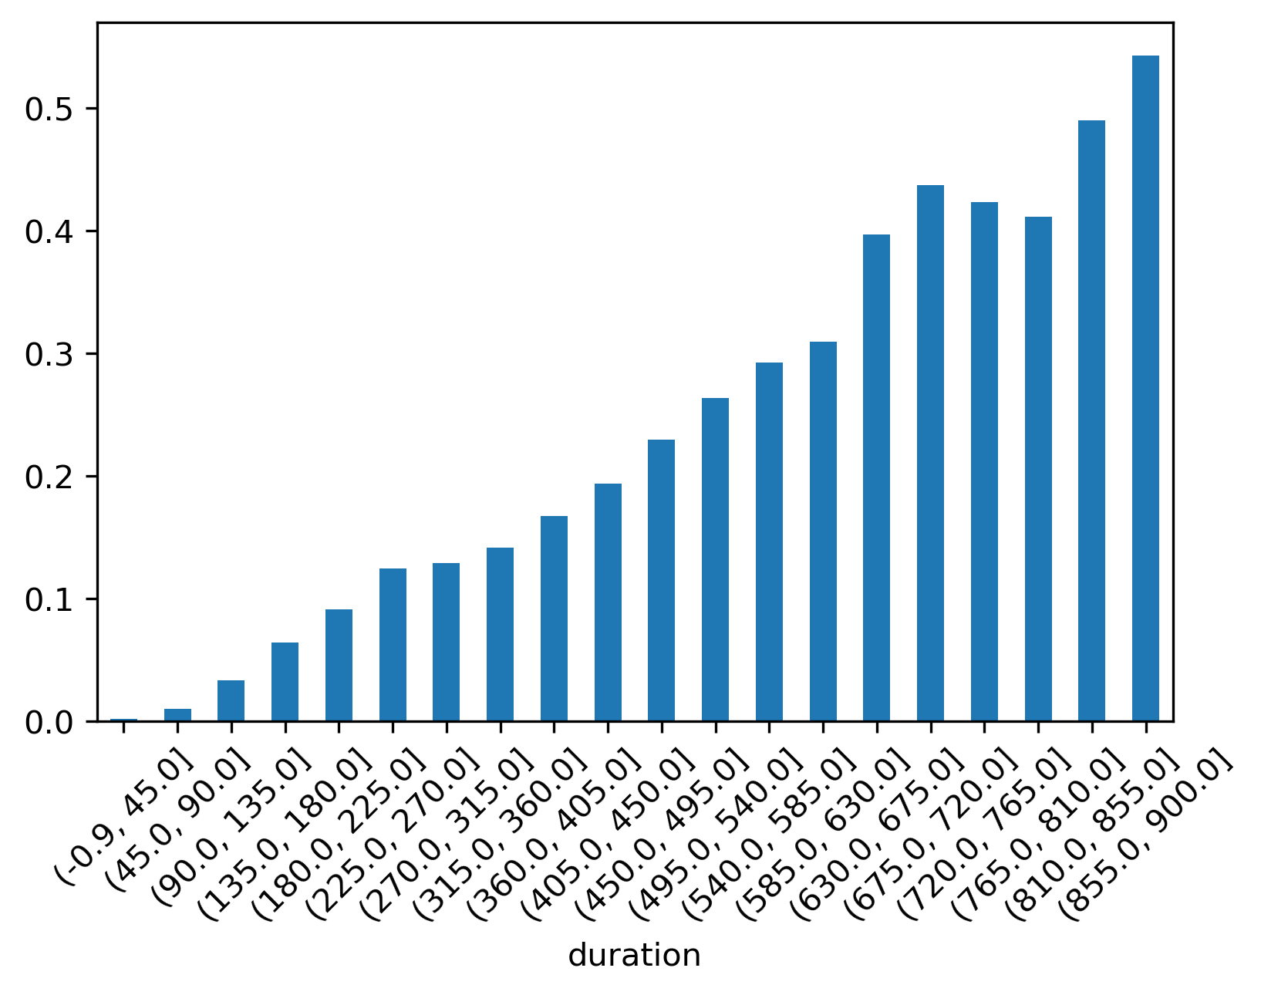
Numerical Predictors
Duration
For those below 15, there’s an increasing subscription probability of clients with longer contact duration

Slide 23
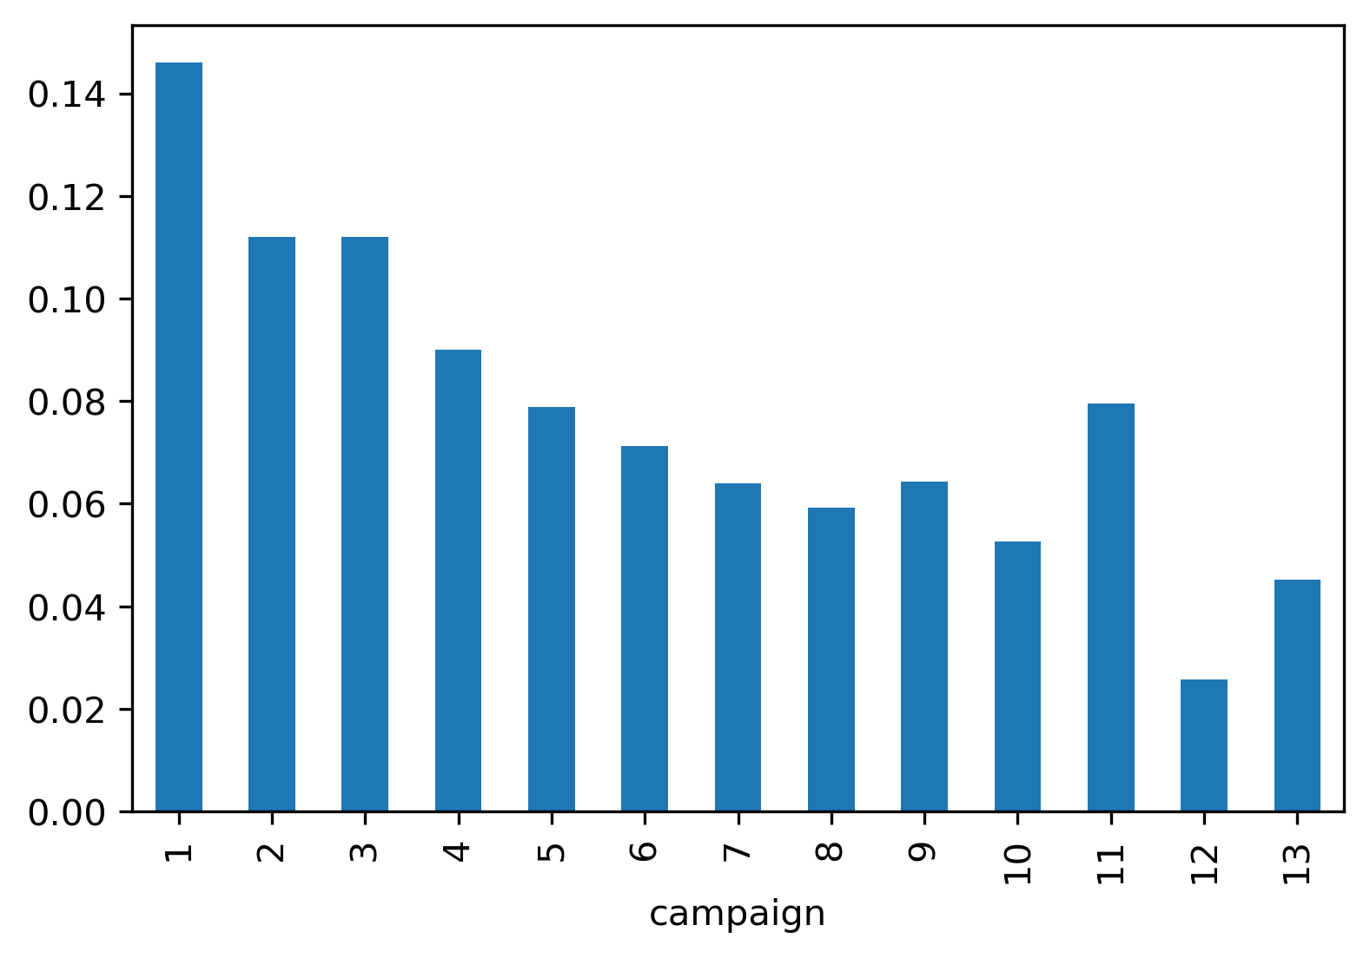
Numerical Predictors
Campaign
As there are very few samples for campaign >= 14 (less than 100 samples per value of campaign), we only look into the subscribing rate of campaigns < 14.
There’s a decreasing probability of subscription as contacts during this campaign grow.

Slide 24
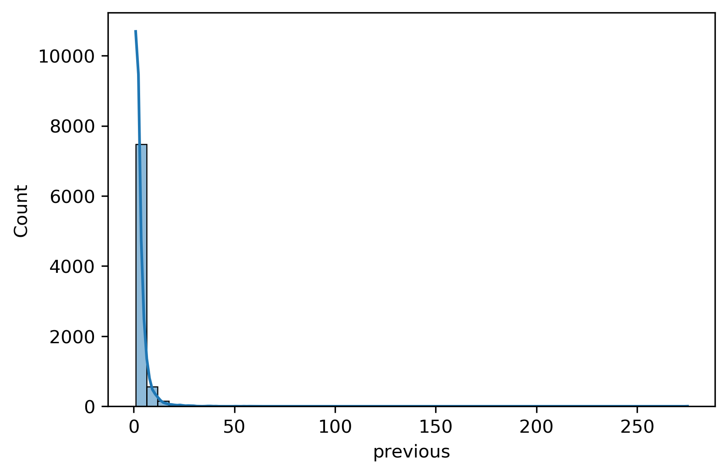
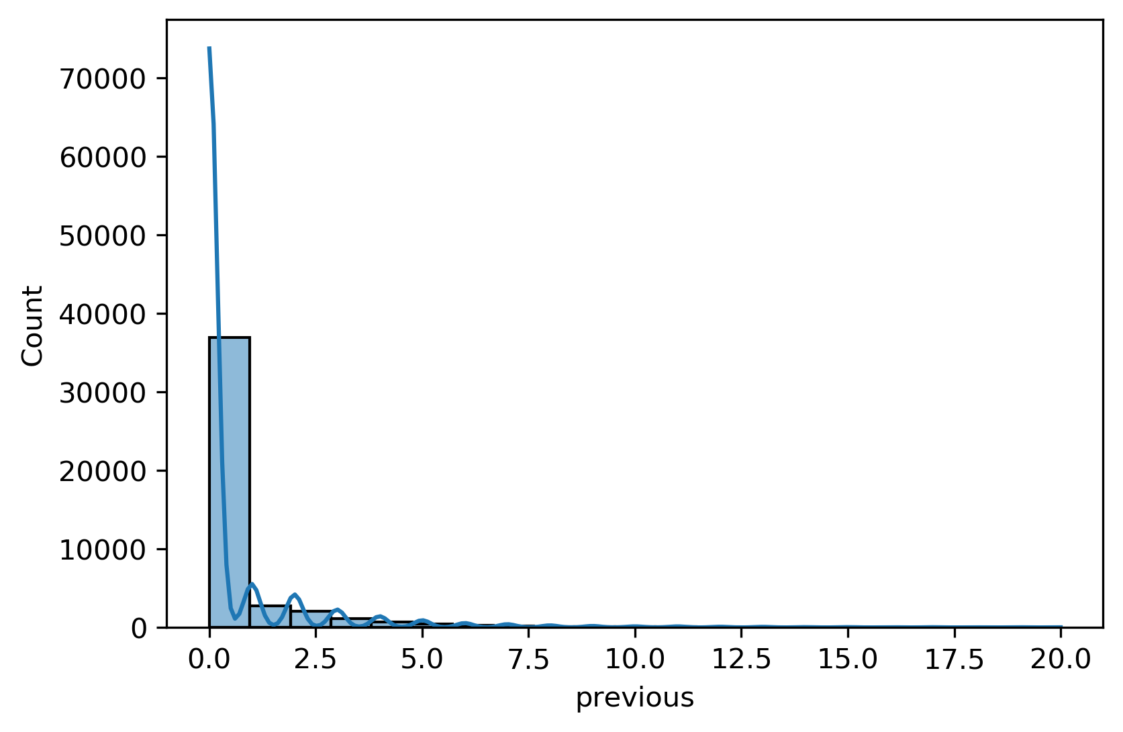
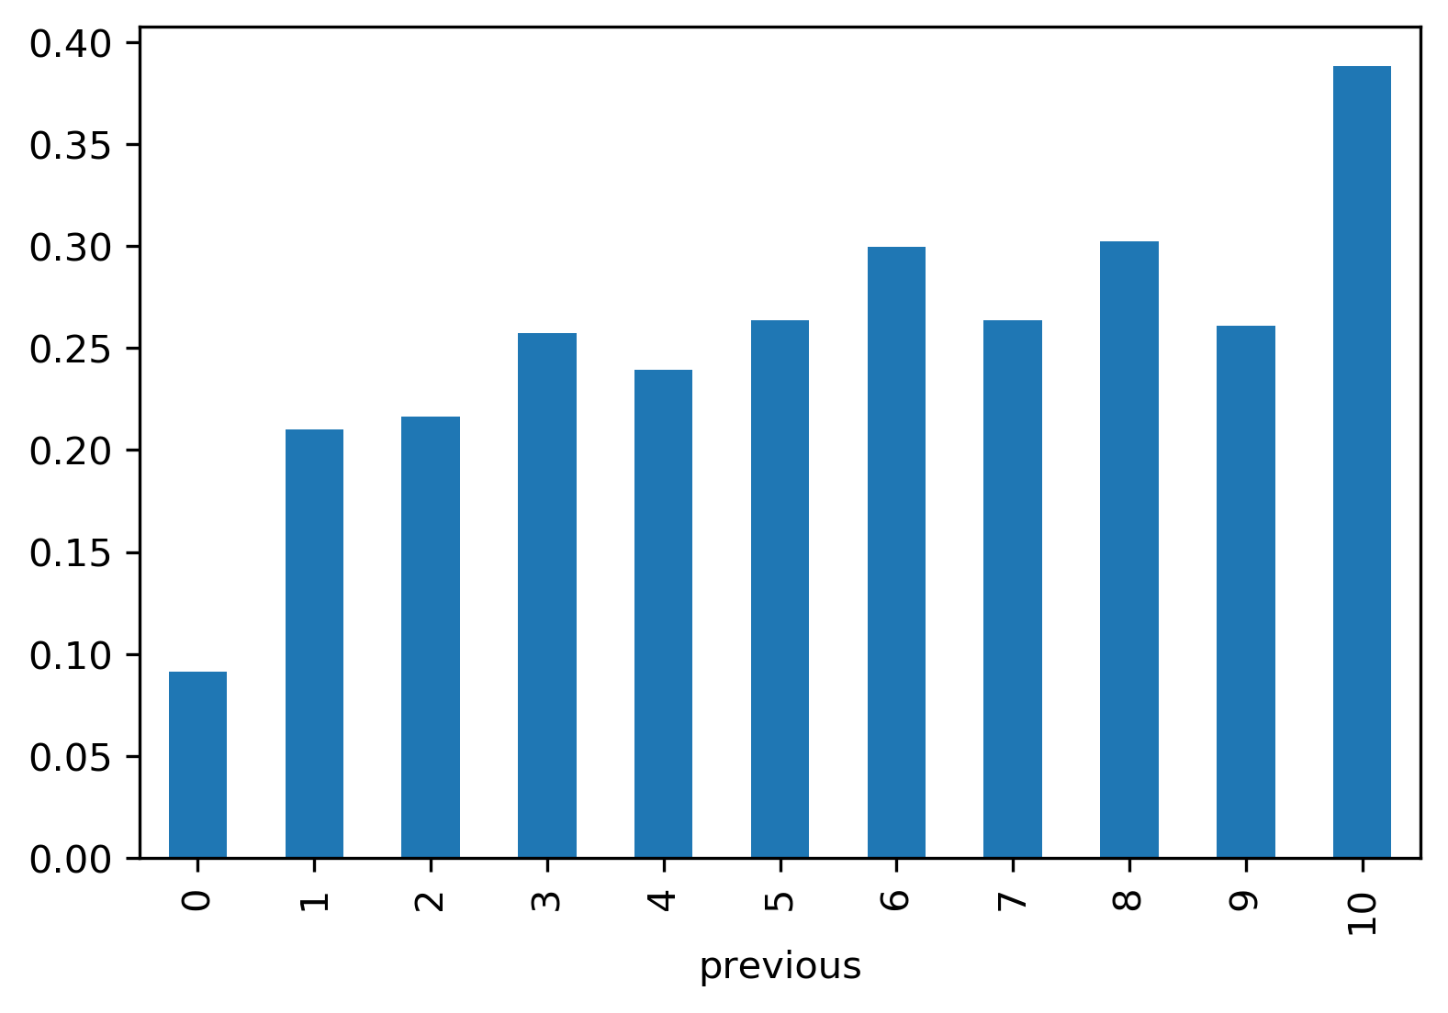
Numerical Predictors
Previous
distribution of 'previous' is also extremely skewed with 22 as its 99.9% quantile.
For those being contacted before this campaign fewer than or equal to 10 times, the subscribing probability grows as the contact counts grow.

Slide 25
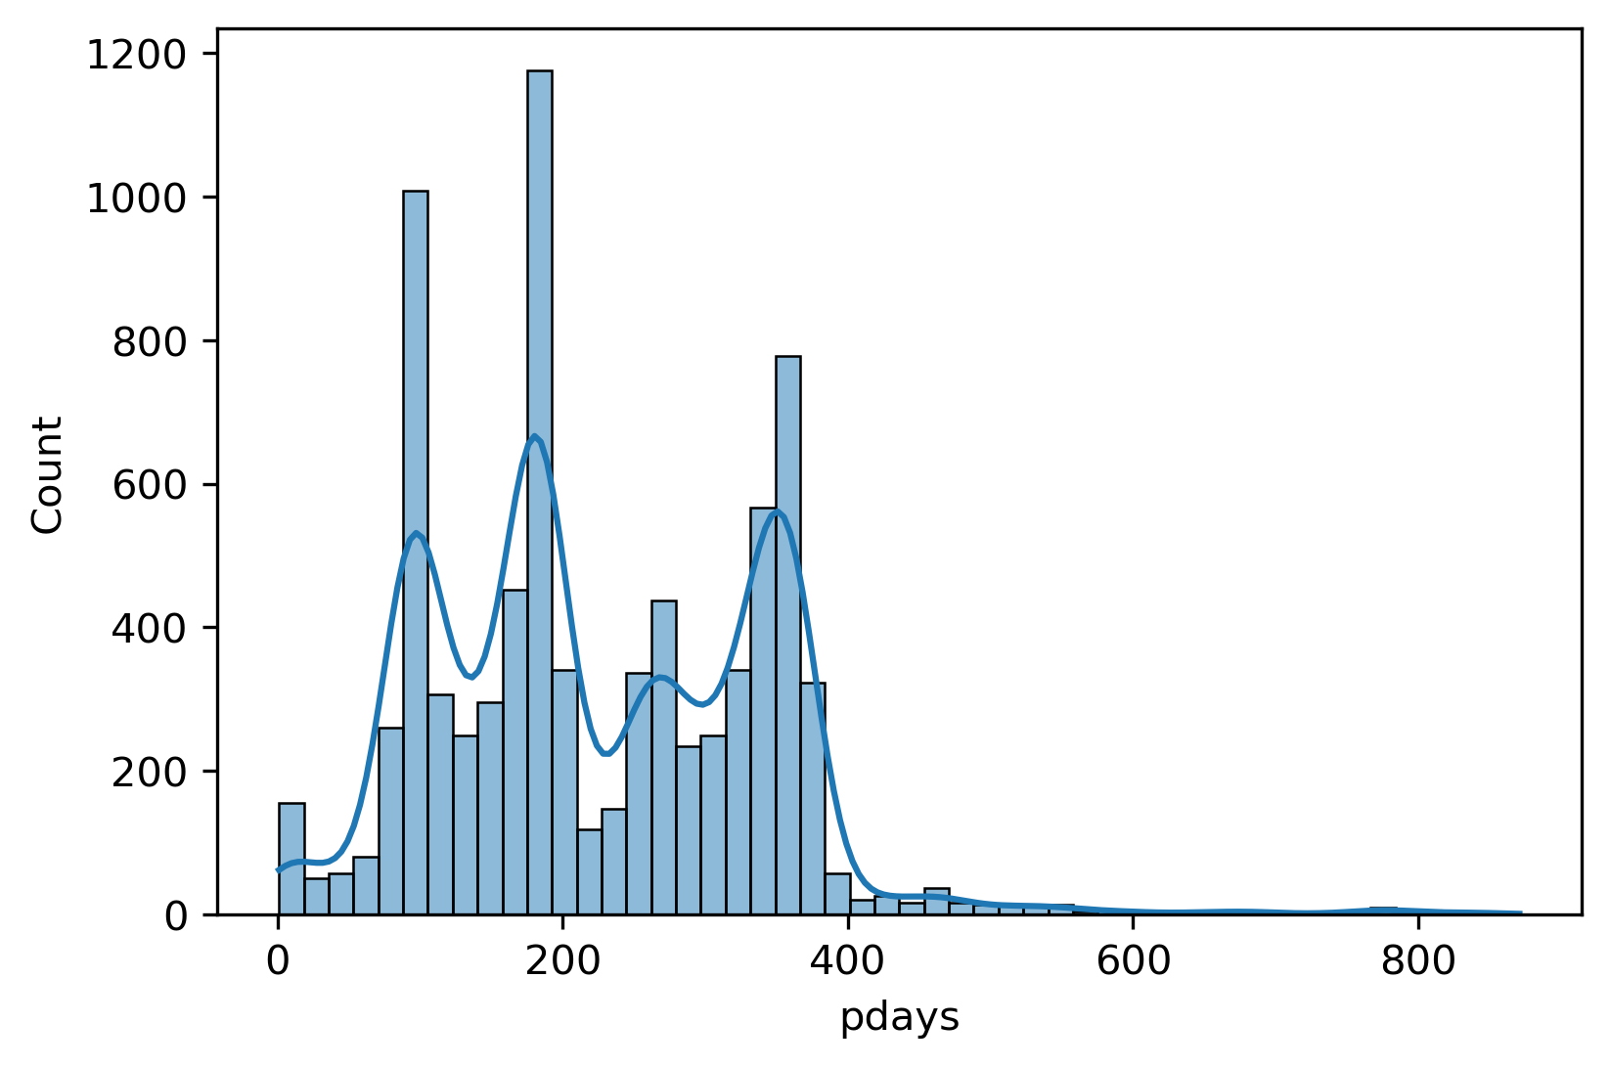
Numerical Predictors
Pdays
The majority of clients wasn’t previously contacted (81.7%). The distribution of clients with previous contacts is shown below.

Slide 26
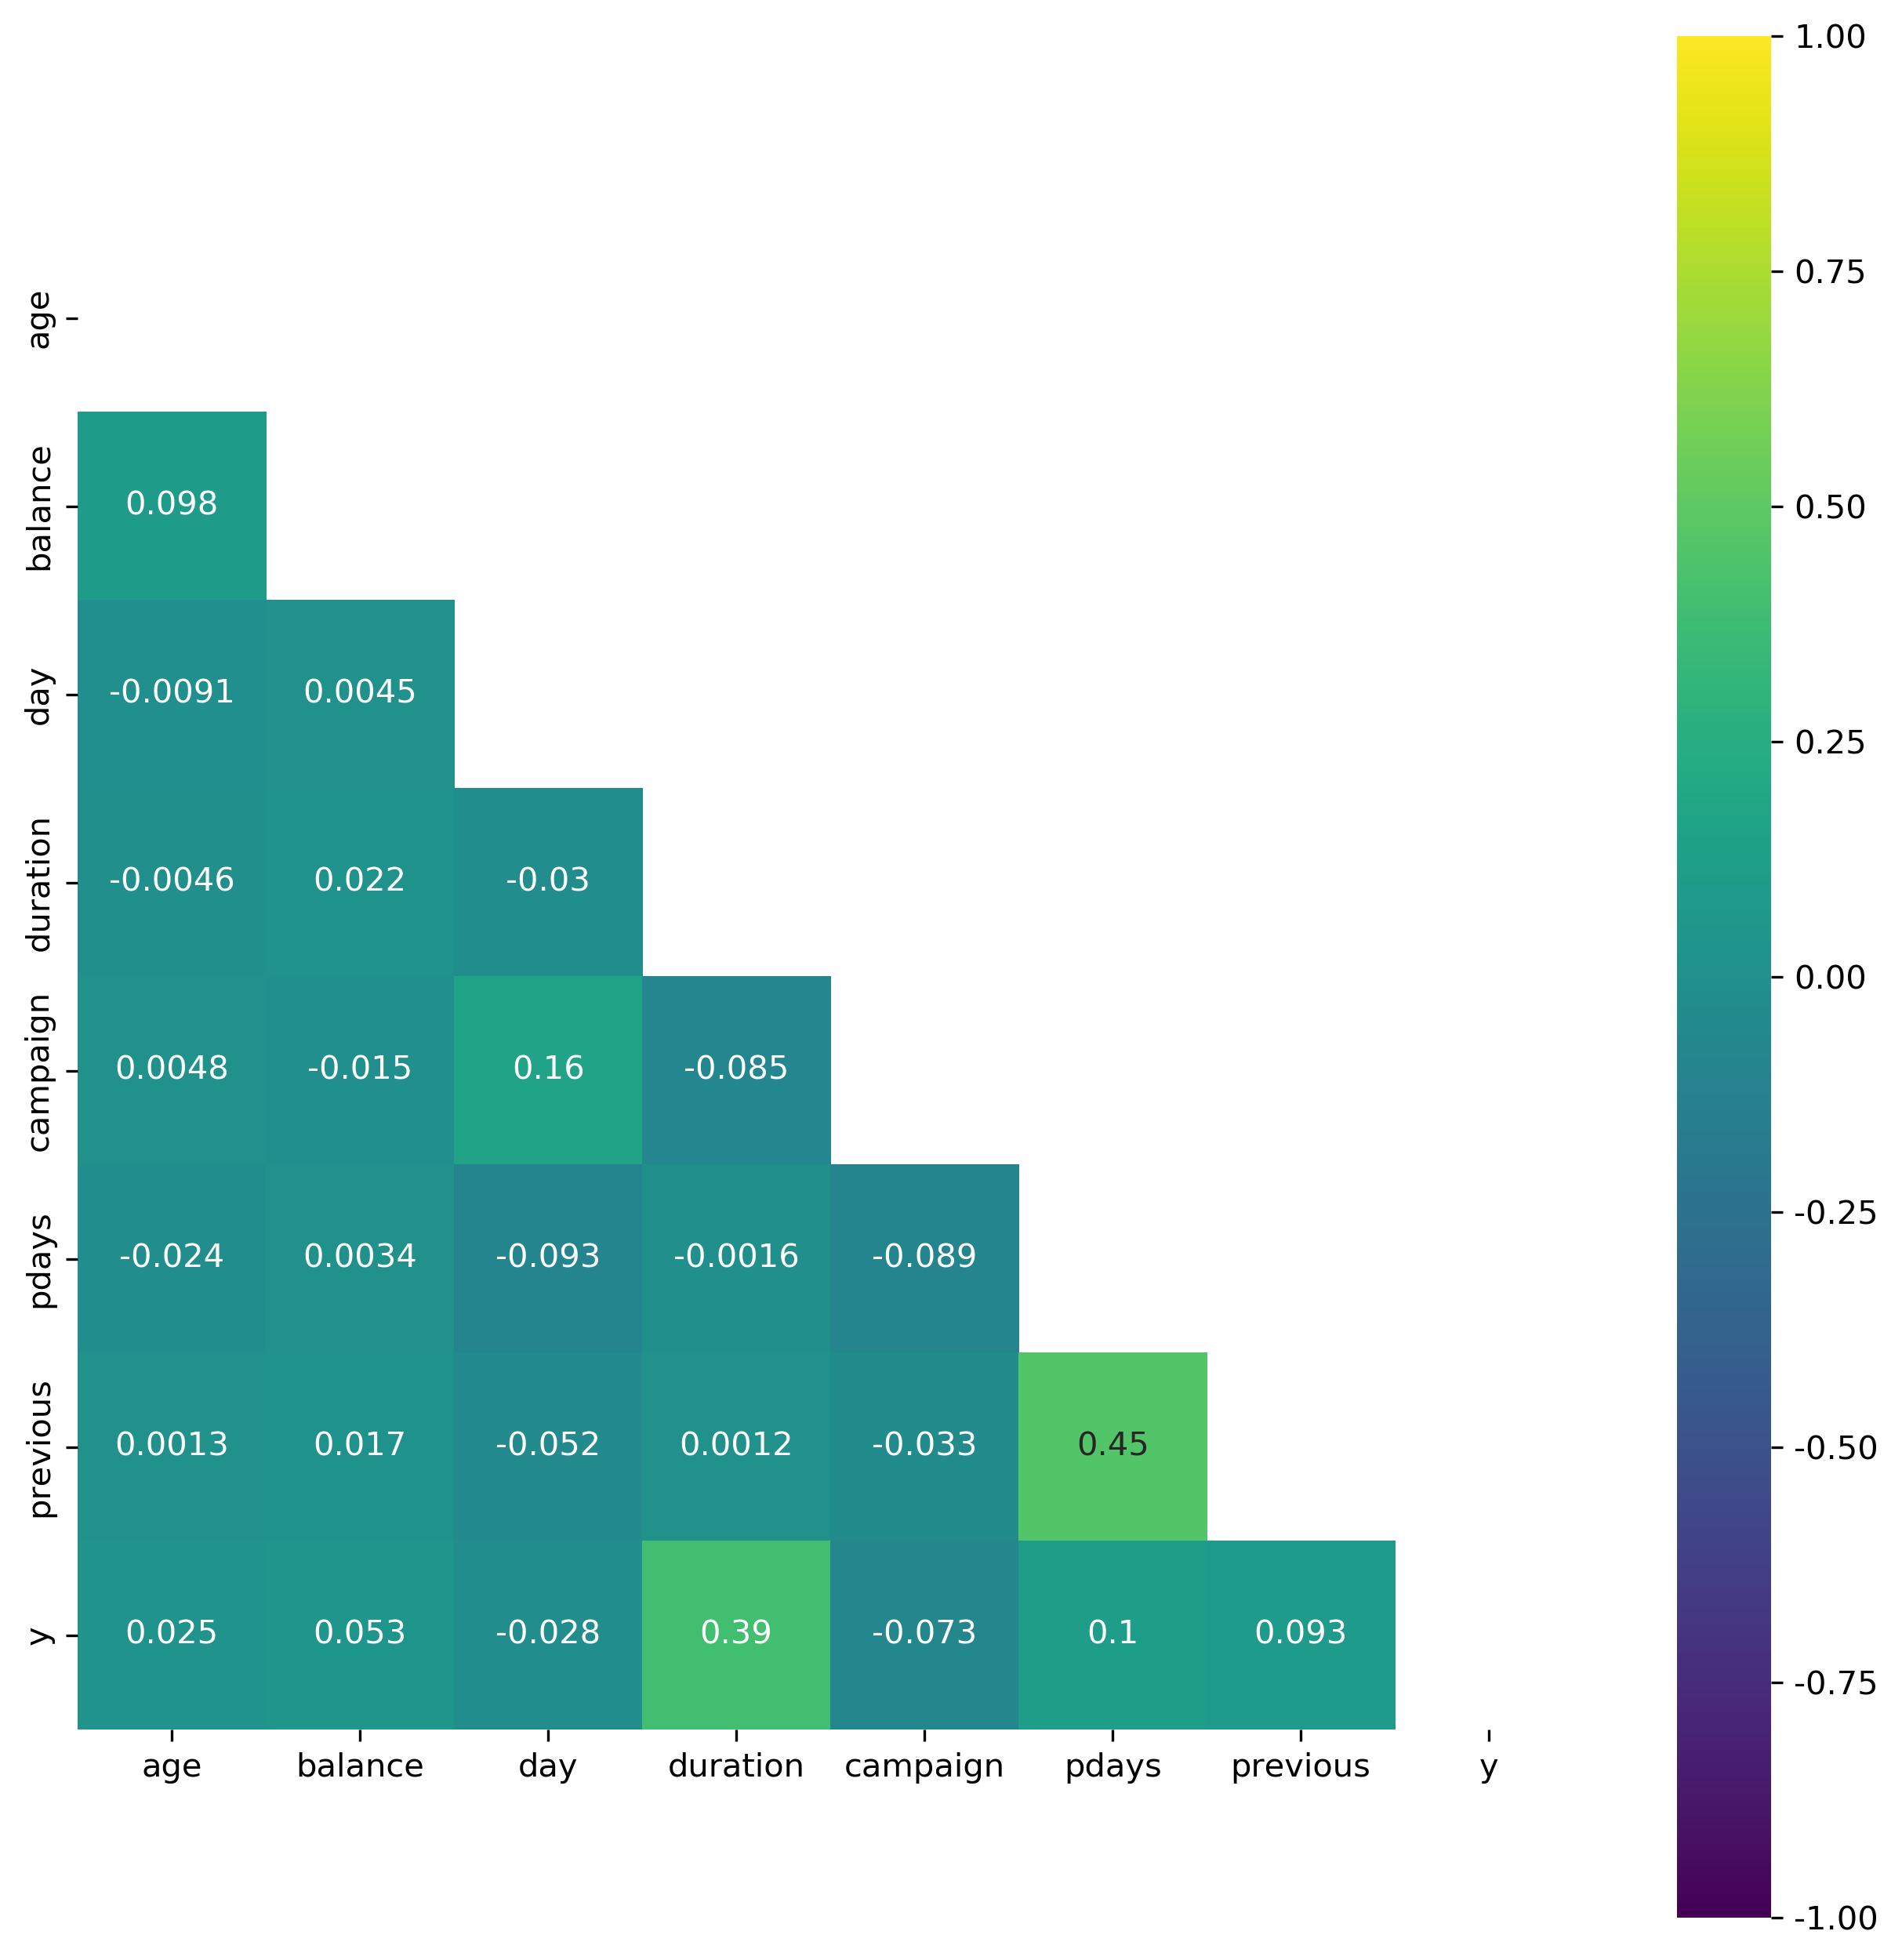
Correlations
The relationship between response ‘y’ and predictor ‘duration’ is relatively stronger.
‘pdays’ and ‘previous’ are correlated.

Slide 27
Data Preprocessing

Slide 28
Simple Transformations
For binary variables ‘default’, ’housing’, ‘loan’, simply map ‘yes’ to 1 and ‘no’ to 0.
Column ‘education’ is ordinal and can be encoded as an integer, with {'unknown':0, 'primary':1, 'secondary':2, 'tertiary’:3} (We will deal with the unknown data in ‘education’ later)
‘month’ is also transformed to integer.

Slide 29
One-hot Encoding
For the rest categorical variables, ‘job’, ‘martial’, ‘contact’, ‘poutcome’, we adopt one-hot encoding to transform them.

Slide 30
“unknown”
Although there is no NULL in the data, there are noticeably many “unknown” values in our categorical data.
For ‘job’, ‘contact’, ‘poutcome’, because ‘unknown’ doesn’t provide additional useful knowledge about the client, we choose to simply drop the one-hot columns representing ‘unknown’ values
Feature Name | Unknown Percentage
Job | 0.6%
Education | 4.1%
Contact | 28.8%
Poutcome | 81.7

Slide 31
“unknown” (cont.)
As we observe an increasing probability of subscription for clients with higher education from the previous EDA results, and the ‘unknown’ proportion isn’t that big, we decide to impute the ‘unknown’ in education by building an elementary Random Forest model, taking ‘education’ as response.
By checking the feature importance of this RF imputer, we know that ‘balance’, ‘duration’ and some ‘job’s are good contributors to impute ‘education’.

Slide 32
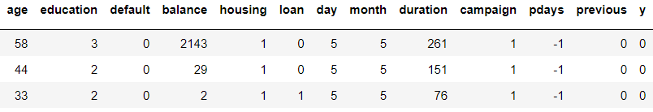
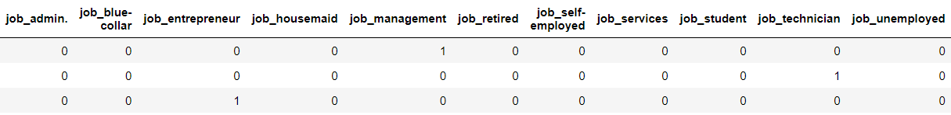
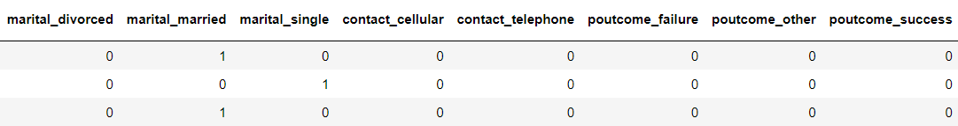
Sample Input Data
Ordinal Data
One-hot Data: job, marital, contact, poutcome

Slide 33
Splitting
Split data into Train and Test in the ratio of 8:2
Within the training set, we utilize 5-fold cross validation to tune the hyper-parameters
80% Training set
20% Test set
5-fold cross validation

Slide 34
Scaling & Balancing Data
Shown in the EDA part, many features are skewed, not Gaussian-like, so we adopt min-max scaler to make predictors into similar scales
Besides, we also use balanced class weight or SMOTE to adjust the issue of data imbalance

Slide 35
Modeling

Slide 36
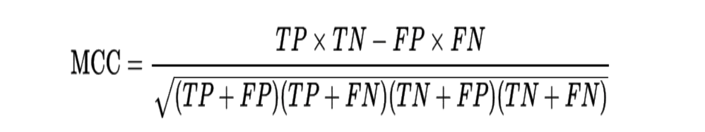
Evaluation Metrics
As our data is inherently imbalanced, accuracy might not be a good measure of model performance
Instead, we adopt Matthews Correlation Coefficient (MCC) for both parameters tuning and final model evaluation
Additionally, we also compare the ROC curves of all models we choose

Slide 37
Selected Models
Logistic Regression
Ridge Regression
Neural Network
Random Forest
Gradient Boosting

Slide 38
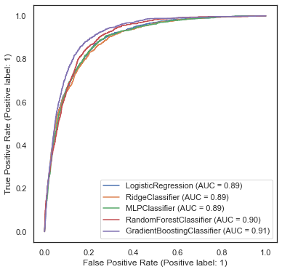
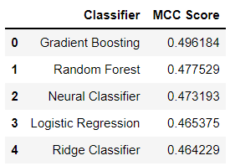
Comparison
Among the models we choose, Gradient Boosting is the one with highest AUC and MCC.

Slide 39
Insights & Conclusions

Slide 40
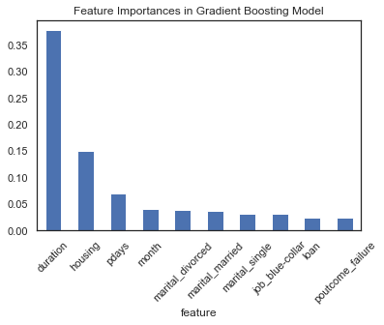
Feature importances
From the feature importances in gradient boosting model, last contact duration plays an important part in predicting clients’ subscription
More efforts and focus should be delivered to those clients with a higher contact duration last time

Slide 41
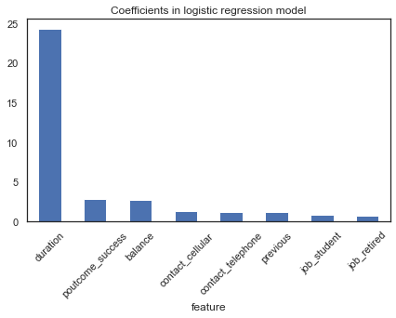
Preferred Client Profile
The users with successful previous campaigns have higher probability to subscribe to a new campaign
Students and the retired are the groups with higher probability of subscription.
Notes:
The two facts are not that surprising. The retired who can no longer work as younger people to make money but with more cumulative wealth tend to invest through term deposit. They don’t have to spend too much energy to manage it and at the same time can get some fair amounts back.
For young students, they don’t have that much wealth accumulation and wealth-managing experience. As they are more vulnerable to potential risks, they might prefer to choose some low-risk financial products to start with.

Slide 42
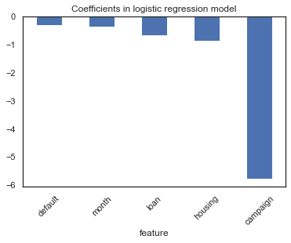
Preferred Client Profile (cont.)
Clients with personal or housing loan have relatively less money to subscribe to a term deposit, while those with higher balance should be the target.

Slide 43
Timing of Marketing
From the predictor ‘month’ we know that most bank marketing calls are during summertime, and May is the month with highest activity counts. However, it’s also the month with lowest subscribing conversion.
Besides, according to the subscribing rate by month, one might suggest that it’s better to market the next campaign during fall or winter. In this case, one should notice the fact that during fall and winter the number of calls are significantly fewer. There might be some other reasons for that.

Slide 44
Directions for Further Improvements

Slide 45
Directions for Further Improvements
Try to find the correlation between subscription with more features, such as last contact day and days after previous campaign (pdays)
Try to do feature selection

Slide 46
Many thanks here!

