Slide 2
Overview
Part 1 – Datapaths
  Introduction
  Datapath Example
  Arithmetic Logic Unit (ALU)
  Shifter
  Datapath Representation and Control Word
Part 2 – A Simple Computer
Part 3 – Multiple Cycle Hardwired Control
Chapter 9 Part 1 <number>

Slide 3
Introduction
Computer Specification
  Instruction Set Architecture (ISA) - the specification of a computer's appearance to a programmer at its lowest level
  Computer Architecture - a high-level description of the hardware implementing the computer derived from the ISA
  The architecture usually includes additional specifications such as speed, cost, and reliability.
Chapter 9 Part 1 <number>

Slide 4
Introduction (continued)
Simple computer architecture decomposed into:
  Datapath for performing operations
  Control unit for controlling datapath operations
A datapath is specified by:
  A set of registers
  The microoperations performed on the data stored in the registers
  A control interface
Chapter 9 Part 1 <number>

Slide 5
Datapaths
Guiding principles for basic datapaths:
  The set of registers
    Collection of individual registers
    A set of registers with common access resources called a register file
    A combination of the above
  Microoperation implementation
    One or more shared resources for implementing microoperations
    Buses - shared transfer paths
    Arithmetic-Logic Unit (ALU) - shared resource for implementing arithmetic and logic microoperations
    Shifter - shared resource for implementing shift microoperations
Chapter 9 Part 1 <number>

Slide 6
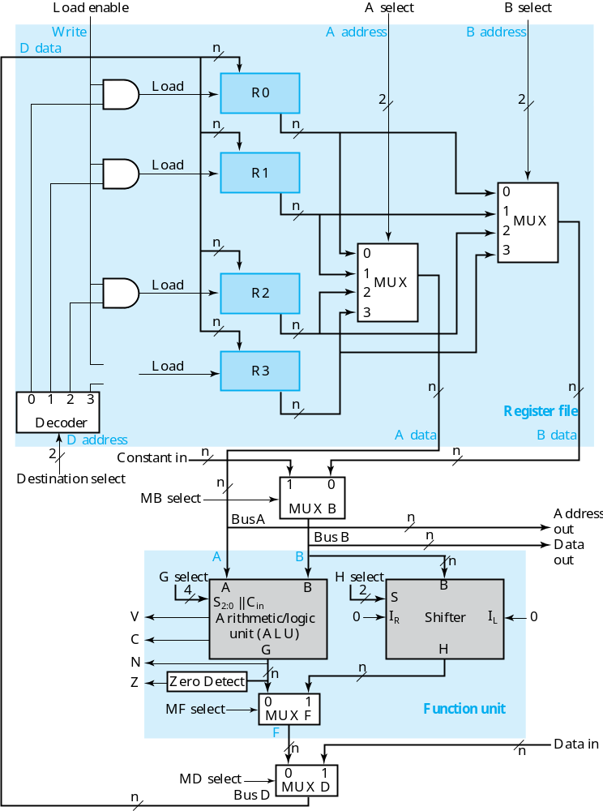
Datapath Example
Four parallel-load registers
Two mux-based register selectors
Register destination decoder
Mux B for external constant input
Buses A and B with external address and data outputs
ALU and Shifter with Mux F for output select
Mux D for external data input
Logic for generating status bits
V, C, N, Z
Chapter 9 Part 1 <number>
Notes:
This is just an example. We’ll build on it later on to implement a simple computer.

Slide 7
Datapath Example: Performing a Microoperation
Microoperation: R0 ← R1 + R2
Apply 01 to A select to place contents of R1 onto Bus A
Apply 10 to B select to place contents of R2 onto B data and apply 0 to Mux B select to place B data on Bus B
Apply 0010 to G select to perform addition G = Bus A + Bus B
Apply 0 to Mux F select and 0 to Mux D select to place the value of G onto BUS D
Apply 00 to Destination select to enable the Load input to R0
Apply 1 to Load Enable to force the Load input to R0 to 1 so that R0 is loaded on the clock pulse (not shown)
The overall microoperation requires
1 clock cycle
Chapter 9 Part 1 <number>

Slide 8
Datapath Example: Key Control Actions for Microoperation Alternatives
Perform a shift microoperation – apply 1 to MF select
Use a constant in a micro- operation using Bus B – apply 1 to MB select
Provide an address and data for a memory or output write microoperation – apply 0 to Load enable to prevent register loading
Provide an address and obtain data for a memory or output read microoperation – apply 1 to MD select
For some of the above, other control signals become don't cares
Chapter 9 Part 1 <number>

Slide 9
Arithmetic Logic Unit (ALU)
In this and the next section, we deal with detailed design of typical ALUs and shifters
Decompose the ALU into:
  An arithmetic circuit
  A logic circuit
  A selector to pick between the two circuits
Arithmetic circuit design
  Decompose the arithmetic circuit into:
    An n-bit parallel adder
    A block of logic that selects four choices for the B input to the adder
    See next slide for diagram
Chapter 9 Part 1 <number>

Slide 10
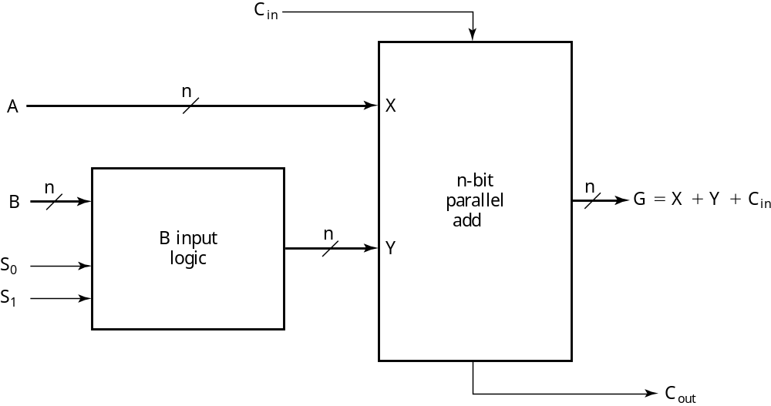
Arithmetic Circuit Design (continued)
There are only four functions of B to select as Y in G = A + Y:
  0
  B
  B
  1
What functions are implemented with carry-in to the adder = 0? =1?
C_{in} = 0
C_{in} = 1
G = A
G = A + 1
G = A + B
G = A + B + 1
G = A + B
G = A + B + 1
G = A – 1
G = A
Chapter 9 Part 1 <number>

Slide 11
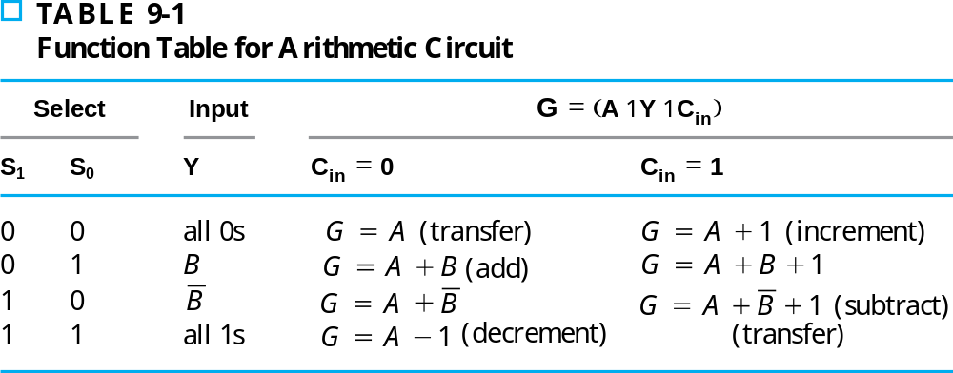
Arithmetic Circuit Design (continued)
Adding selection codes to the functions of B:
The useful arithmetic functions are labeled in the table
Note that all four functions of B produce at least one useful function
+
+
Chapter 9 Part 1 <number>

Slide 12
Arithmetic Logic Unit (ALU)
Next, use the arithmetic circuit, the logic circuit, and a 2-way multiplexer to form the ALU. See the next slide for the bit slice diagram.
The input connections to the arithmetic circuit and logic circuit have been assigned to prepare for seamless addition of the shifter, keeping the selection codes for the combined ALU and the shifter at 4 bits:
  Carry-in C_{i} and Carry-out C_{i+1} go between bits
  A_{i} and B_{i} are connected to both units
  A new signal S₂ performs the arithmetic/logic selection
  The select signal entering the LSB of the arithmetic circuit, C_{in}, is connected to the least significant selection input for the logic circuit, S₀.
Chapter 9 Part 1 <number>

Slide 13
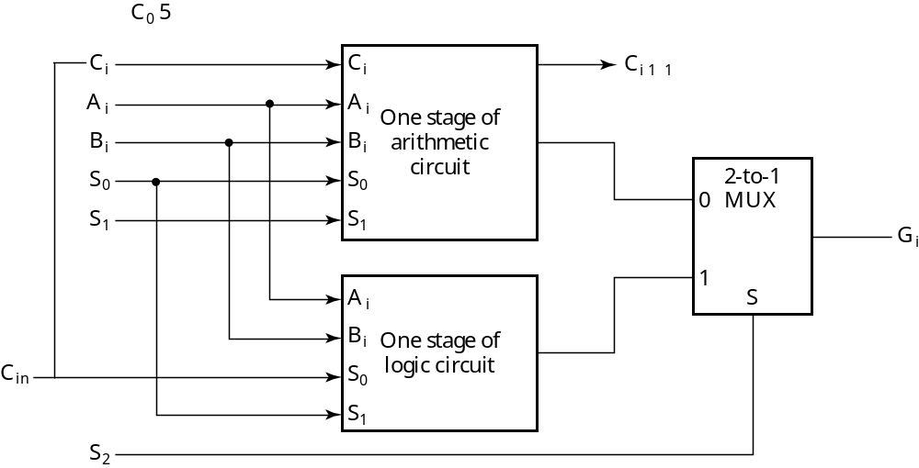
Arithmetic Logic Unit (ALU) (continued)
The next most significant select signals, S0 for the arithmetic circuit and S1 for the logic circuit, are wired together, completing the two select signals for the logic circuit.
The remaining S1 completes the three select signals for the arithmetic circuit.
Chapter 9 Part 1 <number>

Slide 14
Combinational Shifter Parameters
Direction: Left, Right
Number of positions with examples:
  Single bit:
    1 position
    0 and 1 positions
  Multiple bit:
    1 to n – 1 positions
    0 to n – 1 positions
Filling of vacant positions
  Many options depending on instruction set
  Here, will provide input lines or zero fill
Chapter 9 Part 1 <number>

Slide 15
4-Bit Basic Left/Right Shifter
Serial Inputs:
  I_{R} for right shift
  I_{L} for left shift
Serial Outputs
  R for right shift (Same as MSB input)
  L for left shift (Same as LSB input)
B
B
Shift Functions:
(S₁, S₀) = 00 Pass B unchanged
01 Right shift
10 Left shift
11 Unused
3
2
B
1
B
0
Serial
output L
Serial
I
output R
R
I
L
0
1
2
M
0
1
2
M
0
1
2
M
0
1
2
M
S
U
S
U
S
U
S
U
X
X
X
X
S
2
H
3
H
2
H
1
H
0
Chapter 9 Part 1 <number>

Slide 16
Datapath Representation
Have looked at detailed design of ALU and shifter in the datapath in slide 8
Here we move up one level in the hierarchy from that datapath
The registers, and the multiplexer, decoder, and enable hardware for accessing them become a register file
The ALU, shifter, Mux F and status hardware become a function unit
The remaining muxes and buses which handle data transfers are at the new level of the hierarchy
n
Write
D data
m
D address
2
m
x
n
Register file
m
A address
B address
m
A data
B data
Constant in
n
n
n
MB select
1
0
MUX B
Bus A
n
Address out
Bus B
n
Data out
FS
4
A
B
V
C
Function
N
unit
Z
F
n
n
Data in
MD select
0
1
MUX D
Chapter 9 Part 1 <number>

Slide 17
Datapath Representation (continued)
In the register file:
  Multiplexer select inputs become A address and B address
  Decoder input becomes D address
  Multiplexer outputs become A data and B data
  Input data to the registers becomes D data
  Load enable becomes write
The register file now appears like a memory based on clocked flip flops (the clock is not shown)
The function unit labeling is quite straightforward except for FS
n
Write
D data
m
D address
2
m
x
n
Register file
m
A address
B address
m
A data
B data
Constant in
n
n
n
MB select
1
0
MUX B
Bus A
n
Address out
Bus B
n
Data out
FS
4
A
B
V
C
Function
N
unit
Z
F
n
n
Data in
MD select
0
1
MUX D
Chapter 9 Part 1 <number>

Slide 18
Definition of Function Unit Select (FS) Codes
G
Select,
H
Select,
and
MF
in T
of
FS
Codes
MF
G
H
Boolean
Equations:
MFS = F₃ F₂
GS_{i} = F_{i}
HS_{i} = F_{i}
FS(3:0)
Select
Select(3:0)
Select(1:0)
Micr
ooperation
0000
0
0000
XX
←
F A
0001
0
0001
XX
←
+
F A
1
0010
0
0010
XX
←
+
F A
B
0011
0
0011
XX
←
+
+
F A
B
1
0100
0
0100
XX
←
+
F A
B
0101
0
0101
XX
←
+
+
F A
B
1
0110
0
0110
XX
←
−
F A
1
0111
0
0111
XX
F
←
A
1000
0
1
X
00
XX
F
←
∧
A B
1001
0
1
X
01
XX
F
←
∨
A B
1010
0
1
X
10
XX
F
←
⊕
A B
1011
0
1
X
11
XX
F
←
A
1100
1
XXXX
00
F
←
B
1101
1
XXXX
01
F
←
sr
B
1110
1
XXXX
10
F
←
sl
B
Chapter 9 Part 1 <number>

Slide 19
The Control Word
The datapath has many control inputs
The signals driving these inputs can be defined and organized into a control word
To execute a microinstruction, we apply control word values for a clock cycle. For most microoperations, the positive edge of the clock cycle is needed to perform the register load
The datapath control word format and the field definitions are shown on the next slide
Chapter 9 Part 1 <number>

Slide 20
The Control Word Fields
Fields
  DA – D Address
  AA – A Address
  BA – B Address
  MB – Mux B
  FS – Function Select
  MD – Mux D
  RW – Register Write
The connections to datapath are shown in the next slide
15
14
13
12
11
10
9
8
7
6
5
4
3
2
1
0
D
A
AA
BA
M
FS
M
R
B
D
W
Control word
Chapter 9 Part 1 <number>

Slide 21
Control Word Block Diagram
n
R
W
0
Write
D data
D
A
15
14
D address
13
8
x
n
Register file
AA
12
A address
B address
9
BA
11
8
10
A data
B data
7
n
n
Constant in
n
MB
6
1
0
Bus A
MUX B
n
Bus B
n
Address out
Data out
A
B
V
5
C
Function
4
FS
N
unit
3
Z
2
n
n
Data in
0
1
MD
1
MUX D
Bus D
Chapter 9 Part 1 <number>

Slide 22
Control Word Encoding
Encoding of Control
W
D
A
,
AA,
B
A
MB
FS
MD
R
W
Function
Code
Function
Code
Function
Code
Function
Code
Function
Code
R
0
000
Register
0
←
F A
0000
Function
0
No write
0
R
1
001
Constant
1
←
0001
Data In
1
Write
1
F A+1
R
2
010
←
0010
F A+B
R
3
011
←
F A+B+1
0011
R
4
100
←
F A+
B
0100
R
5
101
←
+
0101
F A+
B
1
R
6
110
←
F A-
1
0110
R
7
111
←
F A
0111
←
∧
F A
B
1000
←
∨
F A
B
1001
←
⊕
B
1010
F A
F
←
A
1011
←
1100
F B
F
←
sr
B
1101
F
←
sl
B
1110
Chapter 9 Part 1 <number>

Slide 23
Microoperations for the Datapath - Symbolic Representation
Micr
o-
op
eratio
n
D
A
A
A
B
A
M
B
F
S
M
D
R
W
R
1
←
R
2
R
3
R
1
R
2
R
3
R
e
g
–
ister
F A
B
1
F
unction
Write
=
+ +
R
4
←
s
l R6
R
4
—
R
6
R
e
g
ister
F
=
sl
B
F
unction
Write
R
7
←
R
7 1
R
7
R
7
—
Re
gister
F A
1
Function
Write
+
=
+
R
1
←
R
0 2
R
1
R
0
—
Con
s
+
tant
F A
B
Func
tio
n
Write
=
+
Data out
←
R
3
——
R
3
R
eg
i
s
t
e
r
—
—
N
o Wr
it
e
R
4
←
D
ata in
R
4
——
—
—
Data in
Write
R
←
⊕
5 0
R
5
R
0
R
0
R
e
g
ister
F A
B
F
unction
Write
=
Chapter 9 Part 1 <number>

Slide 24
Microoperations for the Datapath - Binary Representation
m
Microoperations from T
a
Binary C
o
o
Results of simulation of the above
on the next slide
Micr
o-
o
p
eratio
n
D
A
A
A
B
A
M
B
F
S
M
D
R
W
R
1
←
R
2
–
R
3
0
0
1
0
1
0
011
0
010
1
0
1
R
4
←
s
l R6
10
0
XX
X
110
0
111
0
0
1
R
7
←
R
7 1
11
1
1
11
XXX
0
000
1
0
1
+
R
1
←
R
0 2
00
1
0
00
XXX
1
001
0
0
1
+
Data out
←
R
3
XX
X
X
XX
011
0
XXX
X
X
0
R
4
←
D
ata in
10
0
XX
X
XXX
X
XXX
X
1 1
←
R
5 0
1
0
1
0
0
0
000
0
101
0
0
1
Chapter 9 Part 1 <number>

Slide 25
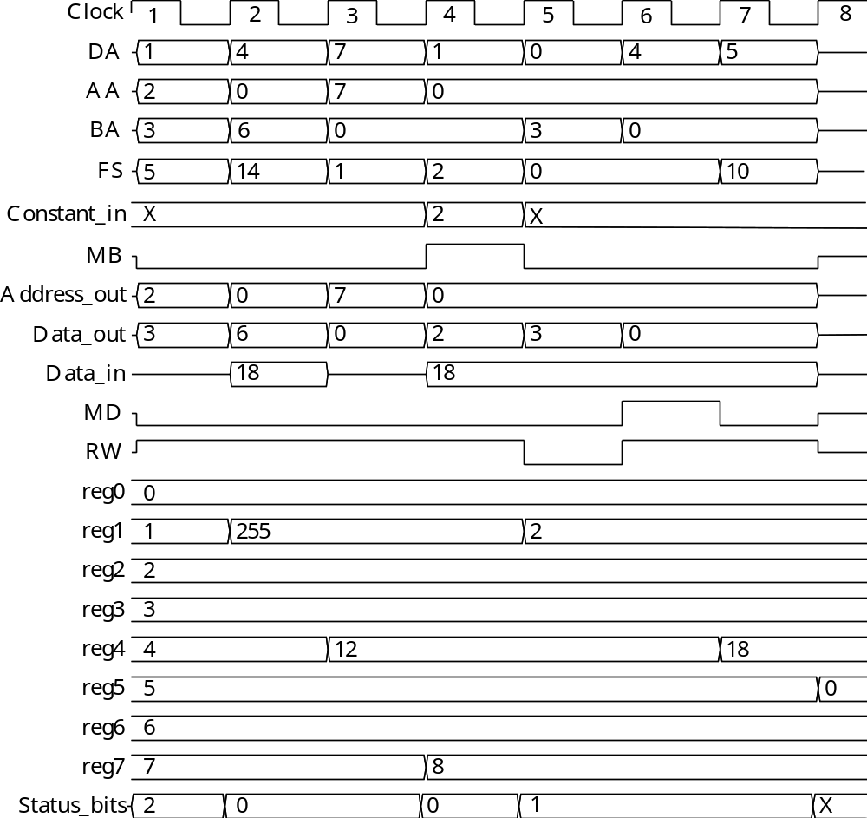
Datapath Simulation
Chapter 9 Part 1 <number>

Slide 26
Terms of Use
All (or portions) of this material © 2008 by Pearson Education, Inc.
Permission is given to incorporate this material or adaptations thereof into classroom presentations and handouts to instructors in courses adopting the latest edition of Logic and Computer Design Fundamentals as the course textbook.
These materials or adaptations thereof are not to be sold or otherwise offered for consideration.
This Terms of Use slide or page is to be included within the original materials or any adaptations thereof.
Chapter 9 Part 1 <number>

