Slide 2
Overview
Part 1 – Datapaths
Part 2 – A Simple Computer
  Instruction Set Architecture (ISA)
  Single-Cycle Hardwired Control
    PC Function
    Instruction Decoder
    Example Instruction Execution
Part 3 – Multiple Cycle Hardwired Control
Chapter 9 Part 2 <number>

Slide 3
Instruction Set Architecture (ISA) for Simple Computer (SC)
A programmable system uses a sequence of instructions to control its operation
An typical instruction specifies:
  Operation to be performed
  Operands to use, and
  Where to place the result, or
  Which instruction to execute next
Instructions are stored in RAM or ROM as a program
The addresses for instructions in a computer are provided by a program counter (PC) that can
  Count up
  Load a new address based on an instruction and, optionally, status information
Chapter 9 Part 2 <number>

Slide 4
Instruction Set Architecture (ISA) (continued)
The PC and associated control logic are part of the Control Unit
Executing an instruction - activating the necessary sequence of operations specified by the instruction
Execution is controlled by the control unit and performed:
  In the datapath
  In the control unit
  In external hardware such as memory or input/output
Chapter 9 Part 2 <number>

Slide 5
ISA: Storage Resources
The storage resources are "visible" to the programmer at the lowest software level (typically, machine or assembly language)
  Separate instruction and
  data memories imply
  "Harvard architecture"
  Done to permit use of
  single clock cycle per
  instruction implementation
  Due to use of "caches" in
  modern computer
  architectures, is a fairly
  realistic model
Program counter
(PC)
Instruction
Memory
(2¹⁵ × 16)
Register file
8 × 16
Data
Memory
(2¹⁵ × 16)
Chapter 9 Part 2 <number>

Slide 6
ISA: Instruction Format
A instruction consists of a bit vector
The fields of an instruction are subvectors representing specific functions and having specific binary codes defined
The format of an instruction defines the subvectors and their function
An ISA usually contains multiple formats
The SC ISA contains the three formats presented on the next slide
Chapter 9 Part 2 <number>

Slide 7
ISA: Instruction Format
15
9
8
6
5
3
2
0
Opcode
Destination
Register (DR)
Source Reg A
(SA)
Source Reg B
(SB)
(a) Register
15
9
8
6
5
3
2
0
Opcode
Destination
Register (DR)
Source Reg A
(SA)
Operand (OP)
(b) Immediate
15
9
8
6
5
3
2
0
Opcode
Address (AD)
(Left)
Source Reg A
(SA)
Address (AD)
(Right)
(c) Jump and Branch
The three formats are: Register, Immediate, and Jump and Branch
All formats contain an Opcode field in bits 9 through 15.
The Opcode specifies the operation to be performed
The purpose of the other fields depends on the kind of instruction
Chapter 9 Part 2 <number>

Slide 8
ISA: Instruction Format – Register
15
9
8
6
5
3
2
0
Opcode
Destination
Register (DR)
Source Reg A
(SA)
Source Reg B
(SB)
This format supports instructions represented by:
  R1 ← R2 + R3
  R1 ← sl R2
There are three 3-bit register fields:
  DR - specifies destination register (R1 in the examples)
  SA - specifies the A source register (R2 in the first example)
  SB - specifies the B source register (R3 in the first example and R2 in the second example)
Why is R2 in the second example SB instead of SA?
  The source for the shifter in our datapath to be used in implementation is Bus B rather than Bus A
Chapter 9 Part 2 <number>

Slide 9
ISA: Instruction Format – Immediate
15
9
8
6
5
3
2
0
Opcode
Destination
Register (DR)
Source Reg A
(SA)
Operand
(OP)
This format supports instructions described by:
  R1 ← R2 + 3
The B Source Register field is replaced by an Operand field OP which specifies a constant.
The Operand:
  3-bit constant
  Values from 0 to 7
The constant:
  Zero-fill (on the left of) the Operand to form 16-bit constant
  16-bit representation for values 0 through 7
Chapter 9 Part 2 <number>

Slide 10
ISA: Instruction Format – Jump and Branch
15
9
8
6
5
3
2
0
Opcode
Address (AD)
(Left)
Source Reg A
(SA)
Address (AD)
(Right)
This instruction supports changes in the sequence of instruction execution by adding an extended, 6-bit, signed 2s-complement address offset to the PC value
The 6-bit Address (AD) field replaces the DR and SB fields
  Example: Suppose that a jump is specified by the Opcode and the PC contains 45 (0…0101101) and Address contains – 12 (110100). Then the new PC value will be:
  0…0101101 + (1…110100) = 0…0100001 (45 + (– 12) = 33)
The SA field is retained to permit jumps and branches on N or Z based on the contents of Source register A
Chapter 9 Part 2 <number>

Slide 11
ISA: Instruction Specifications
The specifications provide:
  The name of the instruction
  The instruction's opcode
  A shorthand name for the opcode called a mnemonic
  A specification for the instruction format
  A register transfer description of the instruction, and
  A listing of the status bits that are meaningful during an instruction's execution (not used in the architectures defined in this chapter)
Chapter 9 Part 2 <number>

Slide 12
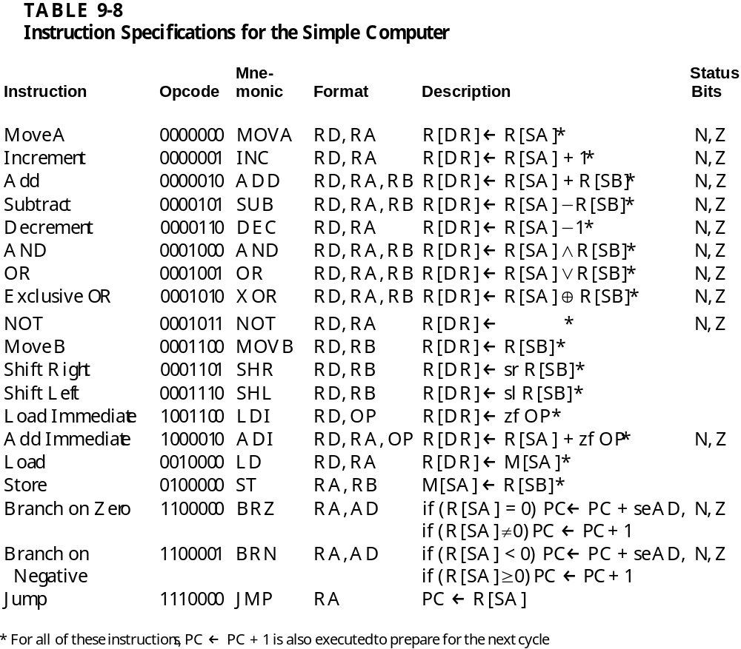
ISA: Instruction Specifications (continued)
Chapter 9 Part 2 <number>

Slide 13
ISA:Example Instructions and Data in Memory
Memory Representation of Instructions and Data
Decimal
Address
Memory Contents
Decimal
Opcode
Other Fields
Operation
25
0000101 001 010 011
5 (Subtract)
DR:1,
SA:2,
SB:3
R1
←
R2
−
R3
35
0100000 000 100 101
32 (Store)
S
A:4, SB:5
M[
R4]
←
R5
45
1000010 010 111 011
66 (Add
Immediate)
DR:
2
, S
A
:
7
, OP
:3
R
2
←
R7
+ 3
55
1100000 101 110 100
96 (Branch
on zero)
AD:
44, SA:6
If R6 =
0,
PC
←
PC
−
20
70
00000000011000000
Data =192. After execution of instruction in 35,
Data =
8
0
.
Chapter 9 Part 2 <number>

Slide 14
Single-Cycle Hardwired Control
Based on the ISA defined, design a computer architecture to support the ISA
The architecture is to fetch and execute each instruction in a single clock cycle
The datapath from Figure 9-15 will be used
The control unit will be defined as a part of the design
Chapter 9 Part 2 <number>

Slide 15
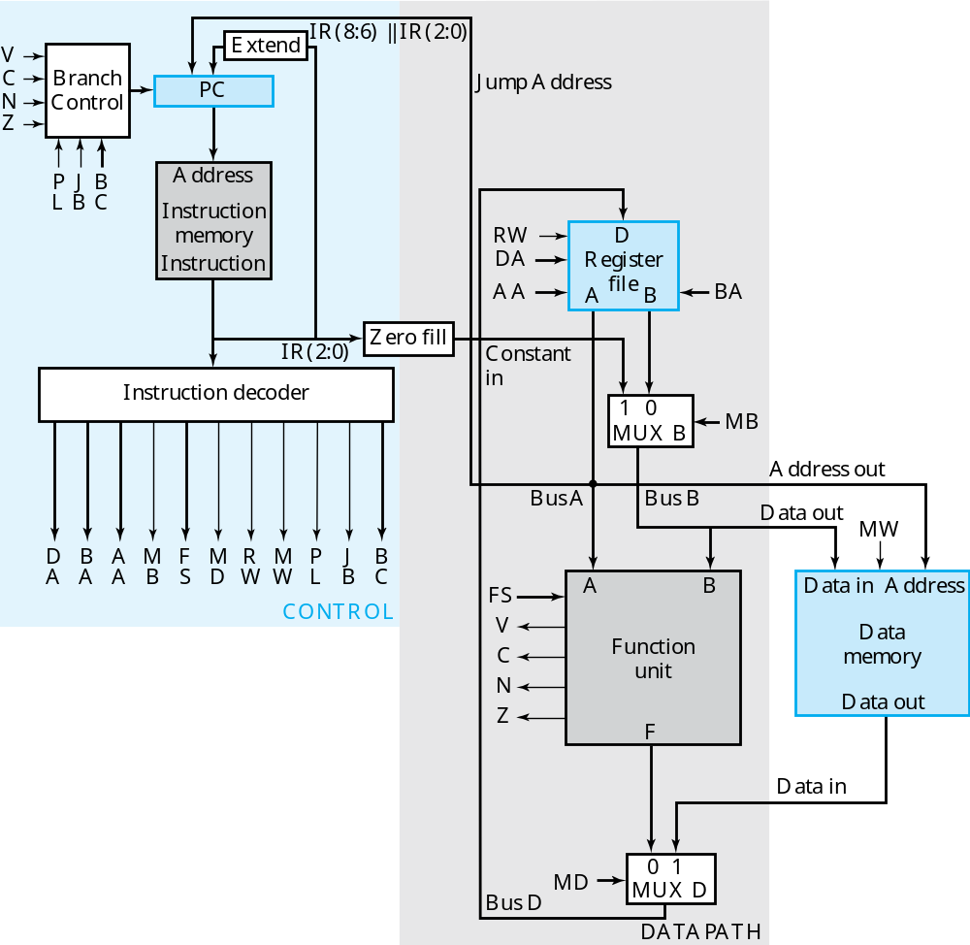
Chapter 9 Part 2 <number>

Slide 16
The Control Unit
The Data Memory has been attached to the Address Out and Data Out and Data In lines of the Datapath.
The MW input to the Data Memory is the Memory Write signal from the Control Unit.
For convenience, the Instruction Memory, which is not usually a part of the Control Unit is shown within it.
The Instruction Memory address input is provided by the PC and its instruction output feeds the Instruction Decoder.
Zero-filled IR(2:0) becomes Constant In
Extended IR(8:6) || IR(2:0) and Bus A are address inputs to the PC.
The PC is controlled by Branch Control logic
Chapter 9 Part 2 <number>

Slide 17
PC Function
PC function is based on instruction specifications involving jumps and branches taken from Slide 13:
In addition to the above register transfers, the PC must also implement: PC ← PC + 1
The first two transfers above require addition to the PC of: Address Offset = Sign Extended {IR(8:6), IR(2:0)}
The third transfer requires that the PC be loaded with: Jump Address = Bus A = R[SA]
The counting function of the PC requires addition to the PC of 1
Branch
on
Zero
BRZ
if (R[
S
A] =
0) PC
←
PC
+ s
e
A
D
Branch
on
Negative
BRN
if (R[
S
A] <
0) PC
←
PC
+ s
e
A
D
J
u
mp
JMP
P
C
←
R[SA
]
Chapter 9 Part 2 <number>

Slide 18
PC Function (continued)
Branch Control determines the PC transfers based on five of its inputs defined as follows:
  N,Z – negative and zero status bits
  PL – load enable for the PC
  JB – Jump/Branch select: If JB = 1, Jump, else Branch
  BC – Branch Condition select: If BC = 1, branch for N = 1, else branch for Z = 1.
The above is summarize by the following table:
Sufficient information is provided here to design the PC
PC Operation | PL | JB | BC
Count Up | 0 | X | X
Jump | 1 | 1 | X
Branch on Negative (else Count Up) | 1 | 0 | 1
Branch on Zero (else Count Up) | 1 | 0 | 0
Chapter 9 Part 2 <number>

Slide 19
Instruction Decoder
The combinational instruction decoder converts the instruction into the signals necessary to control all parts of the computer during the single cycle execution
The input is the 16-bit Instruction
The outputs are control signals:
  Register file addresses DA, AA, and BA,
  Function Unit Select FS
  Multiplexer Select Controls MB and MD,
  Register file and Data Memory Write Controls RW and MW, and
  PC Controls PL, JB, and BC
The register file outputs are simply pass-through signals:
DA = DR, AA = SA, and BA = SB
Determination of the remaining signals is more complex.
Chapter 9 Part 2 <number>

Slide 20
Instruction Decoder (continued)
The remaining control signals do not depend on the addresses, so must be a function of IR(13:9)
Formulation requires examining relationships between the outputs and the opcodes given in Slides 12 and 13.
Observe that for other than branches and jumps, FS = IR(12:9)
This implies that the other control signals should depend as much as possible on IR(15:13) (which actually were assigned with decoding in mind!)
To make some sense of this, we divide instructions into types as shown in the table on the next page
Chapter 9 Part 2 <number>

Slide 21
Instruction Decoder (continued)
T
ruth
T
a
ble for Instruction Decoder Logic
Instruction Bits
Contr
ol
W
o
r
d
Bits
Instruction Function
T
ype
15
14
13
9
M
B
M
D
R
W
M
W
P
L
J
B
B
C
Function unit operations using
0 0 0
X
0 0 1 0
0
X X
registers
Memory read
0
0
1
X
0 1 1 0
0
X X
Memory write
0
1
0
X
0
X
0 1
0
X X
Function unit operations using
1 0 0
X
1 0 1 0
0
X X
register and constant
Conditional branch on zero (Z)
1
1
0
0 X
X
0
0 1 0 0
Conditional branch on negative (N)
1
1
0
1
X X
0
0 1 0 1
Unconditional J
ump
1
1
1
X X
X
0
0 1 1
X
Chapter 9 Part 2 <number>

Slide 22
Instruction Decoder (continued)
The types are based on the blocks controlled and the seven signals to be generated; types can be divided into two groups:
  Datapath and Memory Control (First 4 types)
  PC Control (Last 3 types)
In Datapath and Memory Control blocks controlled are considered:
  Mux B (1st and 4th types)
  Memory and Mux D (2nd and 3rd types)
  By assigning codes with no or only one 1 for these, implementation of MB, MD, RW and MW are simplified.
In Control Unit more of a bit setting approach was used:
  Bit 15 = Bit 14 = 1 were assigned to generate PL
  Bit 13 values were assigned to generate JB.
  Bit 9 was use as BC which contradicts FS = 0000 needed for branches. To force FS(6) to 0 for branches, Bit 9 into FS(6) is disabled by PL.
Also, useful bit correlations between values in the two groups were exploited in assigning the codes.
Chapter 9 Part 2 <number>

Slide 23
Instruction Decoder (continued)
The end result by use of the types, careful assignment of codes, and use of don't cares, yields very simple logic:
This completes the
design of most of the
essential parts of
the single-cycle
simple computer
Instruction
Opcode
DR
SA
SB
15
14
13
12
11
10
9
8
–
6
5
–
3
2
–
0
16
19
–
14
–
17
13
–
11
10
9
–
6
5
4
3
2
1
0
DA
AA
BA
MB
FS
MD
RW
MW
PL
JB
BC
Control word
Chapter 9 Part 2 <number>

Slide 24
Example Instruction Execution
Decoding, control inputs and paths shown for ADI, RD and BRZ on next 6 slides
Six Instructio
ns
for the
Sin
g
le-Cycle Comp
uter
Operation
Symb
ol
ic
co
de
na
m
e
Fo
rm
a
t
D
e
s
c
r
ip
ti
on
Fu
nc
ti
on
MB
MD
R
W
MW
PL
J
B
BC
1000
010
ADI
I
[ ]
←
[ ]
mme
diate
A
dd immediate
R
DR
R
SA
+
zf
I
(2:0)
1
0
1
0 0 0 0
operand
[ ]
←
[ ]
0010
000
LD
Register
Load mem
[ ]
o
ry
R
DR
M R
SA
0
1
1
0 0 1 0
c
ont
e
n
t in
to
reg
i
s
t
er
0100
000
ST
Register
Store re
gister
[ ]
0
1
0
1 0 0 0
M R
[ ]
←
[ ]
SA
R
SB
c
onten
t in
memory
0001
110
SL
Register
Shift
left
[ ]
←
[ ]
R
DR
sl
R
SB
0
0
1
0 0 1 0
0001
011
NO
T
R
[ ]
←
[ ]
egister
Comple
ment
R
DR
R
SA
0
0
1
0 0 0 1
reg
i
s
t
er
1100
000
BRZ
ump/Branch
J
If
R
[SA]
= 0, branch
If R[
SA] = 0,
1
0
0
0 1 0 0
to PC
+ se AD
PC
←
P
C
+
se
AD
,
If R[S
A
]
≠
0,
PC
←
PC
+
1
Chapter 9 Part 2 <number>

Slide 25
Decoding for ADI
1 0 0 0 0 1 0
Instruction
Opcode
DR
SA
SB
15
14
13
12
11
10
9
8
–
6
5
–
3
2
–
0
16
19
–
14
–
17
13
–
11
10
9
–
6
5
4
3
2
1
0
1
0 0 1 0
0
1
0
0
0
0
DA
AA
BA
MB
FS
MD
RW
MW
PL
JB
BC
Control word
Chapter 9 Part 2 <number>

Slide 26
Extend
IR(8:6) || IR(2:0)
V
C
Branch
PC
Control Inputs and Paths for ADI
N
Control
Z
P
J
B
Address
L
B
C
Instruction
1
0
0
0
memory
RW
D
Instruction
DA
Register
Increment
PC
AA
A
file
B
BA
IR(2:0)
Zero fill
Constant
Instruction decoder
in
1
0
MB
1
MUX B
Address out
Bus A
Bus B
0
No Write
Data out
MW
D
B
A
M
F
M
R
M
P
J
B
0 0 1 0
A
A
A
B
S
D
W
W
L
B
C
A
+
B
Data in
Address
1
0
1
0
0
0
0
FS
0 0 1 0
CONTROL
V
Function
Data
C
unit
memory
N
Data out
Z
F
Data in
0
MD
0
1
Bus D
MUX D
DATAPATH
Chapter 9 Part 2 <number>

Slide 27
Decoding for LD
0 0 1 0 0 0 0
Instruction
Opcode
DR
SA
SB
15
14
13
12
11
10
9
8
–
6
5
–
3
2
–
0
16
19
–
14
–
17
13
–
11
10
9
–
6
5
4
3
2
1
0
0
0 0 0 0
1
1
0
0
1
0
DA
AA
BA
MB
FS
MD
RW
MW
PL
JB
BC
Control word
Chapter 9 Part 2 <number>

Slide 28
Extend
IR(8:6) || IR(2:0)
V
C
Branch
PC
Control Inputs and Paths for LD
N
Control
Z
P
J
B
Address
L
B
C
Instruction
1
0
1
0
memory
RW
D
Instruction
DA
Register
Increment
PC
AA
A
file
B
BA
IR(2:0)
Zero fill
Constant
Instruction decoder
in
1
0
MB
0
MUX B
Address out
Bus A
Bus B
0
No Write
Data out
MW
D
B
A
M
F
M
R
M
P
J
B
0 0 0 0
A
A
A
B
S
D
W
W
L
B
C
A
B
Data in
Address
0
1
1
0
0
1
0
FS
0 0 0 0
CONTROL
V
Function
Data
C
unit
memory
N
Data out
Z
F
Data in
1
MD
0
1
Bus D
MUX D
DATAPATH
Chapter 9 Part 2 <number>

Slide 29
Decoding for BRZ
1 1 0 0 0 0 0
Instruction
Opcode
DR
SA
SB
15
14
13
12
11
10
9
8
–
6
5
–
3
2
–
0
16
19
–
14
–
17
13
–
11
10
9
–
6
5
4
3
2
1
0
1
0 0 0 0
0
0
0
1
0
0
DA
AA
BA
MB
FS
MD
RW
MW
PL
JB
BC
Control word
Chapter 9 Part 2 <number>

Slide 30
Extend
IR(8:6) || IR(2:0)
V
C
Branch
PC
Control Inputs and Paths for BRZ
N
Control
Z
No Write
P
J
B
Address
L
B
C
Instruction
0
1
0
0
memory
RW
D
Instruction
DA
Register
Branch on
Z
AA
A
file
B
BA
IR(2:0)
Zero fill
Constant
Instruction decoder
in
1
0
MB
1
MUX B
Address out
Bus A
Bus B
0
No Write
Data out
MW
D
B
A
M
F
M
R
M
P
J
B
0 0 0 0
A
A
A
B
S
D
W
W
L
B
C
A
B
Data in
Address
1
0
0
0
1
0
0
FS
0 0 0 0
CONTROL
V
Function
Data
C
unit
memory
N
Data out
Z
F
Data in
0
MD
0
1
Bus D
MUX D
DATAPATH
Chapter 9 Part 2 <number>

Slide 31
Terms of Use
All (or portions) of this material © 2008 by Pearson Education, Inc.
Permission is given to incorporate this material or adaptations thereof into classroom presentations and handouts to instructors in courses adopting the latest edition of Logic and Computer Design Fundamentals as the course textbook.
These materials or adaptations thereof are not to be sold or otherwise offered for consideration.
This Terms of Use slide or page is to be included within the original materials or any adaptations thereof.
Chapter 9 Part 2 <number>

