Slide 1
ECE 2504: Introduction to Computer Engineering
Section 3:
Combinational Logic Design

Slide 2
Combinational Circuit Design
The hallmark of a combinational circuit is that its outputs are functions ONLY of the current set of inputs. Combinational circuits have no memory.
A combinational circuit is described entirely by the truth table relating each output to the set of inputs.
We can implement a circuit having m combinational outputs using m Boolean functions of the set of n inputs.

Slide 3
Combinational Circuit Design
General Design Process
Identify the problem or need.
Specify the requirements.
Formulate the relationship between inputs and outputs.
Optimize the design (K-maps or other optimization)
Map the design to the available hardware technology
Verify the correctness of the design
Implement the design.
Test the implementation.

Slide 4
Combinational Circuit Design
Design a circuit to convert BCD to Excess-3 .
The circuit transforms the BCD code for a decimal digit to the Excess-3 code
We should consider issues such as speed, cost, reliability, and testability in evaluating the design result.
Notes:
A circuit to accept binary coded decimals in 4 bit.
They are then meant to output a 4bit output of possible w x y z
For all possible combinations of ABCD inputs, we can determine that WXYZ should have values.
If we were to give a BCD value of 0 to ABCD (0000), then we should get a four bit value with excess 3 that will be related to 0011 for WXYZ

Slide 5
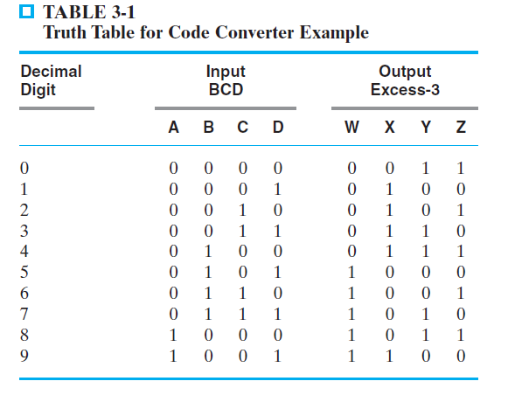
Combinational Circuit Design
Formulation:
BCD inputs: A, B, C, D
Excess-3 outputs W, X, Y, Z
Don’t care about input values 1010-1111 (unused)
Notes:
Each column on output side such as W, X , Y, Z. They individiually represent a function of ABCD
W as a function of ABCD, is equal to sum of minterms 5,6,7,8,9 and don’t cares 12, 13, 14, 15

Slide 6
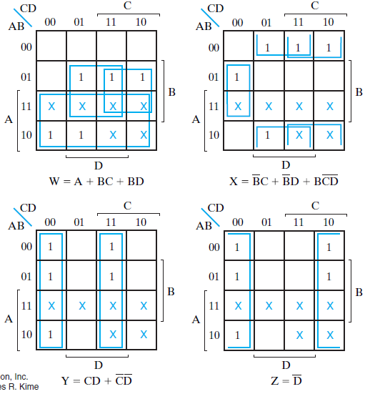
Combinational Circuit Design
Optimization: Use K-maps for outputs
Notes:
Don’t join the bars.

Slide 7
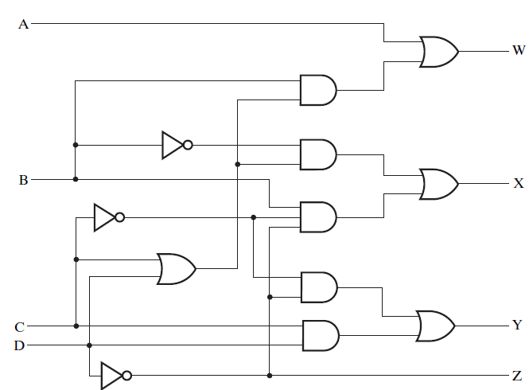
Combinational Circuit Design
Technology mapping after multi-level optimization, and using ANDs, ORs, and inverters

Slide 8
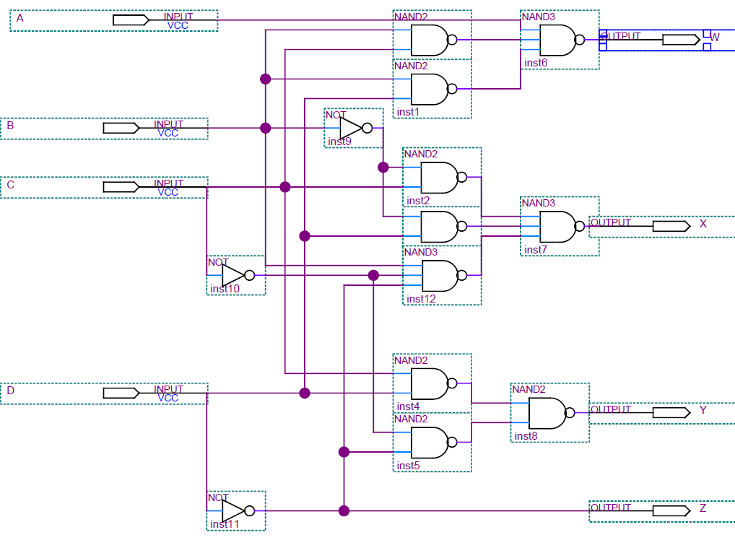
Combinational Circuit Design
Technology mapping using only NANDs and inverters

Slide 9
Combinational Circuit Design
Design Strategies
Make sure that you have a complete specification and model of the circuit.
Decompose larger designs into smaller functional units and design the smaller units separately. Then synthesize the larger design by joining the smaller designs.
Consider the basis for evaluation (Is it cost? Is it speed? Is it reliability?)

Slide 10
Beginning Hierarchical Design
To control the complexity of the function mapping inputs to outputs:
Decompose the function into smaller pieces called blocks
Decompose each block’s function into smaller blocks, repeating as necessary until all blocks are small enough
Any block not decomposed is called a primitive block
The collection of all blocks including the decomposed ones is a hierarchy
Notes:
Primitive block as the same kind of logic gates we studied previously

Slide 11
Beginning Hierarchical Design
Example: 9-input parity tree (see next slide)
Top Level: 9 inputs, one output
2nd Level: Four 3-bit odd parity trees in two levels
3rd Level: Two 2-bit exclusive-OR functions
Primitives: Four 2-input NAND gates
Design requires 4 X 2 X 4 = 32 2-input NAND gates
Notes:
Top level that we are trying to make a function with 9 inputs and an output with odd parity.
Of those 9 inputs, one output design, we can decompose that circuit into wherein the 9 input single output parity function can be thought of as a collection oof 3 input parity functions. Wherein once we sub divide it into 3 such sets each going into its own 3 input parity function. We can then take the output of those 3 input parity chips and into a nother one
See book
Given a certain number of nand gates, we can execute

Slide 12
Hierarchy for Parity Tree Example
X
0
X
1
X
2
9-Input
X
3
odd
X
4
Z
O
X
5
function
X
X
6
0
A
0
3-Input
X
7
A
odd
X
8
X
1
1
B
O
(a) Symbol for circuit
X
A
2
function
2
X
3
A
0
3-Input
A
0
3-Input
X
4
A
1
odd
B
O
A
1
odd
B
O
Z
O
X
A
2
function
A
2
function
5
X
6
A
0
3-Input
X
7
A
1
odd
B
O
X
A
2
function
8
(b) Circuit as interconnected 3-input odd function blocks
A
0
A
1
B
O
A
2
(c) 3-input odd function circuit as
interconnected XOR blocks
(d) XOR block as interconnected NANDS

Slide 13
Reusable Functions
Whenever possible, we try to decompose a complex design into common, reusable function blocks
These blocks are
Verified and well-documented
Placed in libraries for future use

Slide 14
“Top-Down” versus “Bottom-Up”
A top-down design proceeds from an abstract, high-level specification to a more and more detailed design by decomposition and successive refinement
A bottom-up design starts with detailed primitive blocks and combines them into larger and more complex functional blocks
Design usually proceeds top-down to known building blocks ranging from complete CPUs to primitive logic gates or electronic components.
Much of the material in this chapter is devoted to learning about combinational blocks used in top-down design.

Slide 15
Technology Mapping
Mapping Procedures
To NAND gates
To NOR gates
In real systems, there are components available that are more complex than NANDs and NORs

Slide 16
Mapping to NAND gates
Assumptions:
Gate loading and delay are ignored
Cell library contains an inverter and n-input NAND gates
An AND, OR, inverter schematic for the circuit is available
The mapping is accomplished by:
Replacing AND and OR symbols,
Pushing inverters through circuit fan-out points, and
Canceling inverter pairs

Slide 17
NAND Mapping Algorithm
Replace ANDs and ORs:
Repeat the following pair of actions until there is at most one inverter between :
A circuit input or driving NAND gate output, and
The attached NAND gate inputs.

Slide 18
NAND Mapping Example
Notes:
Or gate being that NAND gate with inversion seen in (b)
If an inverter comes beore the node, it can exist from all the branches following the node seen in 5.
(d) Being a representation of the completed circuit

Slide 19
Mapping to NOR gates
Assumptions:
Gate loading and delay are ignored
Cell library contains an inverter and n-input NOR gates
An AND, OR, inverter schematic for the circuit is available
The mapping is accomplished by:
Replacing AND and OR symbols,
Pushing inverters through circuit fan-out points, and
Canceling inverter pairs

Slide 20
NOR Mapping Algorithm
Replace ANDs and ORs:
Repeat the following pair of actions until there is at most one inverter between :
A circuit input or driving NOR gate output, and
The attached NOR gate inputs.

Slide 21
NOR Mapping Example
A
A
B
B
X
2
1
C
F
C
F
3
D
D
E
E
(a)
(b)
A
B
C
F
D
E
(c)

Slide 22
Verification
Verification - show that the final circuit designed implements the original specification
Simple specifications are:
truth tables
Boolean equations
Hardware Description Language (HDL) code
If the above result from formulation and are not the original specification, it is critical that the formulation process be flawless for the verification to be valid!
Notes:
The specification that you will be given have to be based on what you are given. Be it a text specification that you will then use to hopefully match the final.

Slide 23
Basic Verification Methods
Manual Logic Analysis
Find the truth table or Boolean equations for the final circuit
Compare the final circuit truth table with the specified truth table, or
Show that the Boolean equations for the final circuit are equal to the specified Boolean equations
Simulation
Simulate the final circuit (or its netlist, possibly written as an HDL) and the specified truth table, equations, or HDL description using test input values that fully validate correctness.
The obvious test for a combinational circuit is application of all possible “care” input combinations from the specification
Notes:
Verfication can be done through manual logic analysis. Can we verify that after we do a manual circuit that it wll output the same?
Improvements in the means of simulations allow for better ability to learn
Simulations are represntations of cirucits.
A set of inputs can be applied to the simulation in that they will behave in the same manner as if they were real inputs

Slide 24




Verification Example: Manual Analysis
BCD-to-Excess 3 Code Converter
Find the SOP Boolean equations from the final circuit.
Find the truth table from these equations
Compare to the formulation truth table
Finding the Boolean Equations:
Notes:
The joined bar should not definitely be a joined bar. That is incorrect
See notebook

Slide 25
Verification Example: Manual Analysis
Find the circuit truth table from the equations and compare to specification truth table:
Input BCD
Output Excess-3
Input BCD
Output Excess-3
A B C D
WXYZ
A B C D
WXYZ
0 0 0 0
0 0 1 1
0 0 0 0
0 0 1 1
0 0 0 1
0 1 0 0
0 0 0 1
0 1 0 0
0 0 1 0
0 1 0 1
0 0 1 0
0 1 0 1
0 0 1 1
0 1 1 0
0 0 1 1
0 1 1 0
0 1 0 0
0 1 1 1
0 1 0 0
0 1 1 1
0 1 0 1
1 0 0 0
0 1 0 1
1 0 0 0
0 1 1 0
1 0 0 1
0 1 1 0
1 0 0 1
0 1 1 1
1 0 1 0
0 1 1 1
1 0 1 0
1 0 0 0
1 0 1 1
1 0 0 0
1 0 1 1
1 0 0 1
1 0 1 1
1 0 0 1
1 0 1 1
Notes:
Since the outputs are not specified for the don’t cares, no analysis for correctness is needed.
If the truth table is susch that it will produce the same outoupt for all combinations of the inputs. Then it can be certain that it has been designed properly.
If any of the outputs, that the process of coming up with the logic equations has introduced a bit error.

Slide 26
Verification Example: Simulation
Simulation procedure:
Use a schematic editor or text editor to enter a gate level representation of the final circuit
Use a waveform editor or text editor to enter a test consisting of a sequence of input combinations to be applied to the circuit
This test should guarantee the correctness of the circuit if the simulated responses to it are correct
Short of applying all possible “care” input combinations, generation of such a test can be difficult

Slide 27
Verification Example: Simulation
Enter BCD-to-Excess-3 Code Converter Circuit Schematic
Notes:
Probably ought to do this as a live demo of Quartus

Slide 28
Verification Example: Simulation
Enter waveform that applies all possible input combinations:
Are all BCD input combinations present? (Low is logic-0; high is logic-1.)
Notes:
Yes, 0000 through 1001 are present.
TLM on 9/6/2012: Should replace this with a Qsim waveform.
I

Slide 29
Verification Example: Simulation
Run the simulation of the circuit for 120 ns.
Do the simulation output combinations match the original truth table?
Notes:
Yes, the output combinations 0011 through 1100 occur in response to 0000 through 1001, respectively.
TLM 9/6/2012: Should replace this with Qsim waveforms

Slide 30
Combinational Functional Blocks
Now that we have logic gates to use as tools, we can use them to build more complex circuit elements.
These functional blocks implement specific functions that occur frequently.
Notes:
We need to make a shift towards moving away from circuits we design through optomization technique like kmaps. And towards one of combinational circuits that behave in genralizeable ways because of their specific architecture.
They implmenent particuluar designs that we use frequentlyl
We want to use these new basic units like they are AND/OR gates.
This allows us to move up without thinking about primitive elements.
Functional blocks are combinational in nature.

Slide 31
Functions and Functional Blocks
The functions considered are those found to be very useful in design
Corresponding to each of the functions is a combinational circuit implementation called a functional block.
In the past, functional blocks were packaged as small-scale-integrated (SSI), medium-scale integrated (MSI), and large-scale-integrated (LSI) circuits.
Today, they are often simply implemented within a very-large-scale-integrated (VLSI) circuit.
Notes:
Fitting more on a chip allows one to do more whle having the same size

Slide 32
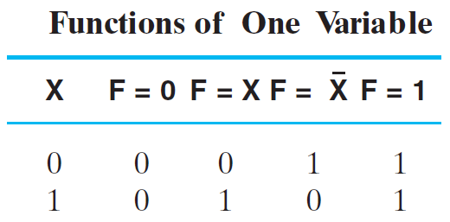
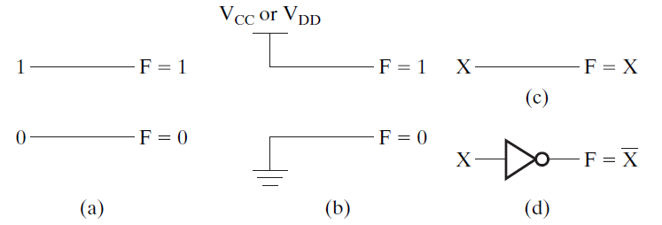
Rudimentary Logic Functions
Functions of a single variable X
Can be used on the inputs to functional blocks to implement other than the block’s intended function
Notes:
Arbirary functions of higher number of values.

Slide 33
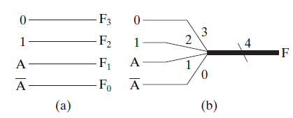
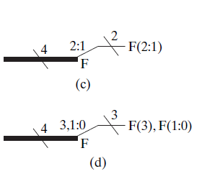
Multiple-bit Rudimentary Functions
A wide line is used to represent a bus which is a vector signal
In (b) of the example, F = (F₃, F₂, F₁, F₀) is a bus.
The bus can be split into individual bits as shown in (b)
Sets of bits can be split from the bus as shown in (c) for bits 2 and 1 of F.
The sets of bits need not be continuous as shown in (d) for bits 3, 1, and 0 of F.
Notes:
A bus is mearley a collection of individual signals that may or may not be different but have some purpose in being collected together.
If we have a set of scalars that we can connect to gether to make a vector.

Slide 34
Enabling Functions
Enabling permits an input signal to pass through to an output
Disabling blocks an input signal from passing through to an output, replacing it with a fixed value
The value on the output when it is disable can be Hi-Z (as for three-state buffers and transmission gates), 0 , or 1
When disabled, 0 output
When disabled, 1 output
Notes:
Sometimes we want the output to become inactive. We doe this by gating access that will allow it to eithe rpass or not. AND gates can be used for this reason.
An X input will be anything.
If the X input is 1, it will be whatever is.’
X does not have to be a signal of its own. It can be its own.
If we wat to make the circuit so that itso ffl.
We can disable from joining us.
When the enable circuit is 0, it will tur off regardeless hat is qual to F.
In example b, if EX input is 1, then

Slide 35
Decoders
A decoder is a combinational circuit that converts binary input information from one coded format to another.
The basic circuit is an n-input, 2^{n}-output device.
A valid n-bit input code asserts the corresponding output line.
You can consider each output to represent one minterm of n variables.
Notes:
A decoder has the quality fo transofmring binary information from one precision or format to anoteh efo s.s

Slide 36
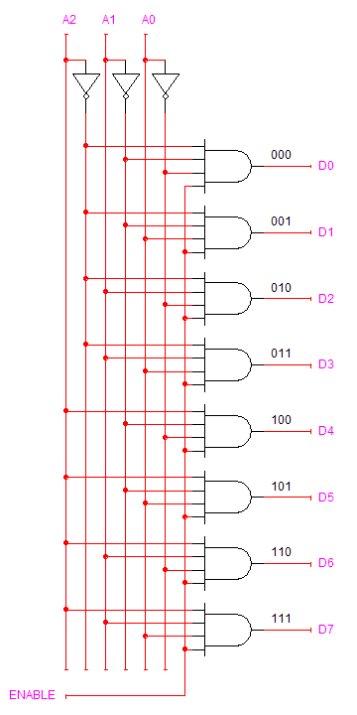
Decoders
3-to-8 decoder with active-high enable.
Notes:
Each AND gate is such that they have a unique combo of the input variables.
At 001, it has for example A2 comp and A1 comp and A0 as its inputs
110, for example only one receiving A2, A1, and A0 comp
Since each AND gate is receiving a distinct input. Then one and only one of these AND gates can have a set of gate inputs that are all 1s for all the other combinations
Thus the only AND gate inputting 1, will be the only one outputting 1, thus all the others will be outputting 0
If we turn off the enable, then no matter what the heck you input, it will just output a 0
If the decoder is enable = 1, the only 1 will output 1
If we wish for an enable value of 1 to somehow give outputs of all 0 and an value of 0 making it act as before. WE just put an inverter on the enable.
We can also change the AND gates to NAND gates to switch the logic level so that there will be just a single 0 when the rest are 1s

Slide 37
Decoder with Enable
In general, attach m-enabling circuits to the outputs
See truth table below for function
Note use of X’s to denote both 0 and 1
Combination containing two X’s represent four binary combinations
Alternatively, can be viewed as distributing value of signal EN to 1 of 4 outputs
In this case, the block is called a demultiplexer
Notes:
Here is a two to four decoder
Box highlighted in blue does not have an enabler.
If the enable is 0, it will just output 0 as it will block the output of the two-to-four section in blue

Slide 38
Multiplexers
A multiplexer is a combinational circuit that receives binary information on 2^{n} input lines and transmits the information on a single output line.
The input line that transmits to the output is chosen using n select lines.
Notes:
A multiplexer is a 2 to the powr of n to the power of 1 device
See textbook
Every multiplexer has a number of select lines.
They select which inputs are going to have its values appear on the output
On every multiplexer that has a 2^n that it will have n select lines. If you have 8 inputs which is thus 2^3, you will then have 3 select ines
If you give the 3 select lines a value of say 110 (which is 6), then input 6 will be value chosen to be outputed

Slide 39
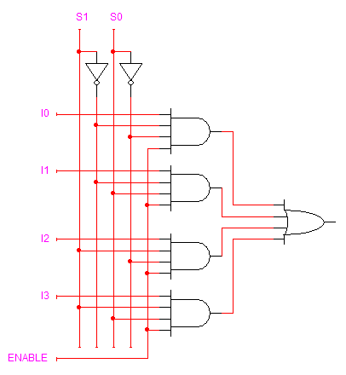
Multiplexers
4-to-1 multiplexer with active-high enable.
Notes:
Four to 1 multiplexer with an enable signal
It is a two level SOP circuit. 4 AND gates unified by an Or gate
On the first level of AND gates, we have where an AND gate is receiving a different combination of the select lines. 10 is receiving comp of S1 and S0
11 is receiving S1 and S0comp and so on and so forth
Here we have inputs, the select lines, and the enables
----
If we gave select lines the value of 1 0
Then only one of these AND gates can have all of its inputs be equal to 1
Because current value of select lines is 1 0, then the first AND gate has to output 0
AND gate two and four are also outputtin 0. Because none of them are feceiving the right one to output 1
AND gate 3 is outputting whatever I2 is. Because enable, S0 and S1 are currently 1 meaning if I2 is 1 , then it will output 1
The final output OR will give will be whatever I2 is because boolean axion X or 0 is X
If ENABLE is set to 0, the multiplexer will output 0. This is because all the AND gates will output 0 to the OR gate. And an OR gate will output a zero if all are zero

Slide 40
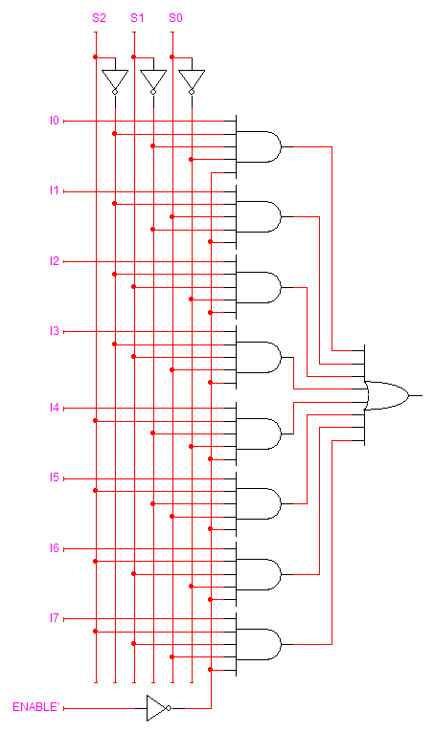
Multiplexers
8-to-1 multiplexer with active-low enable.
Notes:
Ever time we add a select line, we double the amount of inputs
We make an active LOW by inverting everything

Slide 41
Function Implementation
We can use decoders and multiplexers to implement combinational functions in a modular fashion.
These implementations involve less circuit complexity and are easier to modify than circuits implemented at the gate level.
The implementations take advantage of the fact that one combination of decoder inputs or multiplexer selects can correspond to one minterm of a function.

Slide 42
Decoder Implementation
We can use an n-to-2^{n} decoder and an OR gate to realize any combinational function of n variables.
Since each decoder output corresponds to a possible minterm of the function, we will use the decoder to generate all of the possible minterms.
The OR gate then collects those decoder outputs that correspond to actual minterms of the function.
Example: Implement f(A,B,C) = Σm(0,2,3,7)

Slide 43
Multiplexer Implementation
We can implement a function of n variables on a 2^{n}-to-1 multiplexer.
The n input variables of the function are connected to the n select lines. The order of significance is important.
The appropriate output value is applied to the multiplexer input associated with each combination of the inputs.
Example: Implement f(A,B,C) = Σm(0,2,3,7)

Slide 44
Multiplexer Implementation
A “more efficient” implementation involves the use of a multiplexer having fewer select lines than the function has variables.
For example, we might use a multiplexer with one fewer select line.
Use (n – 1) variables as select lines. Each multiplexer input takes on the value of the remaining variable, its complement, logic-0, or logic-1.
Example: Implement f(A,B,C) = Σm(0,2,3,7)

Slide 45
Encoding
Encoding is the opposite of decoding - the conversion of an m-bit input code to a n-bit output code with n ≤ m ≤ 2^{n} such that each valid code word produces a unique output code
Circuits that perform encoding are called encoders
An encoder has 2^{n} (or fewer) input lines and n output lines which generate the binary code corresponding to the input values
Typically, an encoder converts a code containing exactly one bit that is 1 to a binary code corresponding to the position in which the 1 appears.
Notes:
n bit input and getting a 2to the power of n output.

Slide 46
Encoder Example
A decimal-to-BCD encoder
Inputs: 10 bits corresponding to decimal digits 0 through 9, (D₀, …, D₉)
Outputs: 4 bits with BCD codes
Function: If input bit D_{i} = 1, then the output (A₃, A₂, A₁, A₀) is the BCD code for i.
The truth table could be formed, but alternatively, the equations for each of the four outputs can be obtained directly.

Slide 47
Encoder Example (continued)
Input D_{i} is a term in equation A_{j} if bit A_{j} is 1 in the binary value for i.
Equations:
A₃ = D₈ + D₉
A₂ = D₄ + D₅ + D₆ + D₇
A₁ = D₂ + D₃ + D₆ + D₇
A₀ = D₁ + D₃ + D₅ + D₇ + D₉

Slide 48
Priority Encoder
If more than one input value is 1, then the encoder just designed does not work.
One encoder that can accept all possible combinations of input values and produce a meaningful result is a priority encoder.
Among the 1s that appear, it selects the most significant input position (or the least significant input position) containing a 1 and responds with the corresponding binary code for that position.

Slide 49
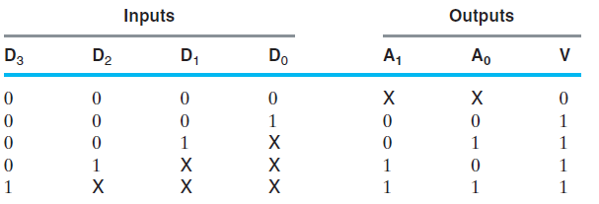
Priority Encoder Example
Priority encoder with 4 inputs (D₃, D₂, D₁, D₀) - highest priority to most significant 1 present - Code outputs A1, A0 and V where V indicates that at least one input equals logic-1.
Xs in input part of table can represent 0 or 1. Thus, the table entries correspond to product terms instead of minterms.
Notes:
Go over table explaining how entries were obtained, particularly those containing Xs

Slide 50
Priority Encoder Example (continued)
Could use a K-map to get equations, but can be read directly from table and manually optimized if careful:
A₁ = D₂ + D₃
A0 = D₃ + D₁D₂′
V = D₃ + D₂ + D₁ + D₀

Slide 51
Terms of Use
All (or portions) of this material © 2008 by Pearson Education, Inc.
Permission is given to incorporate this material or adaptations thereof into classroom presentations and handouts to instructors in courses adopting the latest edition of Logic and Computer Design Fundamentals as the course textbook.
These materials or adaptations thereof are not to be sold or otherwise offered for consideration.
This Terms of Use slide or page is to be included within the original materials or any adaptations thereof.

