Slide 1
ECE 2504: Introduction to Computer Engineering
Section 6:
Registers and Register Transfers
(Mano and Kime, Chapter 7)

Slide 2
Registers
A single flip-flop can hold one bit of information.
A register uses a set of commonly-controlled flip-flops to store words of information.
We can implement registers most easily using D flip-flops, since the outputs of the flip-flops follow the inputs (after a clock pulse). Remember: Q⁺ = D.

Slide 3
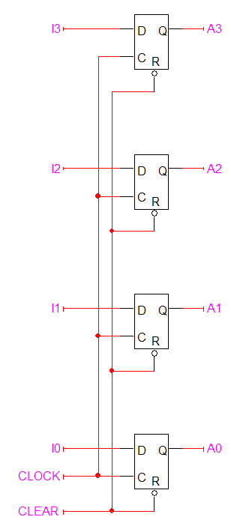
Registers
Figure 2.4: 4-bit register with active-low clear.

Slide 4
Register Control
If they are present, flip-flop inputs such as clear and preset are all connected to a common register input.
In this manner, all of the flip-flops in one register do the same thing at the same time.
The register clock is also connected to the clock input of all of the flip-flops.
It remains to implement a parallel load control line, so that the user can choose to write data to the register or maintain the present data.

Slide 5
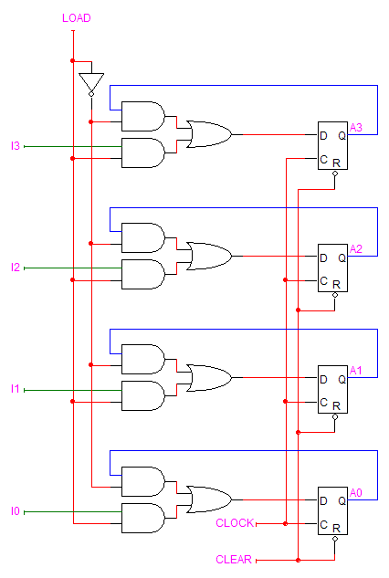
Register Control
4-bit parallel load register

Slide 6
Register Transfers
When size and number of registers is large, the number of states is huge, and it is impractical to design with state tables or diagrams, individual flip-flops and gates
Instead, we take a hierarchical approach with registers and other larger functional blocks, e.g., muxes

Slide 7
Register Transfers
Large digital systems such as computers are partitioned into two modules:
Datapath: performs data processing operations
Control unit: determines the sequence of those operations
Register transfer operations: represents the movement and processing of data
Three basic components:
The set of registers the system contains and their function
The set of micro-operations performed on the information in the registers
The control functions that provide the sequence of micro-operations
A micro-operation is an elementary operation performed on data in one or more registers, usually in a single clock cycle.

Slide 8
Register Transfer Language
We will use a notation called register transfer language (or RTL) to specify the organization of a system.
RTL statements symbolically express all of the elements that specify a computer’s organization.
A set of RTL statements is directly related to the hardware capability of a system.

Slide 9
Specifying Register Transfers
A register’s label may imply something about the register’s use:
MAR – Memory Address Register
MDR – Memory Data Register
An RTL statement might reference a full register, or a particular field (subset of bits) of the register.
Register field denoted with ():
AR(7:4) means bits 7, 6, 5, and 4 of AR
Notes:
MAR is just like a pointer. It points to a point in the memory where that ‘thing’ is.
The only way you know where something in memory is, is thanks to the MAR.

Slide 10
Specifying Register Transfers
A ← B defines a parallel transfer of the contents of register B into register A; the transfer does not usually alter the contents of register B.
Simultaneous transfers are separated by a comma: A ← B, E ← D
Memory addresses specified with square brackets: DR ← M[AR] (more on that after we cover memories)

Slide 11
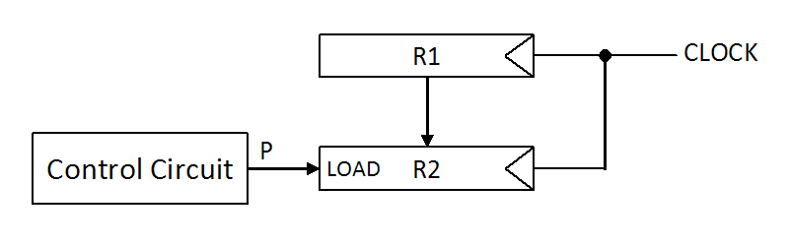
Specifying Register Transfers
The condition that must be present in order to initiate a micro-operation is called a control function.
Example: P: R2 ← R1
Notes:
Control function is the variable that governs wether a register takes in a new value when the clock trigger comes that would normally cause the register to change its value.
It’s not enough for just P to be equal to 1 for R1 to become R2. It requires BOTH a clock trigger and P being equal to 1.

Slide 12
Arithmetic Micro-Operations
An arithmetic operation is one where the result in one bit position can affect the result in another bit position.
Consider P: X ← Y + Z
How might we move the contents of registers Y and Z to the inputs of the adder?
Register X must be loaded with the result.
We may have to store other status bits.
P must specify everything to make all of these things happen.

Slide 13
Arithmetic Micro-Operations
Note how these 2’s complement operations are represented in an accumulator-based format.
A ← A + B Addition
A ← A – B Subtraction
A ← A + B′ + 1
A ← A + 1 Increment
A ← A – 1 Decrement
A ← A′ + 1 Negate

Slide 14
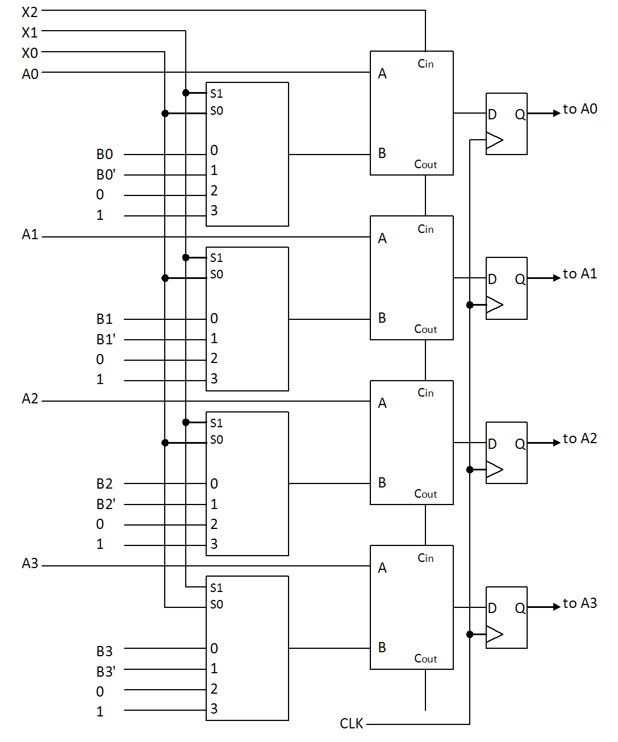
Arithmetic Micro-Operations
Notes:
4 bit ripple carry adder is what this is being built around. Figuring out what operand this is built around.
One of the inputs to the adder, taken as a 4 bit value, is always a value that we call A, and that the other adder input is the multiplexing of other 4 bit values we call B, a 4 bit value we can call B comp, another we can call 0, 0 ,0 ,0 and a 4 bit representation of 1,1,1,1
If we take A and add it to B and add it with the carry in of 0. Then we didn’t do much
But if we did A + Bcomp + carry in of 1, then we change it from doing addition to doing subtraction.
Different combinations of the operands will cause the adder, decriment to do different things, to do soley on what we set specific bits of the opcode to cause operations to be done.
Thus a registry transfer statement can be said to be when X2 is 0 and x1 is zero and x0 is zero. Then we desire that something in this picture, that something in the picture be registered as a state of A. but whatever that something is, is receivin the the result of the sumb of A and B.

Slide 15
Logic Micro-Operations
Logic micro-operations are bitwise operations. The result in one bit position does not affect the result in other bit positions.
These two RTL statements represent the same operation:
P: A ← A ⊕ B
P: A_{i} ← A_{i} ⊕ B_{i}, i ∈ {0,1,…, n – 1}
To distinguish logic operations used in control, we use formal logic symbols to represent logic micro-operations.

Slide 16
Logic Micro-Operations
For binary variables A and B, we can represent 16 distinct logic micro-operations:
F = 0 F ← 0 Clear
F = xy F ← A ∧ B AND
F = x′y F ← A′ ∧ B
F = xy′ F ← A ∧ B′
F = x′y′ F ← (A ∨ B)′ NOR
F = x F ← A Load A
F = x′ F ← A′ Complement A
F = y F ← B Load B
F = y′ F ← B′ Complement B
F = x ⊕ y F ← A ⊕ B XOR
F = x ⊗ y F ← A ⊗ B XNOR
F = x + y F ← A ∨ B OR
F = x′ + y F ← A′ ∨ B
F = x + y′ F ← A ∨ B′
F = x′ + y′ F ← (A ∧ B)′ NAND
F = 1 F ← 1

Slide 17
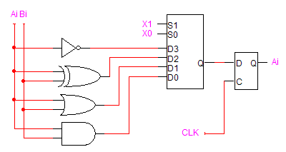
Logic Micro-Operations
X₁ | X₀ | Output | Operation
0 | 0 | A_{i}⁺ = A_{i} ∧ B_{i} | AND
0 | 1 | A_{i}⁺ = A_{i} ∨ B_{i} | OR
1 | 0 | A_{i}⁺ = A_{i} ⊕ B_{i} | XOR
1 | 1 | A_{i}⁺ = A_{i}′ | Complement

Slide 18
Shift Micro-Operations
When we first considered shift operations, we first took note of the question of the vacated bit.
The nature of the shift provides an answer to the question.
We will consider three different shift micro-operations.
(See section 10.6 of the text)

Slide 19
Shift Micro-Operations
In a logical shift, a left or right-shift causes all of the bits to move one position in that direction.
The bit that shifts out of the register is lost.
0 fills the vacated position.
Example 10110101
01101010 – after LSL
01010011
00101001 – after LSR

Slide 20
Shift Micro-Operations
In a circular shift (also called a rotate), a left or right-shift causes all of the bits to move one position in that direction.
The bit that shifts out of the register occupies the vacated position.
Example 10110101
01101011 – after ROL
01010011
10101001 – after ROR

Slide 21
Shift Micro-Operations
In this case, we take the register contents to represent a signed binary number.
In an arithmetic-shift, a left-shift or right shift causes all of the bits to move one position in that direction.
A left-shift corresponds to multiplication by 2. A right-shift corresponds to division by 2.
In general, the arithmetic shift must preserve the value of the sign bit.

Slide 22
Shift Registers
Some registers have the added capability of shifting the information stored in them to the right or the left.
Example Stored word: 0110 Stored word (shifted right): x011 Stored word (shifted left): 110x
In each case, x represents a bit value that must fill the position vacated as a result of the shift.
How is the value of x determined?

Slide 23
Shift Registers
Shift Register Control
Clock
Function control lines (shift-left, shift-right, parallel load, etc.)
Serial right and serial left inputs
Clear
Parallel-load input lines
Shift Register Applications
Arithmetic
Parallel-to-serial and serial-to-parallel conversion

Slide 24
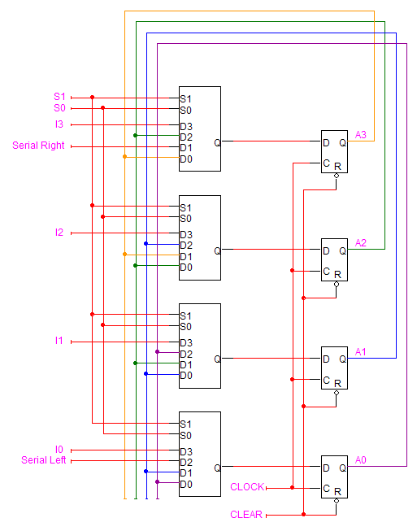
Shift Registers
Bidirectional shift register w/parallel load
Notes:
Serial right fills bits when they move to the right
Serial left fills lease signifigant left when they move to the left.
Outputs of A color wire is what is fed back into D0 of each multiplexer
When S1 and S0 equal 0 and you clock it. Then the values of A# are the values of itself. No change
When S1 and S0 are both 1, then the values will change to the I# of each multiplexer as they are D3 which coresponds to selector of 3.
For S1 0 and S0 1, then it will get D1. The values will shift where now A0 from above wil be A1 as the color wires of the output are being fed into each others D1.

Slide 25
Counters
A counter is a register that cycles through a predetermined state order on the application of input (clock) pulses.
The most common counters are those whose state sequences occur in the standard counting order.
Some counters have additional control lines such as clear and parallel load.

Slide 26
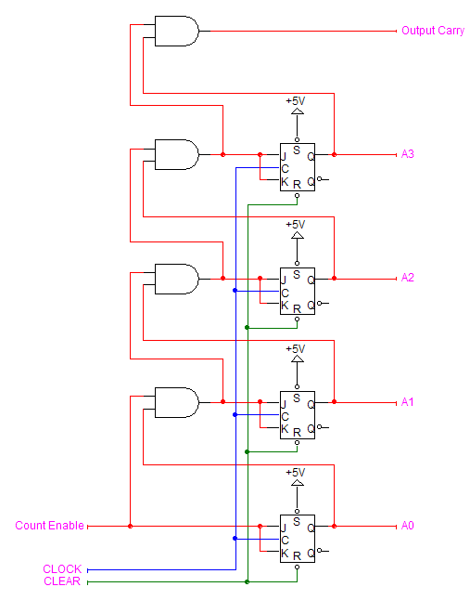
Counters
4-bit up-counter with clear

Slide 27
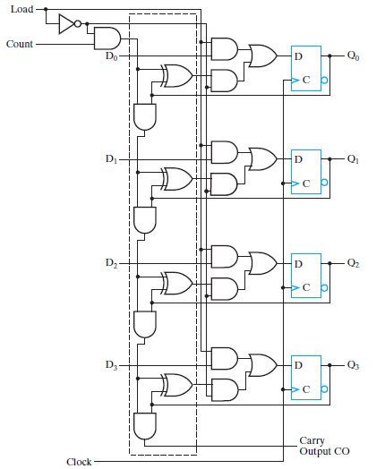
Counters
4-bit counter with parallel load (Figure 7-14)
Notes:
As long as load is 1, what is on the input of the load will be the output .
For the count to have an impact, the count will have to equal 1 while the load is 0
For it to count, it can not load because the load takes precedence.
If count is 1 and load is 0 then the value on the count output, then it will increment by one.

Slide 28
Register cell design
Registers can be iteratively designed, extending the approach we saw earlier with combinational circuits, e.g., ripple adder:
Design one bit of the register
Replicate n copies of the bit
Connect them together to form the register
Modify certain bits as needed, typically LSB and MSB

Slide 29
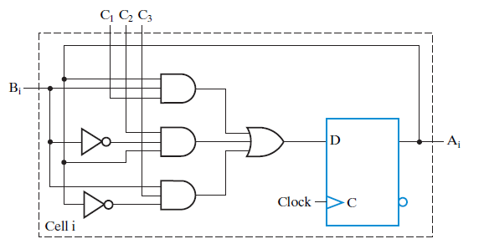
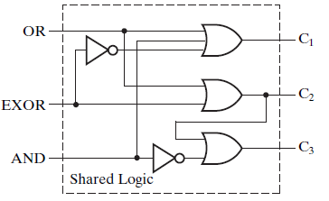
Register cell design
Example: Register cell that computes AND, XOR, OR
Control logic shared by all cells

Slide 30
Bus Transfers
In a system containing x n-bit registers, we need n * x * (x – 1) wires. This is impractical in large systems.
In a bus system, we restrict the number of parallel data transfers to one at a time. All of the wires share access to the same n wires.

Slide 31
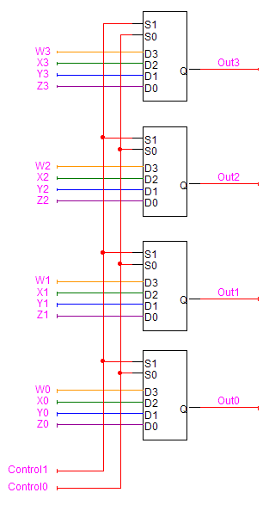
Bus Transfers
We can build a bus using multiplexers.

Slide 32
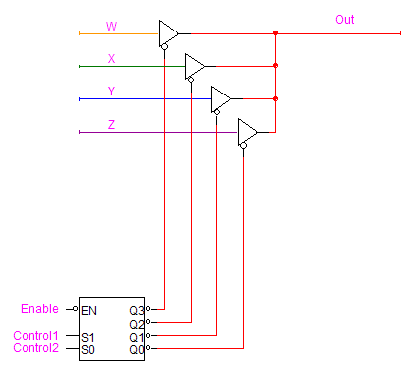
Bus Transfers
We can build a bus using tri-state buffers on the bus line.

Slide 33
Bus Transfers
An RTL statement may or may not explicitly represent a bus transfer.
P: BUS ← R1, C ← BUS
P: C ← R1
Not every register transfer has to use a bus.

Slide 34
Memory Transfers
We can express read and write operations as sequences of register transfers.
Write: Store the contents of R1 at memory address 0x100.
MAR ← 0x100
MDR ← R1
Mem[MAR] ← MDR

Slide 35
Memory Transfers
Read: Load R1 with the contents of memory address 0x100:
MAR ← 0x100
MDR ← Mem[MAR]
R1 ← MDR
(More on memories in the next chapter)

Slide 36
Control Functions
The job of a control function is to provide information to the inputs that operate a device.
Decoder inputs and multiplexer select lines
Adder carry-in
Logic gate inputs
Register and counter load, shift, clear, and increment lines.
We can implement control functions using a combination of status information and timing information
Often implemented as a state machine.

Slide 37
Control Functions
We’ll use register transfers to implement instructions for a CPU
A instruction typically consists of a sequence of micro-operations that must occur in the correct order.
REg₀s₇T₀ | FAD(7) ← RP0, FAD(6:0) ⇐ F
REg₀s₇T₁ | DR ⇐ R[FAD]
REg₀s₇T₂ | DR ⇐ DR plus W
REg₀s₇dT₃ | R[FAD] ⇐ DR
REg₀s₇d′T₃ | W ⇐ DR
REg₀s₅T₀ | FAD(7) ← RP0, FAD(6:0) ⇐ F
REg₀s₅T₁ | DR ⇐ R[FAD]
REg₀s₅T₂ | DR ⇐ DR AND W
REg₀s₅dT₃ | R[FAD] ⇐ DR
REg₀s₅d′T₃ | W ⇐ DR

Slide 38
Control Functions
When the micro-operations in a sequence share status information, we can generate timing signals to distinguish from among them and ensure that they occur in the correct order.
One complete sequence of the timing signals gives the computer’s cycle time.

Slide 39
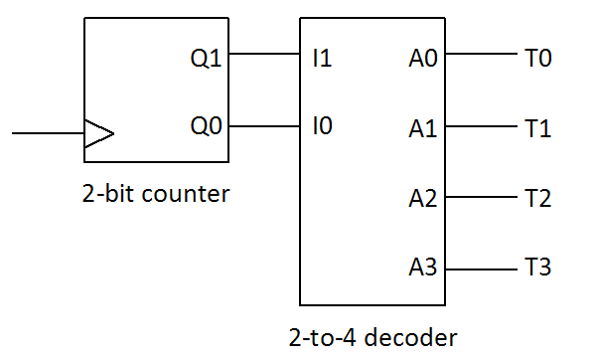
Control Functions
One easy way to generate timing signals is through a counter-decoder combination.

Slide 40
Generating Control Functions
Decompose every instruction into a sequence of micro-operations.
Identify every instance that performs a particular micro-operation.
Derive a master control condition for that micro-operation that combines all of the conditions that cause it to occur.

