Slide 1
Flux & Redux
What is flux & why the future is redux

Slide 2
What is flux?
It is neither a framework nor a library– it is a framework for frameworks, a frameworkception on which are based Redux and many other state containers alike.

Slide 3
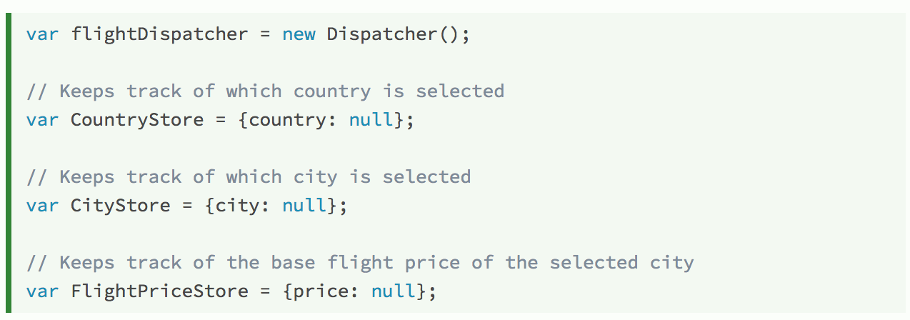
Dispatcher Example
Consider this hypothetical flight destination form, which selects a default city when a country is selected:

Slide 4
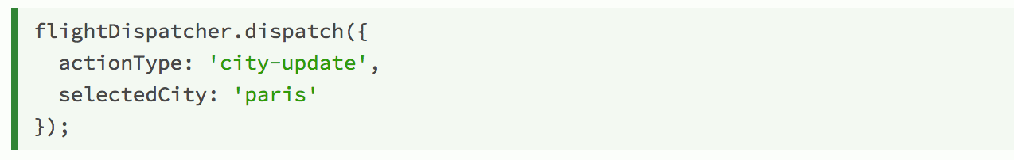
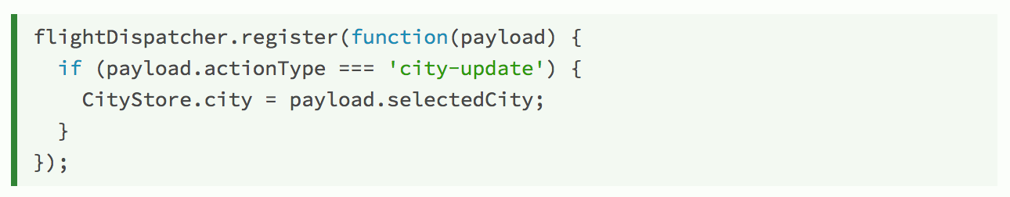
Dispatcher Example
When a user changes the selected city, we dispatch the payload:
This payload is digested by CityStore:

Slide 5
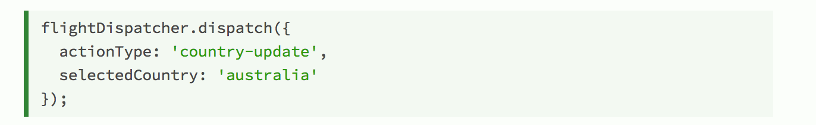
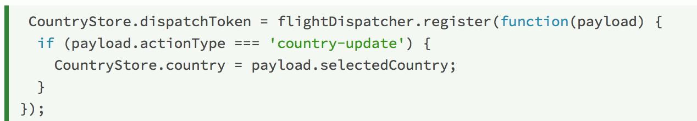
Dispatcher Example
When the user selects a country, we dispatch the payload:
This payload is digested by both stores:

Slide 6
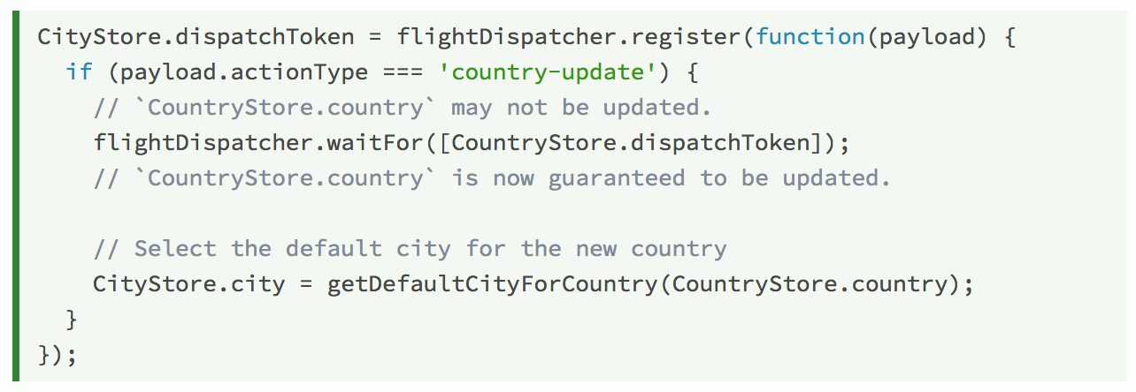
Dispatcher Example
When the callback to update CountryStore is registered, we save a reference to the returned token. Using this token with waitFor(), we can guarantee that CountryStore is updated before the callback that updates CityStore needs to query its data.

Slide 7
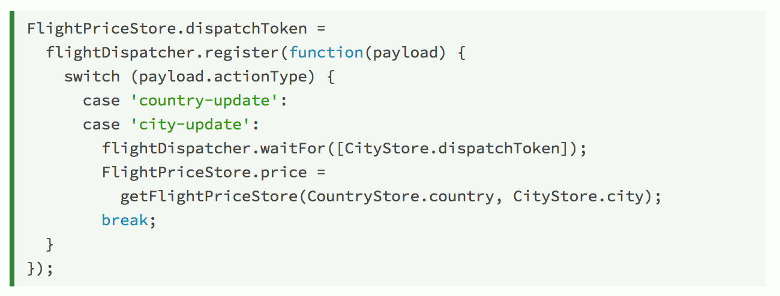
Dispatcher Example
The usage of waitFor() can be chained, for example:
The country-update payload will be guaranteed to invoke the stores' registered callbacks in order: CountryStore, CityStore, then FlightPriceStore.

Slide 8
Flux vs. Redux
Redux’s differences/advantages from Flux:
Stores and actions being pure functions → Easily testable in isolation.
Immutable states → Easier transactions. The dispatcher owns the state and has the power to revert the application to any previous state without the programmer specifically implementing some function to do so.
Immutable states → Simplicity. The assumption that you never mutate your data makes you no longer need the Flux Dispatcher.

Slide 9
Summarization
Flux is a pattern that consists of three major parts: the dispatcher, the stores, and the views (React components).
Redux is a state container library that origins in Flux, but evolved from the pain of writing Flux applications in many ways.
Single store
Pure reducers
Easy transactions
Little mess
Hence, Redux is the future as a Flux implementation.

Slide 10
References
1. https://facebook.github.io/flux/
2. http://redux.js.org/
3. http://jamesknelson.com/which-flux-implementation-should-i-use-with-react/
4. https://www.youtube.com/watch?v=wmYvPYaAwso

