Slide 1
Go Language Sharing
Bowen Chen
2016-11-12

Slide 2
Go History
Go originated as an experiment by Google engineers Robert Griesemer, Rob Pike, and Ken Thompson to design a new programming language that would resolve common criticisms of other languages while maintaining their positive characteristics. The new language was to:
be statically typed, scalable to large systems (as Java and C++).
be productive and readable, without too many mandatory keywords and repetition.
not require tooling, but support it well.
support networking and multiprocessing.
Go was announced in November 2009.
Go 1.0 was released in March 2012.
Go 1.5 was released in August 2015.
Go 1.7 was released in this year.

Slide 3
Go Basic
install(https://golang.org/doc/install)
workspaces(bin, pkg, src)
go tool(fmt build run get test…)
HelloWorld
Syntax, Type

Slide 4
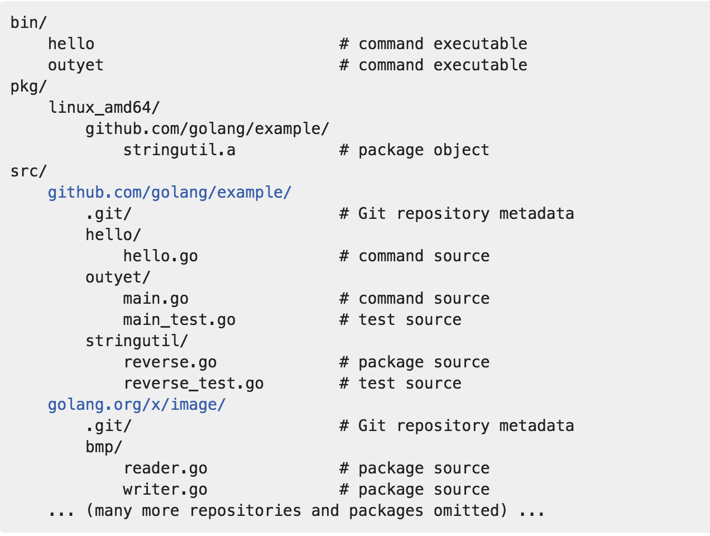
go workspace sample structure

Slide 5
package main
import (
"fmt"
)
func main() {
fmt.Println("Hello, World!")
}

Slide 6
Variables
var a int
a = 3
var a = 3
a := 3
Types
basic data types
int8 int16 int32(rune) int64
uint8 uint16 unit32 unit64
float32 float64
complex64 complex128
var x complex128 = complex(1, 2)
bool
string
s := "hello, world"
fmt.Println(len(s))
fmt.Println(s[0], s[7]) // "104, 119" ('h' and 'w')
fmt.Println(s[0:5] // "hello"
composite types
array
var a [3] int
fmt.Println(a[0])
slices
var x []int
x = append(x, 1)
x = append(x, 2, 3)
fmt.Println(x) // "[1, 2, 3]"
maps
var ages map[string]int
fmt.Println(ages == nil) // "true"
ages = make(map[string]int)
ages["bowen"] = 24
struct
type Point struct{ X, Y int }
p := Point{1, 2}
embedding and anonymous fields
type Circle struct {
Center Point
Radius int
}
type Circle struct {
Point
Radius int
}
function type
func name(parameter-list) (result-list) {
body
}

Slide 7
Go Methods And Interfaces

Slide 8
Go Concurrency

Slide 9
Go Testing

