Slide 1
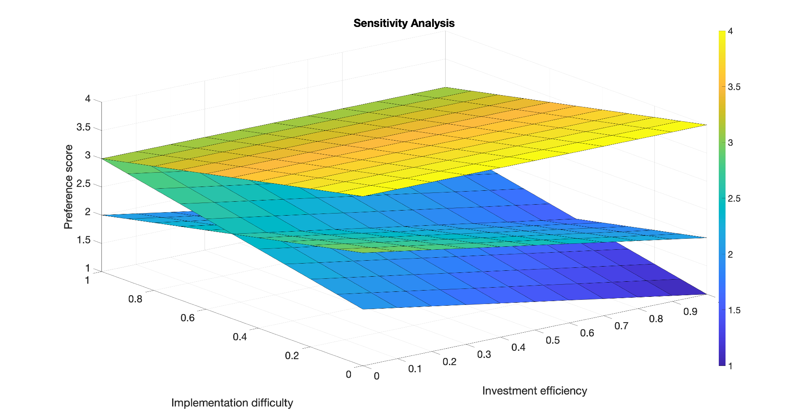
Ocean-going vessels
Refineries
Electricity-generating units

