Slide 1
Even More Fun With DDF
Martin Packer 🦕 , IBM
Notes:
Martin Packer 🦕 , IBM

Slide 2
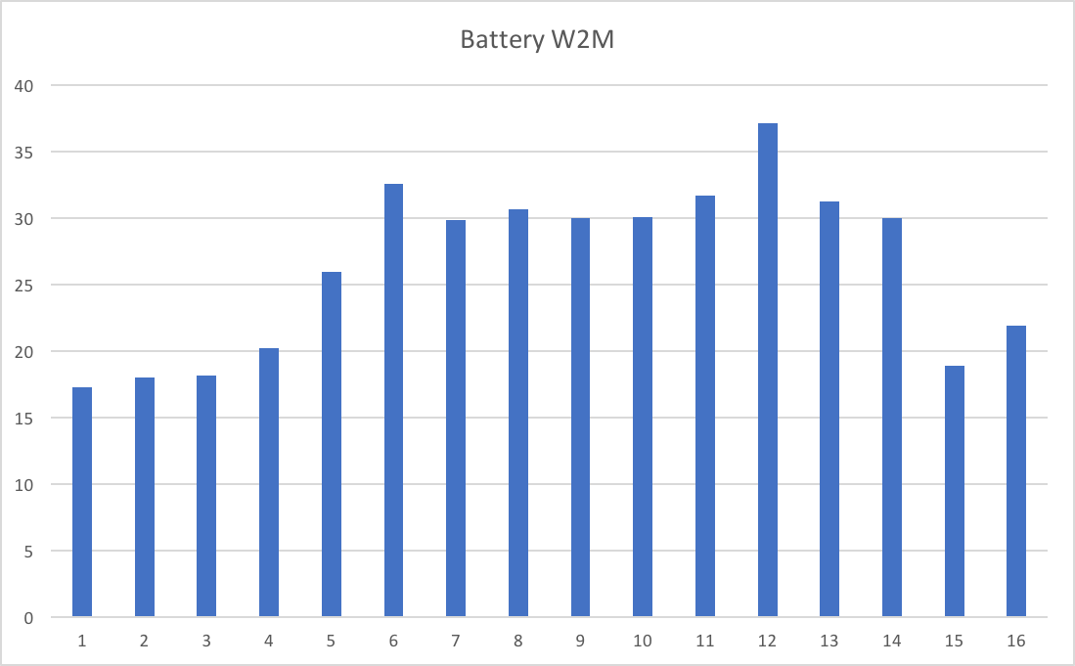
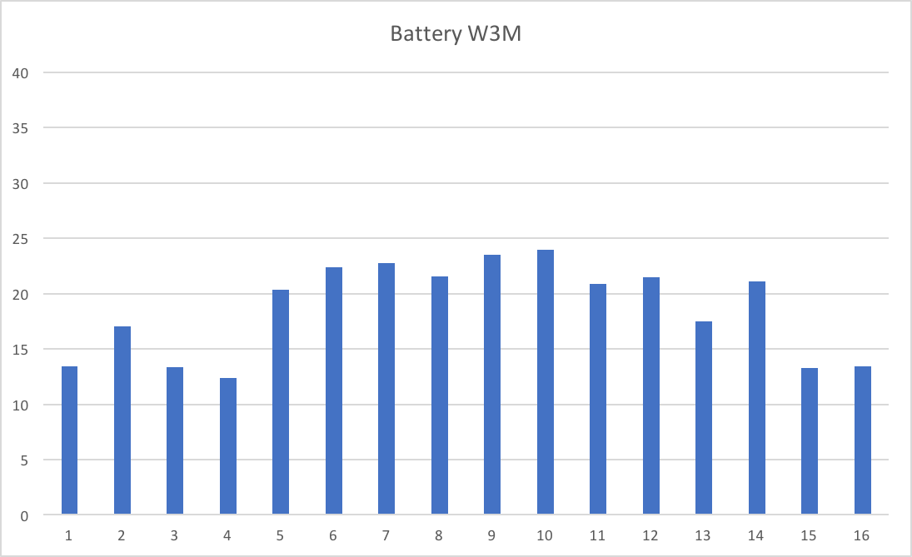
Abstract

