Slide 1
md2pptx Markdown To Powerpoint Converter 0.9.1 10 October, 2020
Presentation built: 10:27 on 11 October, 2020
Metadata:
master: Martin Master.pptx
pageTitleSize: 30
sectionTitleSize: 48
sectionSubtitleSize: 32
numbers: no
abstractTitle: Abstract

Slide 2
Even More Fun With DDF
Martin Packer 🦕 , IBM
Notes:
Martin Packer 🦕 , IBM

Slide 3
Abstract
The idea of "alien" DB2 work coming into your system through DDF strikes fear into even the most seasoned Performance Specialist...
How will I classify it?
What will stop it from taking over my machine?
This presentation describes how to use performance data to address both of those questions, based on the author's recent experiences with numerous customers.
It also enables you to understand what applications and machines are issuing the DDF requests, improving your knowledge of the application landscape.
This presentation has substantially evolved in 2017.

Slide 4
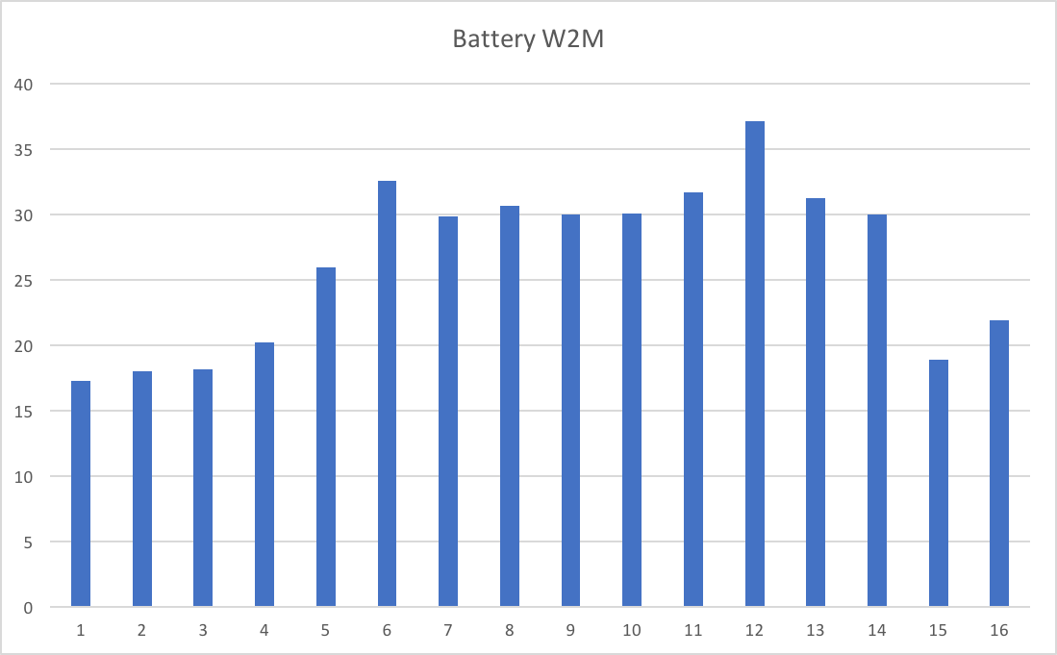
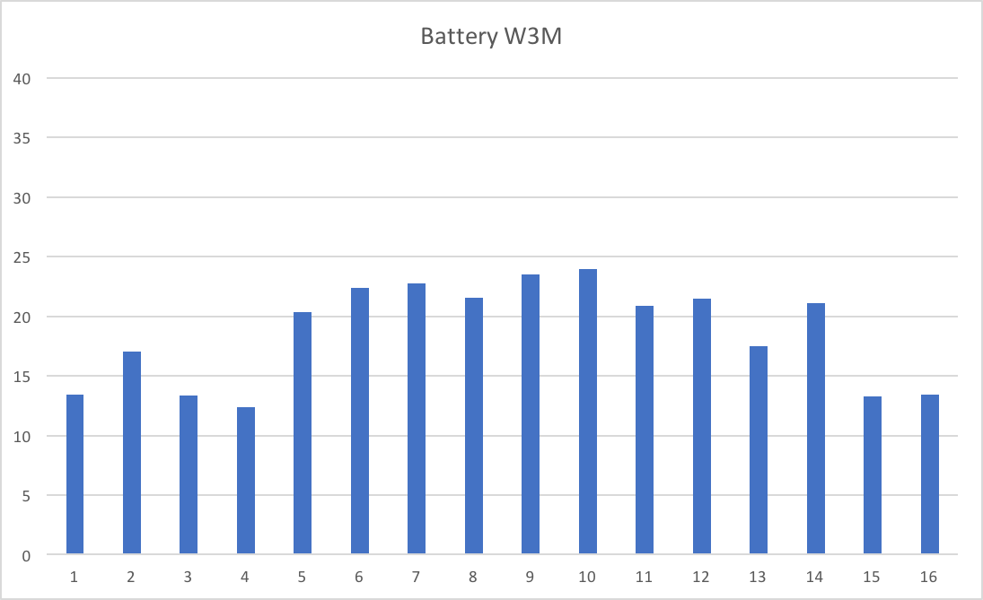
Class 1 CPU From Two Batteries Of 16 Websphere Application Servers Not balanced within each battery or between batteries

