Slide 1
CT2003 Group 1 Presentation
Presented By:
AARON LIM JING KAI
ANG WEE HWA
AQILA BINTE MOHAMED JAHBAR GANI
BOWEN YIP WEI DE
CHUA ZHEN YUN SERAPHINA

Slide 2
Table of Content:
Design Principles (SOLID)
  Examples of Violation in Original Version
  Proposed Solution
  Advantages of the Change
Usage of OOP Concepts
  Encapsulation and Abstraction
  Inheritance & Method Overriding
  Polymorphism
  Exception Handling
Reusability, Maintainability and Extensibility
Additional Feature - “Student’s Appeal” Demo
Frontend GUI Demo
Q&A

Slide 3
THE SOLID PRINCIPLES

Slide 4
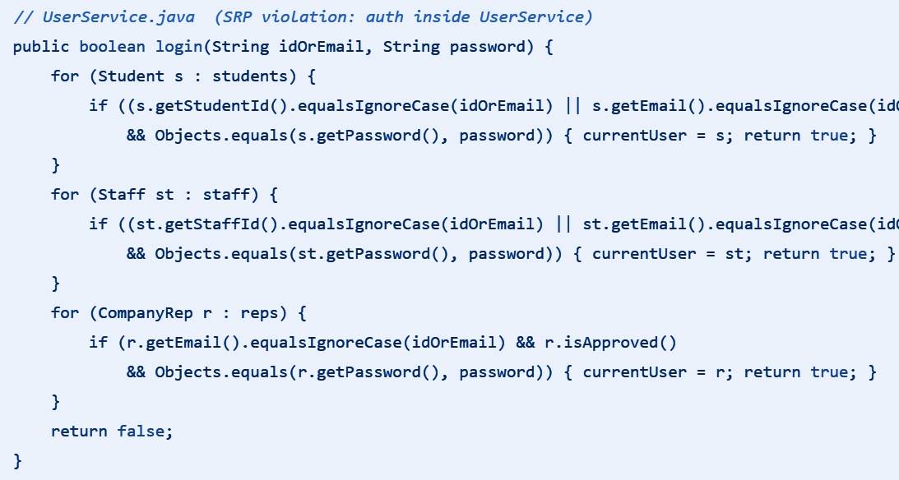
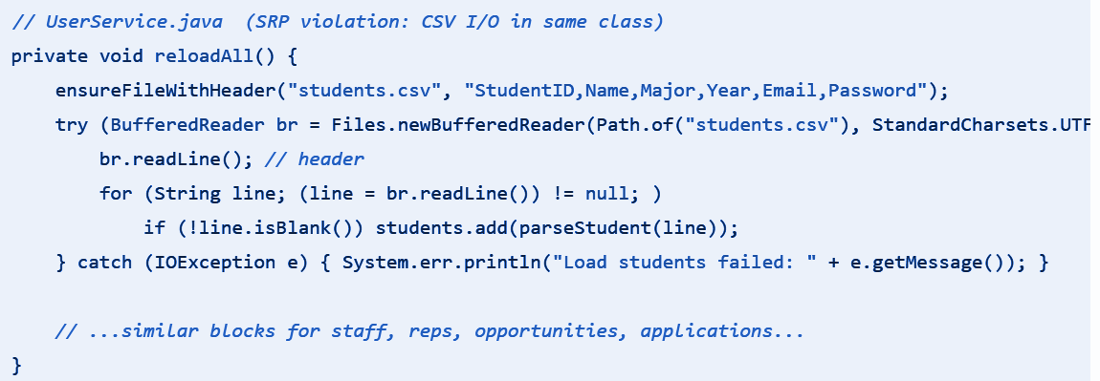
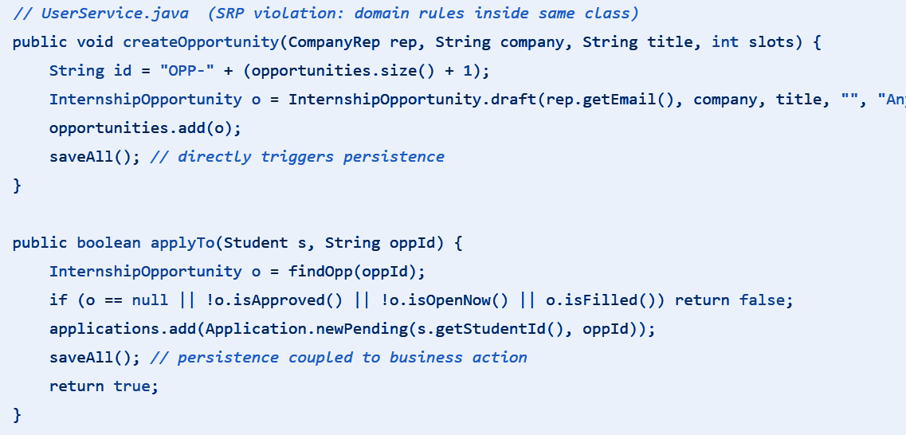
Design Principles -
Single Responsibility Principle (SRP)
S
A single God class UserService that handles anything from user authentication, processing applications and opportunities and even reading/writing CVS.
Violation in Original Version:
  UserService (Authentication Service)
UserService (CVS Persistence Service)
UserService (Applications/Opportunities Processing)
Notes:
🎞️ Slide 1 — Problem: SRP Violation in Original Version
Title:
🧱 Before Refactoring: UserService Doing Too Much
Slide Content (what to show visually):
Screenshot snippets (like the 3 code blocks: authentication, domain, CSV)
A simple list:
Handles authentication, business logic, and CSV persistence — all in one class
“God class” — too many responsibilities
Spoken Script:
“In the original version, we had a single UserService class doing everything — from logging users in, to creating and applying opportunities, and even reading and writing CSV files.
This violates the Single Responsibility Principle, which says a class should have only one reason to change.
Here, we can see three clear responsibilities mixed together — authentication, business logic, and persistence.”
“As a result, any small change in authentication or CSV format could ripple through the entire system, making testing and maintenance difficult.”

Slide 5
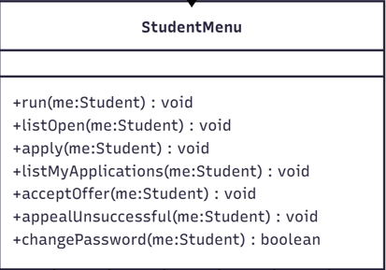
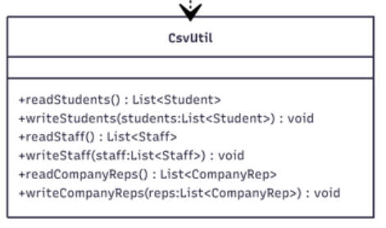
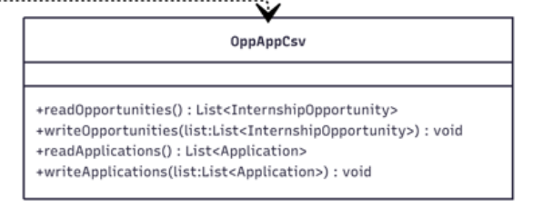
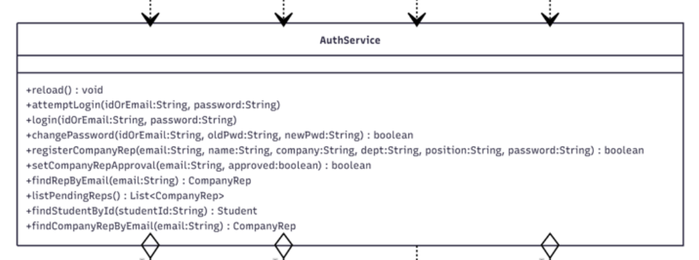
Design Principles -
Single Responsibility Principle (SRP)
S
Solution:
  UI / CLI Layer
    Menus like StudentMenu, CompanyRepMenu, etc.
  Domain Services
    AuthService (login, approve)
    PortalService (create, apply, appeal)
  Persistence Helpers
    CsvUtil, OppAppCsv, PreferenceService
Advantage:
  Change isolation: Auth updates don’t affect CSV or portal logic.
  Easier technology swap: Can replace CSV with database easily.
  Extensible: Easier to add new features later.
Notes:
🎞️ Slide 2 — Solution: Splitting Responsibilities
Title:
🔧 After Refactoring: Separation of Concerns
Slide Content (show your second image):
Organize it as three layers or sections:
UI / CLI Layer
Menus like StudentMenu, CompanyRepMenu, etc.
Domain Services
AuthService (login, approve)
PortalService (create, apply, appeal)
Persistence Helpers
CsvUtil, OppAppCsv, PreferenceService
Spoken Script:
“To fix this, we segregated the UserService into smaller, focused components.
Each layer now handles only one kind of responsibility.
The UI layer focuses on input and output;
the domain layer contains the business logic and rules;
and the persistence helper layer manages all CSV operations.”
“This makes each class cohesive — and each one now has only a single reason to change.”
🎞️ Slide 3 — Results: Advantages of the Change
Title:
🚀 Benefits of Applying SRP
Slide Content (use bullet points):
Change isolation: Auth updates don’t affect CSV or portal logic.
Easier technology swap: Can replace CSV with database easily.
Extensible: Easier to add new features later.
Spoken Script:
“After refactoring, we achieved clearer change isolation — for example, authentication changes affect only AuthService, not the rest of the system.
It’s now easier to swap technologies — if we want to replace CSV with a database, we only update the persistence helpers.
And future extensions are simpler because each class focuses on one role.”
“Overall, this refactor improves maintainability, reduces ripple effects, and aligns our system more closely with the Single Responsibility Principle.”

Slide 6
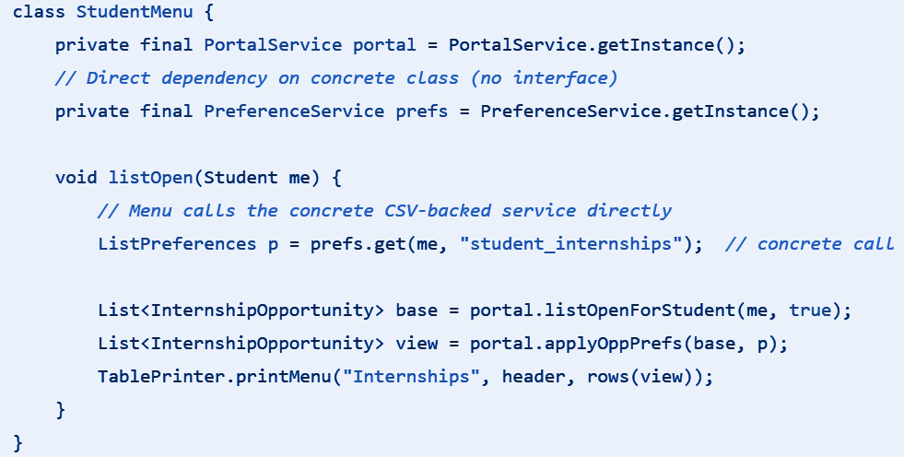
Design Principles -
Open/Closed Principle (OCP)
O
Open for Extension, Closed for modification
Violation in Original Version:
  Menu directly calls the concrete class PreferenceService
By changing the storage Preference Persistence Service, it will requires edits in every menu that calls PreferenceService -> allowing modules to be modified
This violates the Open/Closed Principle changing PreferenceService forces changes in multiple modules (menus).
Notes:
You should be able to add new behaviour without editing existing code.- main idea
Problem that arises is Your Menu directly calls PreferenceService (a concrete class).
If you change how preferences are saved (CSV → Database → JSON → Redis → Encryption),
every Menu class must be edited because they depend on this fixed class.
Why this violates OCP:
Changing PreferenceService forces changes in multiple modules (menus).
Modules should not change just because you want to change storage method.
Code is not closed to modification → many breakpoints, high maintenance.
✔️ In short:
Your menus are tightly coupled to a specific implementation → not flexible.
Modules should not change just because you want to change storage method.
Code is not closed to modification → many breakpoints, high maintenance.

Slide 7
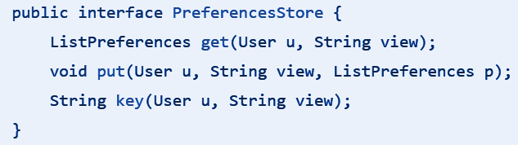
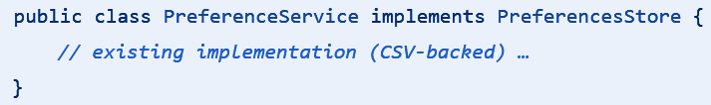
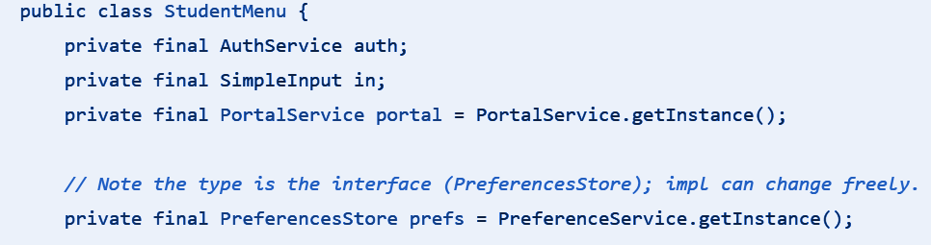
Design Principles -
Open/Closed Principle (OCP)
O
Solution:
  Introducing a new interface PreferencesStore
PreferenceService implements PreferenceStore
Menus now depend on the PreferenceStore
(Not the Concrete Class)
Advantage:
  Callers (menus) now depend on PreferencesStore (the abstraction)
  If we want to switch from CSV cache to DB/encrypted/Redis, you only update PreferenceService
  System is Open for extension (new storage methods) and System is Closed for modification (Menu code change not required) -> achieving Open/Closed Principle
Notes:
1. Menus depend on an abstraction, not concrete implementation
Menus know only the interface PreferenceStore
→ they don't care if preferences are stored in CSV, DB, JSON, cloud, encrypted file, etc.
2. You can extend behaviour without modifying the Menu classes
If tomorrow you want:
RedisPreferenceService
DatabasePreferenceService
EncryptedPreferenceService
You can simply create new classes implementing PreferenceStore and plug them in.
Menus remain untouched.
✔️ 3. System is OPEN for extension
You can add new storage methods.
✔️ 4. System is CLOSED for modification
Menu code does not need to change.

Slide 8
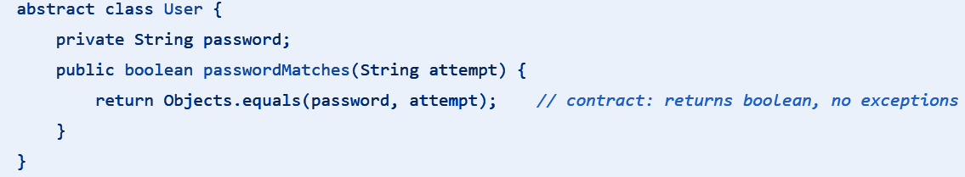
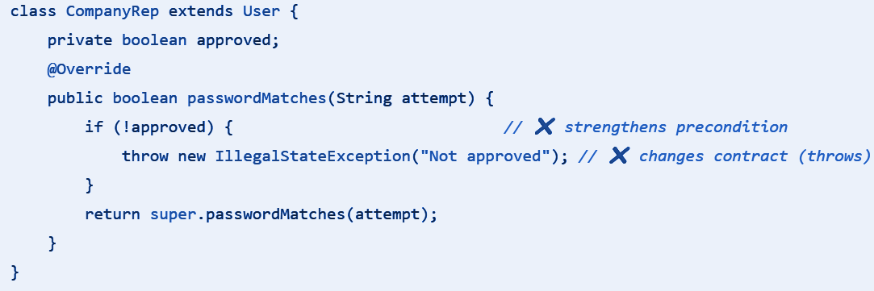
Design Principles -
Liskov Substitution Principle (LSP)
L
The Liskov Substitution Principle (LSP) is a key concept in object-oriented programming, ensuring that superclass objects can be replaced with subclass objects without affecting program correctness.
Violation in Original Version:
Notes:
Next, I’ll talk about the Liskov Substitution Principle, or LSP. LSP means that a subclass should be usable anywhere its superclass is expected, without breaking the program or changing behavior.
In our original design, we found a violation of LSP in the CompanyRep class, specifically in the passwordMatches method. The base class User defines it like this:
<refer to first screenshot>
This method simply checks the password and returns a boolean. It never throws exceptions, which is part of its contract: any subclass that overrides this method should also return a boolean and not change this behavior.
In CompanyRep, we added a check for approval:
<refer to second screenshot>
Here, if the representative is not approved, it throws an exception instead of returning a boolean. In other words, we strengthened the precondition and changed the method’s contract, which is exactly what LSP warns against. A CompanyRep can no longer safely replace a User, and anywhere expecting a User could fail.

Slide 9
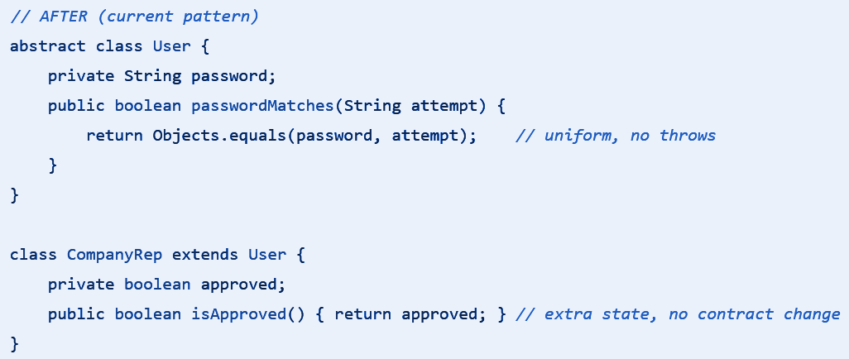
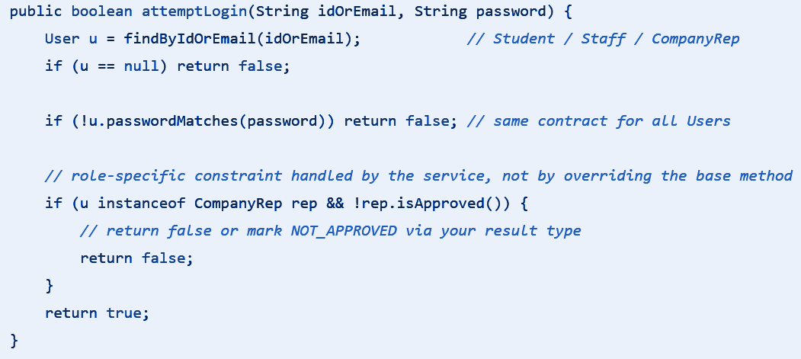
Design Principles -
Liskov Substitution Principle (LSP)
L
Solution:
  Keep User.passwordMatches uniform and side-effect-free across all subclasses.
Moving Role-Specific Checks to AuthService
Advantage:
  By maintaining a stable contract, code written against the User class works identically for Student, Staff, or CompanyRep, without hidden exceptions or extra preconditions. This approach enhances the reliability and maintainability of the system.
Notes:
We fixed this by keeping passwordMatches uniform and handling approval outside the class:
<refer to first screenshot>
Now, passwordMatches behaves the same for all users, and CompanyRep simply exposes its approval state. Role-specific checks, like whether a CompanyRep is approved, are handled in a service such as AuthService:
<refer to second screenshot>
The login service first checks the password consistently, then handles role-specific rules. This keeps the method’s contract stable, ensures subclasses can substitute the superclass safely, and makes the system more reliable and maintainable.

Slide 10
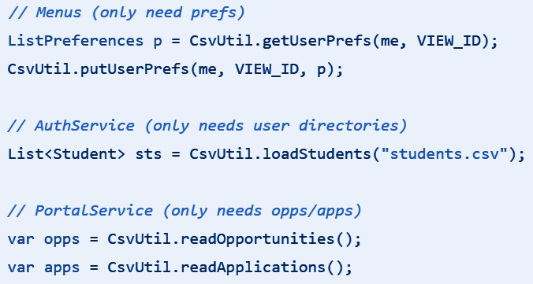
Design Principles -
Interface Segregation Principle (ISP)
I
Interface should not force classes to implement when they cannot do and large interface should be divided into smaller ones.
Violation in Original Version:
  Single utility CsvUtil handles all CSV operations.
  Respective Menu only needed preference but had to import CsvUtil.
  AuthService only need directories yet it includes opportunity, applications and preference.
  Portal Service only need opportunities.application but includes users and preference.
  Multiple classes were forced to depend on method they did not use in CsvUtil.
Notes:
🧩 1️⃣ Explain the Concept Briefly
“Encapsulation means keeping the internal state of an object private and controlling how it can be accessed or changed.
Abstraction means exposing only what is necessary — so other parts of the system can use the object without knowing how it works internally.”
🧱 2️⃣ Link It to the Class Example
“For example, in our InternshipOpportunity class, we keep important data like the opening date, closing date, total slots, and confirmed count as private attributes.
Other classes can’t directly modify them — they must use the public methods that we’ve defined.”
(show UML or code snippet)
💻 3️⃣ Walk Through the Code
“Here, we have three key methods:
isOpenNow() — checks whether the internship is currently open by comparing today’s date with the opening and closing dates.
isFilled() — checks if all available slots are already taken.
increaseConfirmed() — safely increases the confirmed count, but it first checks if the internship is already filled before doing so. If it’s full, it throws an error to protect the data.”
🗣️ Tip: When speaking, pause slightly at each method name, and use your pointer to guide the audience’s eyes to the code.
🧠 4️⃣ Explain Why This Matters (Encapsulation in Action)
“These methods prevent invalid operations — for example, we can’t accidentally overfill the internship because the rule is enforced inside the class.
This shows encapsulation, because the logic and data that belong together stay together.”
“Other classes simply call isOpenNow() or increaseConfirmed(), without needing to know how the rules are implemented — that’s abstraction.”
✅ 5️⃣ Wrap Up with the Advantages
“In short, encapsulation and abstraction make our system:
More secure, since data isn’t exposed directly.
More reliable, since rules are always checked inside the class.
And more maintainable, because the logic is reusable and isolated.”

Slide 11
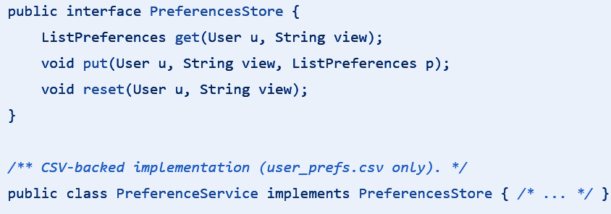
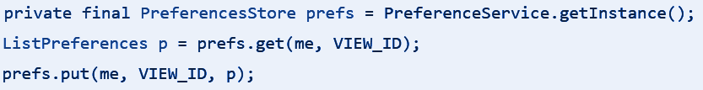
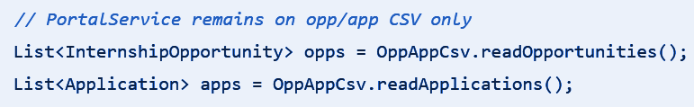
Design Principles -
Interface Segregation Principle (ISP)
I
Solution:
  Segregate capabilities into focused modules that clients only on what it needs (ie: preferenceStore - for preference csv only)
  Ie: preference store solution for O and preference service in I for our principle.
Advantage:
  Changing user CSV column no longer affect menu or PortalService
  Changing opp/app storage does not affect menus or AuthService
  Preferences evolution does not touch user or opp/app code
Notes:
🧩 1️⃣ Explain the Concept Briefly
“Encapsulation means keeping the internal state of an object private and controlling how it can be accessed or changed.
Abstraction means exposing only what is necessary — so other parts of the system can use the object without knowing how it works internally.”
🧱 2️⃣ Link It to the Class Example
“For example, in our InternshipOpportunity class, we keep important data like the opening date, closing date, total slots, and confirmed count as private attributes.
Other classes can’t directly modify them — they must use the public methods that we’ve defined.”
(show UML or code snippet)
💻 3️⃣ Walk Through the Code
“Here, we have three key methods:
isOpenNow() — checks whether the internship is currently open by comparing today’s date with the opening and closing dates.
isFilled() — checks if all available slots are already taken.
increaseConfirmed() — safely increases the confirmed count, but it first checks if the internship is already filled before doing so. If it’s full, it throws an error to protect the data.”
🗣️ Tip: When speaking, pause slightly at each method name, and use your pointer to guide the audience’s eyes to the code.
🧠 4️⃣ Explain Why This Matters (Encapsulation in Action)
“These methods prevent invalid operations — for example, we can’t accidentally overfill the internship because the rule is enforced inside the class.
This shows encapsulation, because the logic and data that belong together stay together.”
“Other classes simply call isOpenNow() or increaseConfirmed(), without needing to know how the rules are implemented — that’s abstraction.”
✅ 5️⃣ Wrap Up with the Advantages
“In short, encapsulation and abstraction make our system:
More secure, since data isn’t exposed directly.
More reliable, since rules are always checked inside the class.
And more maintainable, because the logic is reusable and isolated.”

Slide 12
Design Principles -
Dependency Inversion Principle (DIP)
D
Violation in Original Version:
  High-level modules (Menus) depended on a concrete, low-level class (PreferenceService) and called its singleton
  StudentMenu, StaffMenu, and CompanyRepMenu are high-level modules while PreferenceService is a low-level module (file-backed CSV persistence for user list preferences)
  ANY changes to how preferences are stored (CSV → JSON → DB), would force code changes and re-compilation in all menus
  This is a tight coupling structure, resulting in harder substitution and testing

Slide 13
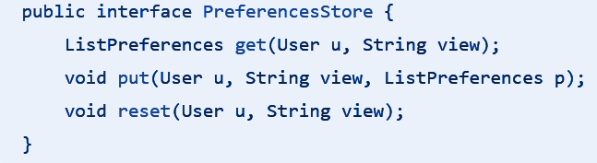
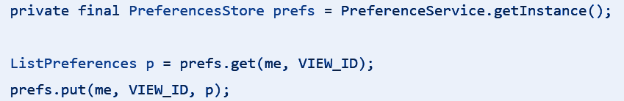
Design Principles -
Dependency Inversion Principle (DIP)
D
Solution:
  Introducing a new interface PreferencesStore
Making PreferenceService implementing it instead
Refactor high-level modules (menus) to the abstraction:
Advantage:
  Menus now depend on PreferencesStore (an abstraction), not PreferenceService (a detail)
  PreferenceService (detail) now implements PreferencesStore (abstraction) , the direction of dependency is inverted.
  Substitutability: swap CSV storage for JSON/DB or an in-memory stub without touching menu code
  Lower ripple: Changes to persistence format/classes no longer cascade into UI flows.

Slide 14
USAGE OF OOP CONCEPTS

Slide 15
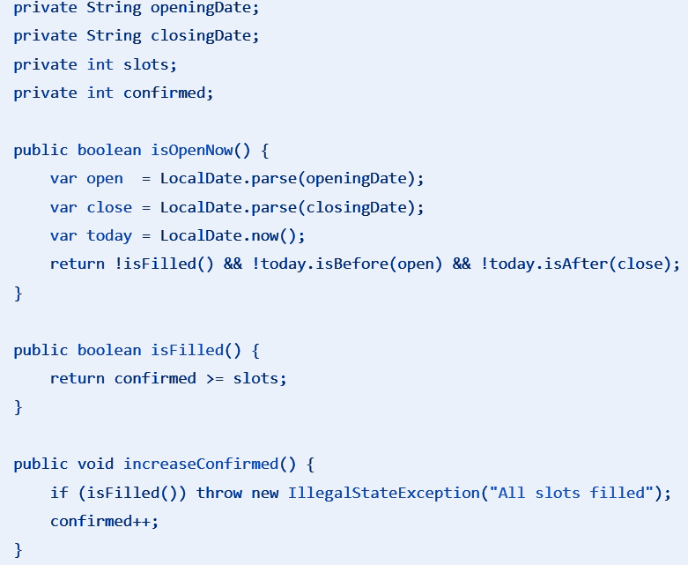
OOP Concepts - Encapsulation and Abstraction
Domain entities keep state private and guard their invariants:
  InternshipOpportunity — window & capacity rules live within the object
Advantages:
  Dates and counters are not exposed directly
  Validity (open window, capacity ceiling) is checked inside the class whenever state changes
  Other parts of the program call isOpenNow() / increaseConfirmed() instead of duplicating rule logic, reusable codes

Slide 16
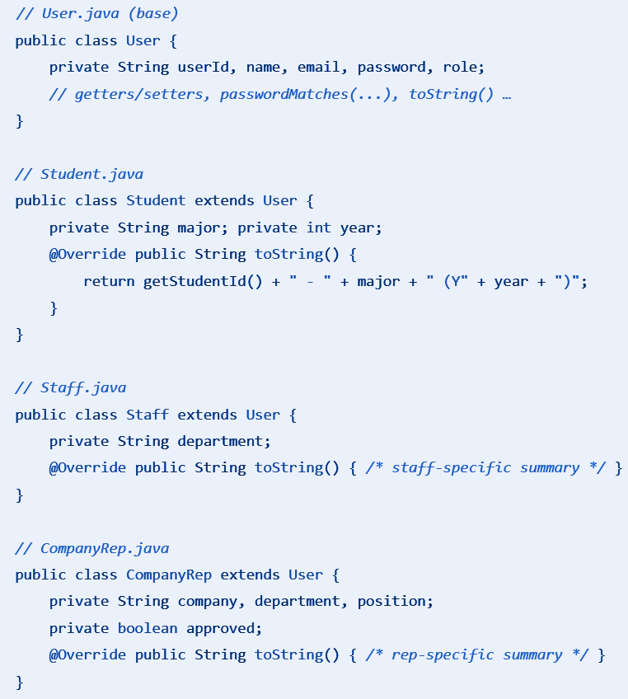
OOP Concepts - Inheritance and Method Overriding
Use of Inheritance to create role hierarchy with one base, three specialisations
  Users extended by Student / Staff / CompanyRep (to avoid repeating common code)
Advantages:
  Common identity/credentials live in User -> All shared fields stay in one place
  Anywhere we handle a User (e.g., after login), we can branch to role-specific menus
  Overridden takes place r (e.g., toString() output) is overridden where it belongs, which refers as Method overriding
  Allows future extension of more User Groups like Alumni, Parents
Notes:
Easier to maintain
After login, we don’t write long if-else checks. Because each subclass overrides getMenu(), we can simply call u.getMenu() and the correct menu is returned automatically
Every role has its own behaviour.Instead of mixing everything in one place, we let each subclass override the function so it controls its own output.
Simple design - easier for future extension

Slide 17
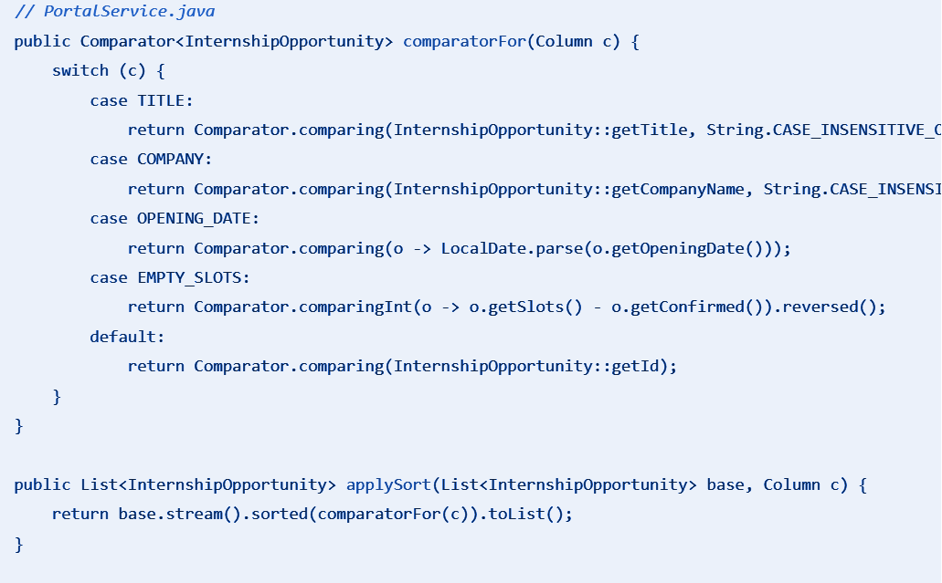
OOP Concepts - Polymorphism
Polymorphism lets one call site dispatch different concrete behaviours at runtime depending on the object or value supplied, and these are the types we used:
Subtype Polymorphism for Sorting:
A single method returns different comparators based on the chosen column, allowing callers to request sorting by a specific column without knowing the underlying comparison logic
ApplySort calls the same method but gets a different comparator object (strategy) depending on c
Notes:
Next, I’ll talk about polymorphism. Polymorphism allows a single function or operation to behave differently depending on the object it works with. This makes software more adaptable and reusable.
In our system, we use two types: subtype polymorphism and strategy polymorphism.
Subtype polymorphism lets the same tool work with different types of objects through a shared interface. For example, when we sort internship opportunities, we use Comparator<InternshipOpportunity>. All comparators share the same interface, so sorting works uniformly whether we sort by title, company name, opening date, or empty slots. Here’s how we select the comparator:
<refer to first function>
For titles and company names, we use a case-insensitive comparison. For opening dates, we parse the string to a LocalDate. For empty slots, we calculate remaining slots and sort in descending order. The default comparator sorts by ID.
Once the comparator is selected, we apply it to the list:
<refer to second function>
This shows how subtype polymorphism lets the same sorting mechanism work across different criteria.

Slide 18
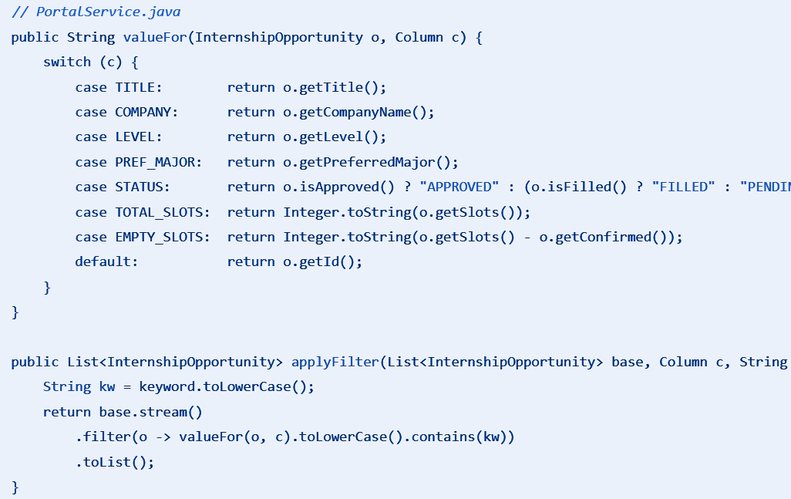
OOP Concepts - Polymorphism
Strategy Polymorphism for Filtering:
Filtering uses a unified key extractor, where the UI passes a column and a keyword, and PortalService determines the appropriate way to extract text for matching
valueFor plays the strategy for “Extracting a searchable value within a Column,” which changes per column, but the filter pipeline remains identical.
Notes:
Strategy polymorphism allows the program to choose a specific behavior at runtime. In our system, this is used for filtering. The valueFor method extracts the relevant data from each internship opportunity based on the selected column:
<refer to first function>
Then, applyFilter applies a keyword search across the chosen column:
<refer to second function>
This allows the filtering logic to work for any column. The program selects the strategy at runtime, keeping the system flexible and maintainable.
By combining subtype and strategy polymorphism, our system can treat objects uniformly through interfaces and select the correct behavior at runtime.

Slide 19
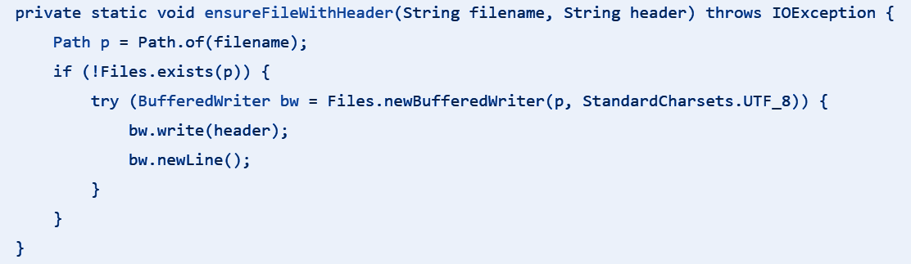
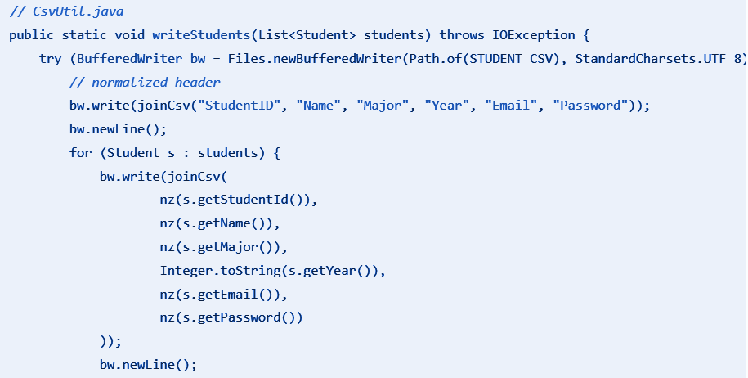
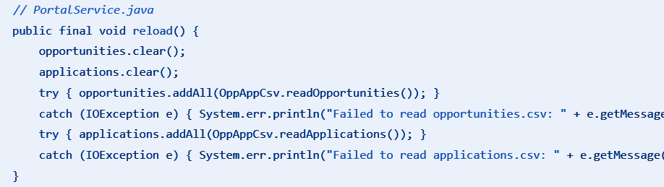
OOP Concepts - Exception Handling
To manage runtime errors and other exceptional conditions that disrupt the normal flow of a program's execution
Proactive file creation:
  Every read starts with ensureFileWithHeader()
  If file missing will create with correct header
All CsvUtil public method throws IOExceptions:
  AuthService.reload() wraps each call in try/catch
  On failure it prints an error to System.err to avoid clashing
PortalService.reload() catches IOException from its CSV helper
  Even AuthService.reload() follows the same pattern (three try/catch blocks for students, staff, reps—on failure it logs and replaces with an empty list).
  This layering “CsvUtil throws, services catch” ensures missing/locked/malformed CSVs never crash the CLI and degrades gracefully (logs + keeps running)
Notes:
🧩 1️⃣ Explain the Concept Briefly
“Encapsulation means keeping the internal state of an object private and controlling how it can be accessed or changed.
Abstraction means exposing only what is necessary — so other parts of the system can use the object without knowing how it works internally.”
🧱 2️⃣ Link It to the Class Example
“For example, in our InternshipOpportunity class, we keep important data like the opening date, closing date, total slots, and confirmed count as private attributes.
Other classes can’t directly modify them — they must use the public methods that we’ve defined.”
(show UML or code snippet)
💻 3️⃣ Walk Through the Code
“Here, we have three key methods:
isOpenNow() — checks whether the internship is currently open by comparing today’s date with the opening and closing dates.
isFilled() — checks if all available slots are already taken.
increaseConfirmed() — safely increases the confirmed count, but it first checks if the internship is already filled before doing so. If it’s full, it throws an error to protect the data.”
🗣️ Tip: When speaking, pause slightly at each method name, and use your pointer to guide the audience’s eyes to the code.
🧠 4️⃣ Explain Why This Matters (Encapsulation in Action)
“These methods prevent invalid operations — for example, we can’t accidentally overfill the internship because the rule is enforced inside the class.
This shows encapsulation, because the logic and data that belong together stay together.”
“Other classes simply call isOpenNow() or increaseConfirmed(), without needing to know how the rules are implemented — that’s abstraction.”
✅ 5️⃣ Wrap Up with the Advantages
“In short, encapsulation and abstraction make our system:
More secure, since data isn’t exposed directly.
More reliable, since rules are always checked inside the class.
And more maintainable, because the logic is reusable and isolated.”

Slide 20
Reusability, Maintainability and Extensibility

Slide 21
Reusability
Maintainability
Layered Design enables reuse across UIs
  The same services can power a future GUI or REST API without code duplication
Shared Utilities (SimpleInput and TablePrinter)
  Reused by StudentMenu, StaffMenu, and CompanyRepMenu
Central Filter/Sort Pipeline
  No menu re-implements filtering or sorting
(SRP) Single responsibility per class.
  UI, domain rules, and persistence are separated, reducing the reasons any file must change
(OCP) Menus call abstractions (PreferenceStore) and service entry points
  Needing to just modify PreferenceService, not within the caller
(LSP) Stable base contracts
  We do not have to keep fixing problems with Superclass / Subclass Usage
(ISP/DIP) Means easier Unit Testing
  Swapping alternate PreferenceStore without touching the rest of system
Graceful failures and ease of debugging due to use of Exception Handling
Notes:
🧩 1️⃣ Explain the Concept Briefly
“Encapsulation means keeping the internal state of an object private and controlling how it can be accessed or changed.
Abstraction means exposing only what is necessary — so other parts of the system can use the object without knowing how it works internally.”
🧱 2️⃣ Link It to the Class Example
“For example, in our InternshipOpportunity class, we keep important data like the opening date, closing date, total slots, and confirmed count as private attributes.
Other classes can’t directly modify them — they must use the public methods that we’ve defined.”
(show UML or code snippet)
💻 3️⃣ Walk Through the Code
“Here, we have three key methods:
isOpenNow() — checks whether the internship is currently open by comparing today’s date with the opening and closing dates.
isFilled() — checks if all available slots are already taken.
increaseConfirmed() — safely increases the confirmed count, but it first checks if the internship is already filled before doing so. If it’s full, it throws an error to protect the data.”
🗣️ Tip: When speaking, pause slightly at each method name, and use your pointer to guide the audience’s eyes to the code.
🧠 4️⃣ Explain Why This Matters (Encapsulation in Action)
“These methods prevent invalid operations — for example, we can’t accidentally overfill the internship because the rule is enforced inside the class.
This shows encapsulation, because the logic and data that belong together stay together.”
“Other classes simply call isOpenNow() or increaseConfirmed(), without needing to know how the rules are implemented — that’s abstraction.”
✅ 5️⃣ Wrap Up with the Advantages
“In short, encapsulation and abstraction make our system:
More secure, since data isn’t exposed directly.
More reliable, since rules are always checked inside the class.
And more maintainable, because the logic is reusable and isolated.”

Slide 22
Extensibility
Ease of Adding New Listing Column
  Simply extend Column and map it once in PortalService (valueFor + comparatorFor)
  All menus pick it up automatically through applyOppPrefs
Ease of Extending Business Functions
  Capacity, eligibility, and appeal policies reside in PortalService
  New changes don’t spill into menus or persistence
Ease of Introducing new user roles (LSP)
  Subclass User (e.g., Alumni) and add role-specific behavior outside base contracts (e.g., policies in AuthService).
New preference backends with zero caller changes (OCP + DIP)
  Swapping CSV to JSON/DB/encrypted/cache only changes the implementation/wiring, not the callers
**Good example of us exhibiting Extensibility is our Additional Feature - “Student’s Appeal”**
Notes:
🧩 1️⃣ Explain the Concept Briefly
“Encapsulation means keeping the internal state of an object private and controlling how it can be accessed or changed.
Abstraction means exposing only what is necessary — so other parts of the system can use the object without knowing how it works internally.”
🧱 2️⃣ Link It to the Class Example
“For example, in our InternshipOpportunity class, we keep important data like the opening date, closing date, total slots, and confirmed count as private attributes.
Other classes can’t directly modify them — they must use the public methods that we’ve defined.”
(show UML or code snippet)
💻 3️⃣ Walk Through the Code
“Here, we have three key methods:
isOpenNow() — checks whether the internship is currently open by comparing today’s date with the opening and closing dates.
isFilled() — checks if all available slots are already taken.
increaseConfirmed() — safely increases the confirmed count, but it first checks if the internship is already filled before doing so. If it’s full, it throws an error to protect the data.”
🗣️ Tip: When speaking, pause slightly at each method name, and use your pointer to guide the audience’s eyes to the code.
🧠 4️⃣ Explain Why This Matters (Encapsulation in Action)
“These methods prevent invalid operations — for example, we can’t accidentally overfill the internship because the rule is enforced inside the class.
This shows encapsulation, because the logic and data that belong together stay together.”
“Other classes simply call isOpenNow() or increaseConfirmed(), without needing to know how the rules are implemented — that’s abstraction.”
✅ 5️⃣ Wrap Up with the Advantages
“In short, encapsulation and abstraction make our system:
More secure, since data isn’t exposed directly.
More reliable, since rules are always checked inside the class.
And more maintainable, because the logic is reusable and isolated.”

Slide 23
Additional Feature
“Student’s Appeal”

Slide 24
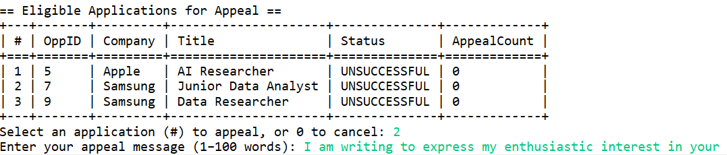
“Student’s Appeal” Demo
Case Example:
  Ng Jia Hao has 3 unsuccessful applications and wishes to appeal for 1 of them
He selects the application to appeal and enters appeal message (1 to 100 words)
List of Applications updated and shows “APPEALING” Status
Notes:
🧩 1️⃣ Explain the Concept Briefly
“Encapsulation means keeping the internal state of an object private and controlling how it can be accessed or changed.
Abstraction means exposing only what is necessary — so other parts of the system can use the object without knowing how it works internally.”
🧱 2️⃣ Link It to the Class Example
“For example, in our InternshipOpportunity class, we keep important data like the opening date, closing date, total slots, and confirmed count as private attributes.
Other classes can’t directly modify them — they must use the public methods that we’ve defined.”
(show UML or code snippet)
💻 3️⃣ Walk Through the Code
“Here, we have three key methods:
isOpenNow() — checks whether the internship is currently open by comparing today’s date with the opening and closing dates.
isFilled() — checks if all available slots are already taken.
increaseConfirmed() — safely increases the confirmed count, but it first checks if the internship is already filled before doing so. If it’s full, it throws an error to protect the data.”
🗣️ Tip: When speaking, pause slightly at each method name, and use your pointer to guide the audience’s eyes to the code.
🧠 4️⃣ Explain Why This Matters (Encapsulation in Action)
“These methods prevent invalid operations — for example, we can’t accidentally overfill the internship because the rule is enforced inside the class.
This shows encapsulation, because the logic and data that belong together stay together.”
“Other classes simply call isOpenNow() or increaseConfirmed(), without needing to know how the rules are implemented — that’s abstraction.”
✅ 5️⃣ Wrap Up with the Advantages
“In short, encapsulation and abstraction make our system:
More secure, since data isn’t exposed directly.
More reliable, since rules are always checked inside the class.
And more maintainable, because the logic is reusable and isolated.”

Slide 25
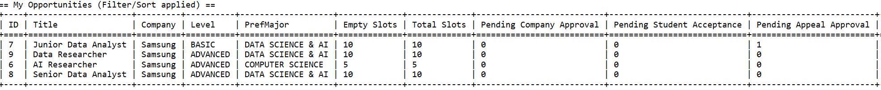
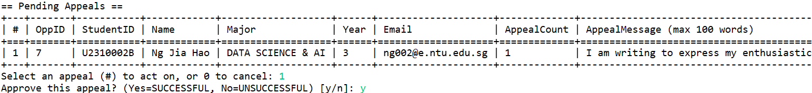
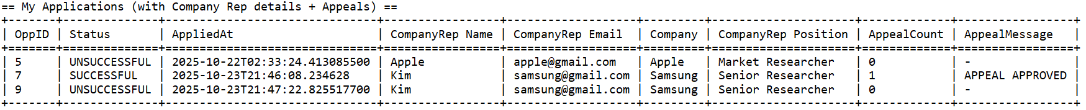
“Student’s Appeal” Demo
Case Example:
  Samsung’s Company Representative List of Opportunities Updated
Appeal is reviewed and being Approved
Ng Jia Hao’s List of Applications is being updated accordingly
Notes:
🧩 1️⃣ Explain the Concept Briefly
“Encapsulation means keeping the internal state of an object private and controlling how it can be accessed or changed.
Abstraction means exposing only what is necessary — so other parts of the system can use the object without knowing how it works internally.”
🧱 2️⃣ Link It to the Class Example
“For example, in our InternshipOpportunity class, we keep important data like the opening date, closing date, total slots, and confirmed count as private attributes.
Other classes can’t directly modify them — they must use the public methods that we’ve defined.”
(show UML or code snippet)
💻 3️⃣ Walk Through the Code
“Here, we have three key methods:
isOpenNow() — checks whether the internship is currently open by comparing today’s date with the opening and closing dates.
isFilled() — checks if all available slots are already taken.
increaseConfirmed() — safely increases the confirmed count, but it first checks if the internship is already filled before doing so. If it’s full, it throws an error to protect the data.”
🗣️ Tip: When speaking, pause slightly at each method name, and use your pointer to guide the audience’s eyes to the code.
🧠 4️⃣ Explain Why This Matters (Encapsulation in Action)
“These methods prevent invalid operations — for example, we can’t accidentally overfill the internship because the rule is enforced inside the class.
This shows encapsulation, because the logic and data that belong together stay together.”
“Other classes simply call isOpenNow() or increaseConfirmed(), without needing to know how the rules are implemented — that’s abstraction.”
✅ 5️⃣ Wrap Up with the Advantages
“In short, encapsulation and abstraction make our system:
More secure, since data isn’t exposed directly.
More reliable, since rules are always checked inside the class.
And more maintainable, because the logic is reusable and isolated.”

Slide 26
“Student’s Appeal” Demo
Case Example:
  Samsung’s Company Representative List of Opportunities Updated
Appeal is reviewed and being Approved
Ng Jia Hao’s List of Applications is being updated accordingly
Ng Jia Hao accepts the Internship Opportunity Successfully
Notes:
🧩 1️⃣ Explain the Concept Briefly
“Encapsulation means keeping the internal state of an object private and controlling how it can be accessed or changed.
Abstraction means exposing only what is necessary — so other parts of the system can use the object without knowing how it works internally.”
🧱 2️⃣ Link It to the Class Example
“For example, in our InternshipOpportunity class, we keep important data like the opening date, closing date, total slots, and confirmed count as private attributes.
Other classes can’t directly modify them — they must use the public methods that we’ve defined.”
(show UML or code snippet)
💻 3️⃣ Walk Through the Code
“Here, we have three key methods:
isOpenNow() — checks whether the internship is currently open by comparing today’s date with the opening and closing dates.
isFilled() — checks if all available slots are already taken.
increaseConfirmed() — safely increases the confirmed count, but it first checks if the internship is already filled before doing so. If it’s full, it throws an error to protect the data.”
🗣️ Tip: When speaking, pause slightly at each method name, and use your pointer to guide the audience’s eyes to the code.
🧠 4️⃣ Explain Why This Matters (Encapsulation in Action)
“These methods prevent invalid operations — for example, we can’t accidentally overfill the internship because the rule is enforced inside the class.
This shows encapsulation, because the logic and data that belong together stay together.”
“Other classes simply call isOpenNow() or increaseConfirmed(), without needing to know how the rules are implemented — that’s abstraction.”
✅ 5️⃣ Wrap Up with the Advantages
“In short, encapsulation and abstraction make our system:
More secure, since data isn’t exposed directly.
More reliable, since rules are always checked inside the class.
And more maintainable, because the logic is reusable and isolated.”

Slide 27
Frontend GUI Demo

Slide 28
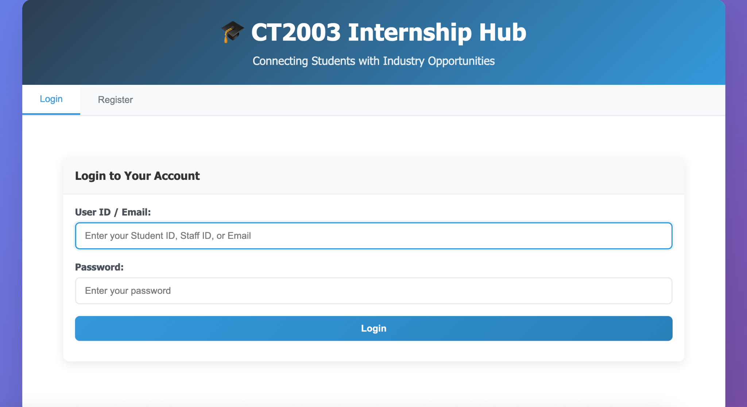
Frontend GUI Demo - Login Page
Notes:
🧩 1️⃣ Explain the Concept Briefly
“Encapsulation means keeping the internal state of an object private and controlling how it can be accessed or changed.
Abstraction means exposing only what is necessary — so other parts of the system can use the object without knowing how it works internally.”
🧱 2️⃣ Link It to the Class Example
“For example, in our InternshipOpportunity class, we keep important data like the opening date, closing date, total slots, and confirmed count as private attributes.
Other classes can’t directly modify them — they must use the public methods that we’ve defined.”
(show UML or code snippet)
💻 3️⃣ Walk Through the Code
“Here, we have three key methods:
isOpenNow() — checks whether the internship is currently open by comparing today’s date with the opening and closing dates.
isFilled() — checks if all available slots are already taken.
increaseConfirmed() — safely increases the confirmed count, but it first checks if the internship is already filled before doing so. If it’s full, it throws an error to protect the data.”
🗣️ Tip: When speaking, pause slightly at each method name, and use your pointer to guide the audience’s eyes to the code.
🧠 4️⃣ Explain Why This Matters (Encapsulation in Action)
“These methods prevent invalid operations — for example, we can’t accidentally overfill the internship because the rule is enforced inside the class.
This shows encapsulation, because the logic and data that belong together stay together.”
“Other classes simply call isOpenNow() or increaseConfirmed(), without needing to know how the rules are implemented — that’s abstraction.”
✅ 5️⃣ Wrap Up with the Advantages
“In short, encapsulation and abstraction make our system:
More secure, since data isn’t exposed directly.
More reliable, since rules are always checked inside the class.
And more maintainable, because the logic is reusable and isolated.”

Slide 29
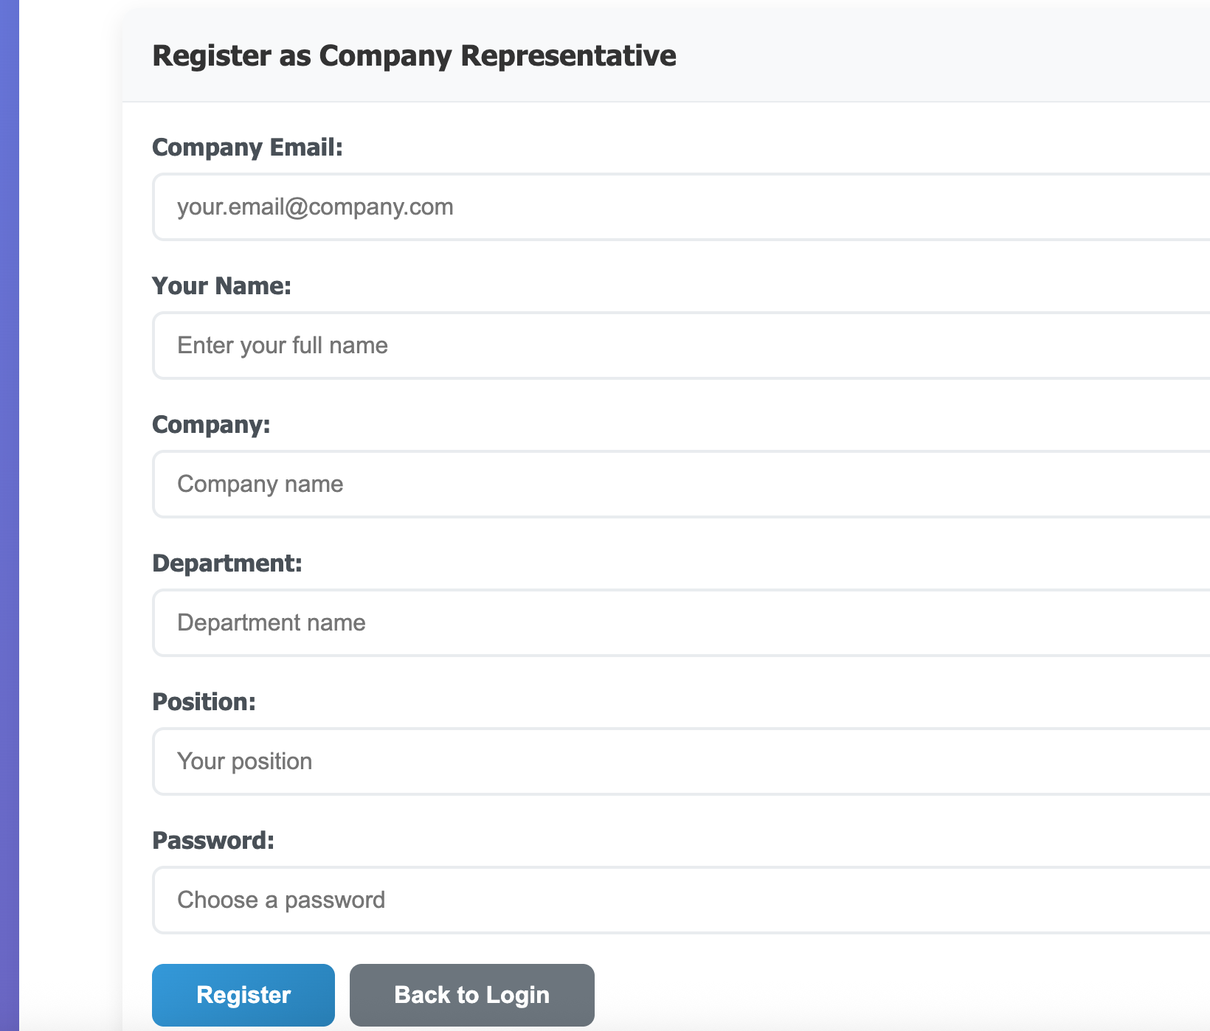
Frontend GUI Demo -
Register New Company Representatives
Notes:
🧩 1️⃣ Explain the Concept Briefly
“Encapsulation means keeping the internal state of an object private and controlling how it can be accessed or changed.
Abstraction means exposing only what is necessary — so other parts of the system can use the object without knowing how it works internally.”
🧱 2️⃣ Link It to the Class Example
“For example, in our InternshipOpportunity class, we keep important data like the opening date, closing date, total slots, and confirmed count as private attributes.
Other classes can’t directly modify them — they must use the public methods that we’ve defined.”
(show UML or code snippet)
💻 3️⃣ Walk Through the Code
“Here, we have three key methods:
isOpenNow() — checks whether the internship is currently open by comparing today’s date with the opening and closing dates.
isFilled() — checks if all available slots are already taken.
increaseConfirmed() — safely increases the confirmed count, but it first checks if the internship is already filled before doing so. If it’s full, it throws an error to protect the data.”
🗣️ Tip: When speaking, pause slightly at each method name, and use your pointer to guide the audience’s eyes to the code.
🧠 4️⃣ Explain Why This Matters (Encapsulation in Action)
“These methods prevent invalid operations — for example, we can’t accidentally overfill the internship because the rule is enforced inside the class.
This shows encapsulation, because the logic and data that belong together stay together.”
“Other classes simply call isOpenNow() or increaseConfirmed(), without needing to know how the rules are implemented — that’s abstraction.”
✅ 5️⃣ Wrap Up with the Advantages
“In short, encapsulation and abstraction make our system:
More secure, since data isn’t exposed directly.
More reliable, since rules are always checked inside the class.
And more maintainable, because the logic is reusable and isolated.”

Slide 30
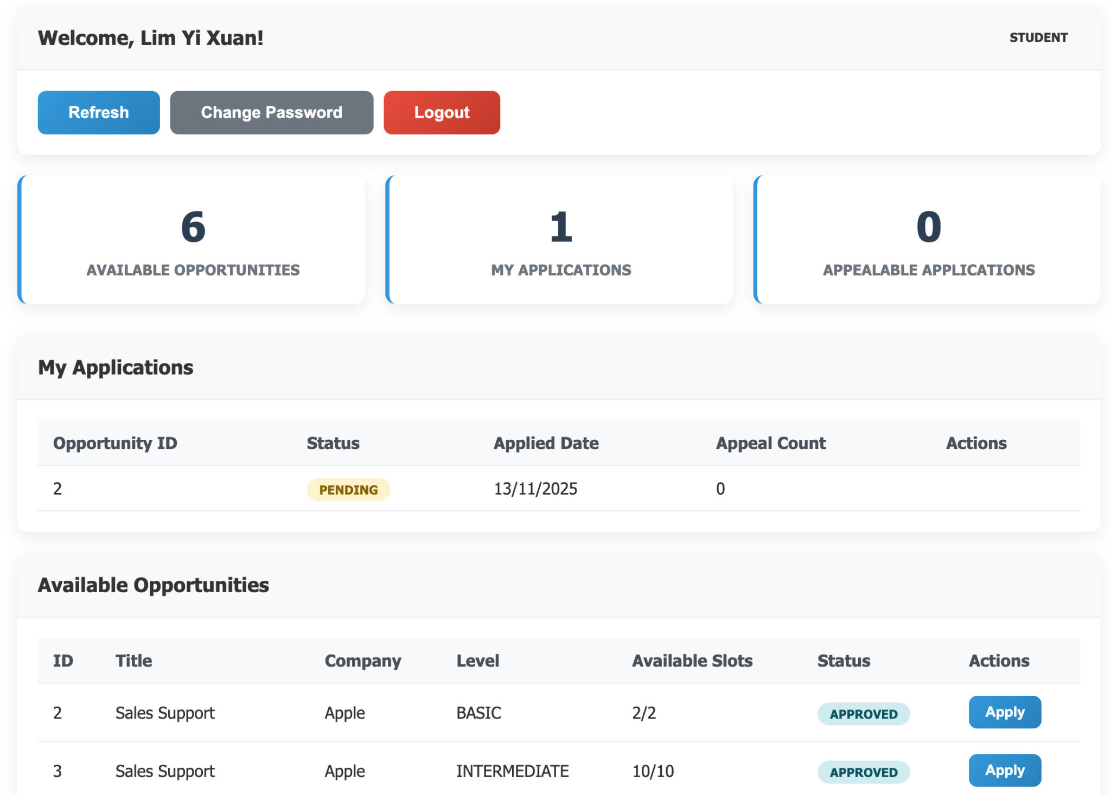
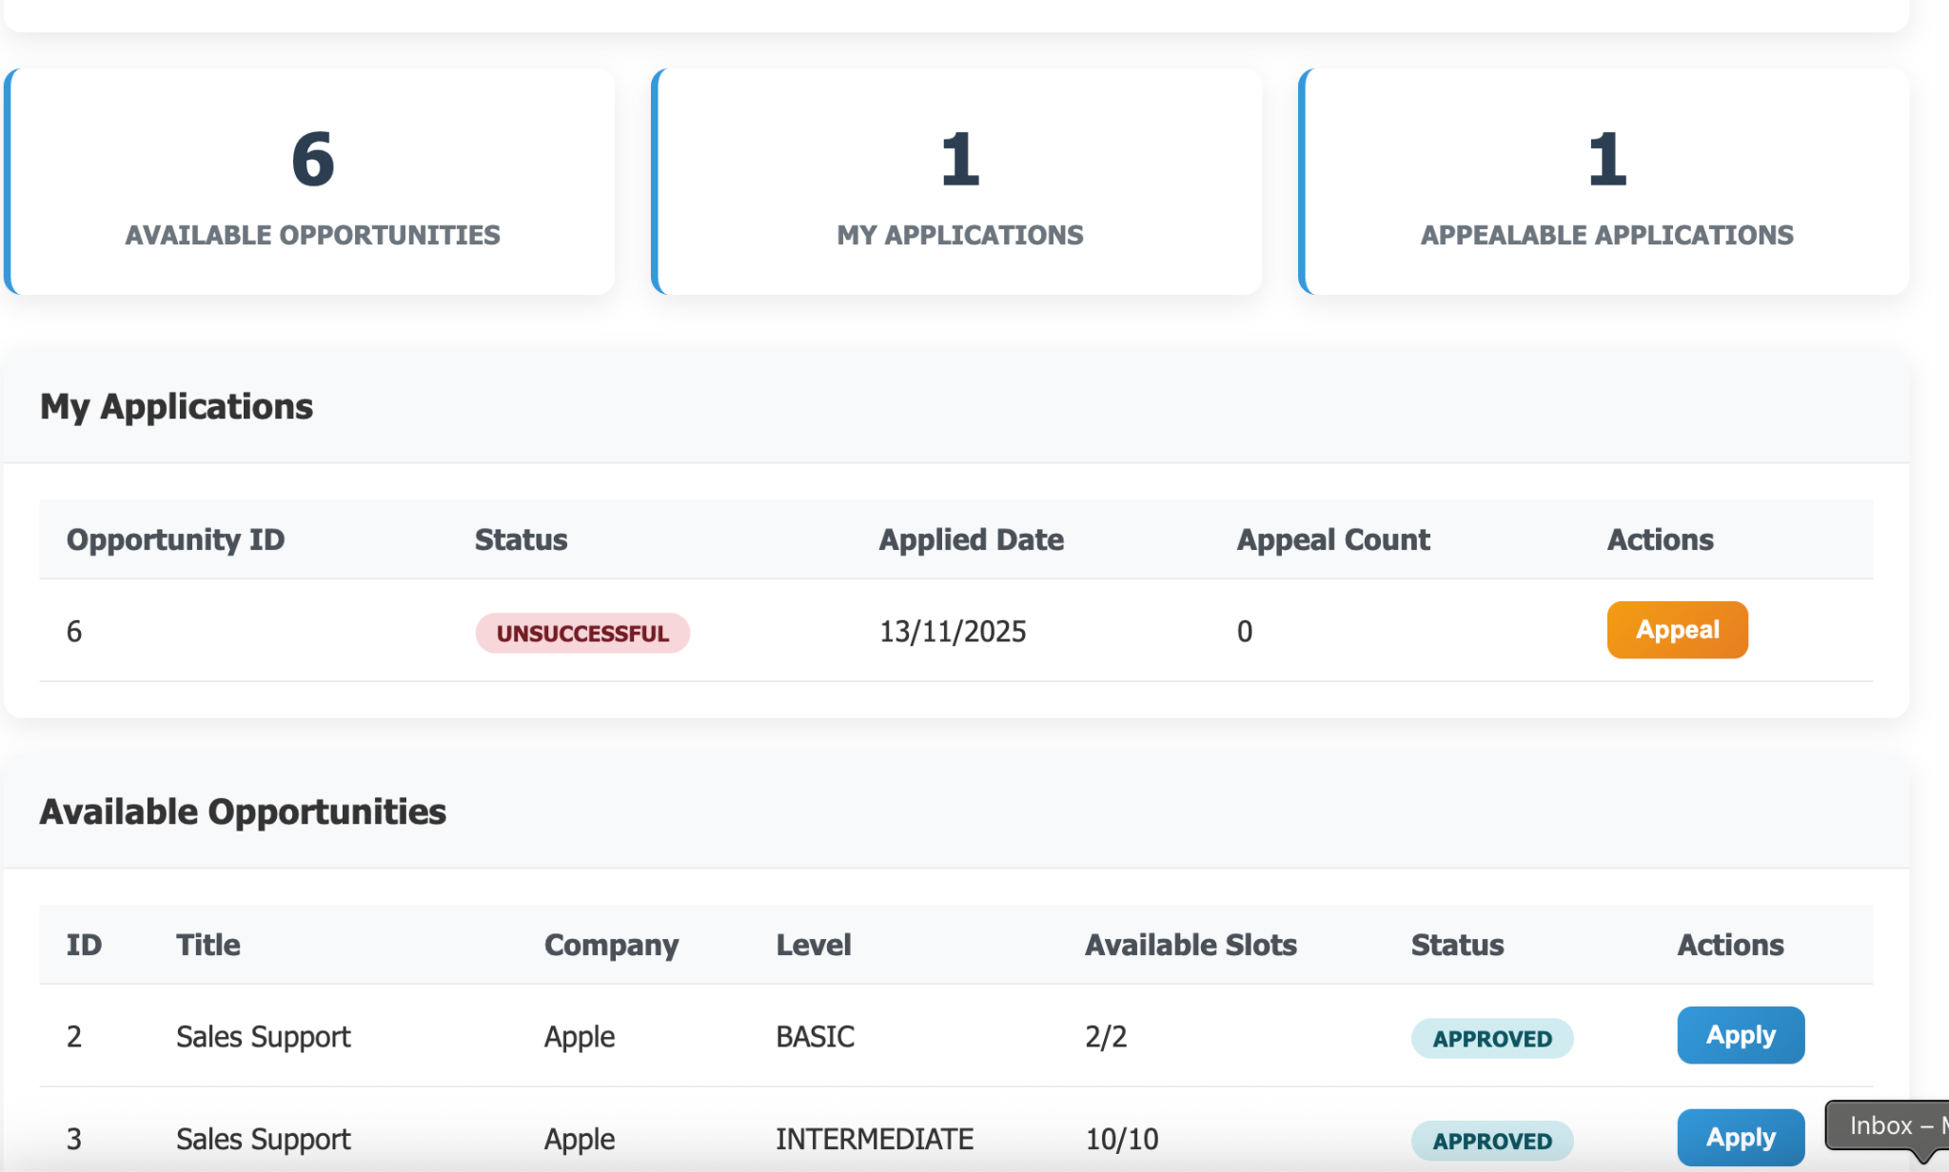
Frontend GUI Demo -
Student Menu (Opportunities / Applications)
Notes:
🧩 1️⃣ Explain the Concept Briefly
“Encapsulation means keeping the internal state of an object private and controlling how it can be accessed or changed.
Abstraction means exposing only what is necessary — so other parts of the system can use the object without knowing how it works internally.”
🧱 2️⃣ Link It to the Class Example
“For example, in our InternshipOpportunity class, we keep important data like the opening date, closing date, total slots, and confirmed count as private attributes.
Other classes can’t directly modify them — they must use the public methods that we’ve defined.”
(show UML or code snippet)
💻 3️⃣ Walk Through the Code
“Here, we have three key methods:
isOpenNow() — checks whether the internship is currently open by comparing today’s date with the opening and closing dates.
isFilled() — checks if all available slots are already taken.
increaseConfirmed() — safely increases the confirmed count, but it first checks if the internship is already filled before doing so. If it’s full, it throws an error to protect the data.”
🗣️ Tip: When speaking, pause slightly at each method name, and use your pointer to guide the audience’s eyes to the code.
🧠 4️⃣ Explain Why This Matters (Encapsulation in Action)
“These methods prevent invalid operations — for example, we can’t accidentally overfill the internship because the rule is enforced inside the class.
This shows encapsulation, because the logic and data that belong together stay together.”
“Other classes simply call isOpenNow() or increaseConfirmed(), without needing to know how the rules are implemented — that’s abstraction.”
✅ 5️⃣ Wrap Up with the Advantages
“In short, encapsulation and abstraction make our system:
More secure, since data isn’t exposed directly.
More reliable, since rules are always checked inside the class.
And more maintainable, because the logic is reusable and isolated.”

Slide 31
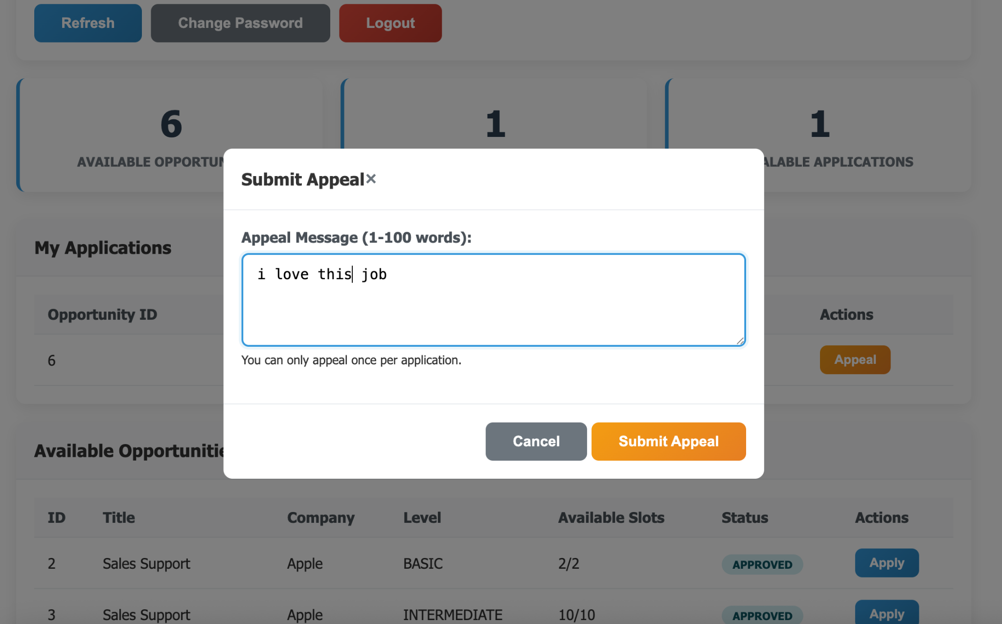
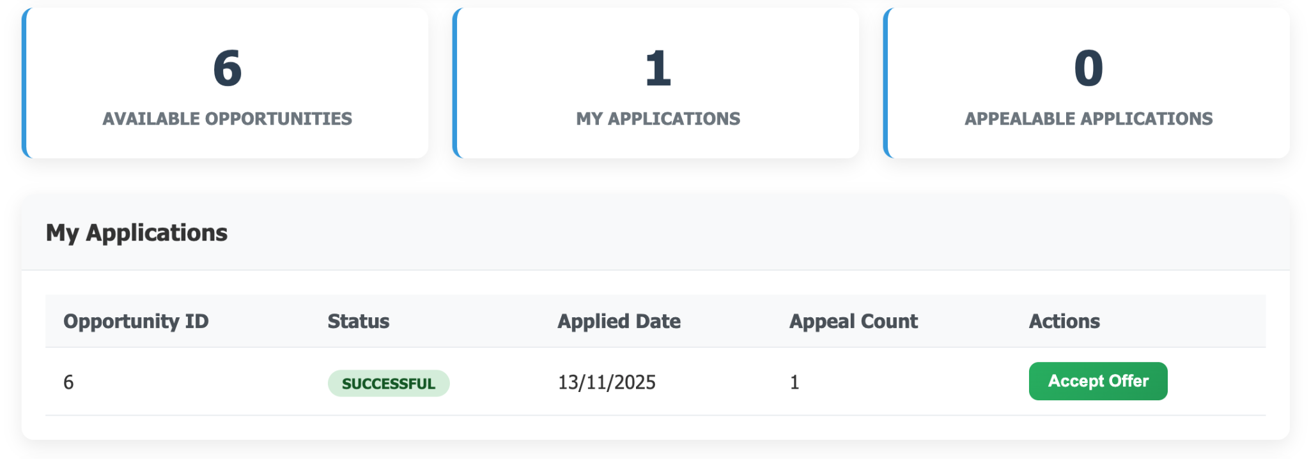
Frontend GUI Demo -
Student Menu (Appeal / Accept Offers)
Notes:
🧩 1️⃣ Explain the Concept Briefly
“Encapsulation means keeping the internal state of an object private and controlling how it can be accessed or changed.
Abstraction means exposing only what is necessary — so other parts of the system can use the object without knowing how it works internally.”
🧱 2️⃣ Link It to the Class Example
“For example, in our InternshipOpportunity class, we keep important data like the opening date, closing date, total slots, and confirmed count as private attributes.
Other classes can’t directly modify them — they must use the public methods that we’ve defined.”
(show UML or code snippet)
💻 3️⃣ Walk Through the Code
“Here, we have three key methods:
isOpenNow() — checks whether the internship is currently open by comparing today’s date with the opening and closing dates.
isFilled() — checks if all available slots are already taken.
increaseConfirmed() — safely increases the confirmed count, but it first checks if the internship is already filled before doing so. If it’s full, it throws an error to protect the data.”
🗣️ Tip: When speaking, pause slightly at each method name, and use your pointer to guide the audience’s eyes to the code.
🧠 4️⃣ Explain Why This Matters (Encapsulation in Action)
“These methods prevent invalid operations — for example, we can’t accidentally overfill the internship because the rule is enforced inside the class.
This shows encapsulation, because the logic and data that belong together stay together.”
“Other classes simply call isOpenNow() or increaseConfirmed(), without needing to know how the rules are implemented — that’s abstraction.”
✅ 5️⃣ Wrap Up with the Advantages
“In short, encapsulation and abstraction make our system:
More secure, since data isn’t exposed directly.
More reliable, since rules are always checked inside the class.
And more maintainable, because the logic is reusable and isolated.”

Slide 32
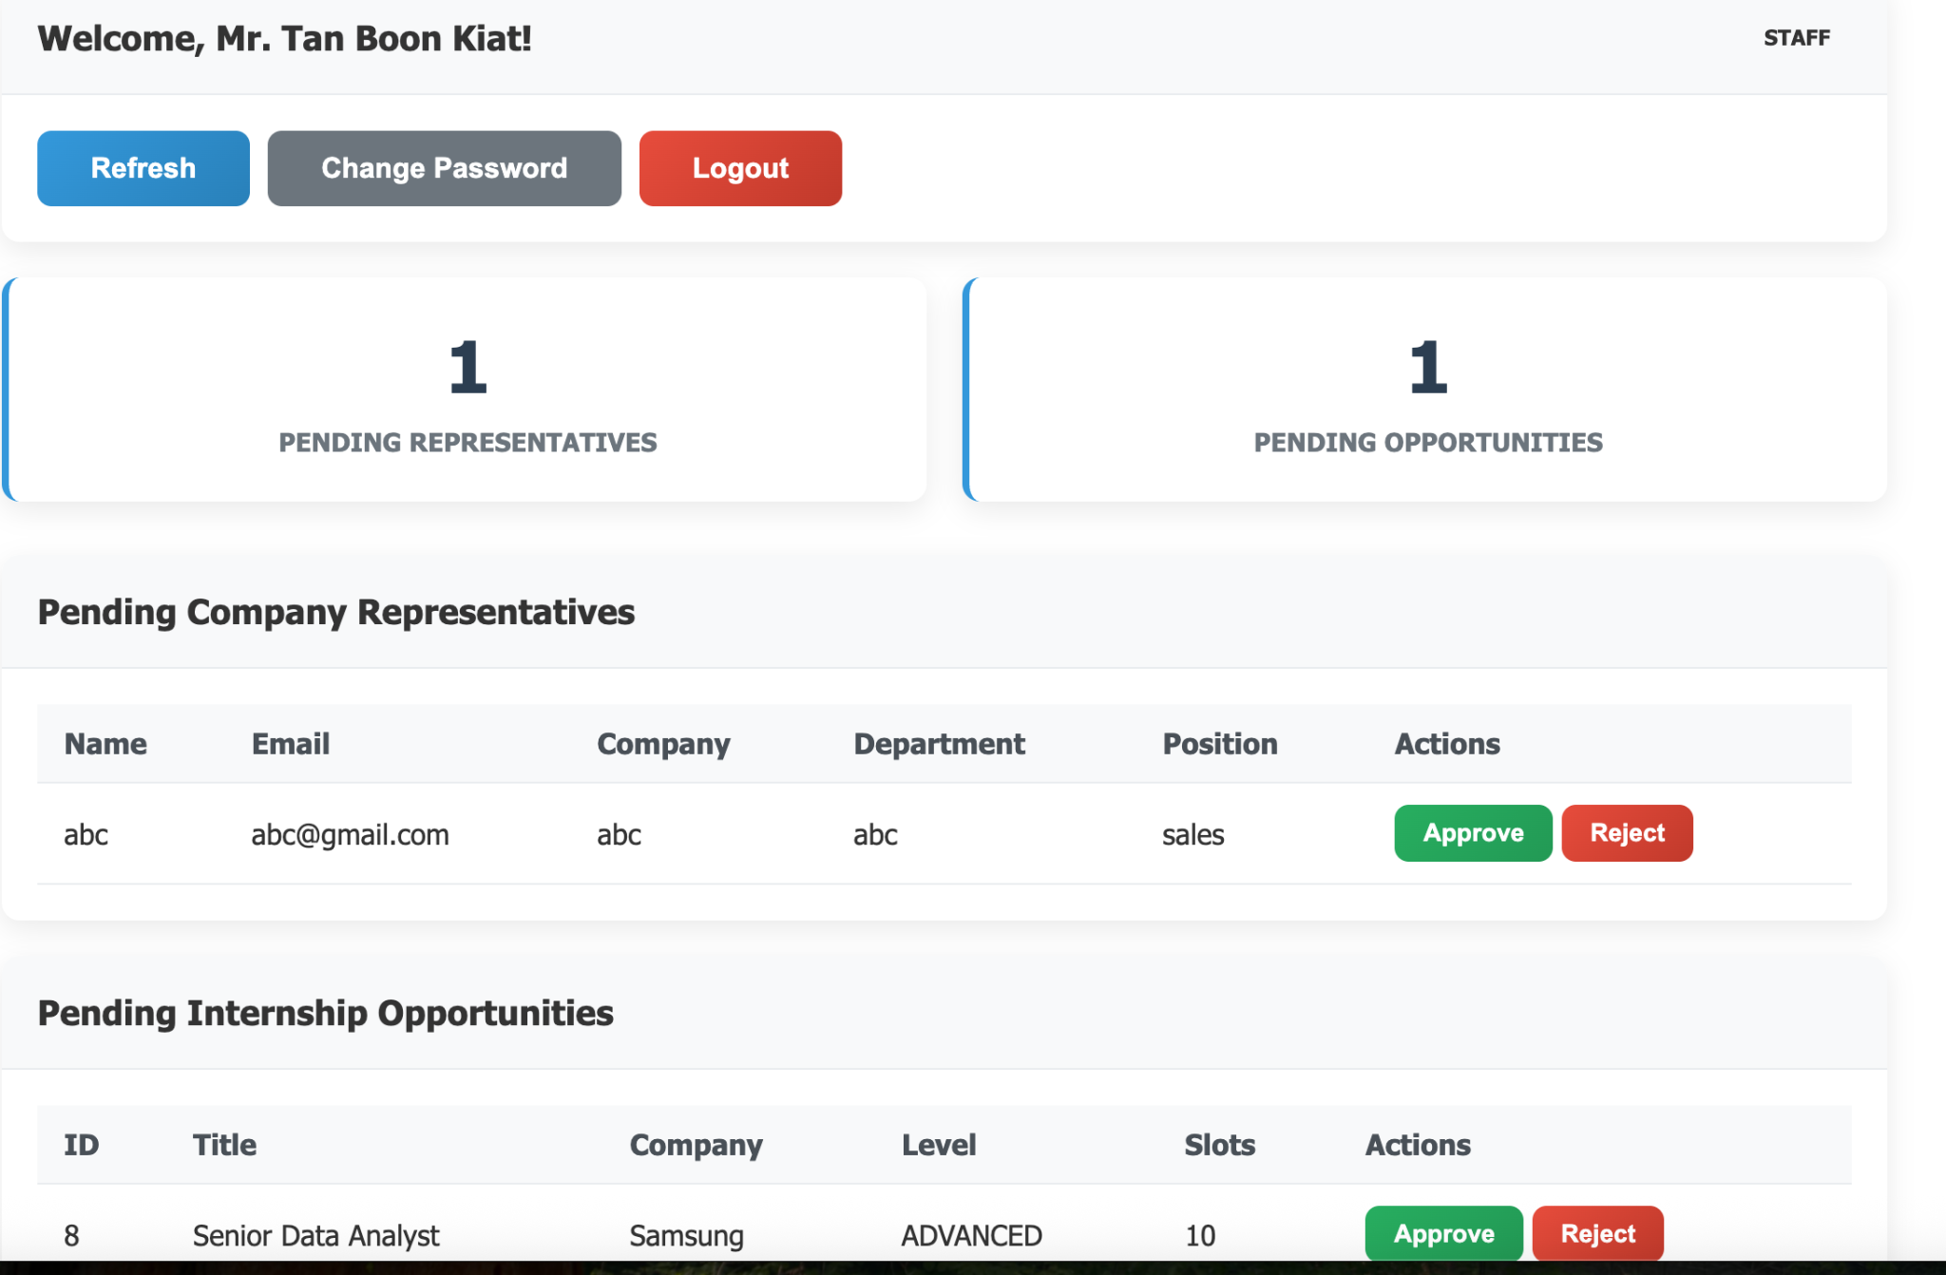
Frontend GUI Demo -
Staff Menu (Approve/Reject)
Notes:
🧩 1️⃣ Explain the Concept Briefly
“Encapsulation means keeping the internal state of an object private and controlling how it can be accessed or changed.
Abstraction means exposing only what is necessary — so other parts of the system can use the object without knowing how it works internally.”
🧱 2️⃣ Link It to the Class Example
“For example, in our InternshipOpportunity class, we keep important data like the opening date, closing date, total slots, and confirmed count as private attributes.
Other classes can’t directly modify them — they must use the public methods that we’ve defined.”
(show UML or code snippet)
💻 3️⃣ Walk Through the Code
“Here, we have three key methods:
isOpenNow() — checks whether the internship is currently open by comparing today’s date with the opening and closing dates.
isFilled() — checks if all available slots are already taken.
increaseConfirmed() — safely increases the confirmed count, but it first checks if the internship is already filled before doing so. If it’s full, it throws an error to protect the data.”
🗣️ Tip: When speaking, pause slightly at each method name, and use your pointer to guide the audience’s eyes to the code.
🧠 4️⃣ Explain Why This Matters (Encapsulation in Action)
“These methods prevent invalid operations — for example, we can’t accidentally overfill the internship because the rule is enforced inside the class.
This shows encapsulation, because the logic and data that belong together stay together.”
“Other classes simply call isOpenNow() or increaseConfirmed(), without needing to know how the rules are implemented — that’s abstraction.”
✅ 5️⃣ Wrap Up with the Advantages
“In short, encapsulation and abstraction make our system:
More secure, since data isn’t exposed directly.
More reliable, since rules are always checked inside the class.
And more maintainable, because the logic is reusable and isolated.”

Slide 33
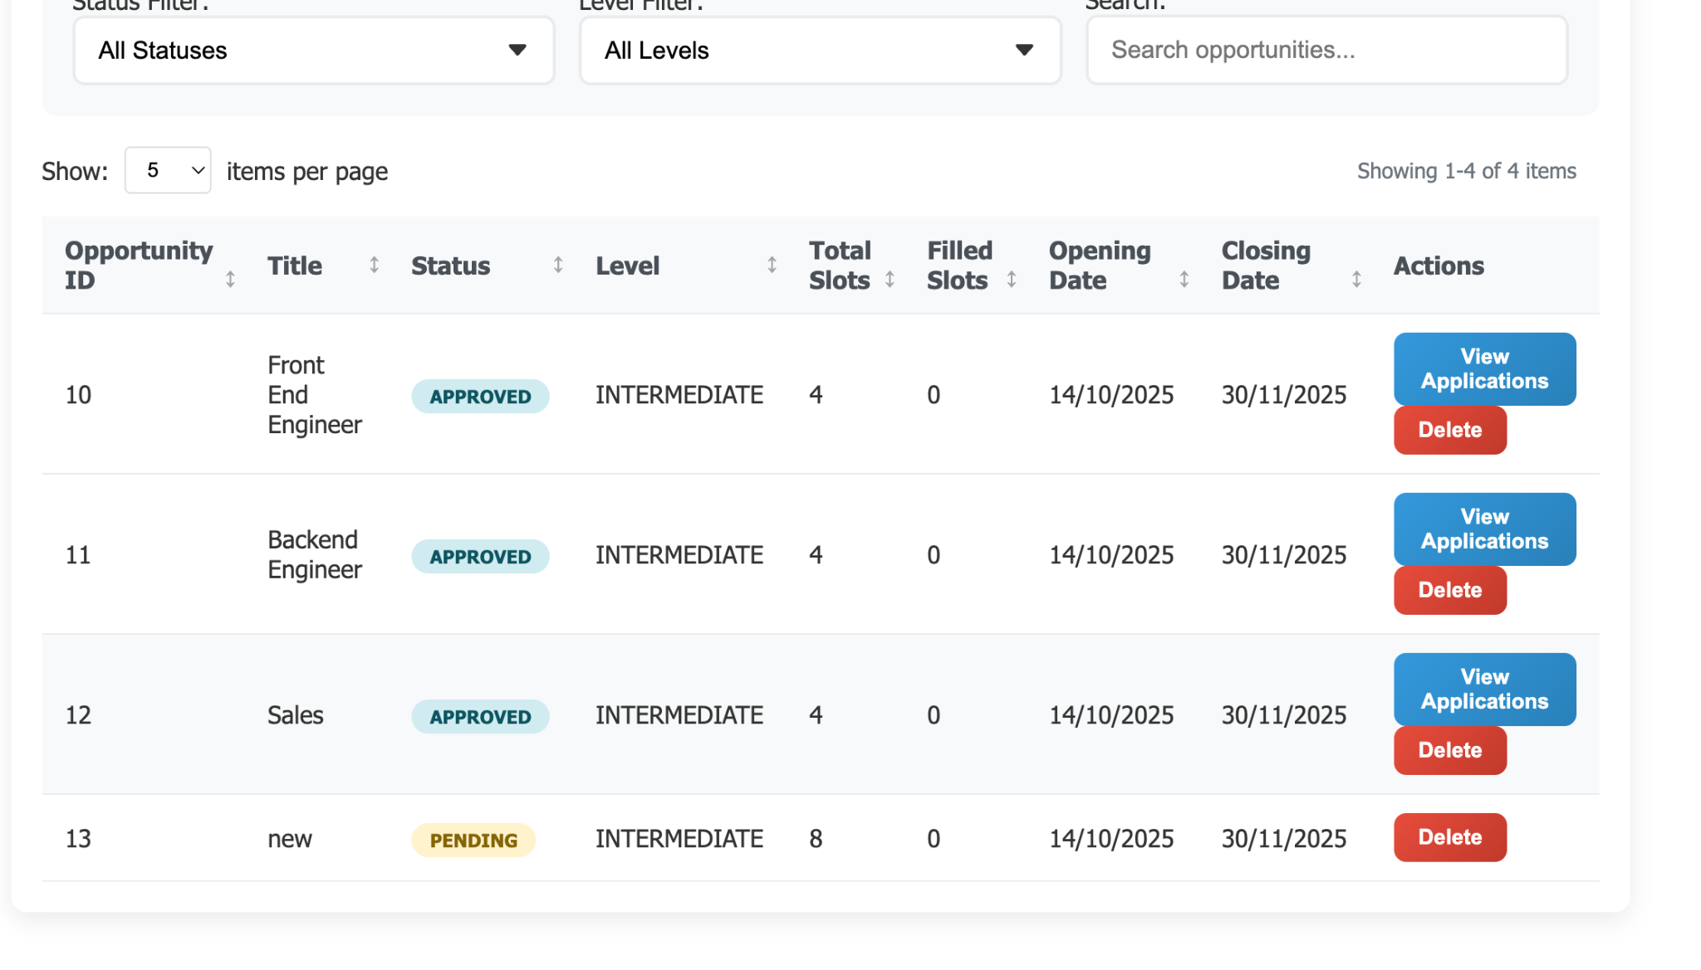
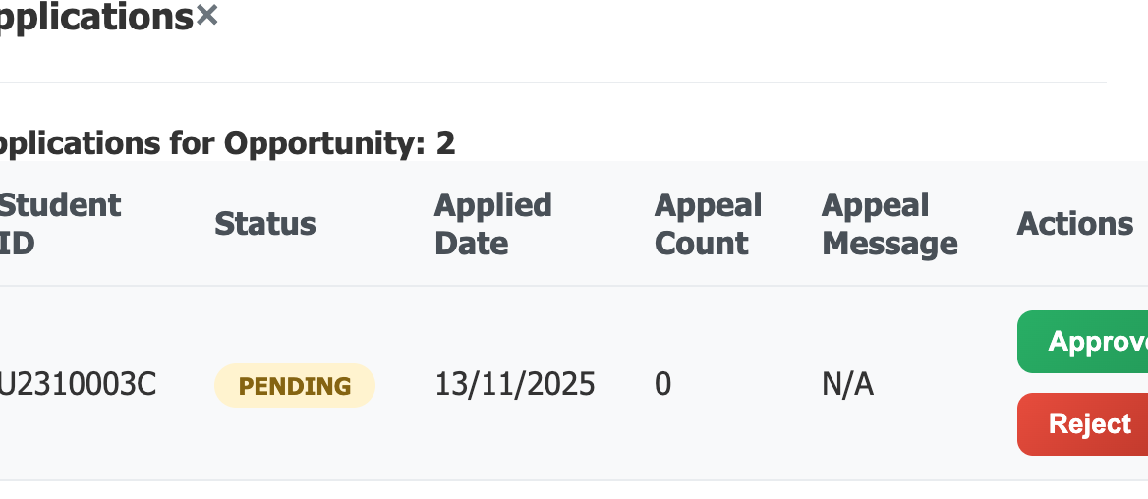
Frontend GUI Demo -
Company Representative Menu
Notes:
🧩 1️⃣ Explain the Concept Briefly
“Encapsulation means keeping the internal state of an object private and controlling how it can be accessed or changed.
Abstraction means exposing only what is necessary — so other parts of the system can use the object without knowing how it works internally.”
🧱 2️⃣ Link It to the Class Example
“For example, in our InternshipOpportunity class, we keep important data like the opening date, closing date, total slots, and confirmed count as private attributes.
Other classes can’t directly modify them — they must use the public methods that we’ve defined.”
(show UML or code snippet)
💻 3️⃣ Walk Through the Code
“Here, we have three key methods:
isOpenNow() — checks whether the internship is currently open by comparing today’s date with the opening and closing dates.
isFilled() — checks if all available slots are already taken.
increaseConfirmed() — safely increases the confirmed count, but it first checks if the internship is already filled before doing so. If it’s full, it throws an error to protect the data.”
🗣️ Tip: When speaking, pause slightly at each method name, and use your pointer to guide the audience’s eyes to the code.
🧠 4️⃣ Explain Why This Matters (Encapsulation in Action)
“These methods prevent invalid operations — for example, we can’t accidentally overfill the internship because the rule is enforced inside the class.
This shows encapsulation, because the logic and data that belong together stay together.”
“Other classes simply call isOpenNow() or increaseConfirmed(), without needing to know how the rules are implemented — that’s abstraction.”
✅ 5️⃣ Wrap Up with the Advantages
“In short, encapsulation and abstraction make our system:
More secure, since data isn’t exposed directly.
More reliable, since rules are always checked inside the class.
And more maintainable, because the logic is reusable and isolated.”

Slide 34
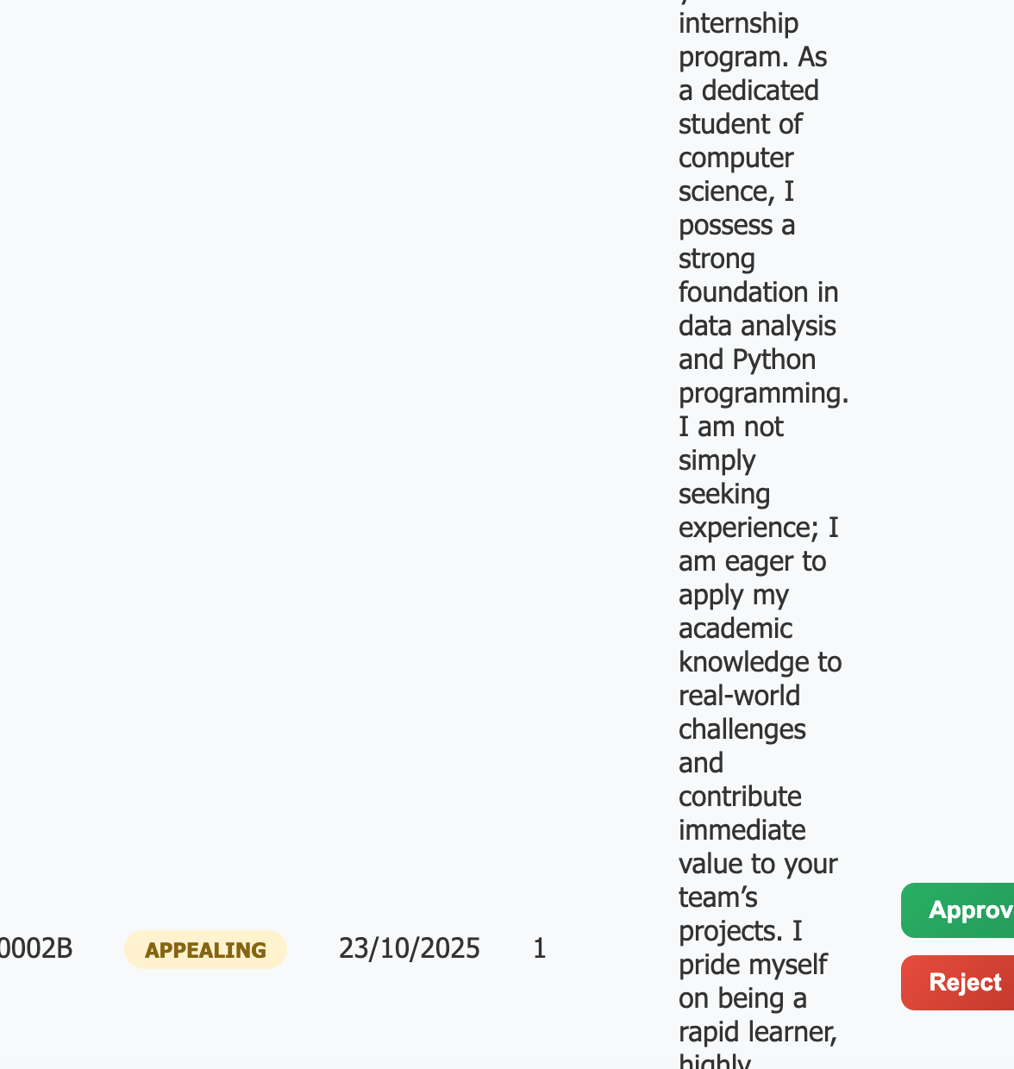
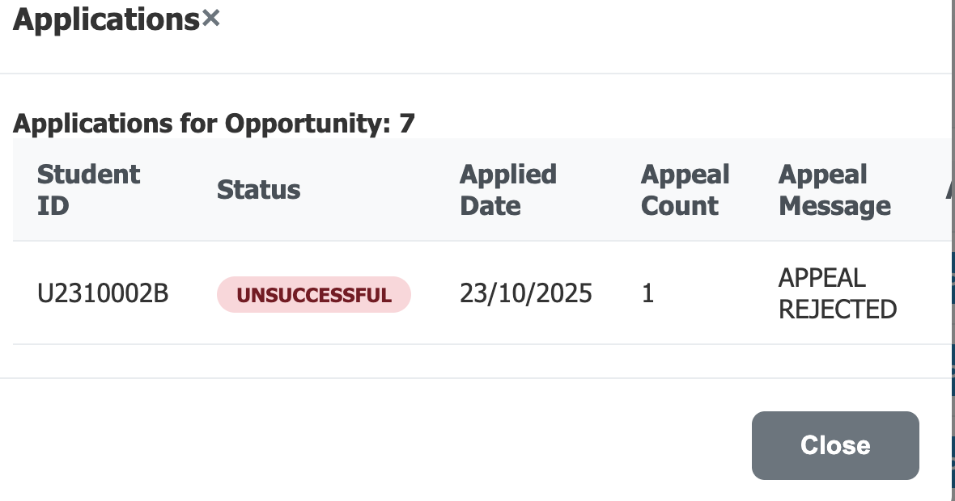
Frontend GUI Demo -
Company Representative Menu (Reviewing Appeals)
Notes:
🧩 1️⃣ Explain the Concept Briefly
“Encapsulation means keeping the internal state of an object private and controlling how it can be accessed or changed.
Abstraction means exposing only what is necessary — so other parts of the system can use the object without knowing how it works internally.”
🧱 2️⃣ Link It to the Class Example
“For example, in our InternshipOpportunity class, we keep important data like the opening date, closing date, total slots, and confirmed count as private attributes.
Other classes can’t directly modify them — they must use the public methods that we’ve defined.”
(show UML or code snippet)
💻 3️⃣ Walk Through the Code
“Here, we have three key methods:
isOpenNow() — checks whether the internship is currently open by comparing today’s date with the opening and closing dates.
isFilled() — checks if all available slots are already taken.
increaseConfirmed() — safely increases the confirmed count, but it first checks if the internship is already filled before doing so. If it’s full, it throws an error to protect the data.”
🗣️ Tip: When speaking, pause slightly at each method name, and use your pointer to guide the audience’s eyes to the code.
🧠 4️⃣ Explain Why This Matters (Encapsulation in Action)
“These methods prevent invalid operations — for example, we can’t accidentally overfill the internship because the rule is enforced inside the class.
This shows encapsulation, because the logic and data that belong together stay together.”
“Other classes simply call isOpenNow() or increaseConfirmed(), without needing to know how the rules are implemented — that’s abstraction.”
✅ 5️⃣ Wrap Up with the Advantages
“In short, encapsulation and abstraction make our system:
More secure, since data isn’t exposed directly.
More reliable, since rules are always checked inside the class.
And more maintainable, because the logic is reusable and isolated.”

Slide 35
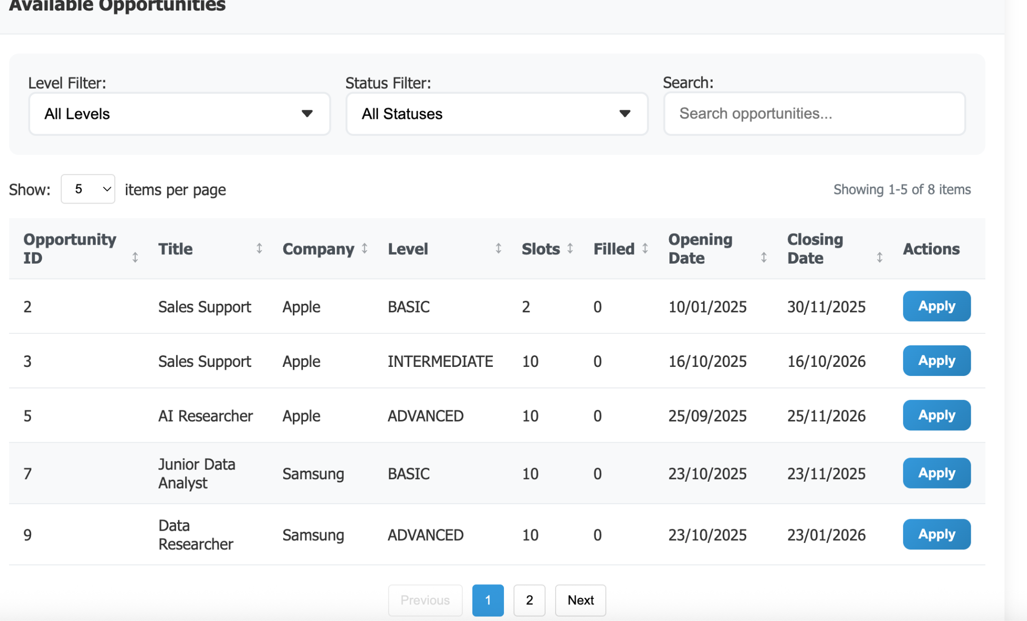
Frontend GUI Demo -
Filtering Dropdown Menu / Sorting Button
Notes:
🧩 1️⃣ Explain the Concept Briefly
“Encapsulation means keeping the internal state of an object private and controlling how it can be accessed or changed.
Abstraction means exposing only what is necessary — so other parts of the system can use the object without knowing how it works internally.”
🧱 2️⃣ Link It to the Class Example
“For example, in our InternshipOpportunity class, we keep important data like the opening date, closing date, total slots, and confirmed count as private attributes.
Other classes can’t directly modify them — they must use the public methods that we’ve defined.”
(show UML or code snippet)
💻 3️⃣ Walk Through the Code
“Here, we have three key methods:
isOpenNow() — checks whether the internship is currently open by comparing today’s date with the opening and closing dates.
isFilled() — checks if all available slots are already taken.
increaseConfirmed() — safely increases the confirmed count, but it first checks if the internship is already filled before doing so. If it’s full, it throws an error to protect the data.”
🗣️ Tip: When speaking, pause slightly at each method name, and use your pointer to guide the audience’s eyes to the code.
🧠 4️⃣ Explain Why This Matters (Encapsulation in Action)
“These methods prevent invalid operations — for example, we can’t accidentally overfill the internship because the rule is enforced inside the class.
This shows encapsulation, because the logic and data that belong together stay together.”
“Other classes simply call isOpenNow() or increaseConfirmed(), without needing to know how the rules are implemented — that’s abstraction.”
✅ 5️⃣ Wrap Up with the Advantages
“In short, encapsulation and abstraction make our system:
More secure, since data isn’t exposed directly.
More reliable, since rules are always checked inside the class.
And more maintainable, because the logic is reusable and isolated.”

Slide 36
Q & A

