Slide 1
Reconciliation between dietary energy consumption from FBS and NHS

Slide 2
Dietary Energy Supply
Dietary Energy Supply (DES) refers to food available for human consumption during the course of the reference period, expressed in terms of energy (kcal/person/day).

Slide 3
Reasons for using consumption estimates from Food Balance Sheets
covers practically all countries of the world
regularly revised and up-dated
readily available source of information for the PoU at the national level
assess impact on the distribution of dietary energy consumption
assess combined effect of food supply increase and inequality reduction

Slide 4

FBS Scope
Covers value chain from Post-Harvest to Retail (Pre-Harvest and Retail sales are not covered)
NHS Scope
Only covers household consumption (Retail and Individual level are not covered, neither non-household)

Slide 5
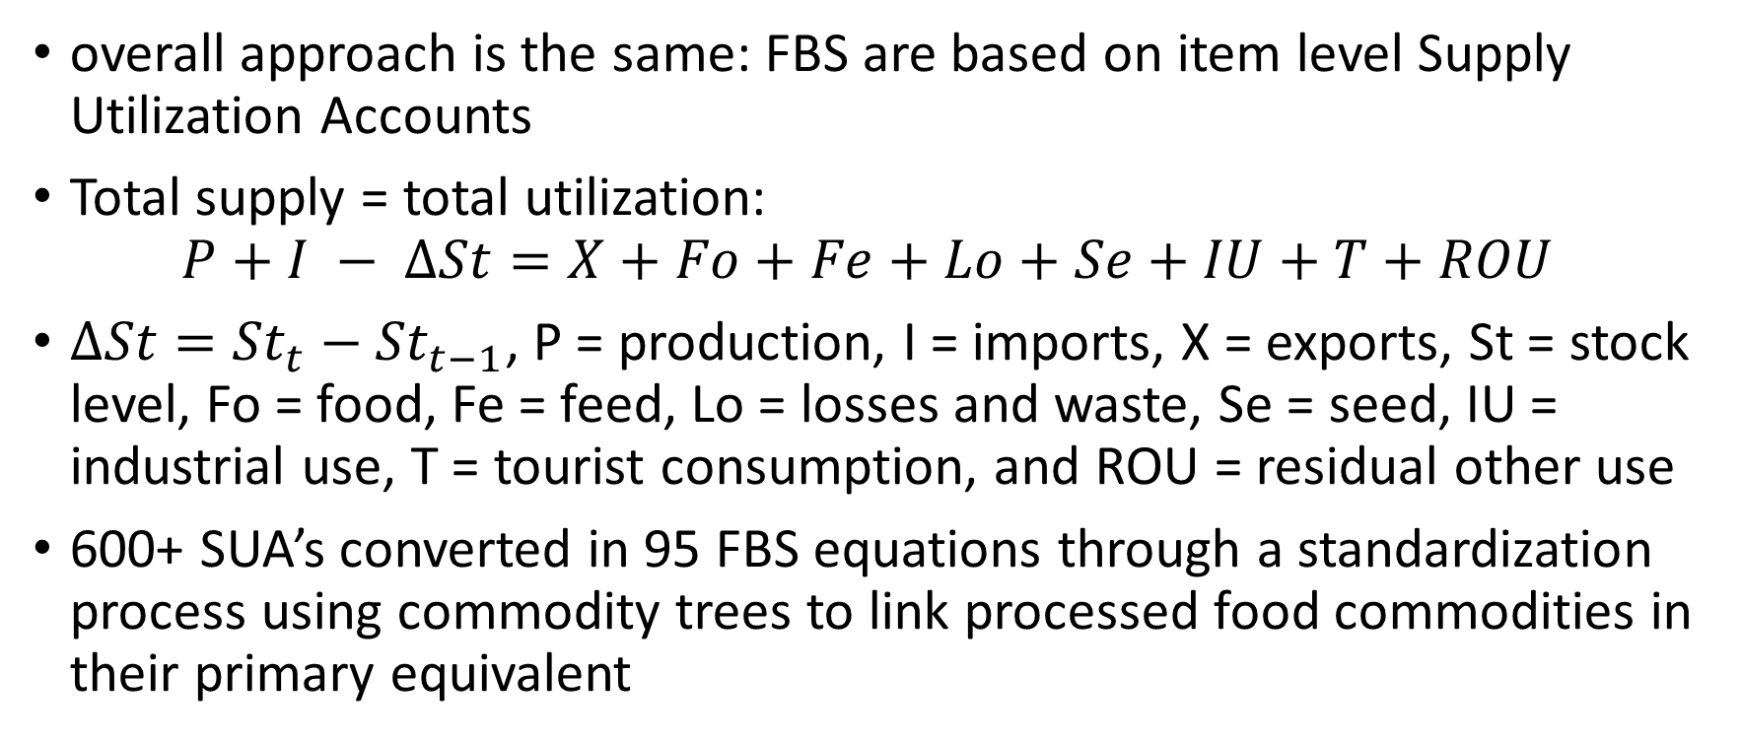
New FBS methods
overall approach is the same: FBS are based on item level Supply Utilization Accounts
Total supply = total utilization: $P+I − ∆St=X+Fo+Fe+Lo+Se+IU+T+ROU$
$∆St={St}_{t}−{St}_{t−1}$, P = production, I = imports, X = exports, St = stock level, Fo = food, Fe = feed, Lo = losses and waste, Se = seed, IU = industrial use, T = tourist consumption, and ROU = residual other use
600+ SUA’s converted in 95 FBS equations through a standardization process using commodity trees to link processed food commodities in their primary equivalent

Slide 6
Limitations of the previous FBS methodology
Many manual estimates of the less informed elements (stocks, losses, industrial use, tourism consumption)
Food consumption obtained as a residual, thus absorbing the cumulated error in all other elements
Standardization module had become a black box. Some operations were hard coded (standardizing vegetable fats in their primary oilcrop equivalent) leading to negative utilizations
Balancing the SUA's was in many instances a manual operation, obtained by adjusting the various elements until the balance was obtained

Slide 7
Address limitations of previous FBS methodology
Reduce the cumulated error and have no unknown element in the SUA equation: 8 modules imputing missing data for each SUA element (production, trade, feed, seed, losses, stocks, industrial utilization, tourist consumption) based on statistical modeling or regression functions
Food consumption estimated separately
Standardization module has been untangled
Balancing is obtained with a maximum likelihood approach

Slide 8
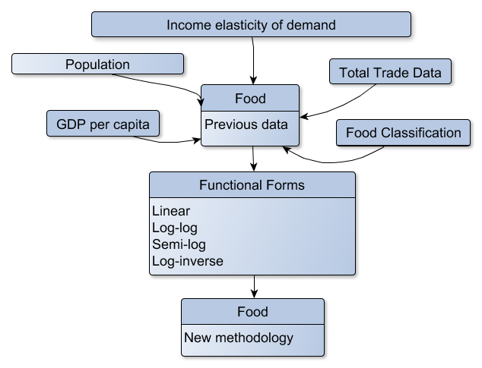
Food Model Visualization

Slide 9
Points for discussion
objective: improve food consumption estimates
how can hh surveys be used to improve Food estimates in the FBS?
how can hh surveys be used to validate the FBS?
which suggested approaches were not followed in the past?
what are the acceptable gaps between data sources (FBS, NHS)?
what case studies (in addition to USA, e.g. Mexico?)

